Slide 1
Why engine
A tiny engine chains every ERC check and reports ok when goldens match
learn_erc — 01 erc engine
Notes:
A tiny engine chains every ERC check and reports ok when goldens match.

Slide 2
The idea
GOLDEN: floating=1, undriven=1, multi=1, short=1, well=1, markers=5, ok=True
learn_erc — 01 erc engine
Notes:
GOLDEN: floating=1, undriven=1, multi=1, short=1, well=1, markers=5, ok=True.

Slide 3
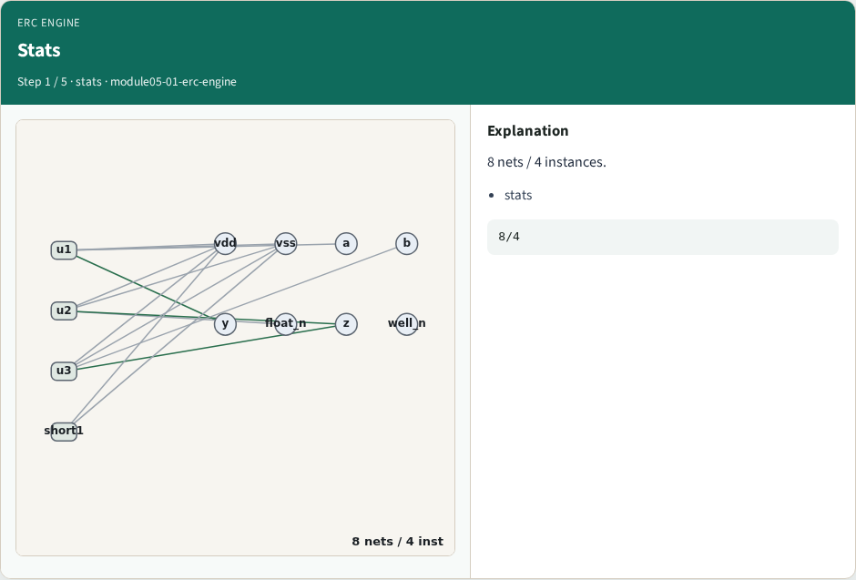
Stats
Stats
learn_erc — 01 erc engine
Notes:
8 nets / 4 instances.

Slide 4
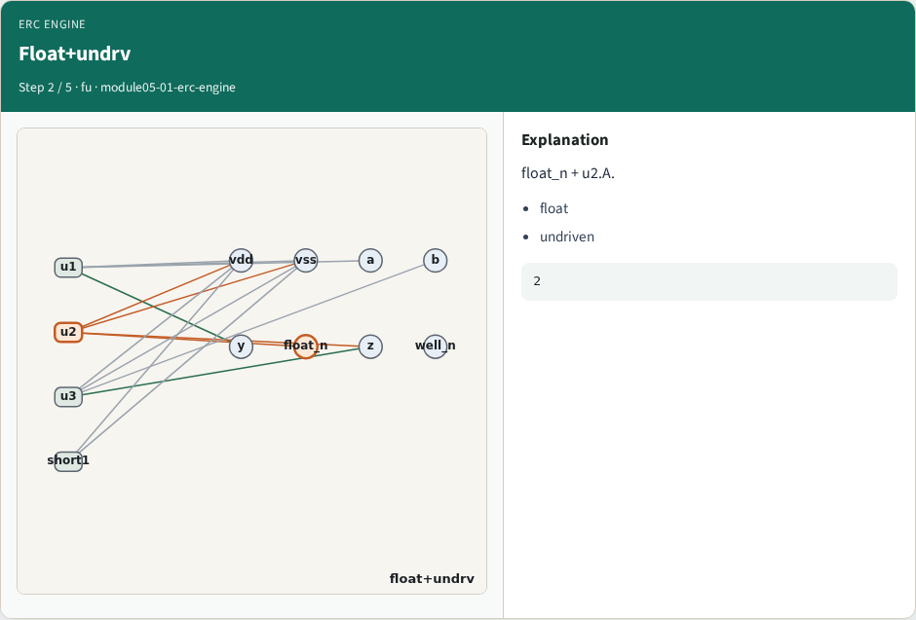
Float+undrv
Float+undrv
learn_erc — 01 erc engine
Notes:
float_n + u2.A.

Slide 5
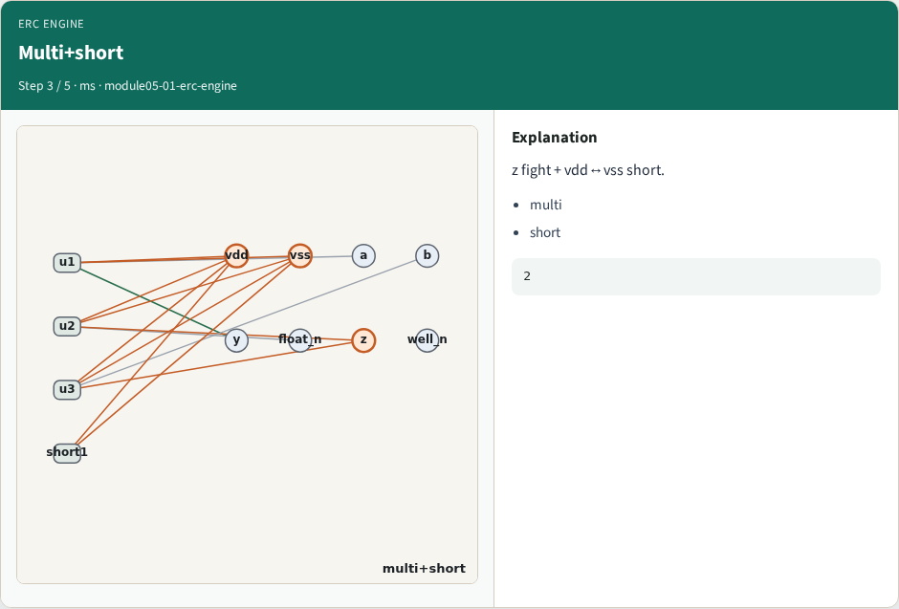
Multi+short
Multi+short
learn_erc — 01 erc engine
Notes:
z fight + vdd↔vss short.

Slide 6
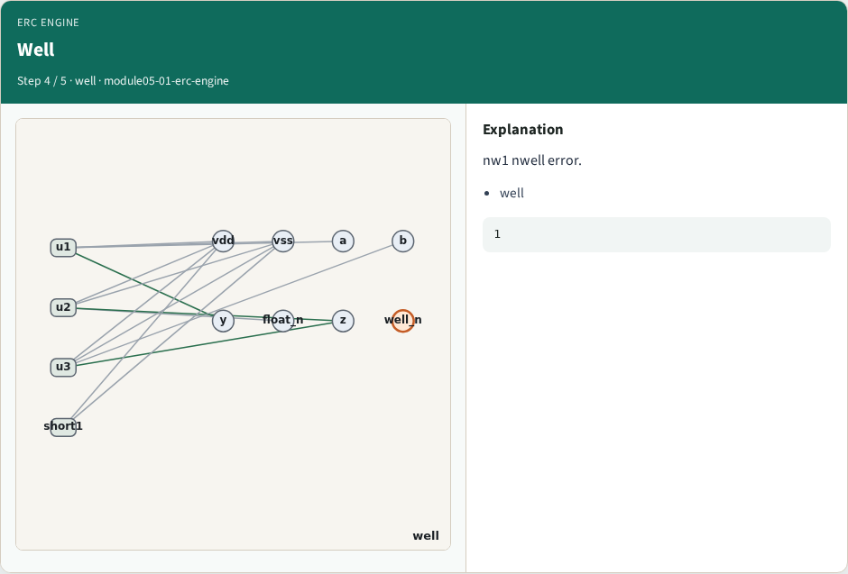
Well
Well
learn_erc — 01 erc engine
Notes:
nw1 nwell error.

Slide 7
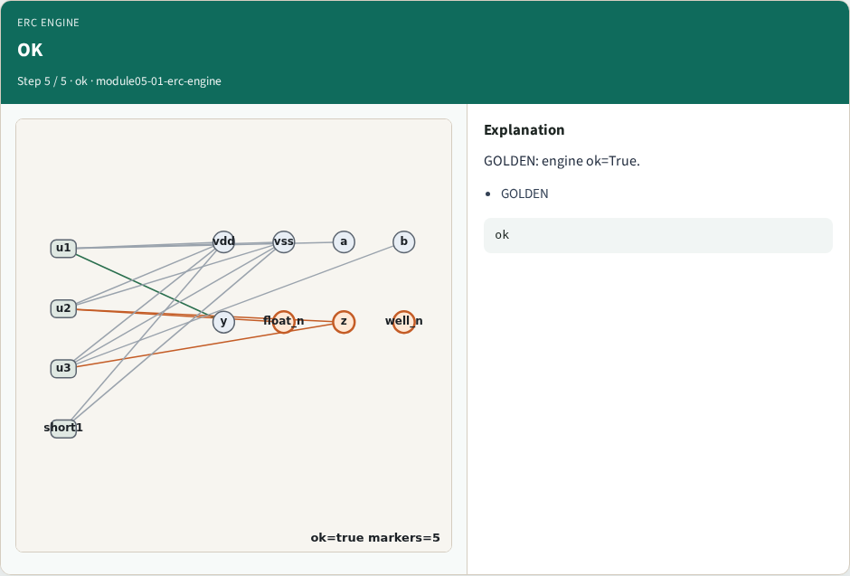
OK
OK
learn_erc — 01 erc engine
Notes:
GOLDEN: engine ok=True.

Slide 8

Browser lab track
Browser lab starter
learn_erc — 01 erc engine
Notes:
Open **erc-engine**. Run engine; confirm ok.

Slide 9
Implement track
Call erc_engine(); assert ok and markers.count==5
learn_erc — 01 erc engine
Notes:
Call erc_engine(); assert ok and markers.count==5.

Slide 10
Pitfalls
Reporting partial checks
Changing the toy without updating goldens
learn_erc — 01 erc engine
Notes:
Reporting partial checks. Changing the toy without updating goldens.

Slide 11
Your turn
Next: offline compare, then wrap
learn_erc — 01 erc engine
Notes:
Next: offline compare, then wrap.

