Slide 1
Why netlists
Every SPICE solve starts from a netlist , nodes, elements, and a ground reference
learn_spice — 01 netlist nodes
Notes:
Every SPICE solve starts from a netlist — nodes, elements, and a ground reference.

Slide 2
The idea
GOLDEN: 5 elements, 2 unknown nodes (1, 2), ground 0
learn_spice — 01 netlist nodes
Notes:
GOLDEN: 5 elements, 2 unknown nodes (1, 2), ground 0.

Slide 3
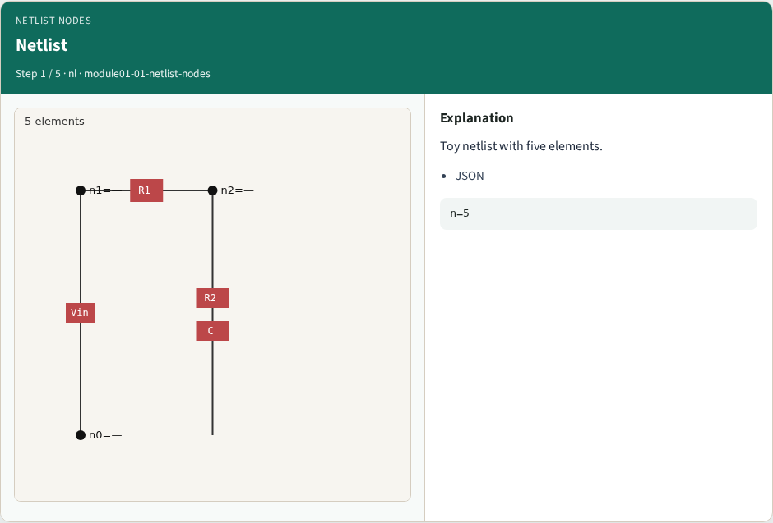
Netlist
Netlist
learn_spice — 01 netlist nodes
Notes:
Toy netlist with five elements.

Slide 4

Ground
Ground
learn_spice — 01 netlist nodes
Notes:
Node 0 is ground reference.

Slide 5
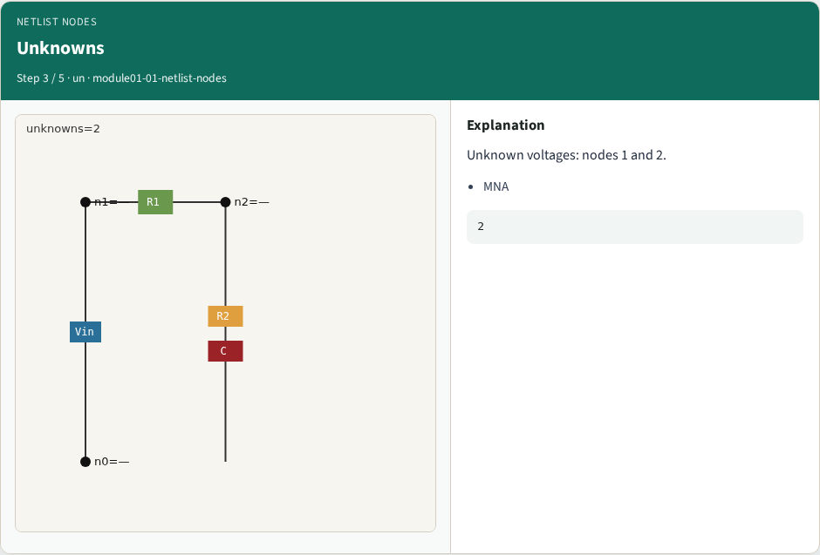
Unknowns
Unknowns
learn_spice — 01 netlist nodes
Notes:
Unknown voltages: nodes 1 and 2.

Slide 6
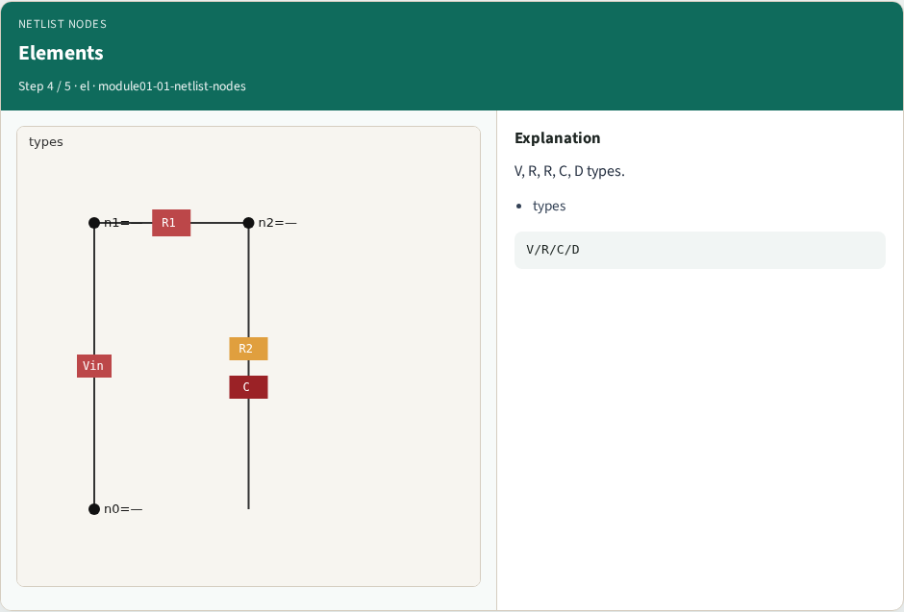
Elements
Elements
learn_spice — 01 netlist nodes
Notes:
V, R, R, C, D types.

Slide 7
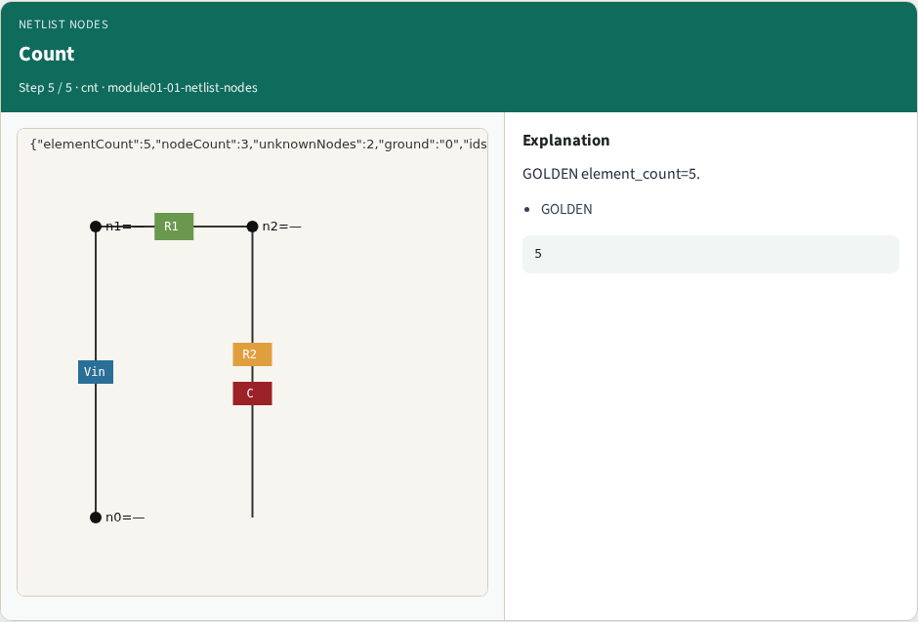
Count
Count
learn_spice — 01 netlist nodes
Notes:
GOLDEN element_count=5.

Slide 8
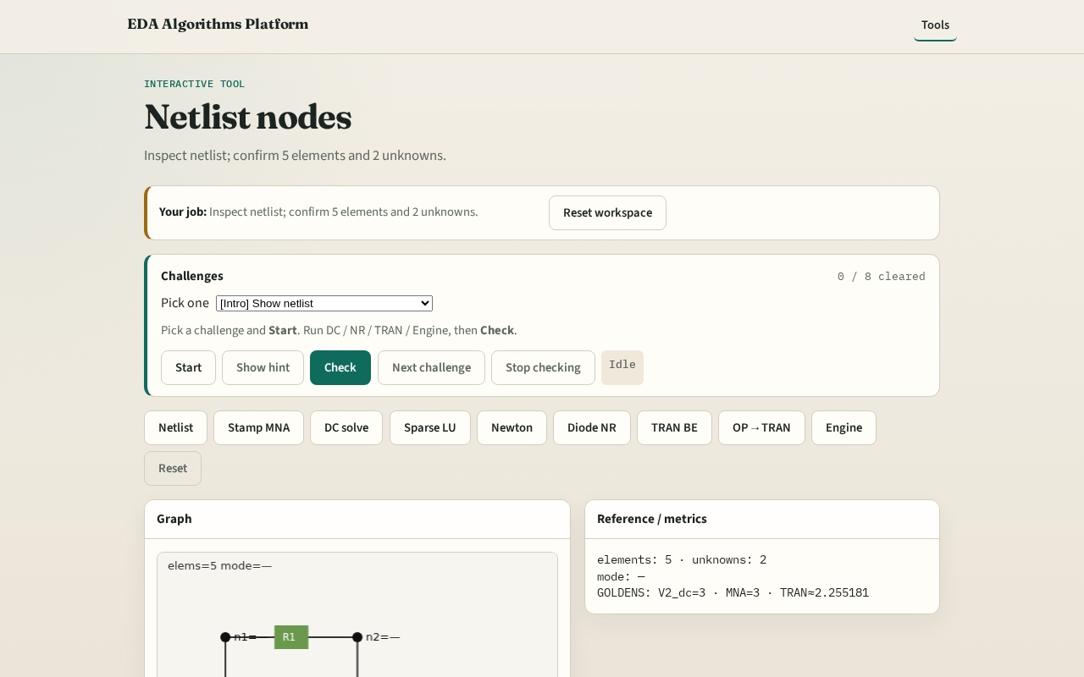
Browser lab track
Browser lab starter
learn_spice — 01 netlist nodes
Notes:
Open **netlist-nodes**. Inspect tiny_spice; confirm 5 elements and 2 unknown nodes.

Slide 9
Implement track
Call netlist_stats(); assert element_count==5, unknown_nodes==2, ground=='0'
learn_spice — 01 netlist nodes
Notes:
Call netlist_stats(); assert element_count==5, unknown_nodes==2, ground=='0'.

Slide 10
Pitfalls
Counting ground as unknown
Ignoring element ids vs node names
learn_spice — 01 netlist nodes
Notes:
Counting ground as unknown. Ignoring element ids vs node names.

Slide 11
Your turn
Next: stamp R and V into MNA
learn_spice — 01 netlist nodes
Notes:
Next: stamp R and V into MNA.

