Slide 1
Why MNA
Modified nodal analysis builds G and b by stamping each element into a shared matrix
learn_spice — 03 mna stamps
Notes:
Modified nodal analysis builds G and b by stamping each element into a shared matrix.

Slide 2
The idea
GOLDEN: mna size 3 , unknowns v1, v2, branch current i_Vin
learn_spice — 03 mna stamps
Notes:
GOLDEN: mna size 3 — unknowns v1, v2, branch current i_Vin.

Slide 3
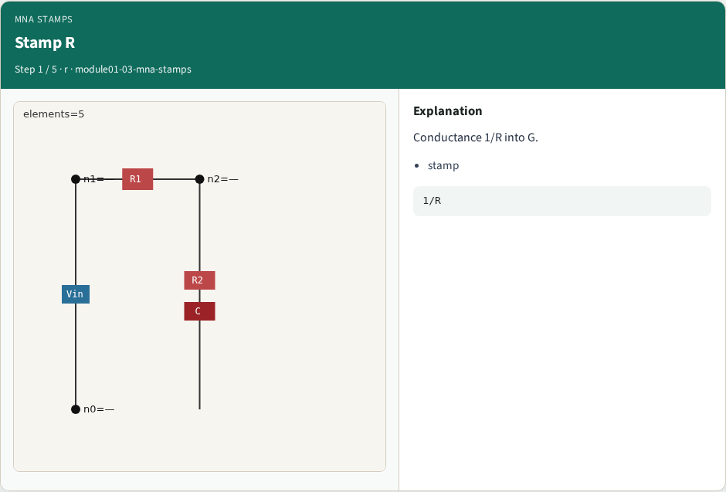
Stamp R
Stamp R
learn_spice — 03 mna stamps
Notes:
Conductance 1/R into G.

Slide 4
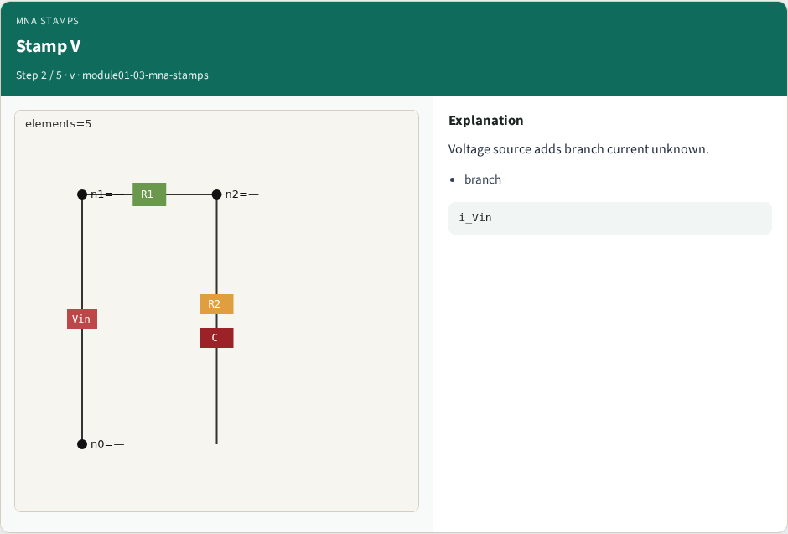
Stamp V
Stamp V
learn_spice — 03 mna stamps
Notes:
Voltage source adds branch current unknown.

Slide 5

Matrix G
Matrix G
learn_spice — 03 mna stamps
Notes:
Build dense G for the toy.

Slide 6

RHS b
RHS b
learn_spice — 03 mna stamps
Notes:
RHS holds source values.

Slide 7
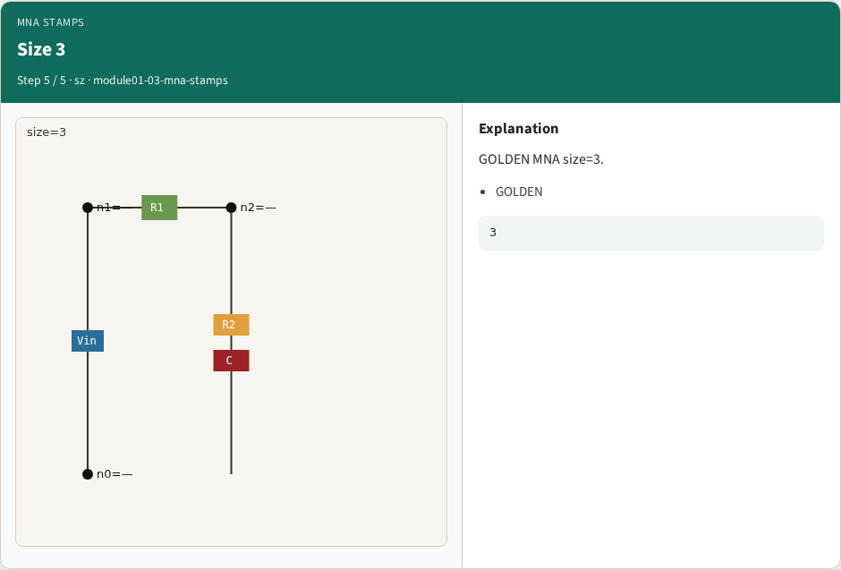
Size 3
Size 3
learn_spice — 03 mna stamps
Notes:
GOLDEN MNA size=3.

Slide 8
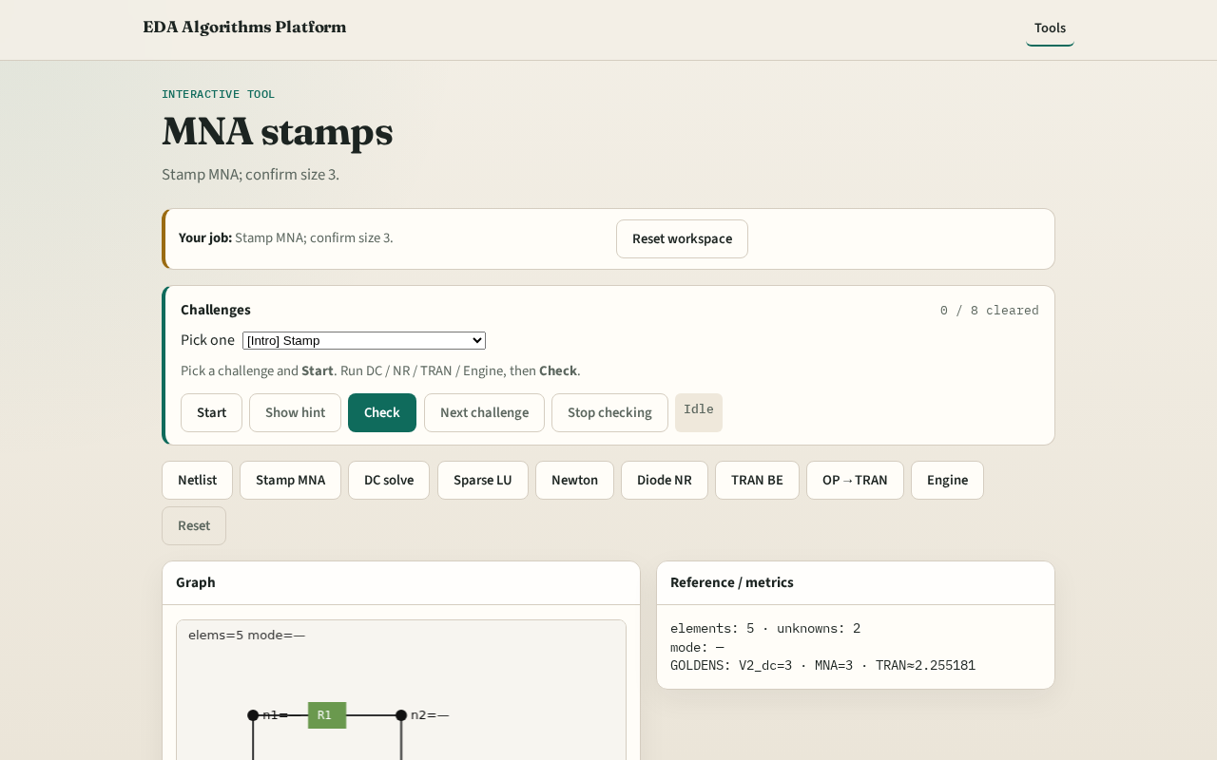
Browser lab track
Browser lab starter
learn_spice — 03 mna stamps
Notes:
Open **mna-stamps**. Build MNA; confirm matrix size 3.

Slide 9
Implement track
Call build_mna_linear_dc(); assert size==3
learn_spice — 03 mna stamps
Notes:
Call build_mna_linear_dc(); assert size==3.

Slide 10
Pitfalls
Forgetting voltage-source branch currents
Stamping C or D in linear DC MNA
learn_spice — 03 mna stamps
Notes:
Forgetting voltage-source branch currents. Stamping C or D in linear DC MNA.

Slide 11
Your turn
Next: solve linear DC for V2=3
learn_spice — 03 mna stamps
Notes:
Next: solve linear DC for V2=3.

