Slide 1
Why DC
Linear DC finds the operating point before Newton or transient analysis
learn_spice — 01 dc linear
Notes:
Linear DC finds the operating point before Newton or transient analysis.

Slide 2
The idea
GOLDEN: V1=5.0, V2=3.0 from the divider 5×3/(2+3)
learn_spice — 01 dc linear
Notes:
GOLDEN: V1=5.0, V2=3.0 from the divider 5×3/(2+3).

Slide 3
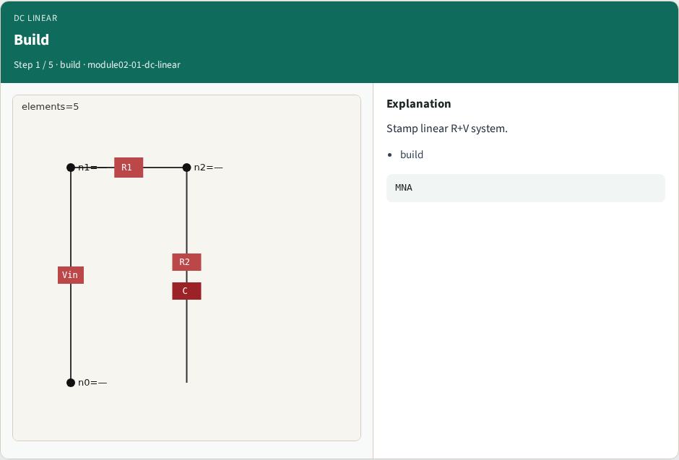
Build
Build
learn_spice — 01 dc linear
Notes:
Stamp linear R+V system.

Slide 4

Solve
Solve
learn_spice — 01 dc linear
Notes:
Dense solve Gx=b.

Slide 5

V1=5
V1=5
learn_spice — 01 dc linear
Notes:
Node 1 fixed by Vin.

Slide 6
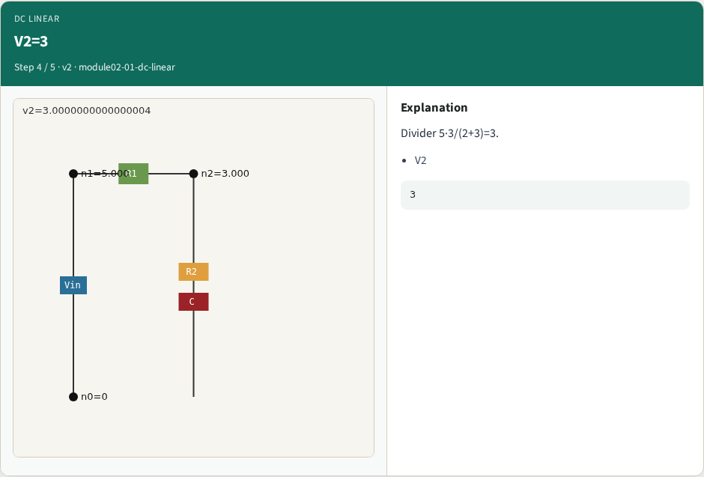
V2=3
V2=3
learn_spice — 01 dc linear
Notes:
Divider 5·3/(2+3)=3.

Slide 7
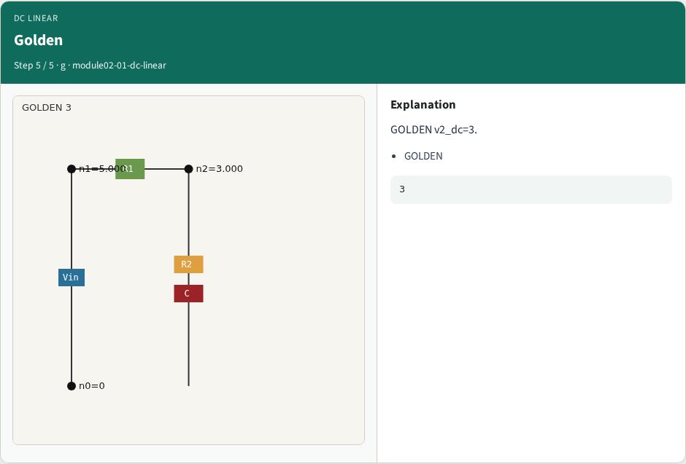
Golden
Golden
learn_spice — 01 dc linear
Notes:
GOLDEN v2_dc=3.

Slide 8
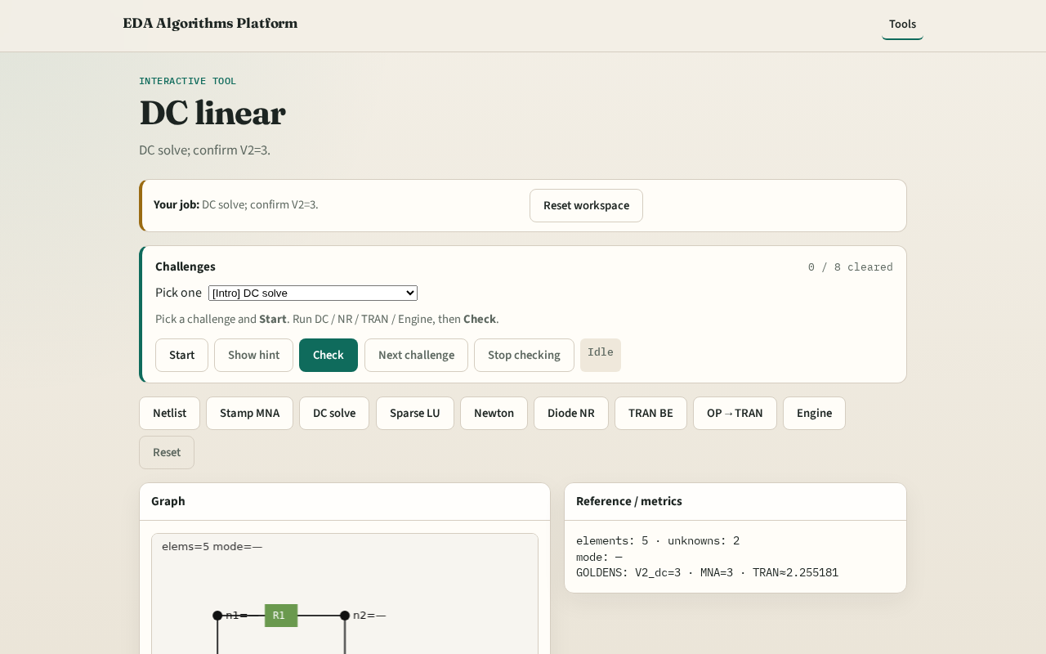
Browser lab track
Browser lab starter
learn_spice — 01 dc linear
Notes:
Open **dc-linear**. Solve DC; confirm V2=3.0.

Slide 9
Implement track
Call dc_linear_solve(); assert abs(volts['2']-3.0)<1e-9 and volts['1']==5.0
learn_spice — 01 dc linear
Notes:
Call dc_linear_solve(); assert abs(volts['2']-3.0)<1e-9 and volts['1']==5.0.

Slide 10
Pitfalls
Including diode in linear DC
Wrong divider formula
learn_spice — 01 dc linear
Notes:
Including diode in linear DC. Wrong divider formula.

Slide 11
Your turn
Next: sparse LU literacy on G
learn_spice — 01 dc linear
Notes:
Next: sparse LU literacy on G.

