Slide 1
Why sparse
Production SPICE uses sparse LU , count nonzeros and inspect L/U structure
learn_spice — 03 sparse lu
Notes:
Production SPICE uses sparse LU — count nonzeros and inspect L/U structure.

Slide 2
The idea
GOLDEN: nnz=6 on the toy MNA conductance matrix
learn_spice — 03 sparse lu
Notes:
GOLDEN: nnz=6 on the toy MNA conductance matrix.

Slide 3
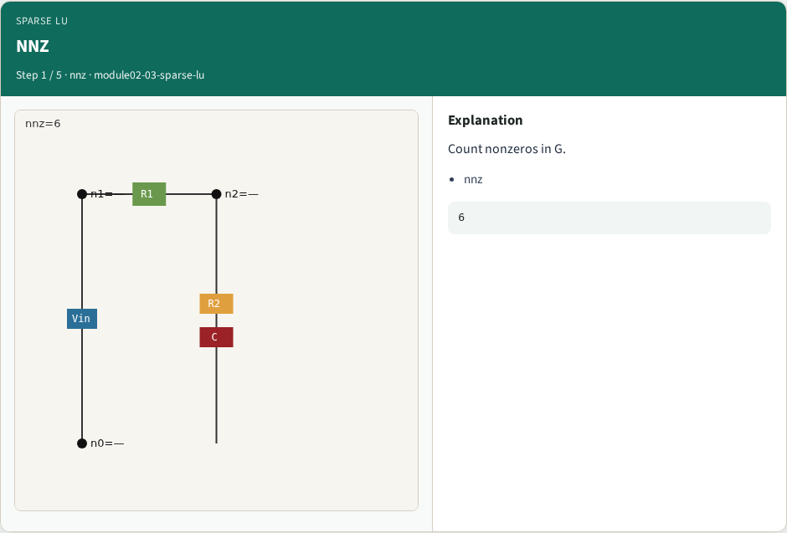
NNZ
NNZ
learn_spice — 03 sparse lu
Notes:
Count nonzeros in G.

Slide 4
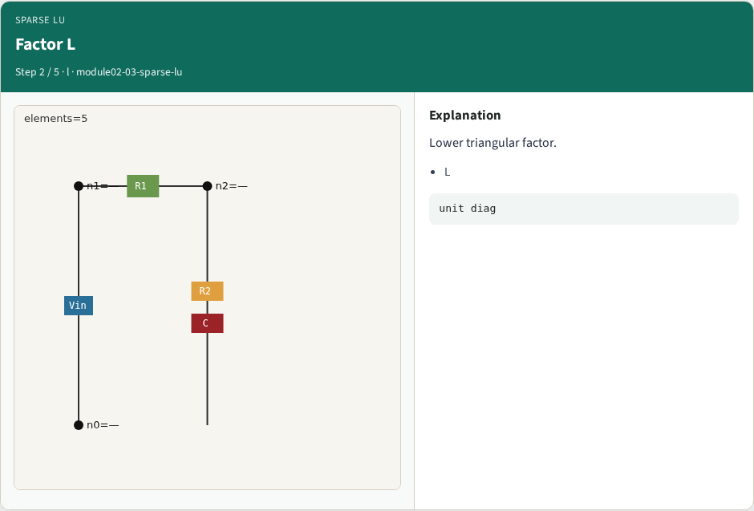
Factor L
Factor L
learn_spice — 03 sparse lu
Notes:
Lower triangular factor.

Slide 5

Factor U
Factor U
learn_spice — 03 sparse lu
Notes:
Upper triangular factor.

Slide 6

Fwd/back idea
Fwd/back idea
learn_spice — 03 sparse lu
Notes:
Solve Ly=b then Ux=y.

Slide 7

NNZ 6
NNZ 6
learn_spice — 03 sparse lu
Notes:
GOLDEN nnz=6 on toy G.

Slide 8
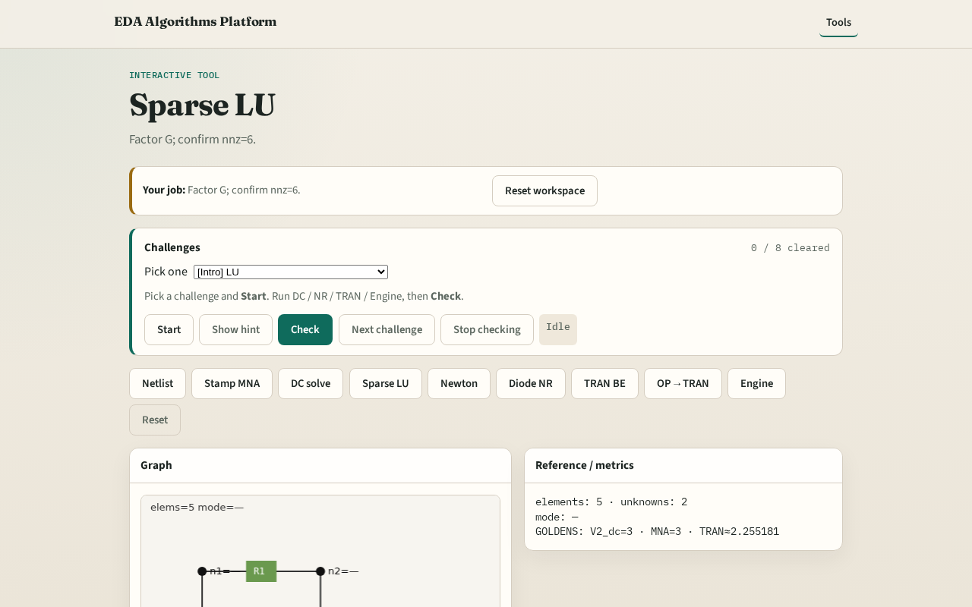
Browser lab track
Browser lab starter
learn_spice — 03 sparse lu
Notes:
Open **sparse-lu**. Factor G; confirm nnz=6.

Slide 9
Implement track
Call sparse_lu_lite(G from dc_linear_solve); assert nnz==6
learn_spice — 03 sparse lu
Notes:
Call sparse_lu_lite(G from dc_linear_solve); assert nnz==6.

Slide 10
Pitfalls
Confusing nnz with matrix dimension
Expecting fill-in on this tiny dense G
learn_spice — 03 sparse lu
Notes:
Confusing nnz with matrix dimension. Expecting fill-in on this tiny dense G.

Slide 11
Your turn
Next: Newton-Raphson on the same stamps
learn_spice — 03 sparse lu
Notes:
Next: Newton-Raphson on the same stamps.

