Slide 1
Why Newton
Newton-Raphson linearizes nonlinear devices and iterates until the residual drops
learn_spice — 01 newton raphson
Notes:
Newton-Raphson linearizes nonlinear devices and iterates until the residual drops.

Slide 2
The idea
GOLDEN: 1 iteration with linear-only stamps; v2=3.0
learn_spice — 01 newton raphson
Notes:
GOLDEN: 1 iteration with linear-only stamps; v2=3.0.

Slide 3

Guess
Guess
learn_spice — 01 newton raphson
Notes:
Start from linear OP.

Slide 4

Jacobian
Jacobian
learn_spice — 01 newton raphson
Notes:
Restamp G each iteration.

Slide 5

Update
Update
learn_spice — 01 newton raphson
Notes:
Solve and update x.

Slide 6

Residual
Residual
learn_spice — 01 newton raphson
Notes:
Stop when |dx| small.

Slide 7
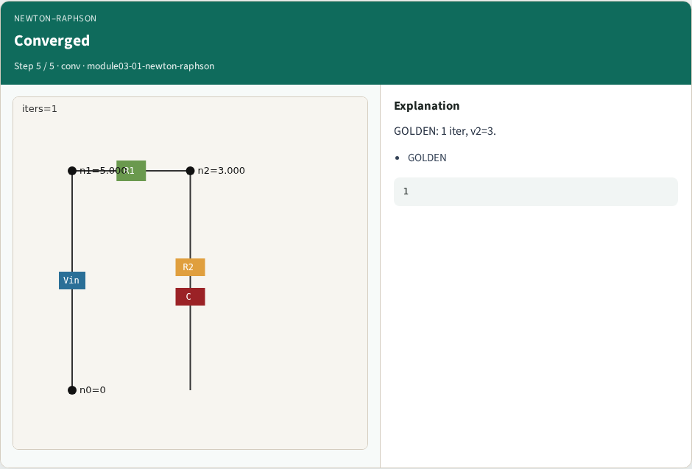
Converged
Converged
learn_spice — 01 newton raphson
Notes:
GOLDEN: 1 iter, v2=3.

Slide 8

Browser lab track
Browser lab starter
learn_spice — 01 newton raphson
Notes:
Open **newton-raphson**. Run NR without diode; confirm 1 iter and v2=3.

Slide 9
Implement track
Call newton_raphson_dc(include_diode=False); assert iters==1 and v2≈3.0
learn_spice — 01 newton raphson
Notes:
Call newton_raphson_dc(include_diode=False); assert iters==1 and v2≈3.0.

Slide 10
Pitfalls
Enabling diode when the lesson is linear convergence
Wrong tolerance units
learn_spice — 01 newton raphson
Notes:
Enabling diode when the lesson is linear convergence. Wrong tolerance units.

Slide 11
Your turn
Next: device callbacks for diodes
learn_spice — 01 newton raphson
Notes:
Next: device callbacks for diodes.

