Slide 1
Why callbacks
Nonlinear devices expose i(v) and g=di/dv to the MNA Newton loop
learn_spice — 03 device callbacks
Notes:
Nonlinear devices expose i(v) and g=di/dv to the MNA Newton loop.

Slide 2
The idea
GOLDEN: diode_loop_newton converges; callback returns i and g at vd
learn_spice — 03 device callbacks
Notes:
GOLDEN: diode_loop_newton converges; callback returns i and g at vd.

Slide 3
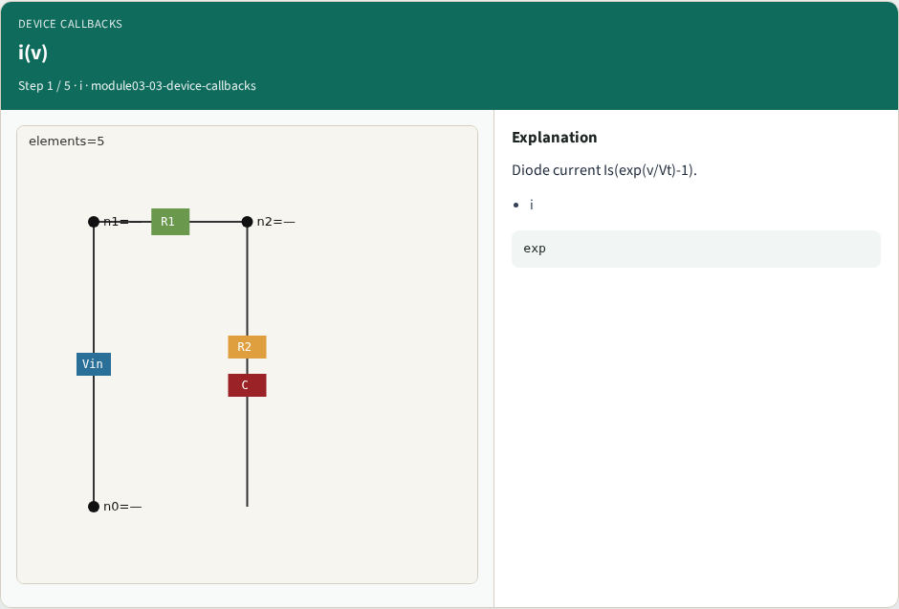
i(v)
i(v)
learn_spice — 03 device callbacks
Notes:
Diode current Is(exp(v/Vt)-1).

Slide 4

g=di/dv
g=di/dv
learn_spice — 03 device callbacks
Notes:
Conductance for Jacobian.

Slide 5

1-D loop
1-D loop
learn_spice — 03 device callbacks
Notes:
Series R+diode Newton.

Slide 6
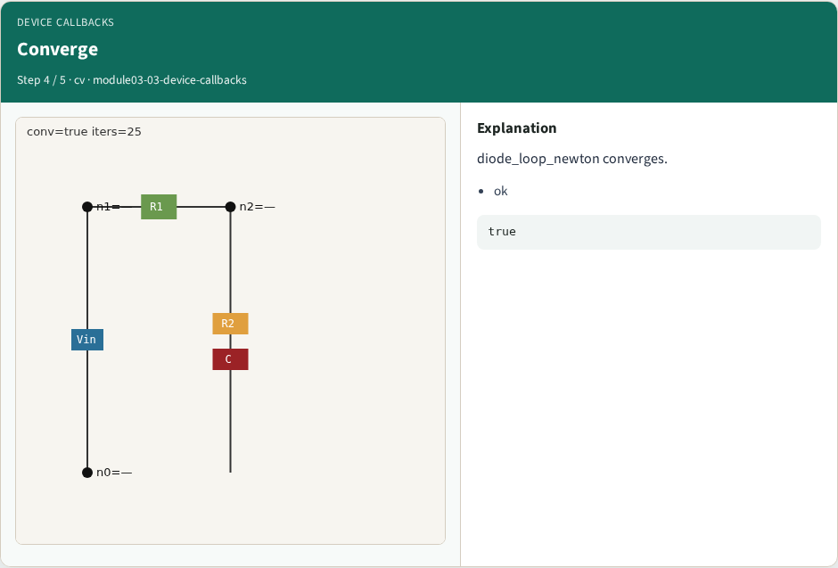
Converge
Converge
learn_spice — 03 device callbacks
Notes:
diode_loop_newton converges.

Slide 7

Hook
Hook
learn_spice — 03 device callbacks
Notes:
Callbacks plug into MNA stamps.

Slide 8
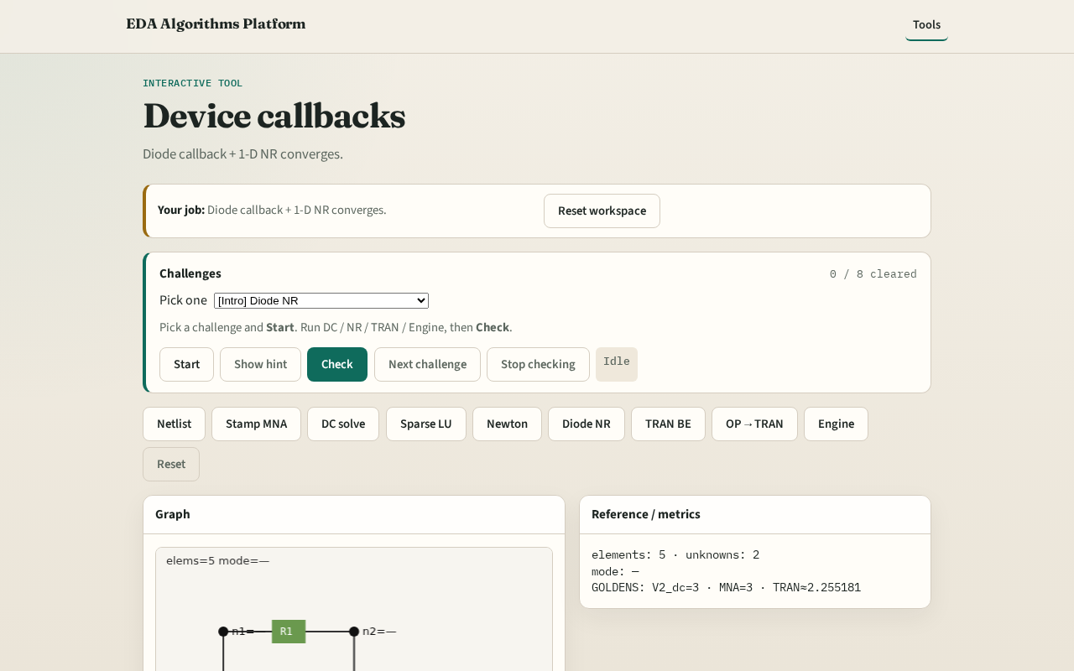
Browser lab track
Browser lab starter
learn_spice — 03 device callbacks
Notes:
Open **device-callbacks**. Run callback + 1-D loop; confirm convergence.

Slide 9
Implement track
Call device_callback_diode(0.0) and diode_loop_newton(); assert converged
learn_spice — 03 device callbacks
Notes:
Call device_callback_diode(0.0) and diode_loop_newton(); assert converged.

Slide 10
Pitfalls
Using linear diode model
Forgetting companion conductance in transient
learn_spice — 03 device callbacks
Notes:
Using linear diode model. Forgetting companion conductance in transient.

Slide 11
Your turn
Next: backward-Euler transient on RC
learn_spice — 03 device callbacks
Notes:
Next: backward-Euler transient on RC.

