Slide 1
Why transient
Transient analysis steps time: capacitors use companion models at each dt
learn_spice — 01 transient be
Notes:
Transient analysis steps time: capacitors use companion models at each dt.

Slide 2
The idea
GOLDEN: dt=0.5, 4 steps, final_v2≈2.255181 (BE RC from v2_init=0)
learn_spice — 01 transient be
Notes:
GOLDEN: dt=0.5, 4 steps, final_v2≈2.255181 (BE RC from v2_init=0).

Slide 3
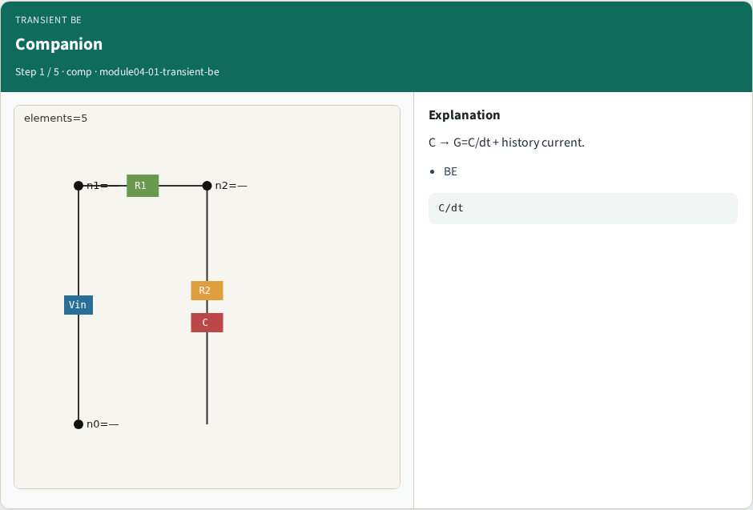
Companion
Companion
learn_spice — 01 transient be
Notes:
C → G=C/dt + history current.

Slide 4
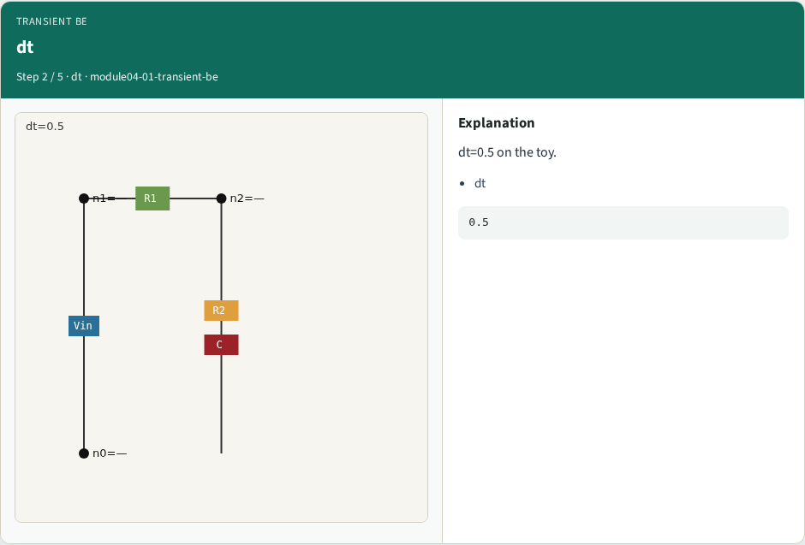
dt
dt
learn_spice — 01 transient be
Notes:
dt=0.5 on the toy.

Slide 5
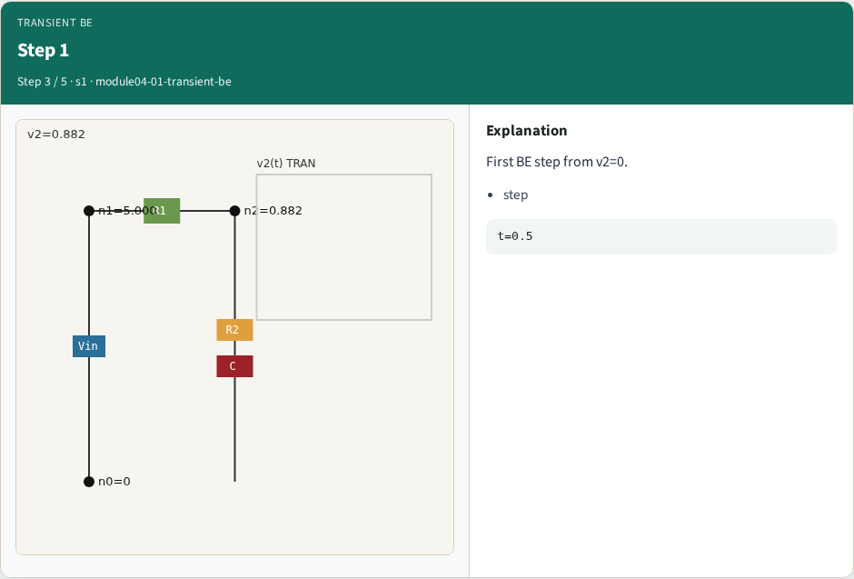
Step 1
Step 1
learn_spice — 01 transient be
Notes:
First BE step from v2=0.

Slide 6

Waveform
Waveform
learn_spice — 01 transient be
Notes:
Four steps toward DC.

Slide 7
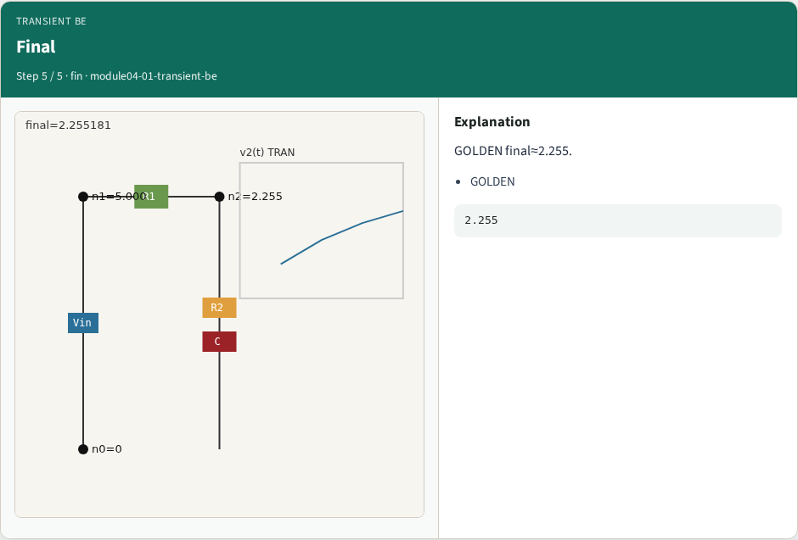
Final
Final
learn_spice — 01 transient be
Notes:
GOLDEN final≈2.255.

Slide 8
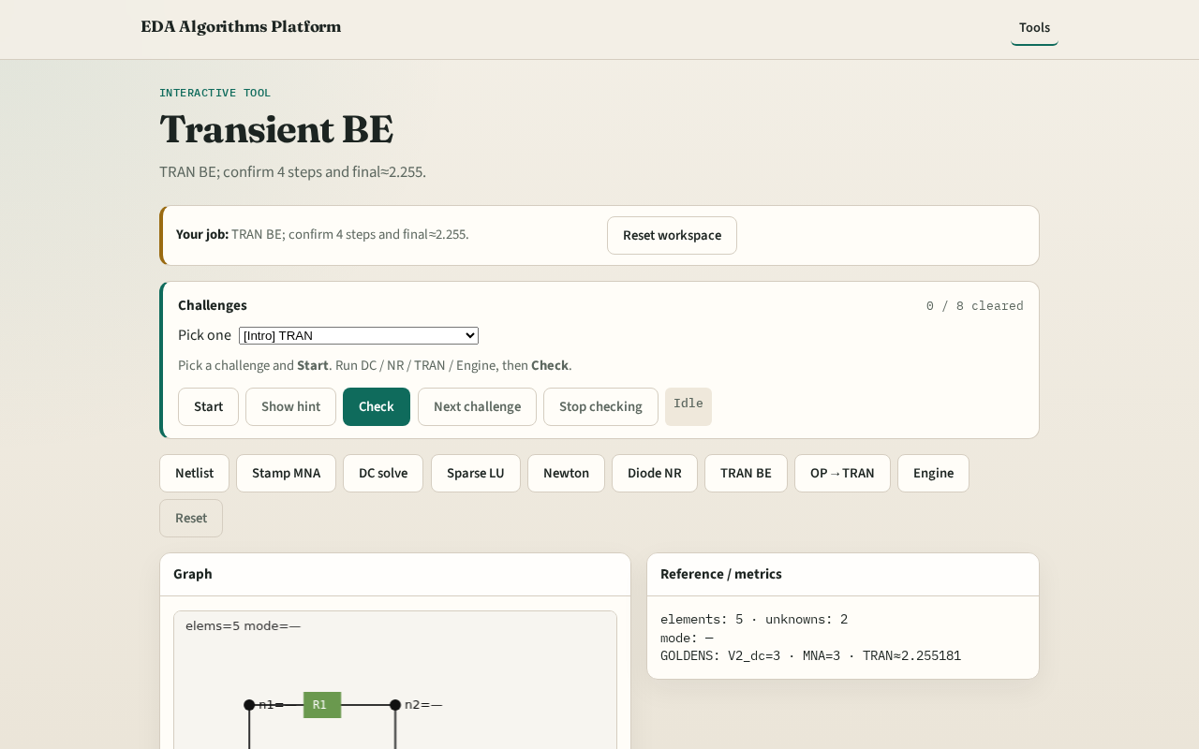
Browser lab track
Browser lab starter
learn_spice — 01 transient be
Notes:
Open **transient-be**. Run BE; confirm final_v2≈2.255181.

Slide 9
Implement track
Call transient_be(dt=0.5, steps=4); assert abs(final_v2-2.255181)<1e-5
learn_spice — 01 transient be
Notes:
Call transient_be(dt=0.5, steps=4); assert abs(final_v2-2.255181)<1e-5.

Slide 10
Pitfalls
Using forward Euler by mistake
Wrong initial capacitor voltage
learn_spice — 01 transient be
Notes:
Using forward Euler by mistake. Wrong initial capacitor voltage.

Slide 11
Your turn
Next: OP then TRAN pipeline
learn_spice — 01 transient be
Notes:
Next: OP then TRAN pipeline.

