Slide 1
Why pipeline
Production SPICE runs OP first, initializes storage elements, then steps TRAN
learn_spice — 03 op tran pipeline
Notes:
Production SPICE runs OP first, initializes storage elements, then steps TRAN.

Slide 2
The idea
GOLDEN: OP V2=3.0; TRAN from v2_init=0 → final_v2≈2.255181
learn_spice — 03 op tran pipeline
Notes:
GOLDEN: OP V2=3.0; TRAN from v2_init=0 → final_v2≈2.255181.

Slide 3
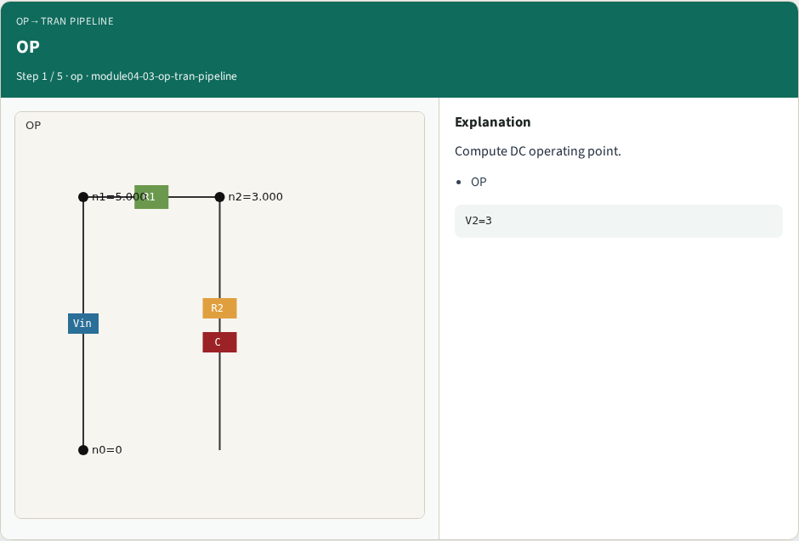
OP
OP
learn_spice — 03 op tran pipeline
Notes:
Compute DC operating point.

Slide 4
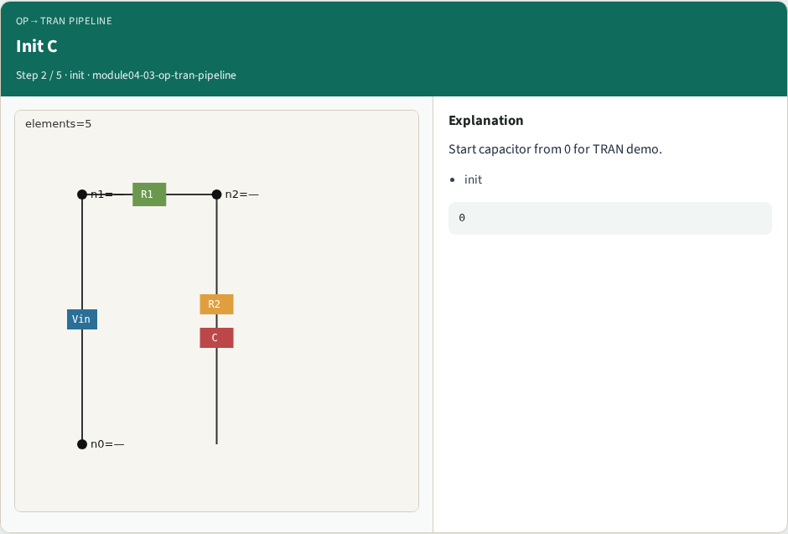
Init C
Init C
learn_spice — 03 op tran pipeline
Notes:
Start capacitor from 0 for TRAN demo.

Slide 5
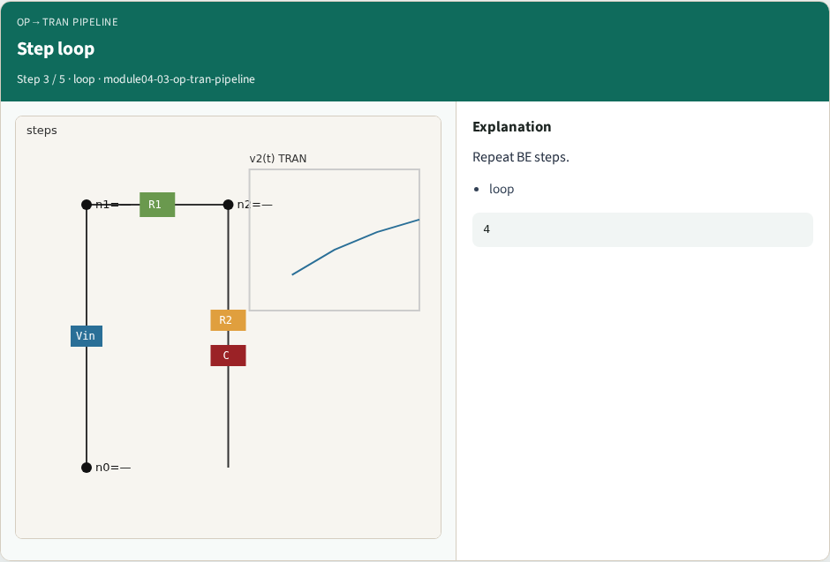
Step loop
Step loop
learn_spice — 03 op tran pipeline
Notes:
Repeat BE steps.

Slide 6
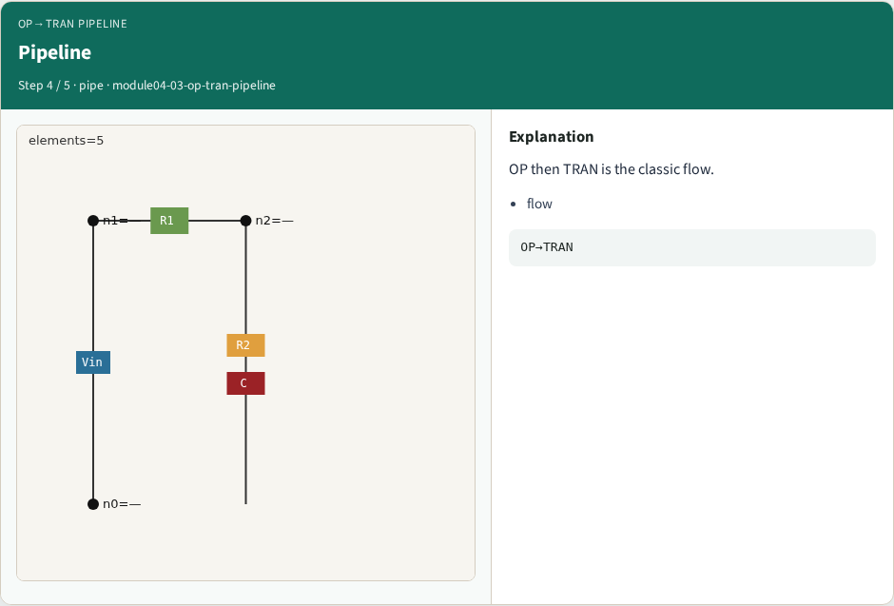
Pipeline
Pipeline
learn_spice — 03 op tran pipeline
Notes:
OP then TRAN is the classic flow.

Slide 7
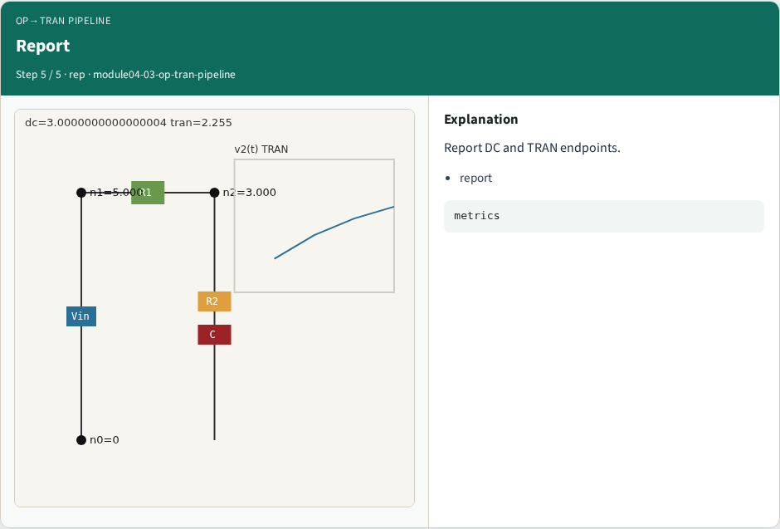
Report
Report
learn_spice — 03 op tran pipeline
Notes:
Report DC and TRAN endpoints.

Slide 8
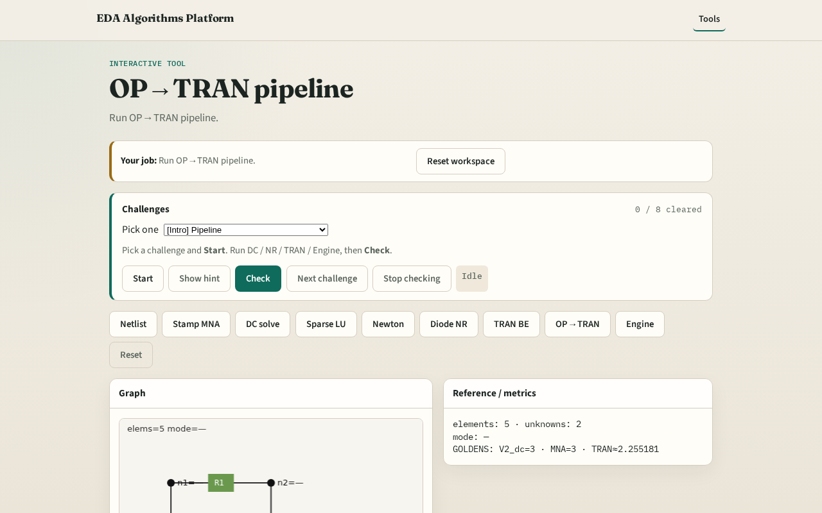
Browser lab track
Browser lab starter
learn_spice — 03 op tran pipeline
Notes:
Open **op-tran-pipeline**. Run OP then TRAN; compare v2 at OP vs final.

Slide 9
Implement track
Call dc_linear_solve() then transient_be(v2_init=0.0); report both v2 values
learn_spice — 03 op tran pipeline
Notes:
Call dc_linear_solve() then transient_be(v2_init=0.0); report both v2 values.

Slide 10
Pitfalls
Starting TRAN from OP cap voltage when lab sets v2_init=0
Skipping OP check
learn_spice — 03 op tran pipeline
Notes:
Starting TRAN from OP cap voltage when lab sets v2_init=0. Skipping OP check.

Slide 11
Your turn
Next: full spice_engine integration
learn_spice — 03 op tran pipeline
Notes:
Next: full spice_engine integration.

