Slide 1
Why engine
A tiny engine chains DC, NR, transient, and diode checks on one netlist
learn_spice — 01 spice engine
Notes:
A tiny engine chains DC, NR, transient, and diode checks on one netlist.

Slide 2
The idea
GOLDEN: dc_v2=3, nr converged, tran final_v2≈2.255181, diode NR ok
learn_spice — 01 spice engine
Notes:
GOLDEN: dc_v2=3, nr converged, tran final_v2≈2.255181, diode NR ok.

Slide 3
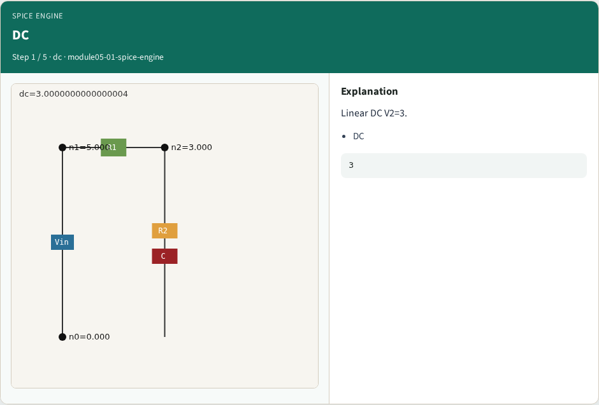
DC
DC
learn_spice — 01 spice engine
Notes:
Linear DC V2=3.

Slide 4

NR
NR
learn_spice — 01 spice engine
Notes:
NR converges in 1 iter.

Slide 5
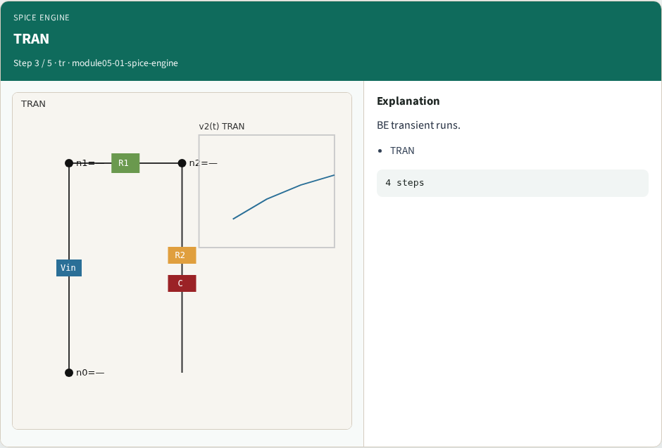
TRAN
TRAN
learn_spice — 01 spice engine
Notes:
BE transient runs.

Slide 6

Diode NR
Diode NR
learn_spice — 01 spice engine
Notes:
1-D diode Newton ok.

Slide 7
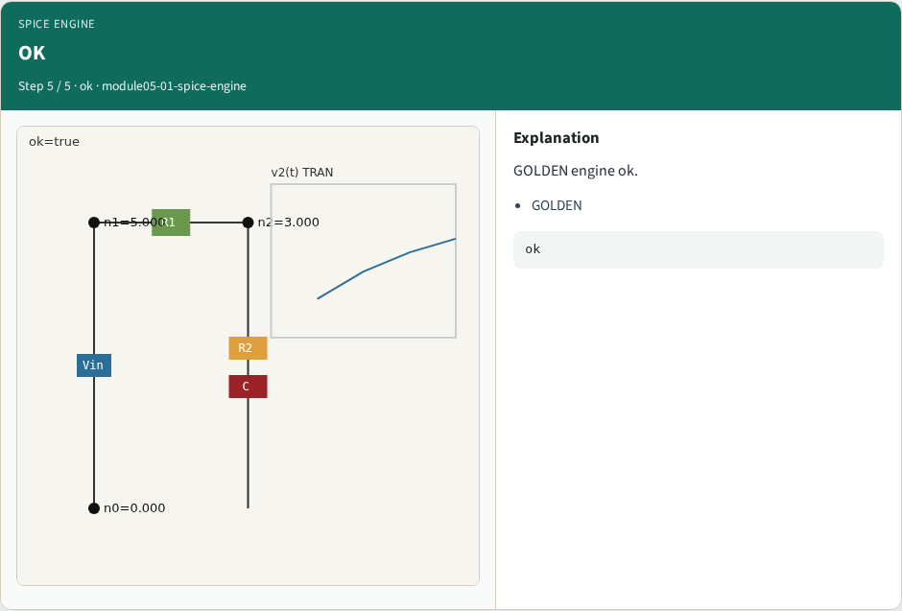
OK
OK
learn_spice — 01 spice engine
Notes:
GOLDEN engine ok.

Slide 8
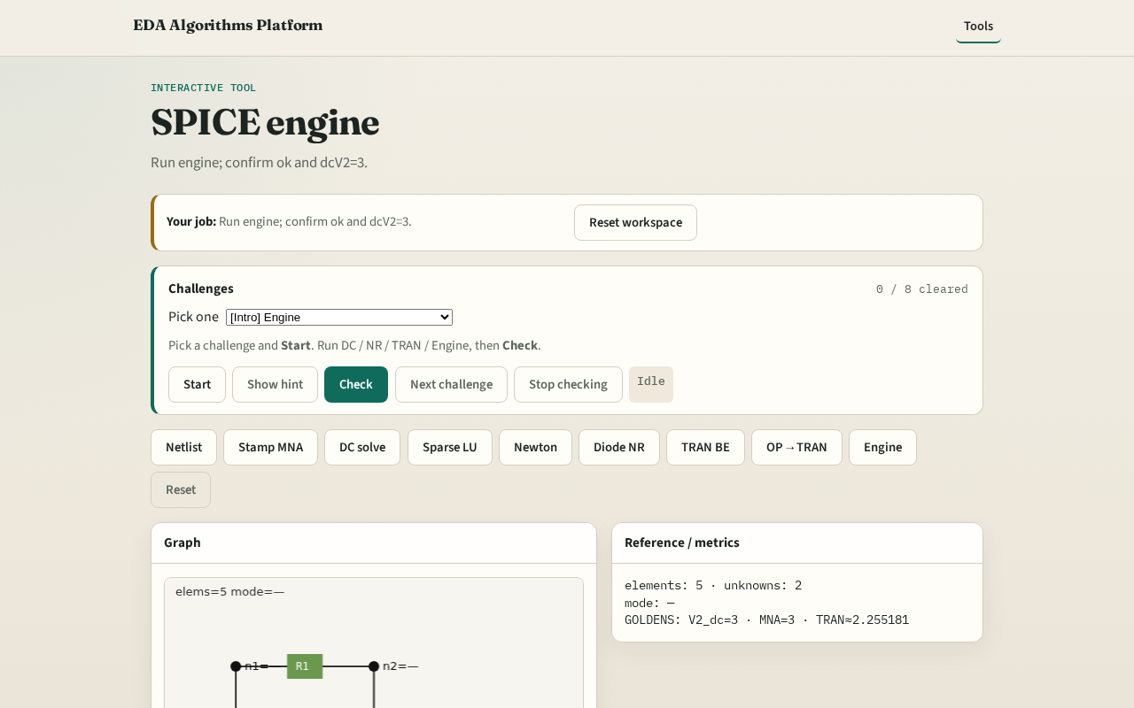
Browser lab track
Browser lab starter
learn_spice — 01 spice engine
Notes:
Open **spice-engine**. Run engine; confirm all goldens.

Slide 9
Implement track
Call spice_engine(); assert ok, dc_v2≈3.0, nr_converged, diode converged
learn_spice — 01 spice engine
Notes:
Call spice_engine(); assert ok, dc_v2≈3.0, nr_converged, diode converged.

Slide 10
Pitfalls
Reporting partial results
Mixing linear and nonlinear paths inconsistently
learn_spice — 01 spice engine
Notes:
Reporting partial results. Mixing linear and nonlinear paths inconsistently.

Slide 11
Your turn
Next: offline benchmark compare, then wrap
learn_spice — 01 spice engine
Notes:
Next: offline benchmark compare, then wrap.

