Slide 1
Spec vs impl
Equivalence checking always compares two circuits: a golden spec and a candidate implementation
learn_equivalence — 01 spec impl
Notes:
Equivalence checking always compares two circuits: a golden spec and a candidate implementation.

Slide 2
The idea
Spec computes f=(a∧b)∨c with two gates
learn_equivalence — 01 spec impl
Notes:
Spec computes f=(a∧b)∨c with two gates; impl_good rewrites with De Morgan; impl_bad uses (a∧b)∧c — same PIs, different logic.

Slide 3
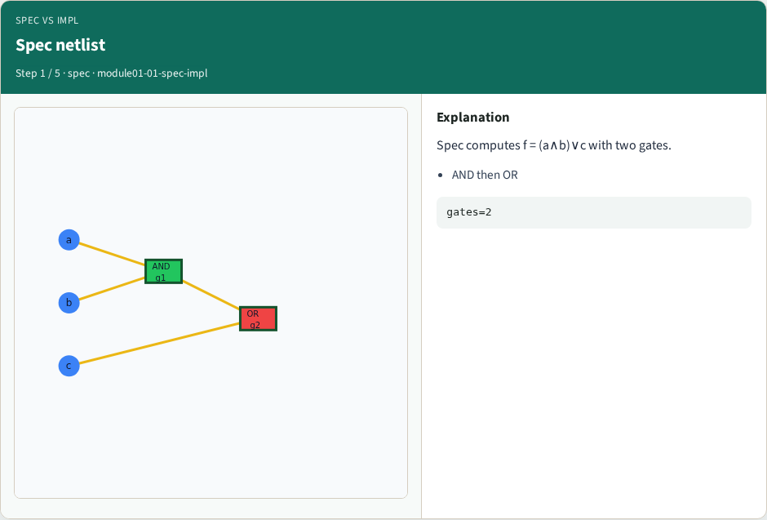
Spec netlist
Spec netlist
learn_equivalence — 01 spec impl
Notes:
Spec computes f = (a∧b)∨c with two gates.

Slide 4
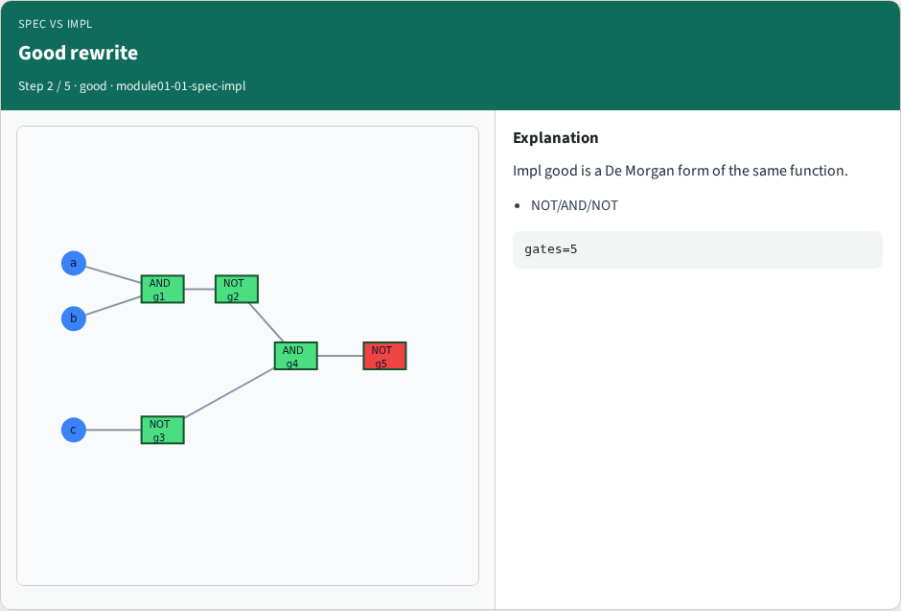
Good rewrite
Good rewrite
learn_equivalence — 01 spec impl
Notes:
Impl good is a De Morgan form of the same function.

Slide 5
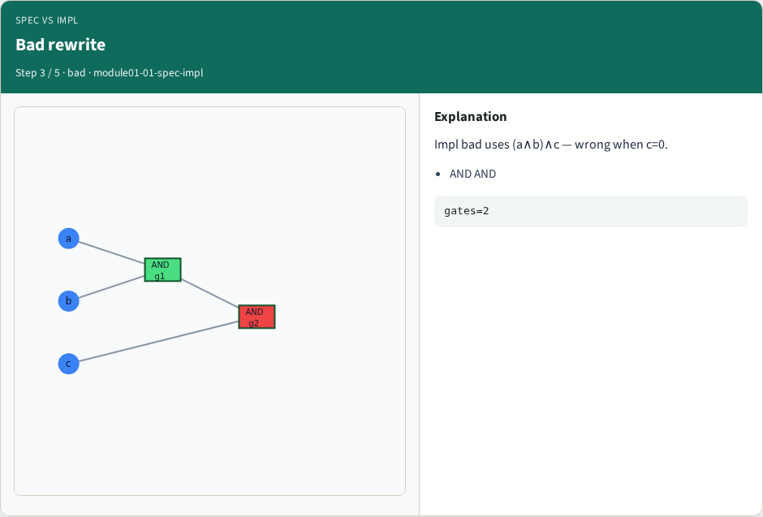
Bad rewrite
Bad rewrite
learn_equivalence — 01 spec impl
Notes:
Impl bad uses (a∧b)∧c — wrong when c=0.

Slide 6
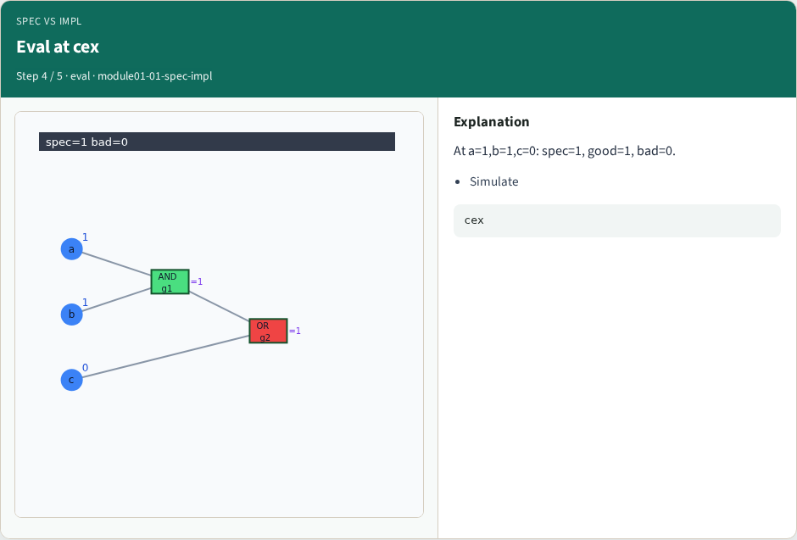
Eval at cex
Eval at cex
learn_equivalence — 01 spec impl
Notes:
At a=1,b=1,c=0: spec=1, good=1, bad=0.

Slide 7
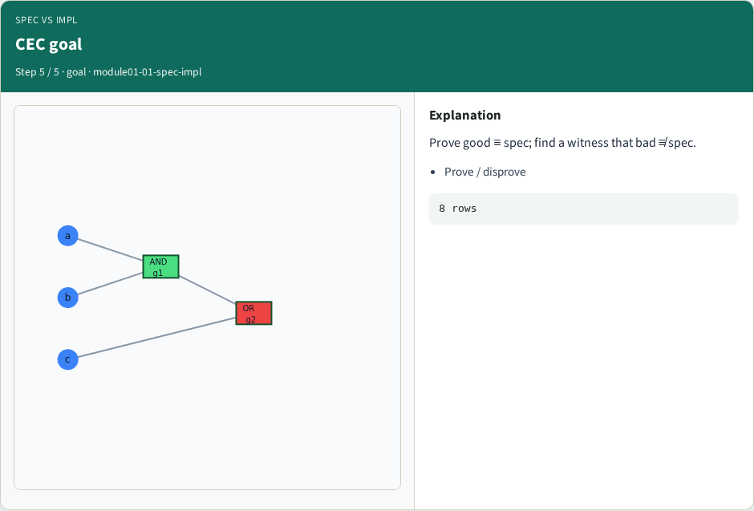
CEC goal
CEC goal
learn_equivalence — 01 spec impl
Notes:
Prove good ≡ spec; find a witness that bad ≢ spec.

Slide 8
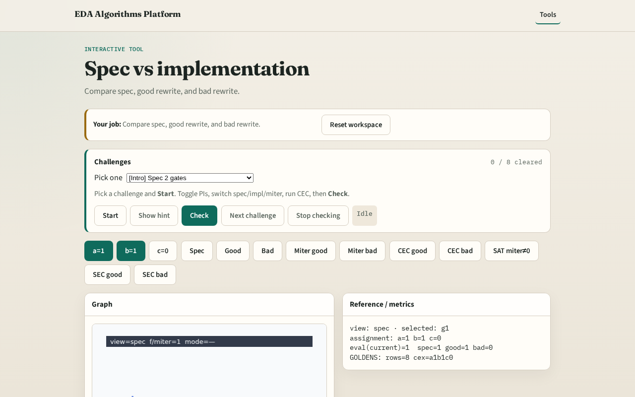
Browser lab track
Browser lab starter
learn_equivalence — 01 spec impl
Notes:
Open **spec-impl**. Compare spec vs impl_good vs impl_bad truth tables side by side.

Slide 9
Implement track
Load tiny_equiv.json; call evaluate_circuit on spec and both impls for all 8 rows
learn_equivalence — 01 spec impl
Notes:
Load tiny_equiv.json; call evaluate_circuit on spec and both impls for all 8 rows.

Slide 10
Pitfalls
Swapping spec and impl
Comparing only one input corner
learn_equivalence — 01 spec impl
Notes:
Swapping spec and impl. Comparing only one input corner.

Slide 11
Your turn
Next: build the miter (XOR of outputs)
learn_equivalence — 01 spec impl
Notes:
Next: build the miter (XOR of outputs).

