Slide 1
Miter build
A miter merges spec and impl and XORs their outputs , equivalent designs yield miter PO=0 everywhere
learn_equivalence — 03 miter build
Notes:
A miter merges spec and impl and XORs their outputs — equivalent designs yield miter PO=0 everywhere.

Slide 2
The idea
Build_miter(spec, impl_good) adds i_-prefixed impl gates and miter_xor = spec_f XOR impl_f
learn_equivalence — 03 miter build
Notes:
build_miter(spec, impl_good) adds i_-prefixed impl gates and miter_xor = spec_f XOR impl_f.

Slide 3
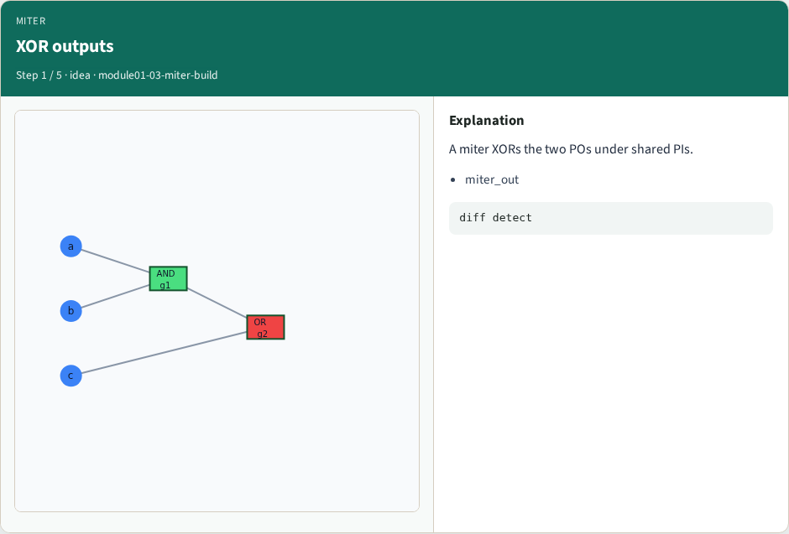
XOR outputs
XOR outputs
learn_equivalence — 03 miter build
Notes:
A miter XORs the two POs under shared PIs.

Slide 4
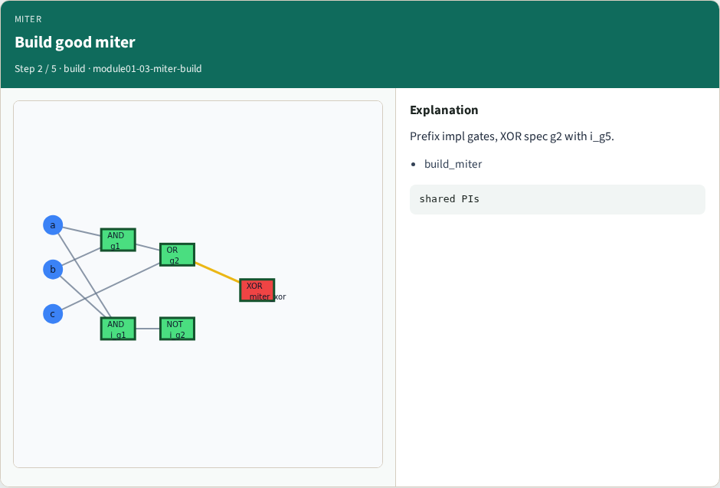
Build good miter
Build good miter
learn_equivalence — 03 miter build
Notes:
Prefix impl gates, XOR spec g2 with i_g5.

Slide 5
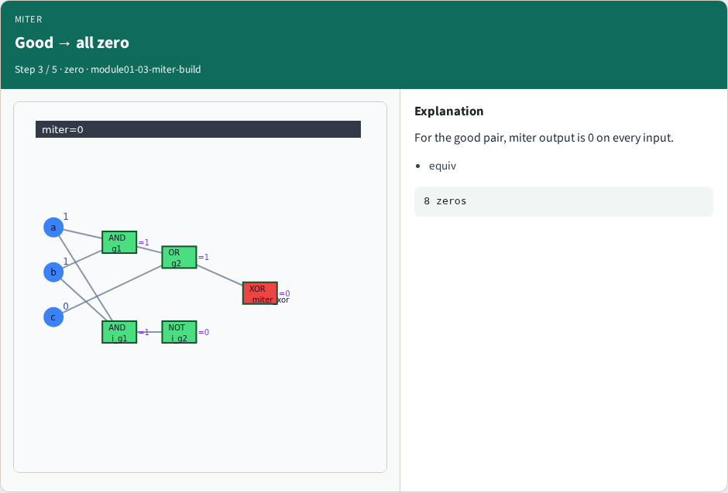
Good → all zero
Good → all zero
learn_equivalence — 03 miter build
Notes:
For the good pair, miter output is 0 on every input.

Slide 6
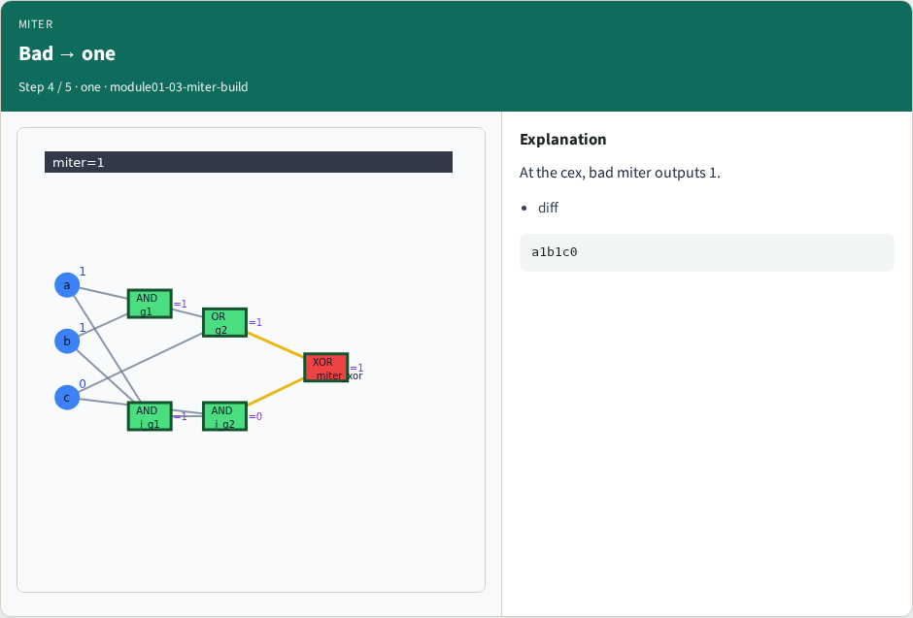
Bad → one
Bad → one
learn_equivalence — 03 miter build
Notes:
At the cex, bad miter outputs 1.

Slide 7

Why miters
Why miters
learn_equivalence — 03 miter build
Notes:
SAT/BDD CEC asks whether miter_out can be 1.

Slide 8
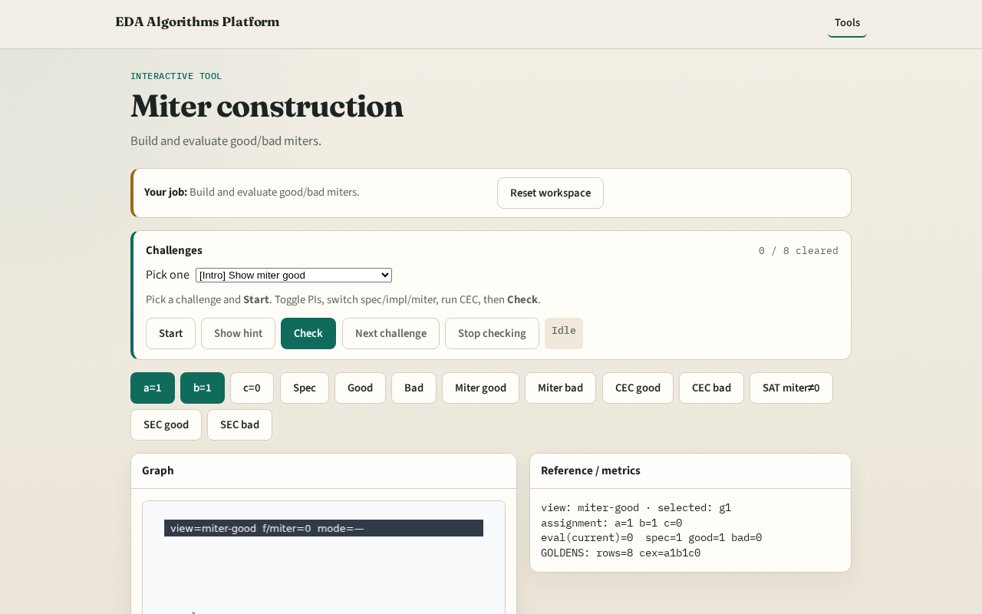
Browser lab track
Browser lab starter
learn_equivalence — 03 miter build
Notes:
Open **miter-build**. Build miter; highlight XOR output; confirm all-zero for good pair.

Slide 9
Implement track
Call build_miter(spec, impl_good); miter_output must be 0 on every assignment
learn_equivalence — 03 miter build
Notes:
Call build_miter(spec, impl_good); miter_output must be 0 on every assignment.

Slide 10
Pitfalls
XORing inputs instead of outputs
Forgetting to clear old output flags
learn_equivalence — 03 miter build
Notes:
XORing inputs instead of outputs. Forgetting to clear old output flags.

Slide 11
Your turn
Next: exhaustive truth-table CEC
learn_equivalence — 03 miter build
Notes:
Next: exhaustive truth-table CEC.

