Slide 1
Truth-table CEC
Truth-table CEC enumerates every PI assignment , fine for tiny circuits, infeasible for wide buses
learn_equivalence — 01 truth table cec
Notes:
Truth-table CEC enumerates every PI assignment — fine for tiny circuits, infeasible for wide buses.

Slide 2
The idea
Truth_table_cec walks all 8 rows; returns equivalent=True or counterexample dict
learn_equivalence — 01 truth table cec
Notes:
truth_table_cec walks all 8 rows; returns equivalent=True or counterexample dict.

Slide 3
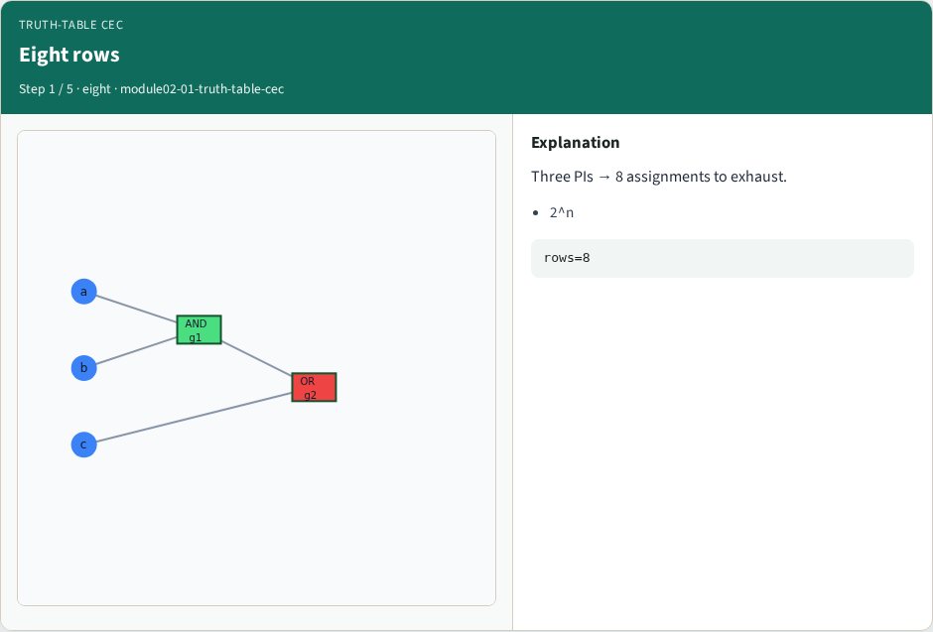
Eight rows
Eight rows
learn_equivalence — 01 truth table cec
Notes:
Three PIs → 8 assignments to exhaust.

Slide 4
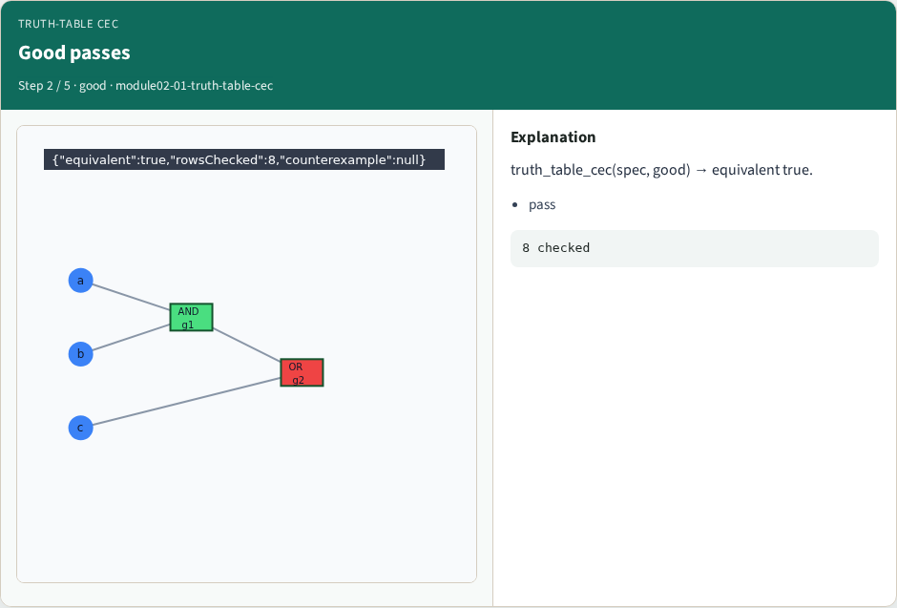
Good passes
Good passes
learn_equivalence — 01 truth table cec
Notes:
truth_table_cec(spec, good) → equivalent true.

Slide 5

Bad fails
Bad fails
learn_equivalence — 01 truth table cec
Notes:
Bad fails; first mismatch is the counterexample.

Slide 6
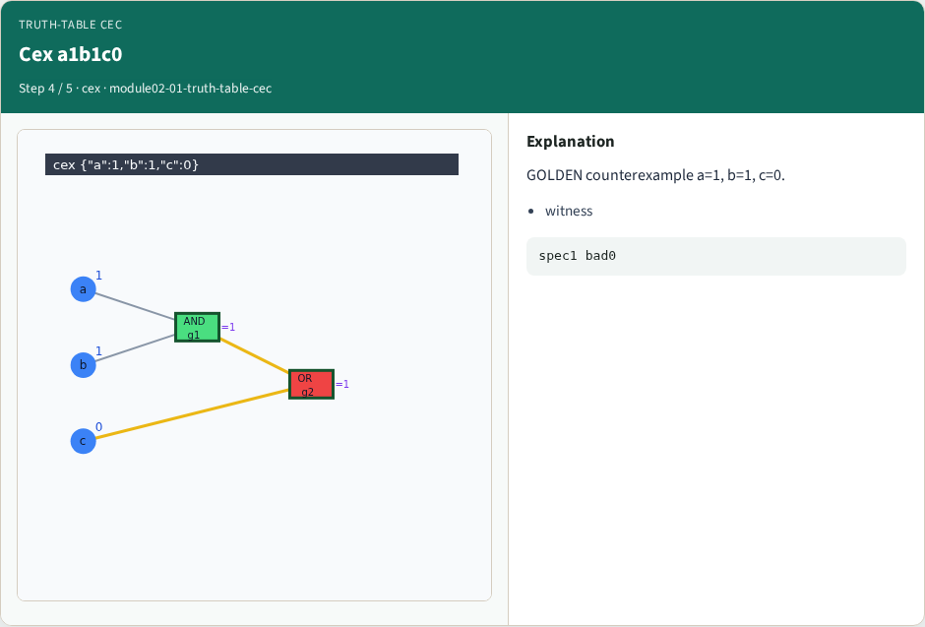
Cex a1b1c0
Cex a1b1c0
learn_equivalence — 01 truth table cec
Notes:
GOLDEN counterexample a=1, b=1, c=0.

Slide 7
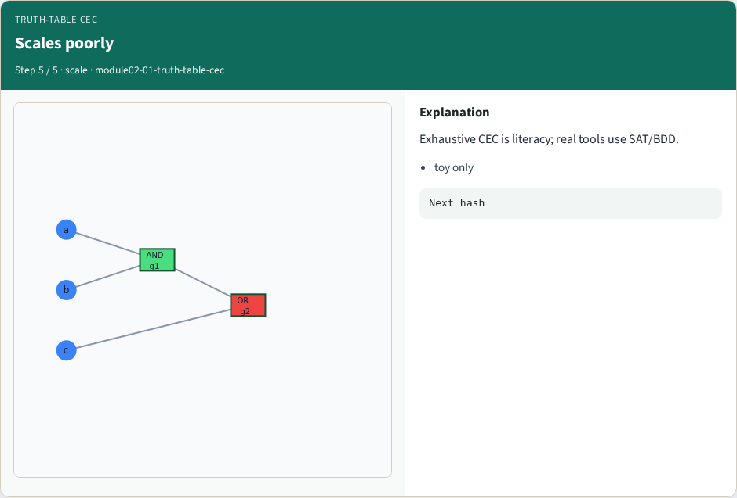
Scales poorly
Scales poorly
learn_equivalence — 01 truth table cec
Notes:
Exhaustive CEC is literacy; real tools use SAT/BDD.

Slide 8
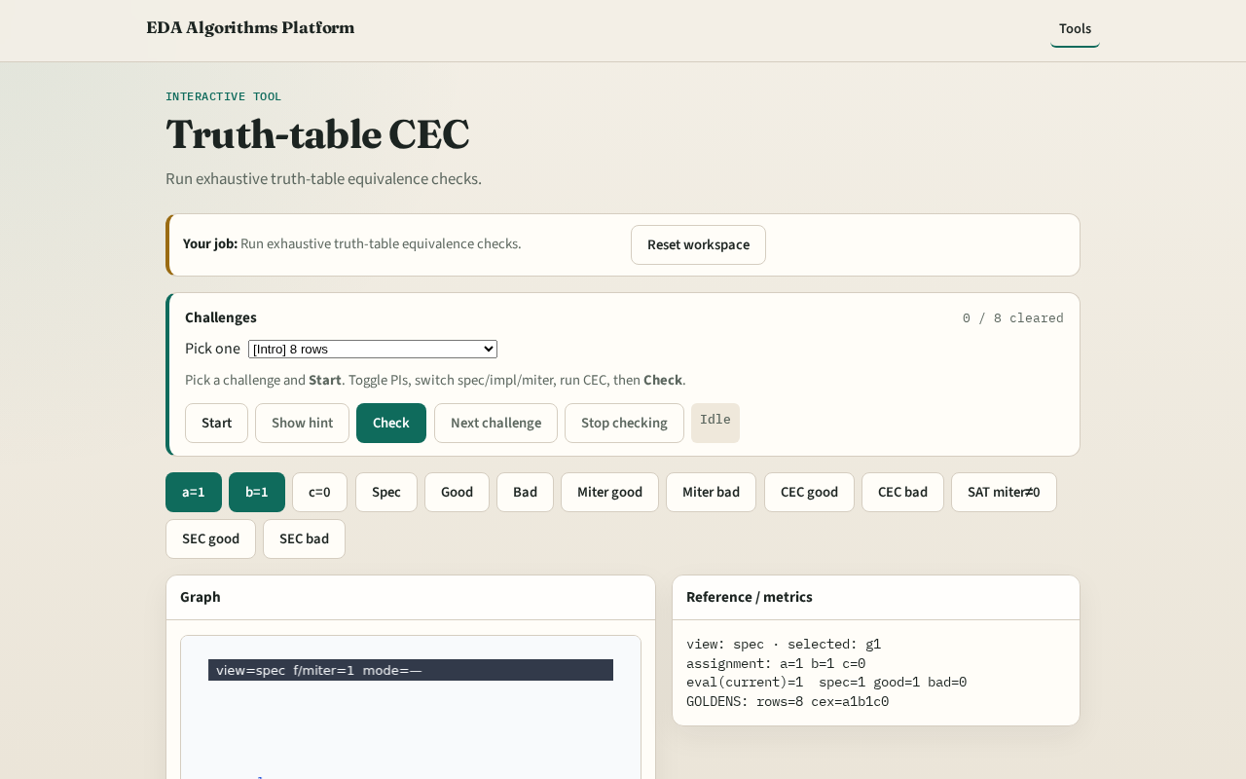
Browser lab track
Browser lab starter
learn_equivalence — 01 truth table cec
Notes:
Open **truth-table-cec**. Run CEC on good and bad pairs; read counterexample panel.

Slide 9
Implement track
Call truth_table_cec(spec, impl_good) and (spec, impl_bad); assert goldens
learn_equivalence — 01 truth table cec
Notes:
Call truth_table_cec(spec, impl_good) and (spec, impl_bad); assert goldens.

Slide 10
Pitfalls
Stopping at first match instead of first mismatch
Missing a PI bit in enumeration
learn_equivalence — 01 truth table cec
Notes:
Stopping at first match instead of first mismatch. Missing a PI bit in enumeration.

Slide 11
Your turn
Next: structural hashing / FRAIG lite
learn_equivalence — 01 truth table cec
Notes:
Next: structural hashing / FRAIG lite.

