Slide 1
Struct hash
Structural hashing finds functionally identical subexpressions , the idea behind FRAIG and AIG strashing
learn_equivalence — 03 structural hash
Notes:
Structural hashing finds functionally identical subexpressions — the idea behind FRAIG and AIG strashing.

Slide 2
The idea
Spec has 2 unique gates
learn_equivalence — 03 structural hash
Notes:
Spec has 2 unique gates; impl_good has 5 gates but fewer unique hashes after sharing literals.

Slide 3
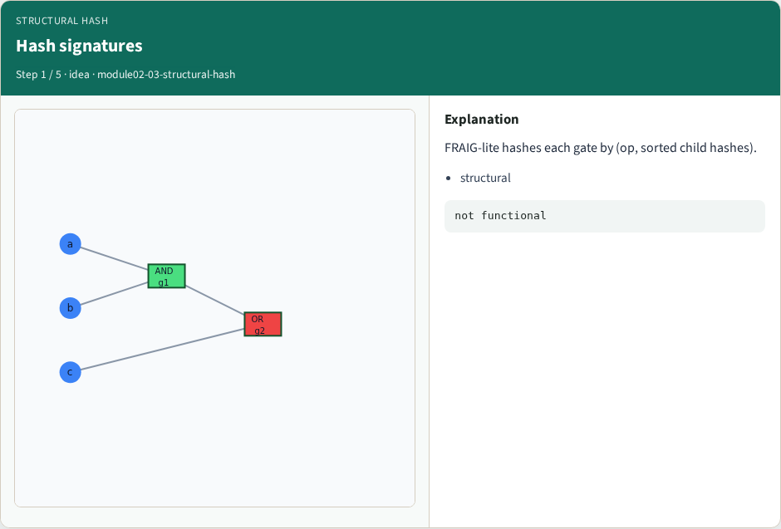
Hash signatures
Hash signatures
learn_equivalence — 03 structural hash
Notes:
FRAIG-lite hashes each gate by (op, sorted child hashes).

Slide 4
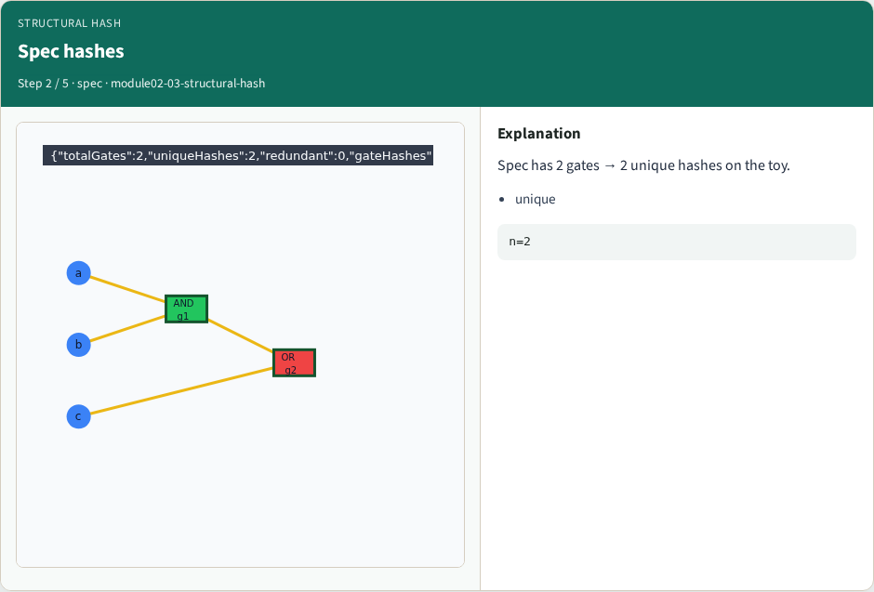
Spec hashes
Spec hashes
learn_equivalence — 03 structural hash
Notes:
Spec has 2 gates → 2 unique hashes on the toy.

Slide 5
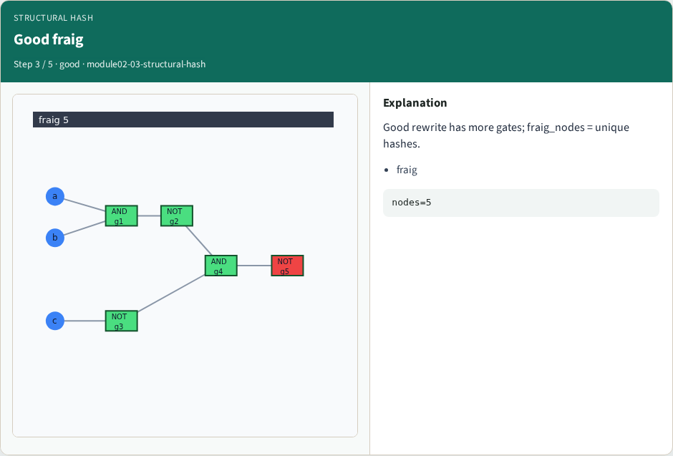
Good fraig
Good fraig
learn_equivalence — 03 structural hash
Notes:
Good rewrite has more gates; fraig_nodes = unique hashes.

Slide 6
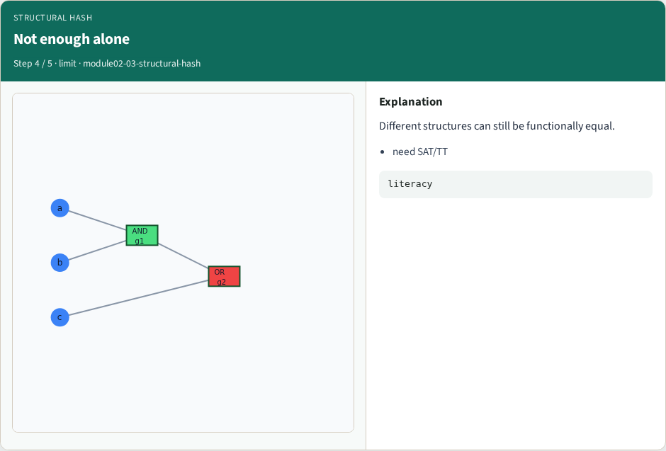
Not enough alone
Not enough alone
learn_equivalence — 03 structural hash
Notes:
Different structures can still be functionally equal.

Slide 7
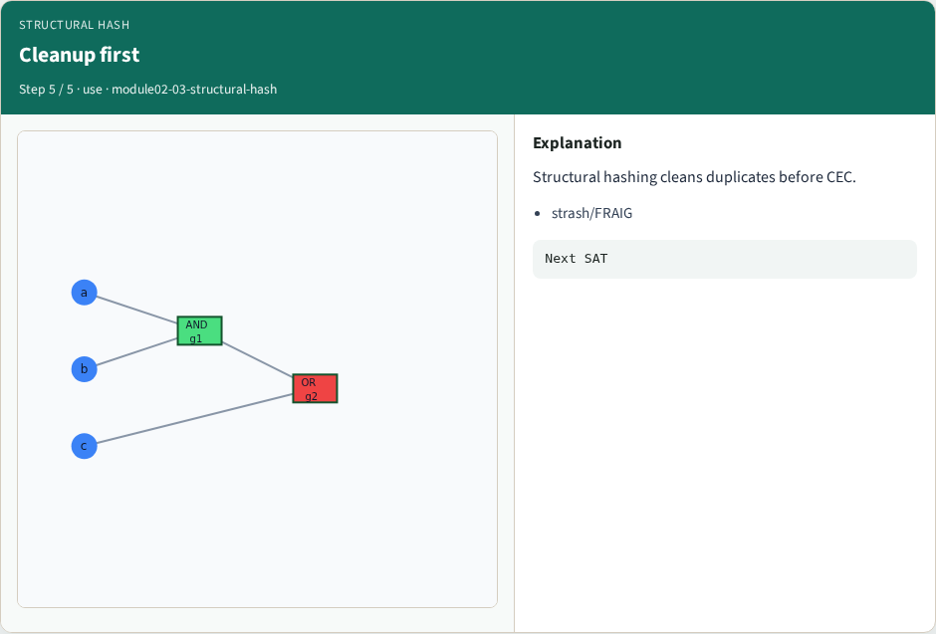
Cleanup first
Cleanup first
learn_equivalence — 03 structural hash
Notes:
Structural hashing cleans duplicates before CEC.

Slide 8
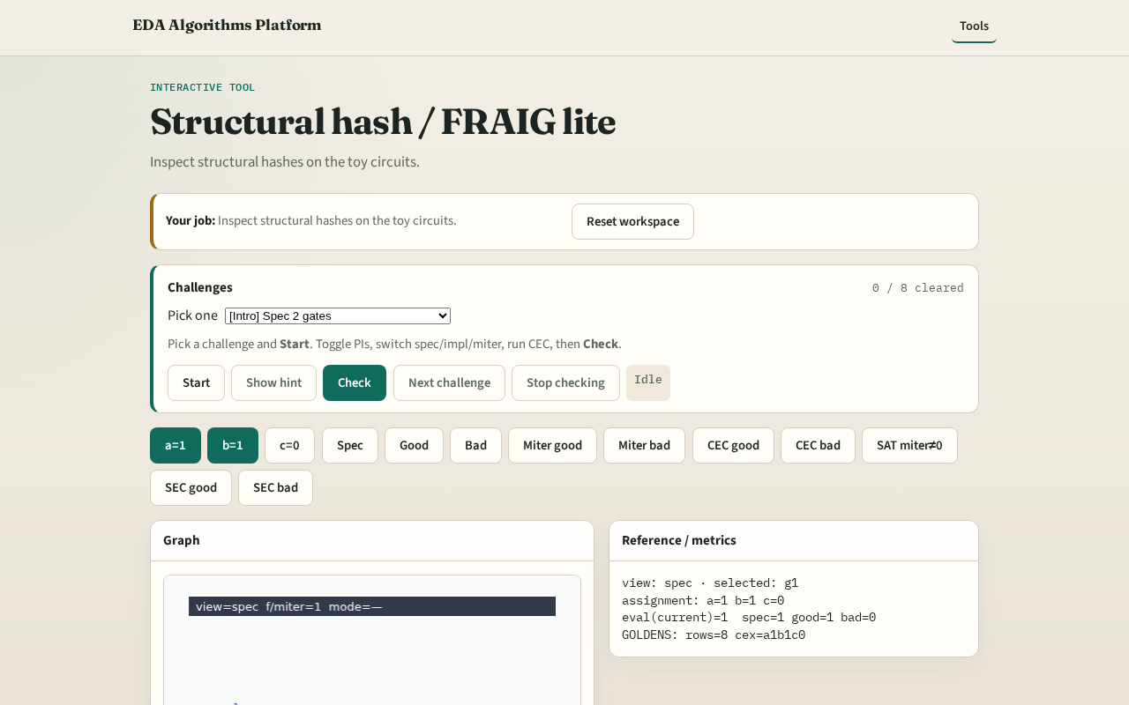
Browser lab track
Browser lab starter
learn_equivalence — 03 structural hash
Notes:
Open **structural-hash**. Highlight hash buckets; compare spec vs impl_good gate counts.

Slide 9
Implement track
Call structural_hash_stats(spec) and fraig_lite(impl_good)
learn_equivalence — 03 structural hash
Notes:
Call structural_hash_stats(spec) and fraig_lite(impl_good).

Slide 10
Pitfalls
Hashing by gate id instead of structure
Expecting full industrial FRAIG fixpoint
learn_equivalence — 03 structural hash
Notes:
Hashing by gate id instead of structure. Expecting full industrial FRAIG fixpoint.

Slide 11
Your turn
Next: SAT / CNF encoding lite
learn_equivalence — 03 structural hash
Notes:
Next: SAT / CNF encoding lite.

