Slide 1
SAT CNF lite
Industrial CEC uses SAT on a miter , first learn clause count on a tiny netlist
learn_equivalence — 05 sat cnf lite
Notes:
Industrial CEC uses SAT on a miter — first learn clause count on a tiny netlist.

Slide 2
The idea
Encode_sat_cnf_lite assigns PI vars 1..3 and adds clauses per AND/OR/NOT gate
learn_equivalence — 05 sat cnf lite
Notes:
encode_sat_cnf_lite assigns PI vars 1..3 and adds clauses per AND/OR/NOT gate.

Slide 3
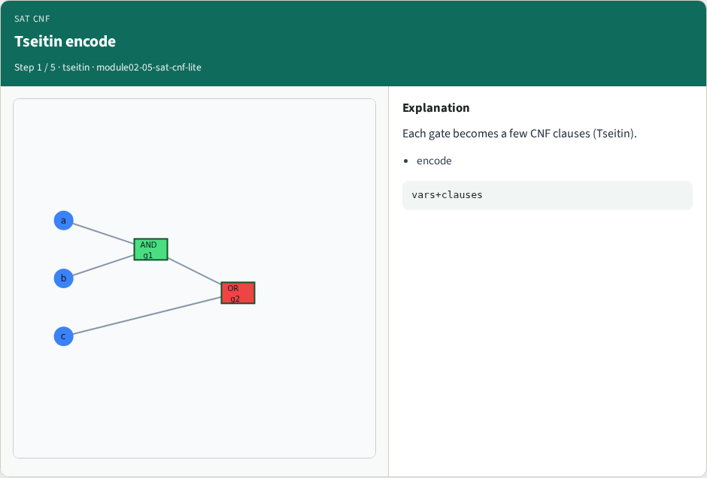
Tseitin encode
Tseitin encode
learn_equivalence — 05 sat cnf lite
Notes:
Each gate becomes a few CNF clauses (Tseitin).

Slide 4
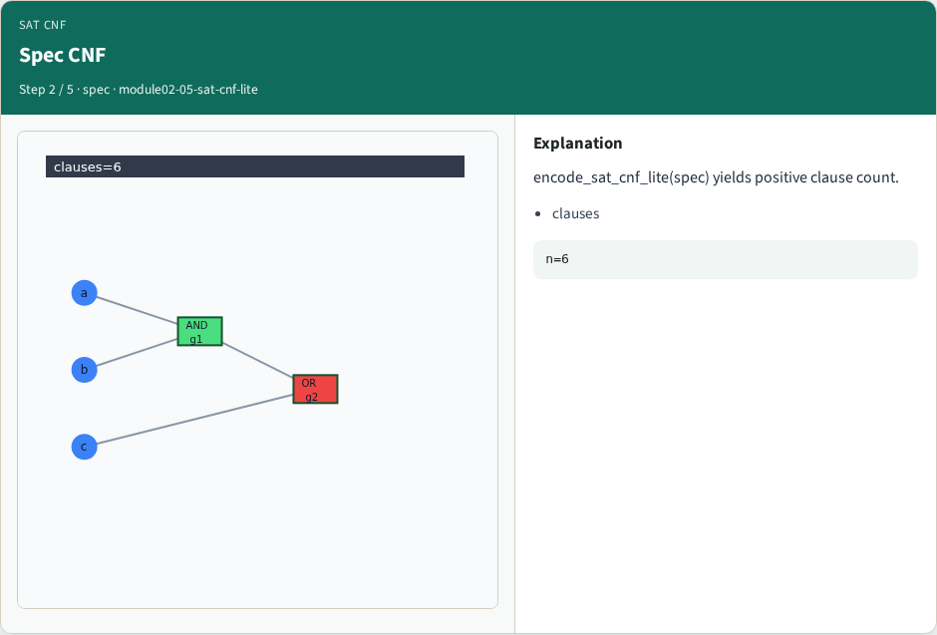
Spec CNF
Spec CNF
learn_equivalence — 05 sat cnf lite
Notes:
encode_sat_cnf_lite(spec) yields positive clause count.

Slide 5
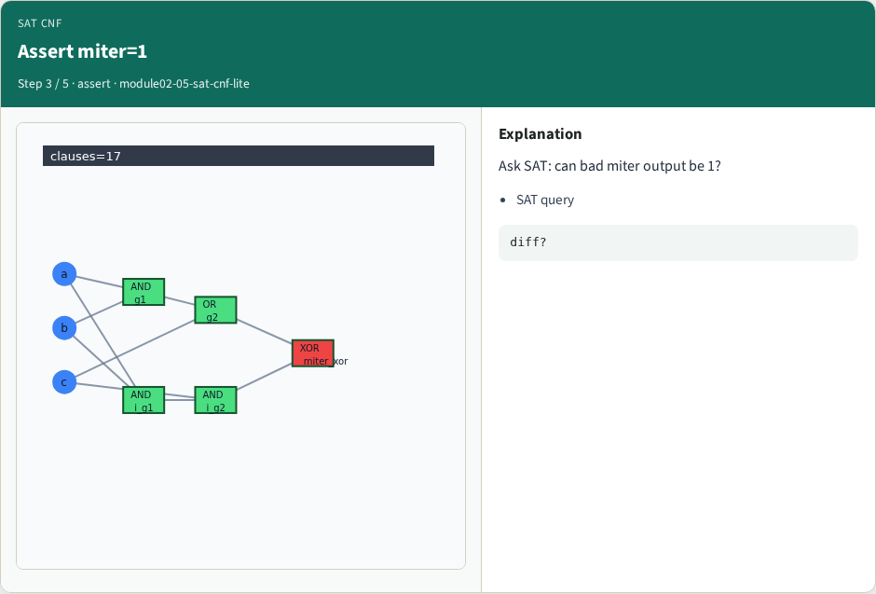
Assert miter=1
Assert miter=1
learn_equivalence — 05 sat cnf lite
Notes:
Ask SAT: can bad miter output be 1?

Slide 6
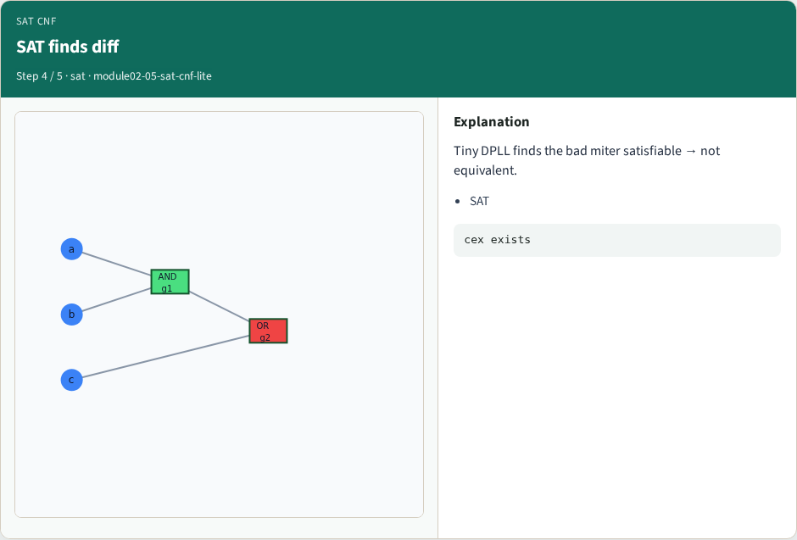
SAT finds diff
SAT finds diff
learn_equivalence — 05 sat cnf lite
Notes:
Tiny DPLL finds the bad miter satisfiable → not equivalent.

Slide 7
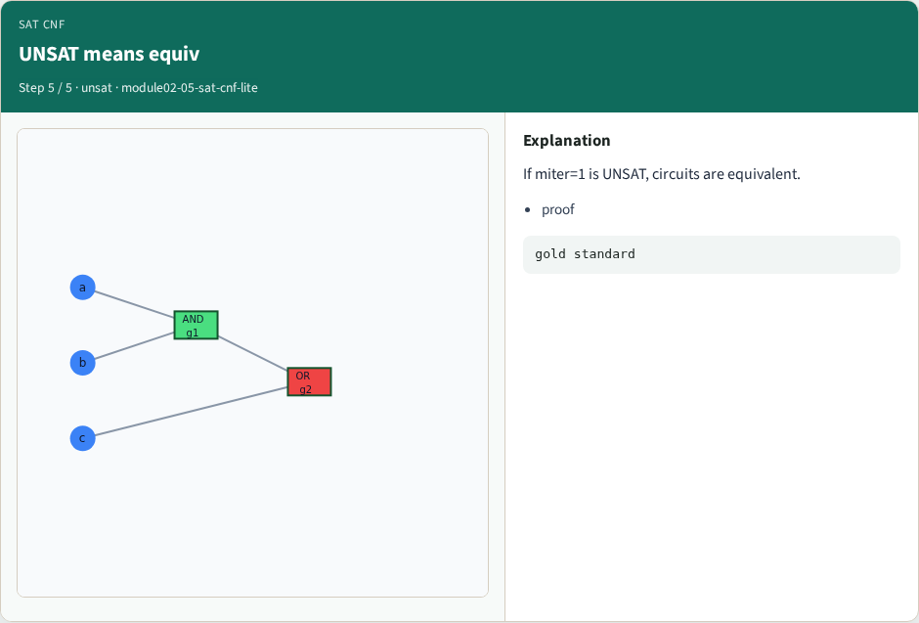
UNSAT means equiv
UNSAT means equiv
learn_equivalence — 05 sat cnf lite
Notes:
If miter=1 is UNSAT, circuits are equivalent.

Slide 8
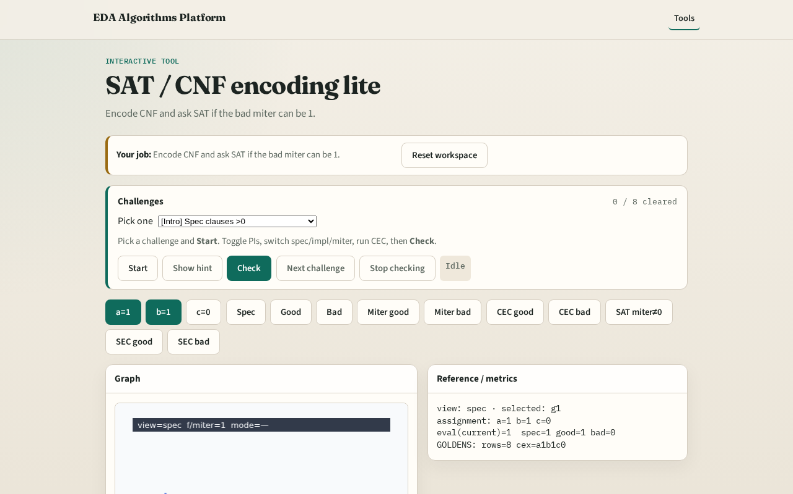
Browser lab track
Browser lab starter
learn_equivalence — 05 sat cnf lite
Notes:
Open **sat-cnf-lite**. Show CNF stats; toggle assert PO=1 and run Check.

Slide 9
Implement track
Call encode_sat_cnf_lite(spec)
learn_equivalence — 05 sat cnf lite
Notes:
Call encode_sat_cnf_lite(spec); print num_vars, num_clauses; sat_satisfiable on asserted PO.

Slide 10
Pitfalls
CNF on outputs without Tseitin auxiliaries
Expecting full Glucose run
learn_equivalence — 05 sat cnf lite
Notes:
CNF on outputs without Tseitin auxiliaries. Expecting full Glucose run.

Slide 11
Your turn
Next: counterexample debug from CEC
learn_equivalence — 05 sat cnf lite
Notes:
Next: counterexample debug from CEC.

