Slide 1
Counterexample
When CEC fails, the counterexample is your shortest bug story , one input pattern where POs differ
learn_equivalence — 07 counterexample
Notes:
When CEC fails, the counterexample is your shortest bug story — one input pattern where POs differ.

Slide 2
The idea
Find_counterexample(spec, impl_bad) returns {'a':1,'b':1,'c':0}; spec_out=1, impl_out=0
learn_equivalence — 07 counterexample
Notes:
find_counterexample(spec, impl_bad) returns {'a':1,'b':1,'c':0}; spec_out=1, impl_out=0.

Slide 3
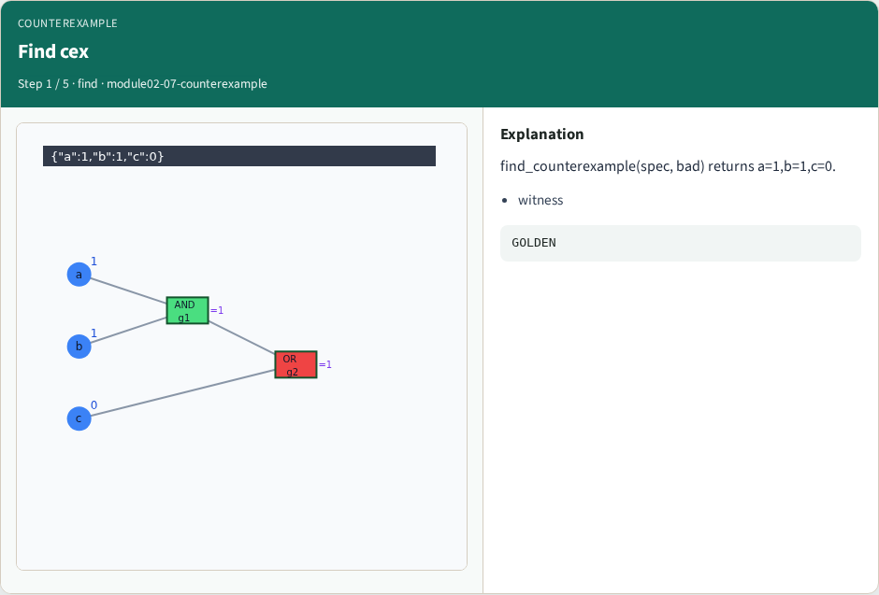
Find cex
Find cex
learn_equivalence — 07 counterexample
Notes:
find_counterexample(spec, bad) returns a=1,b=1,c=0.

Slide 4
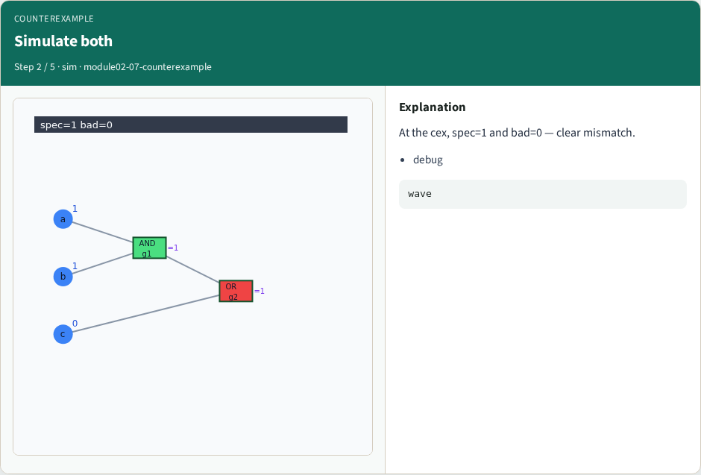
Simulate both
Simulate both
learn_equivalence — 07 counterexample
Notes:
At the cex, spec=1 and bad=0 — clear mismatch.

Slide 5
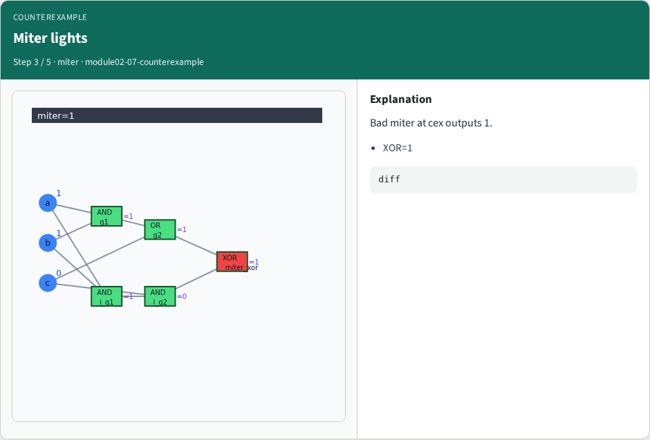
Miter lights
Miter lights
learn_equivalence — 07 counterexample
Notes:
Bad miter at cex outputs 1.

Slide 6
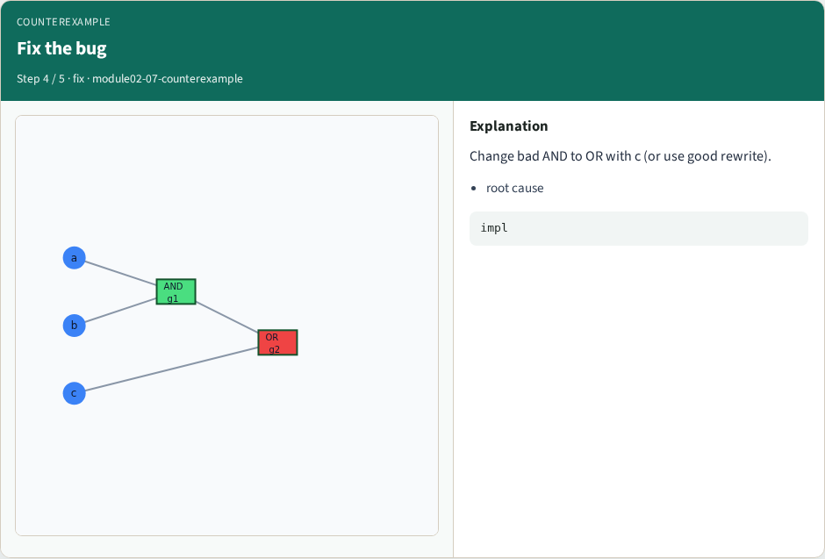
Fix the bug
Fix the bug
learn_equivalence — 07 counterexample
Notes:
Change bad AND to OR with c (or use good rewrite).

Slide 7
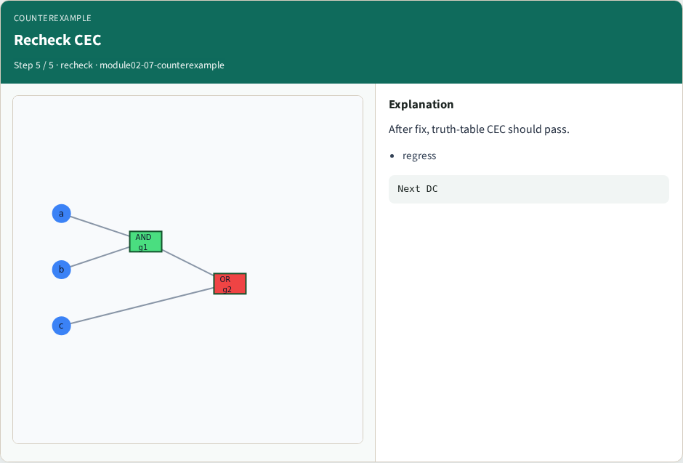
Recheck CEC
Recheck CEC
learn_equivalence — 07 counterexample
Notes:
After fix, truth-table CEC should pass.

Slide 8
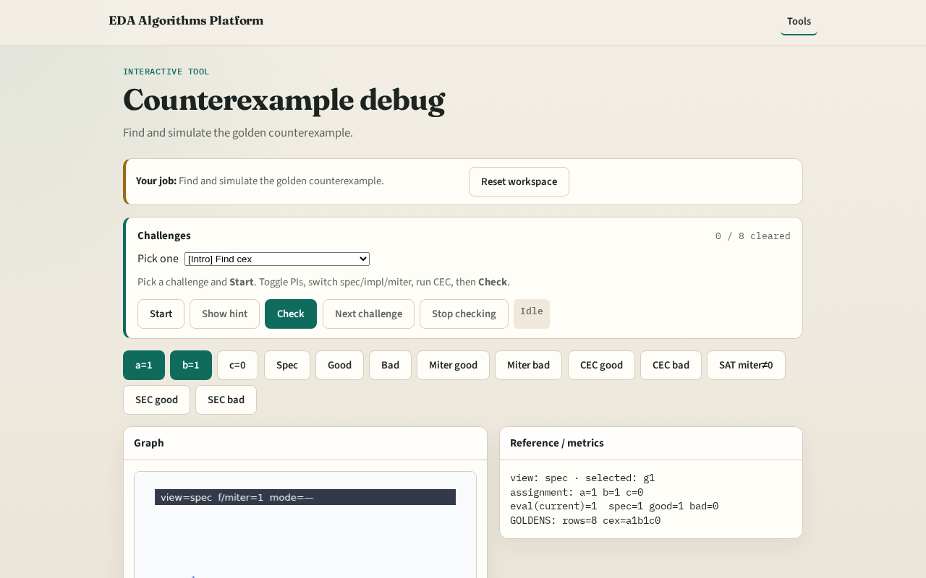
Browser lab track
Browser lab starter
learn_equivalence — 07 counterexample
Notes:
Open **counterexample**. Load bad impl; highlight cex row in truth table.

Slide 9
Implement track
Call find_counterexample(spec, impl_bad); print spec and impl PO at cex
learn_equivalence — 07 counterexample
Notes:
Call find_counterexample(spec, impl_bad); print spec and impl PO at cex.

Slide 10
Pitfalls
Ignoring cex and random sim
Fixing only one corner without regression
learn_equivalence — 07 counterexample
Notes:
Ignoring cex and random sim. Fixing only one corner without regression.

Slide 11
Your turn
Next: don't-care CEC
learn_equivalence — 07 counterexample
Notes:
Next: don't-care CEC.

