Slide 1
Don't-care
Real specs have don't-cares , CEC must only compare care inputs, not illegal or unconstrained bits
learn_equivalence — 01 dont care
Notes:
Real specs have don't-cares — CEC must only compare care inputs, not illegal or unconstrained bits.

Slide 2
The idea
Dont_care_mask with c fixed to 0 still finds a=1,b=1,c=0 mismatch on impl_bad
learn_equivalence — 01 dont care
Notes:
dont_care_mask with c fixed to 0 still finds a=1,b=1,c=0 mismatch on impl_bad.

Slide 3
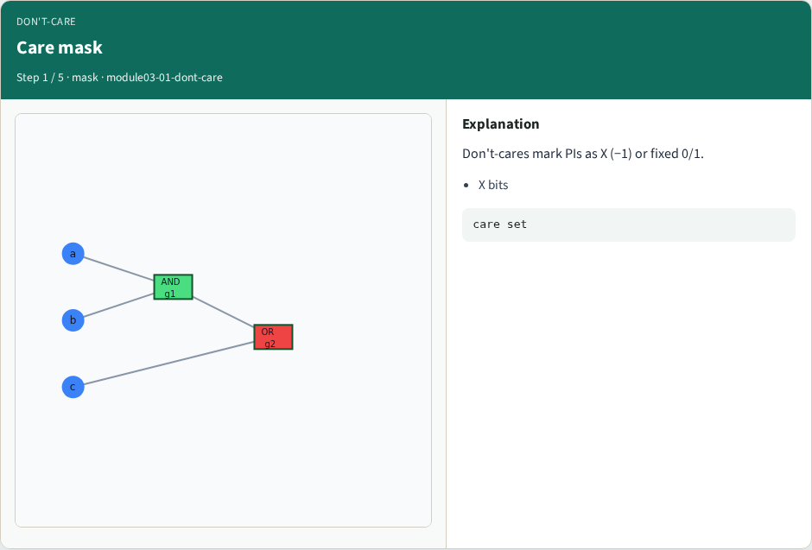
Care mask
Care mask
learn_equivalence — 01 dont care
Notes:
Don't-cares mark PIs as X (−1) or fixed 0/1.

Slide 4
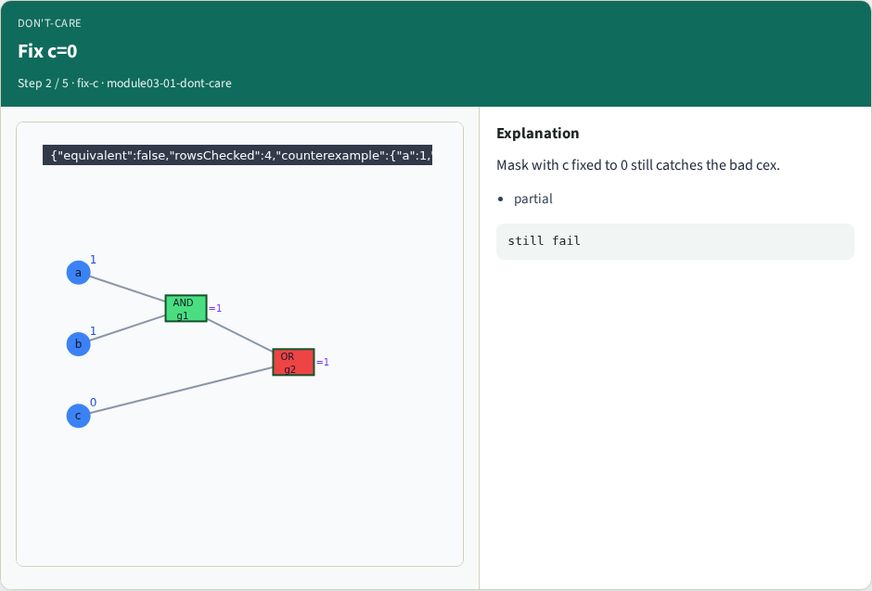
Fix c=0
Fix c=0
learn_equivalence — 01 dont care
Notes:
Mask with c fixed to 0 still catches the bad cex.

Slide 5
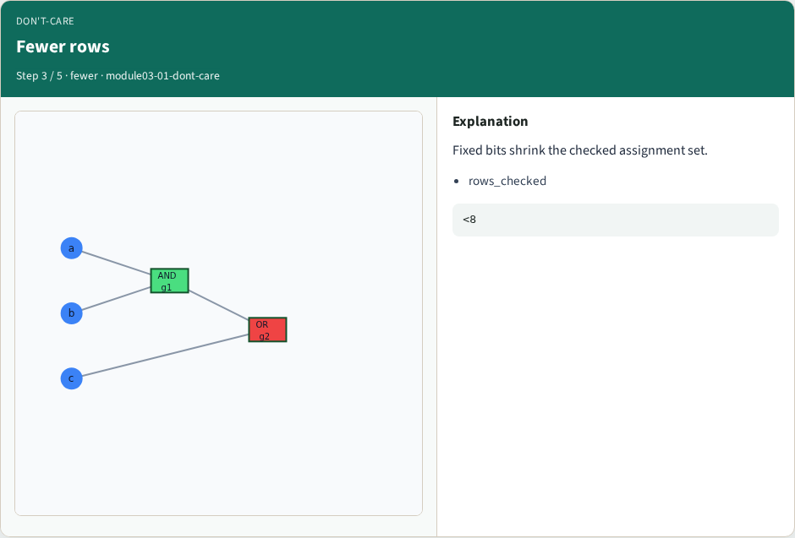
Fewer rows
Fewer rows
learn_equivalence — 01 dont care
Notes:
Fixed bits shrink the checked assignment set.

Slide 6
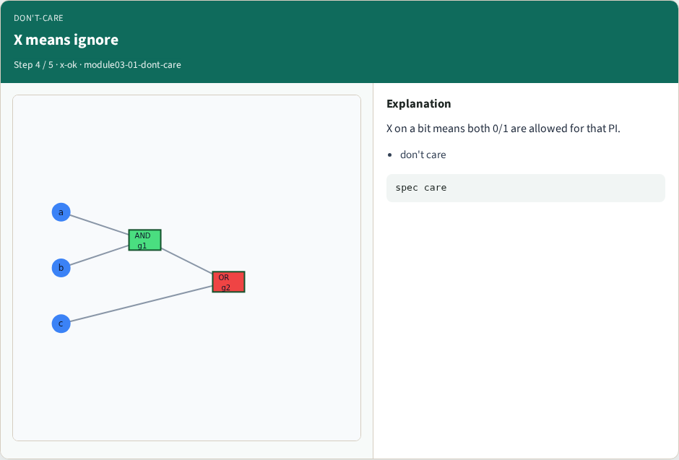
X means ignore
X means ignore
learn_equivalence — 01 dont care
Notes:
X on a bit means both 0/1 are allowed for that PI.

Slide 7
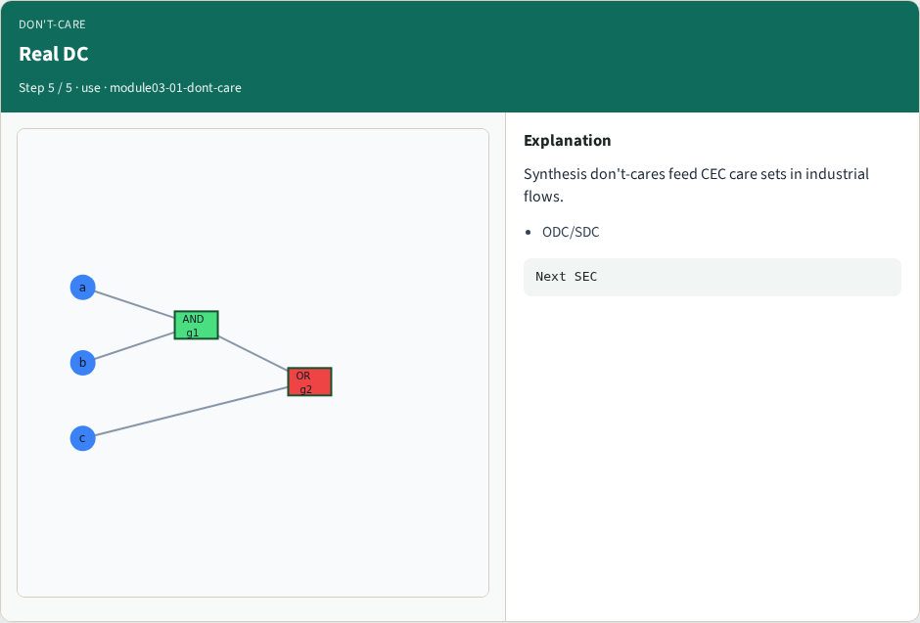
Real DC
Real DC
learn_equivalence — 01 dont care
Notes:
Synthesis don't-cares feed CEC care sets in industrial flows.

Slide 8
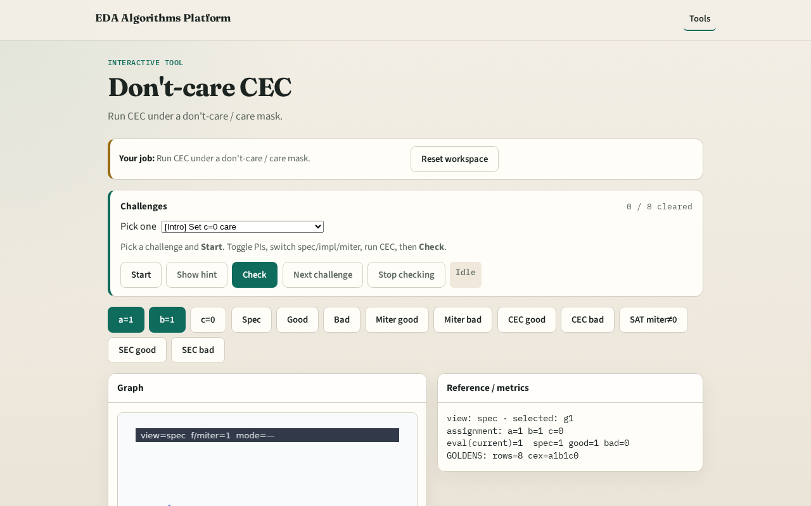
Browser lab track
Browser lab starter
learn_equivalence — 01 dont care
Notes:
Open **dont-care**. Set c care=0; run masked CEC; read reduced row count.

Slide 9
Implement track
Call dont_care_mask(spec, impl_bad, {'a':-1,'b':-1,'c':0})
learn_equivalence — 01 dont care
Notes:
Call dont_care_mask(spec, impl_bad, {'a':-1,'b':-1,'c':0}).

Slide 10
Pitfalls
Treating X as 0
Checking illegal input combinations as failures
learn_equivalence — 01 dont care
Notes:
Treating X as 0. Checking illegal input combinations as failures.

Slide 11
Your turn
Next: sequential unrolling
learn_equivalence — 01 dont care
Notes:
Next: sequential unrolling.

