Slide 1
Seq unroll
Sequential equivalence often unrolls both designs for k cycles and runs combinational CEC on the unrolled POs
learn_equivalence — 03 sequential unroll
Notes:
Sequential equivalence often unrolls both designs for k cycles and runs combinational CEC on the unrolled POs.

Slide 2
The idea
Sequential_unroll(spec
learn_equivalence — 03 sequential unroll
Notes:
sequential_unroll(spec, 2) expands FF next_q = a XOR q into time-stamped gates q_0,a_0,a_1,q_1,q_2.

Slide 3
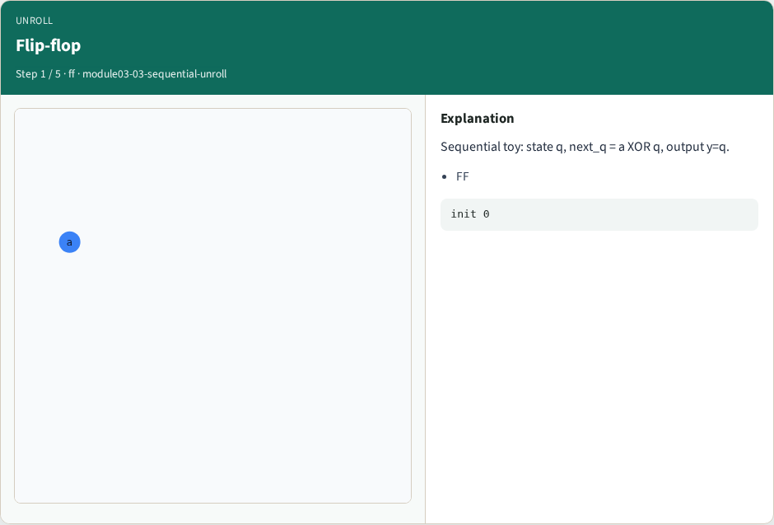
Flip-flop
Flip-flop
learn_equivalence — 03 sequential unroll
Notes:
Sequential toy: state q, next_q = a XOR q, output y=q.

Slide 4
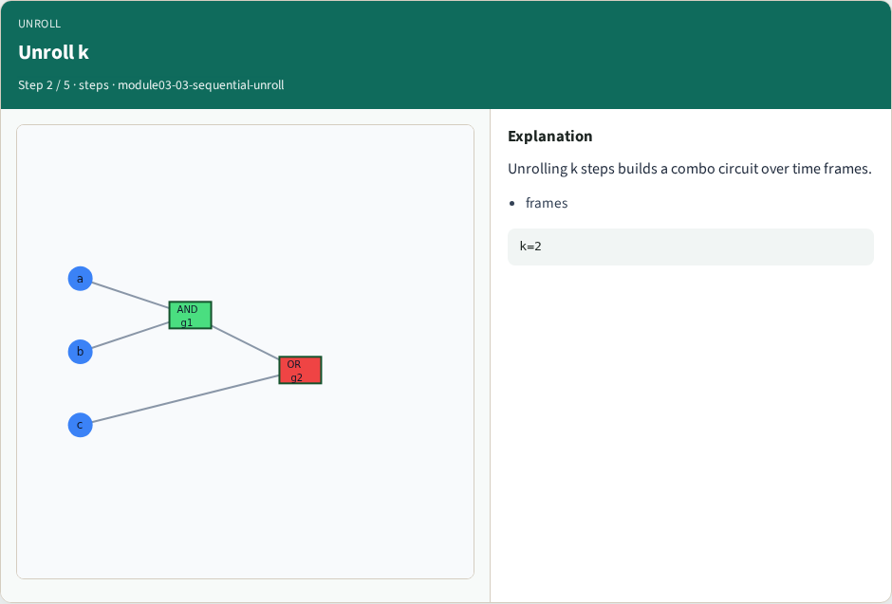
Unroll k
Unroll k
learn_equivalence — 03 sequential unroll
Notes:
Unrolling k steps builds a combo circuit over time frames.

Slide 5
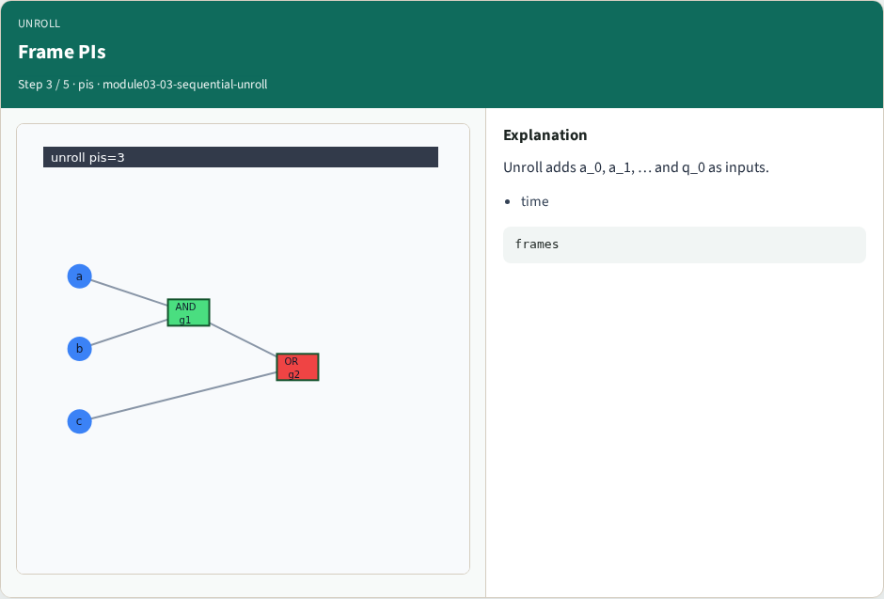
Frame PIs
Frame PIs
learn_equivalence — 03 sequential unroll
Notes:
Unroll adds a_0, a_1, … and q_0 as inputs.

Slide 6
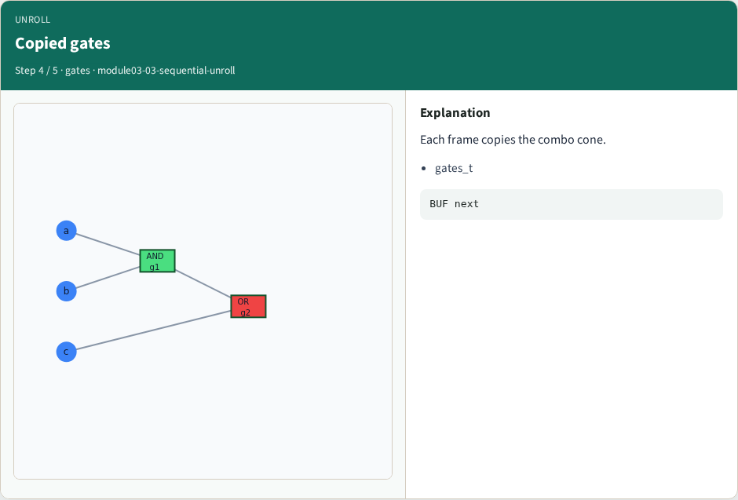
Copied gates
Copied gates
learn_equivalence — 03 sequential unroll
Notes:
Each frame copies the combo cone.

Slide 7
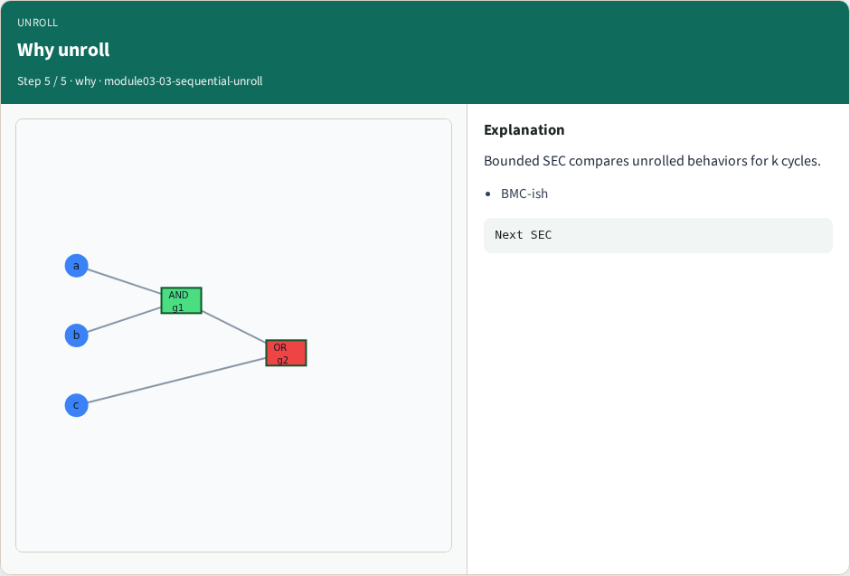
Why unroll
Why unroll
learn_equivalence — 03 sequential unroll
Notes:
Bounded SEC compares unrolled behaviors for k cycles.

Slide 8
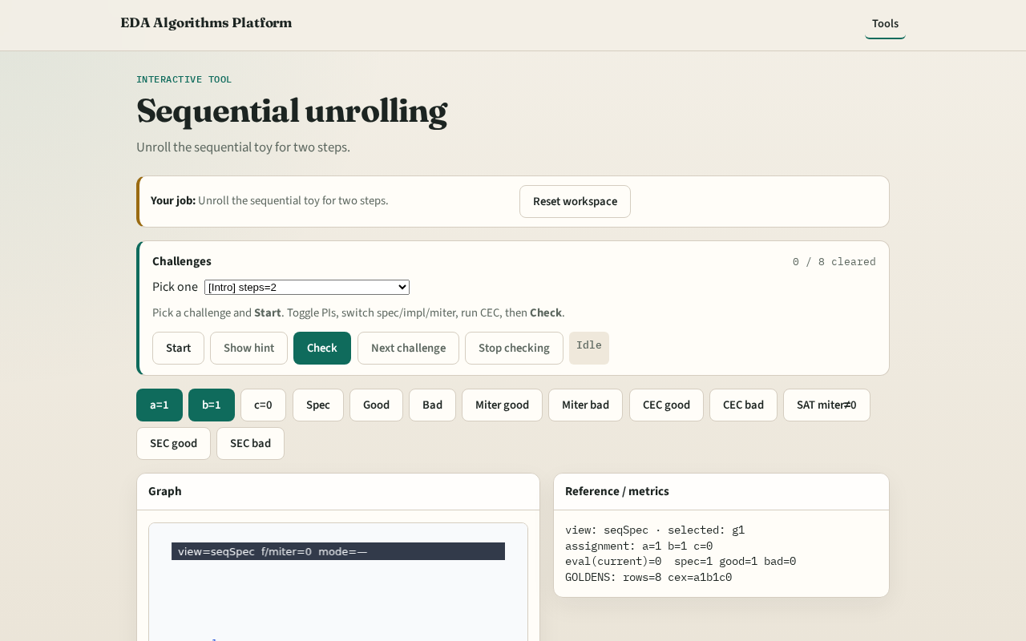
Browser lab track
Browser lab starter
learn_equivalence — 03 sequential unroll
Notes:
Open **sequential-unroll**. Show unrolled netlist view for n=2.

Slide 9
Implement track
Call sequential_unroll(DATA['sequential']['spec'], 2); inspect gates and PIs
learn_equivalence — 03 sequential unroll
Notes:
Call sequential_unroll(DATA['sequential']['spec'], 2); inspect gates and PIs.

Slide 10
Pitfalls
Unrolling without resetting state
Confusing PO y with next state
learn_equivalence — 03 sequential unroll
Notes:
Unrolling without resetting state. Confusing PO y with next state.

Slide 11
Your turn
Next: sequential CEC lite
learn_equivalence — 03 sequential unroll
Notes:
Next: sequential CEC lite.

