Slide 1
Sequential CEC
Sequential CEC asks whether two FSMs agree on all input sequences , we check 2 unroll steps as literacy
learn_equivalence — 05 sequential cec
Notes:
Sequential CEC asks whether two FSMs agree on all input sequences — we check 2 unroll steps as literacy.

Slide 2
The idea
Sequential_cec_lite enumerates input sequences
learn_equivalence — 05 sequential cec
Notes:
sequential_cec_lite enumerates input sequences; spec vs impl_good match; impl_bad diverges when a matters.

Slide 3
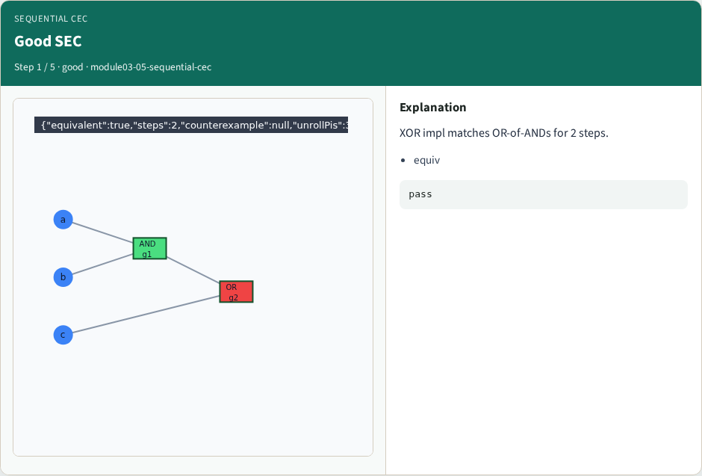
Good SEC
Good SEC
learn_equivalence — 05 sequential cec
Notes:
XOR impl matches OR-of-ANDs for 2 steps.

Slide 4

Bad SEC
Bad SEC
learn_equivalence — 05 sequential cec
Notes:
NOT-q impl ignores a and fails within 2 steps.

Slide 5
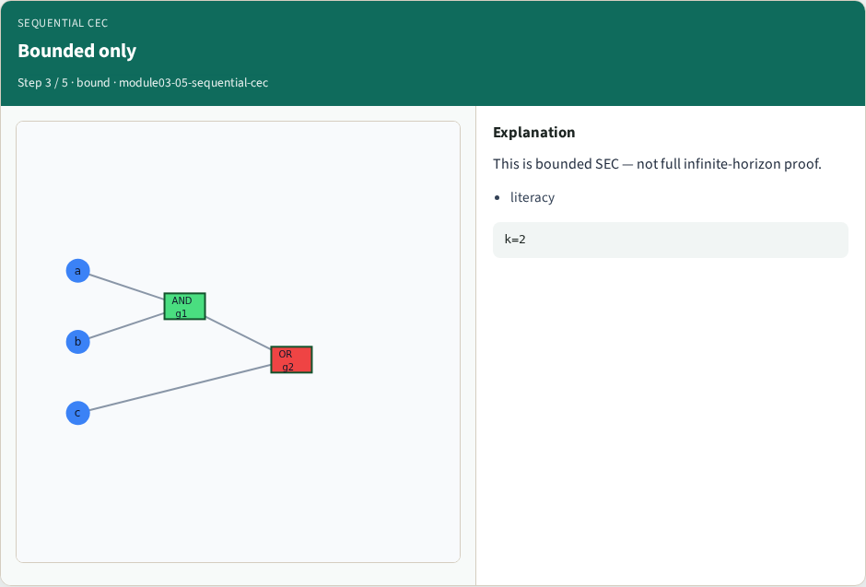
Bounded only
Bounded only
learn_equivalence — 05 sequential cec
Notes:
This is bounded SEC — not full infinite-horizon proof.

Slide 6
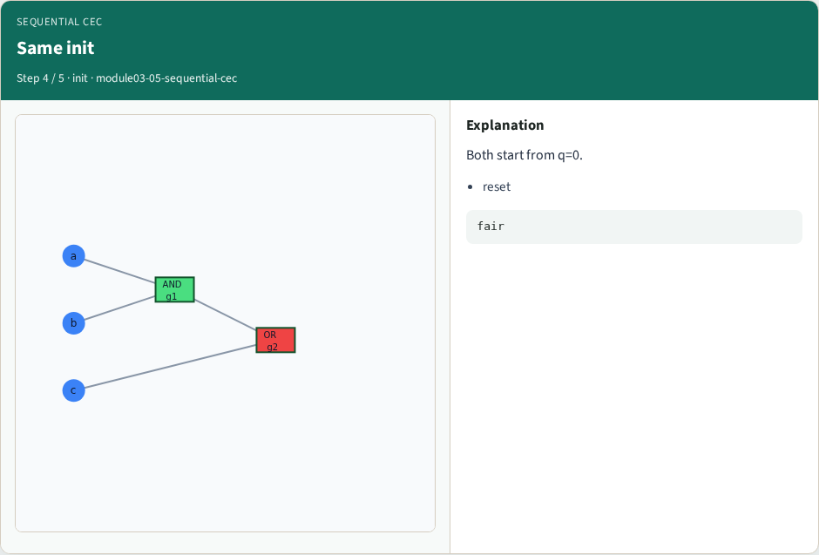
Same init
Same init
learn_equivalence — 05 sequential cec
Notes:
Both start from q=0.

Slide 7
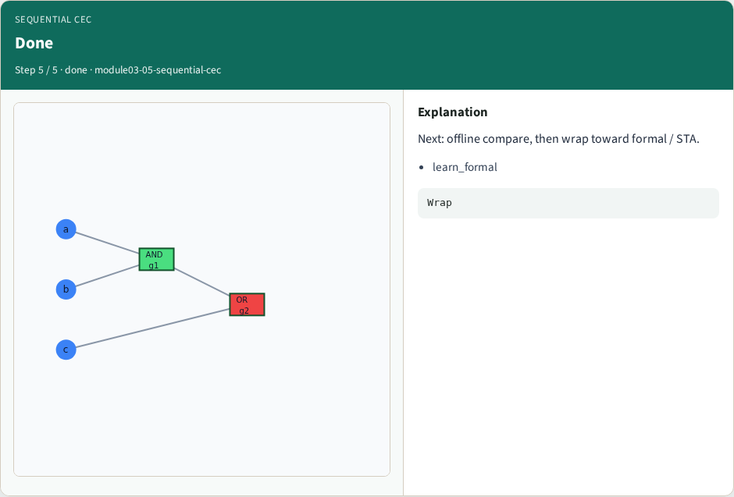
Done
Done
learn_equivalence — 05 sequential cec
Notes:
Next: offline compare, then wrap toward formal / STA.

Slide 8
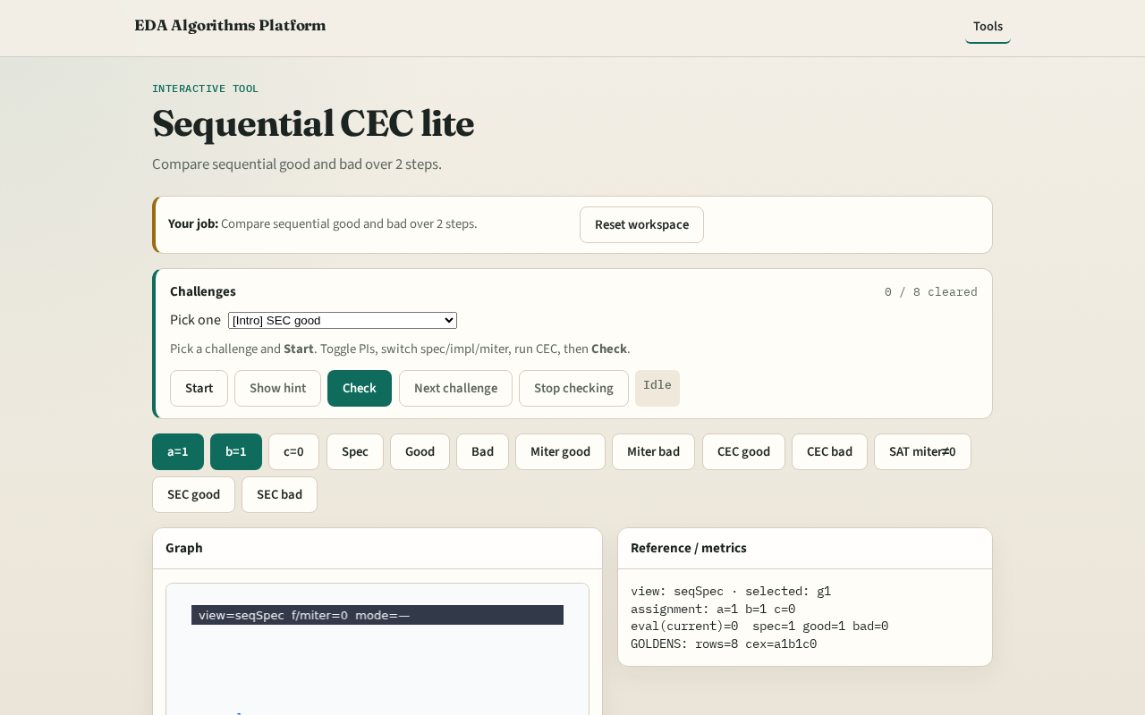
Browser lab track
Browser lab starter
learn_equivalence — 05 sequential cec
Notes:
Open **sequential-cec**. Run 2-step SEC on good vs bad sequential pair.

Slide 9
Implement track
Call sequential_cec_lite(seq_spec, seq_good, 2) True; seq_bad False
learn_equivalence — 05 sequential cec
Notes:
Call sequential_cec_lite(seq_spec, seq_good, 2) True; seq_bad False.

Slide 10
Pitfalls
Checking one reset cycle only
Comparing comb outputs without state update
learn_equivalence — 05 sequential cec
Notes:
Checking one reset cycle only. Comparing comb outputs without state update.

Slide 11
Your turn
Next: offline benchmark, then wrap
learn_equivalence — 05 sequential cec
Notes:
Next: offline benchmark, then wrap.

