Slide 1
Why rtlil
Yosys stores designs in RTLIL , modules, wires, processes, and $-typed cells you see in dump/stat
learn_yosys — 03 rtlil vocab
Notes:
Yosys stores designs in RTLIL — modules, wires, processes, and $-typed cells you see in dump/stat.

Slide 2
The idea
GOLDEN: after_read modules=2 processes=1 and_count=2; vocab includes $and $or $not $dff
learn_yosys — 03 rtlil vocab
Notes:
GOLDEN: after_read modules=2 processes=1 and_count=2; vocab includes $and $or $not $dff.

Slide 3
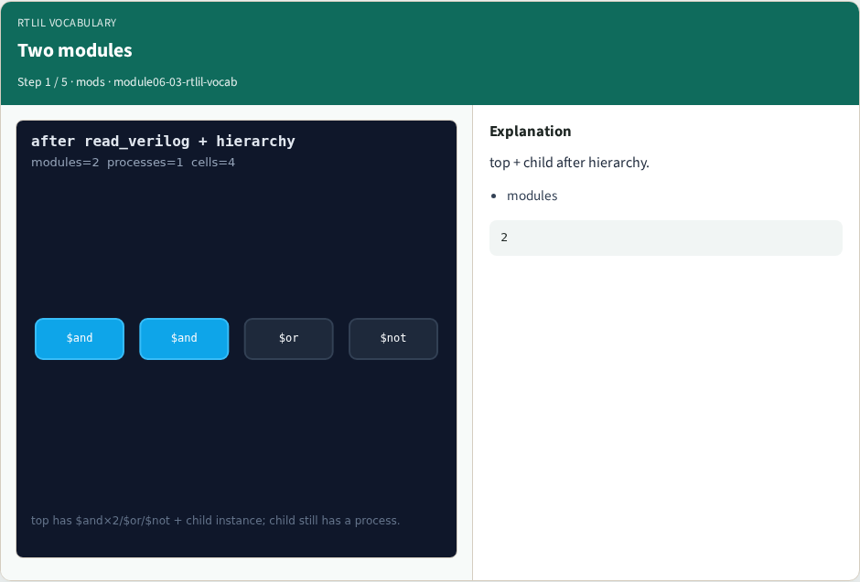
Two modules
Two modules
learn_yosys — 03 rtlil vocab
Notes:
top + child after hierarchy.

Slide 4

Process in child
Process in child
learn_yosys — 03 rtlil vocab
Notes:
Child still has 1 process.

Slide 5
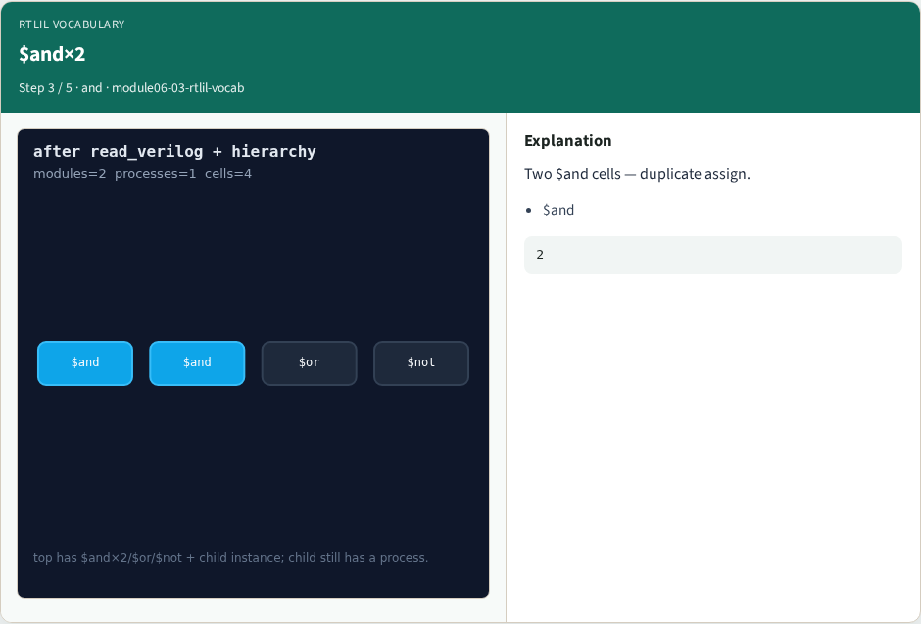
$and×2
$and×2
learn_yosys — 03 rtlil vocab
Notes:
Two $and cells — duplicate assign.

Slide 6
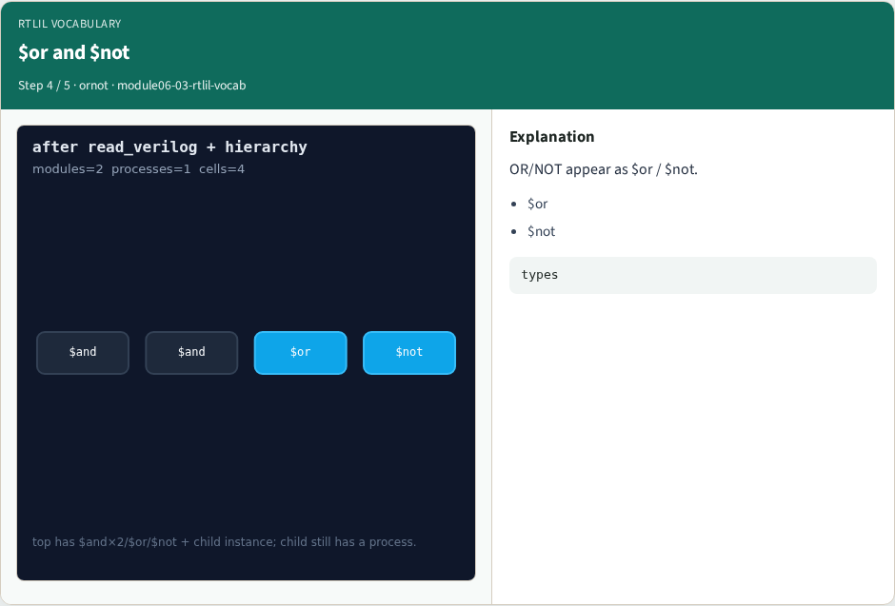
$or and $not
$or and $not
learn_yosys — 03 rtlil vocab
Notes:
OR/NOT appear as $or / $not.

Slide 7
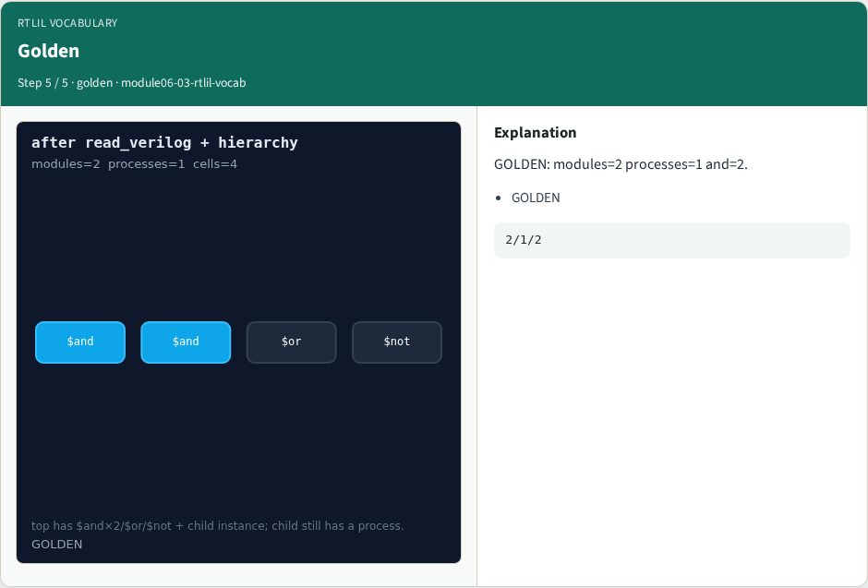
Golden
Golden
learn_yosys — 03 rtlil vocab
Notes:
GOLDEN: modules=2 processes=1 and=2.

Slide 8
Browser lab track
Open rtlil-vocab
Open rtlil-vocab
Show read_hierarchy stage; select $and
learn_yosys — 03 rtlil vocab
Notes:
Open **rtlil-vocab**. Open **rtlil-vocab**. Show read_hierarchy stage; select $and.

Slide 9
Implement track
Call pass_rtlil_vocab(); assert ok and and_count==2
learn_yosys — 03 rtlil vocab
Notes:
Call pass_rtlil_vocab(); assert ok and and_count==2.

Slide 10
Pitfalls
Calling RTLIL 'gates' without $ prefix
Ignoring processes
learn_yosys — 03 rtlil vocab
Notes:
Calling RTLIL 'gates' without $ prefix. Ignoring processes.

Slide 11
Try these
From the common folder
learn_yosys — 03 rtlil vocab
Notes:
From the common folder, run the real solvers self-test, or call `pass_rtlil_vocab` directly.

Slide 12
Try these — try these
cd courses/learn_yosys/common
python3 real_solvers.py
learn_yosys — 03 rtlil vocab

Slide 13
Pseudocode
Here is the check in plain steps
learn_yosys — 03 rtlil vocab
Notes:
Here is the check in plain steps.

Slide 14
Pseudocode — try these
load evidence after hierarchy
assert modules=2 processes=1 and=2
learn_yosys — 03 rtlil vocab

Slide 15
Next
Complete the quiz for this part
Next: real proc
learn_yosys — 03 rtlil vocab
Notes:
Next: real proc.

