Slide 1
Why real
Real proc lowers Verilog processes into RTLIL cells , the child always block becomes $dff
learn_yosys — 01 real proc
Notes:
Real proc lowers Verilog processes into RTLIL cells — the child always block becomes $dff.

Slide 2
The idea
GOLDEN: after_proc processes=0 has_dff=True; types include $dff
learn_yosys — 01 real proc
Notes:
GOLDEN: after_proc processes=0 has_dff=True; types include $dff.

Slide 3

Before: process
Before: process
learn_yosys — 01 real proc
Notes:
No $dff yet — child still has a process.

Slide 4
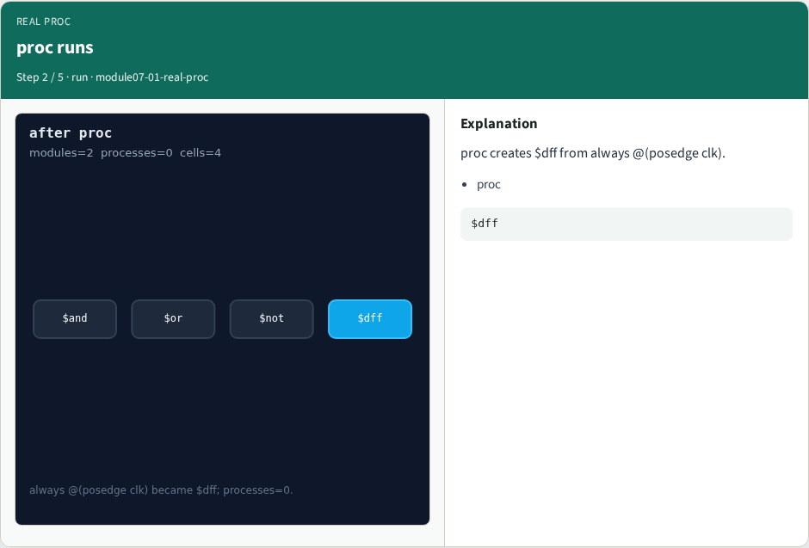
proc runs
proc runs
learn_yosys — 01 real proc
Notes:
proc creates $dff from always @(posedge clk).

Slide 5

Processes cleared
Processes cleared
learn_yosys — 01 real proc
Notes:
processes → 0 after proc.

Slide 6
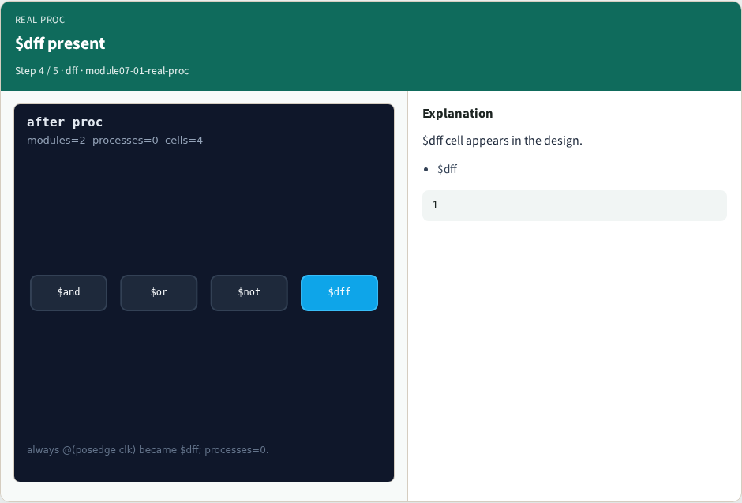
$dff present
$dff present
learn_yosys — 01 real proc
Notes:
$dff cell appears in the design.

Slide 7

Golden
Golden
learn_yosys — 01 real proc
Notes:
GOLDEN: processes=0 has_dff=True.

Slide 8
Browser lab track
Open real-proc
Open real-proc
Show proc stage; confirm $dff and processes=0
learn_yosys — 01 real proc
Notes:
Open **real-proc**. Open **real-proc**. Show proc stage; confirm $dff and processes=0.

Slide 9
Implement track
Call pass_real_proc(); assert ok
learn_yosys — 01 real proc
Notes:
Call pass_real_proc(); assert ok.

Slide 10
Pitfalls
Confusing toy pass_proc with real proc
Expecting $dff before proc
learn_yosys — 01 real proc
Notes:
Confusing toy pass_proc with real proc. Expecting $dff before proc.

Slide 11
Try these
From the common folder, run the real solvers self-test, or call `pass_real_proc` directly
learn_yosys — 01 real proc
Notes:
From the common folder, run the real solvers self-test, or call `pass_real_proc` directly.

Slide 12
Try these — try these
cd courses/learn_yosys/common
python3 real_solvers.py
learn_yosys — 01 real proc

Slide 13
Pseudocode
Here is the check in plain steps
learn_yosys — 01 real proc
Notes:
Here is the check in plain steps.

Slide 14
Pseudocode — try these
run proc
assert processes=0 and dff present
learn_yosys — 01 real proc

Slide 15
Next
Complete the quiz for this part
Next: flatten + opt
learn_yosys — 01 real proc
Notes:
Next: flatten + opt.

