Slide 1
Why real
Flatten inlines child into top; opt merges identical cells and cleans dead logic
learn_yosys — 03 real flatten opt
Notes:
flatten inlines child into top; opt merges identical cells and cleans dead logic.

Slide 2
The idea
GOLDEN: flatten modules=1 cells=4; opt cells=4 and_count=1
learn_yosys — 03 real flatten opt
Notes:
GOLDEN: flatten modules=1 cells=4; opt cells=4 and_count=1.

Slide 3

Before flatten
Before flatten
learn_yosys — 03 real flatten opt
Notes:
Still two modules with a child instance.

Slide 4

flatten
flatten
learn_yosys — 03 real flatten opt
Notes:
Child $dff inlined — module_count=1.

Slide 5
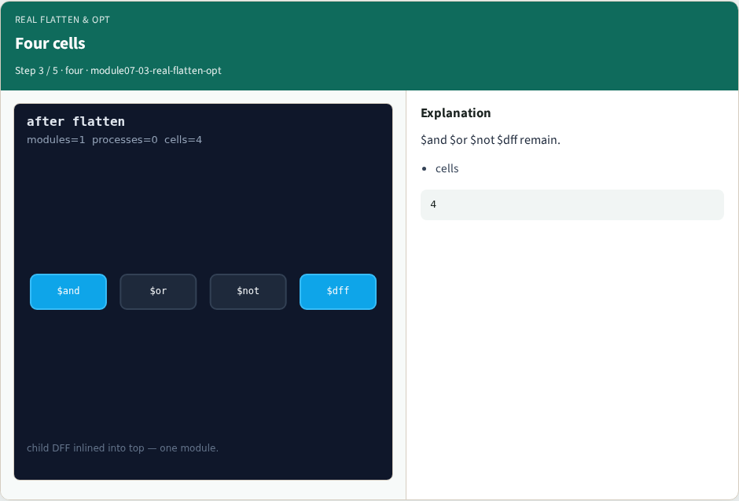
Four cells
Four cells
learn_yosys — 03 real flatten opt
Notes:
$and $or $not $dff remain.

Slide 6
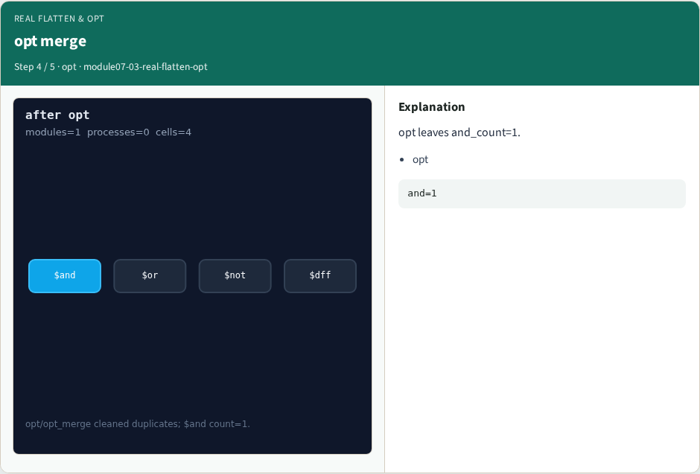
opt merge
opt merge
learn_yosys — 03 real flatten opt
Notes:
opt leaves and_count=1.

Slide 7

Golden
Golden
learn_yosys — 03 real flatten opt
Notes:
GOLDEN: flat cells=4; opt and=1.

Slide 8
Browser lab track
Open real-flatten-opt
Open real-flatten-opt
Show flatten then opt stages
learn_yosys — 03 real flatten opt
Notes:
Open **real-flatten-opt**. Open **real-flatten-opt**. Show flatten then opt stages.

Slide 9
Implement track
Call pass_real_flatten_opt(); assert ok
learn_yosys — 03 real flatten opt
Notes:
Call pass_real_flatten_opt(); assert ok.

Slide 10
Pitfalls
Expecting module_count=2 after flatten
Counting instance cells after flatten
learn_yosys — 03 real flatten opt
Notes:
Expecting module_count=2 after flatten. Counting instance cells after flatten.

Slide 11
Try these
From the common folder
learn_yosys — 03 real flatten opt
Notes:
From the common folder, run the real solvers self-test, or call `pass_real_flatten_opt` directly.

Slide 12
Try these — try these
cd courses/learn_yosys/common
python3 real_solvers.py
learn_yosys — 03 real flatten opt

Slide 13
Pseudocode
Here is the check in plain steps
learn_yosys — 03 real flatten opt
Notes:
Here is the check in plain steps.

Slide 14
Pseudocode — try these
flatten then opt
assert modules=1 cells=4 and=1
learn_yosys — 03 real flatten opt

Slide 15
Next
Complete the quiz for this part
Next: aigmap + synth
learn_yosys — 03 real flatten opt
Notes:
Next: aigmap + synth.

