Slide 1
Why aigmap
Aigmap pushes toward AND/NOT form; synth -top runs Yosys's generic recipe to gate-level cells
learn_yosys — 01 aigmap synth
Notes:
aigmap pushes toward AND/NOT form; synth -top runs Yosys's generic recipe to gate-level cells.

Slide 2
The idea
GOLDEN: aigmap cells=7; synth cells=2 types=$_AOI3_,$_DFF_P_
learn_yosys — 01 aigmap synth
Notes:
GOLDEN: aigmap cells=7; synth cells=2 types=$_AOI3_,$_DFF_P_.

Slide 3

Before aigmap
Before aigmap
learn_yosys — 01 aigmap synth
Notes:
opt netlist with $and/$or/$not/$dff.

Slide 4
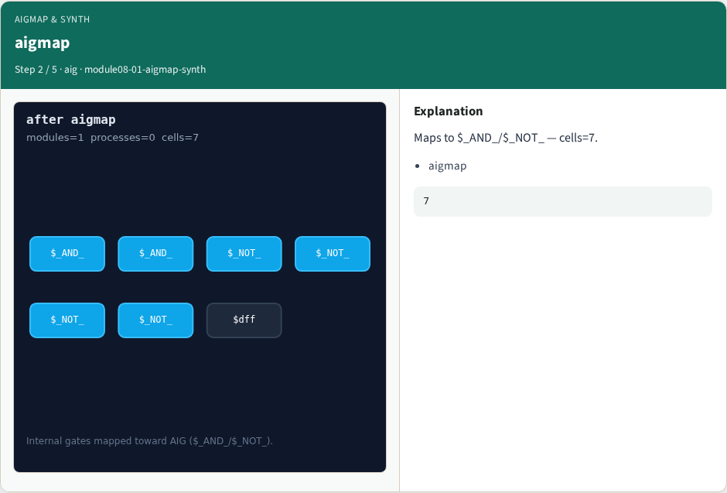
aigmap
aigmap
learn_yosys — 01 aigmap synth
Notes:
Maps to $_AND_/$_NOT_ — cells=7.

Slide 5

synth recipe
synth recipe
learn_yosys — 01 aigmap synth
Notes:
synth -top top runs the built-in flow.

Slide 6
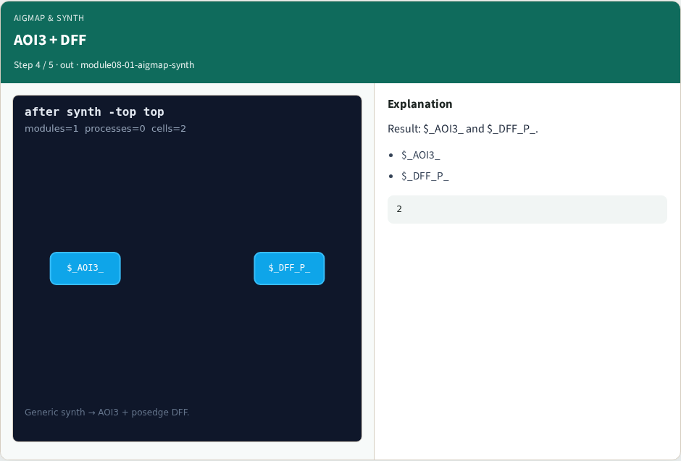
AOI3 + DFF
AOI3 + DFF
learn_yosys — 01 aigmap synth
Notes:
Result: $_AOI3_ and $_DFF_P_.

Slide 7
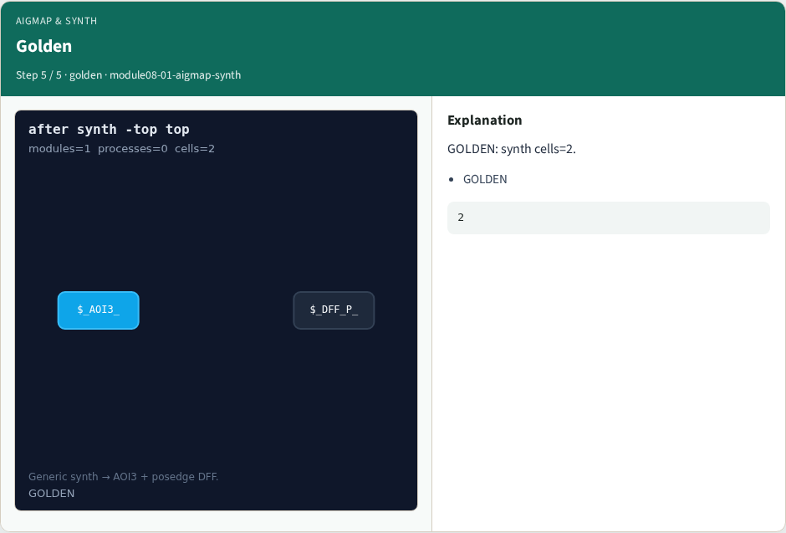
Golden
Golden
learn_yosys — 01 aigmap synth
Notes:
GOLDEN: synth cells=2.

Slide 8
Browser lab track
Open aigmap-synth
Open aigmap-synth
Show aigmap then synth; select $_AOI3_
learn_yosys — 01 aigmap synth
Notes:
Open **aigmap-synth**. Open **aigmap-synth**. Show aigmap then synth; select $_AOI3_.

Slide 9
Implement track
Call pass_aigmap_synth(); assert ok
learn_yosys — 01 aigmap synth
Notes:
Call pass_aigmap_synth(); assert ok.

Slide 10
Pitfalls
Expecting NAND2 from the toy techmap
Skipping synth -top
learn_yosys — 01 aigmap synth
Notes:
Expecting NAND2 from the toy techmap. Skipping synth -top.

Slide 11
Try these
From the common folder
learn_yosys — 01 aigmap synth
Notes:
From the common folder, run the real solvers self-test, or call `pass_aigmap_synth` directly.

Slide 12
Try these — try these
cd courses/learn_yosys/common
python3 real_solvers.py
learn_yosys — 01 aigmap synth

Slide 13
Pseudocode
Here is the check in plain steps
learn_yosys — 01 aigmap synth
Notes:
Here is the check in plain steps.

Slide 14
Pseudocode — try these
aigmap then synth
assert cells seven then two AOI and DFF
learn_yosys — 01 aigmap synth

Slide 15
Next
Complete the quiz for this part
Next: real evidence engine
learn_yosys — 01 aigmap synth
Notes:
Next: real evidence engine.

