Slide 1
Why real
The evidence engine checks CLI order, RTLIL goldens, proc/flatten/opt, and synth outputs together
learn_yosys — 03 real evidence
Notes:
The evidence engine checks CLI order, RTLIL goldens, proc/flatten/opt, and synth outputs together.

Slide 2
The idea
GOLDEN: engine ok=True; after_synth_cells=2
learn_yosys — 03 real evidence
Notes:
GOLDEN: engine ok=True; after_synth_cells=2.

Slide 3
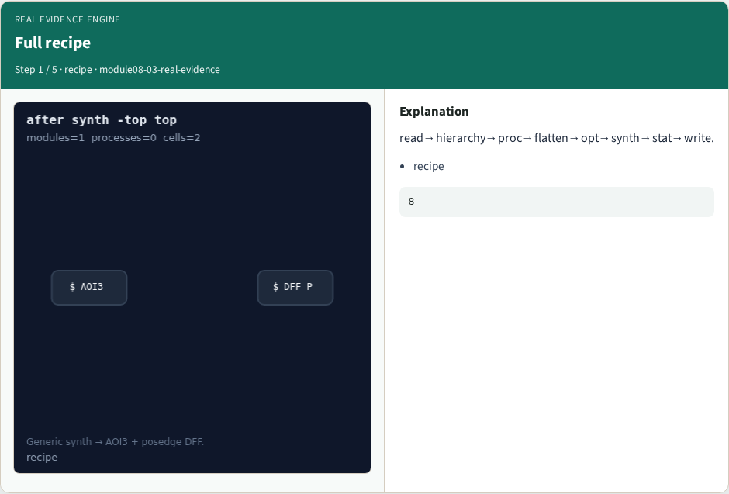
Full recipe
Full recipe
learn_yosys — 03 real evidence
Notes:
read→hierarchy→proc→flatten→opt→synth→stat→write.

Slide 4
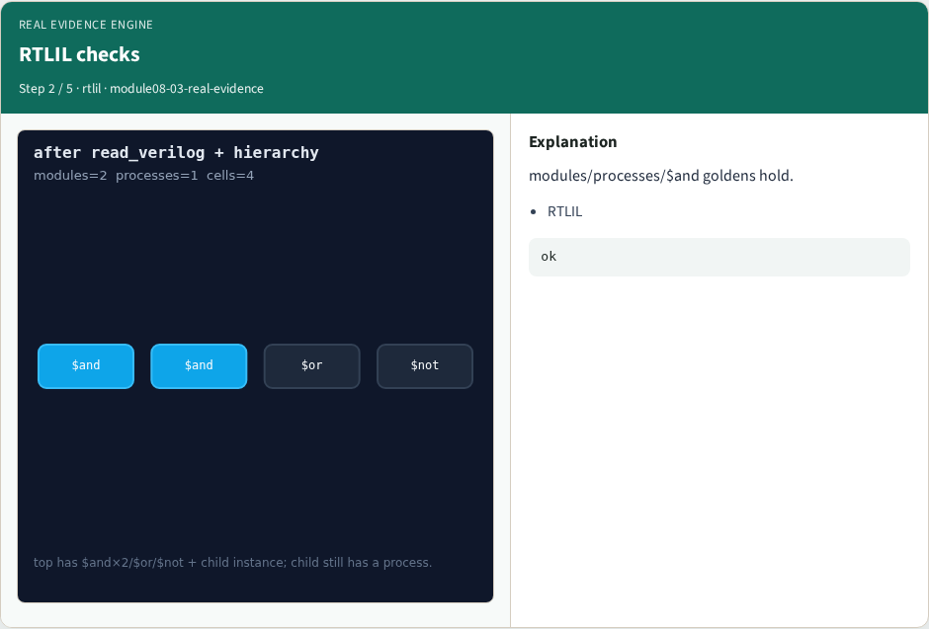
RTLIL checks
RTLIL checks
learn_yosys — 03 real evidence
Notes:
modules/processes/$and goldens hold.

Slide 5
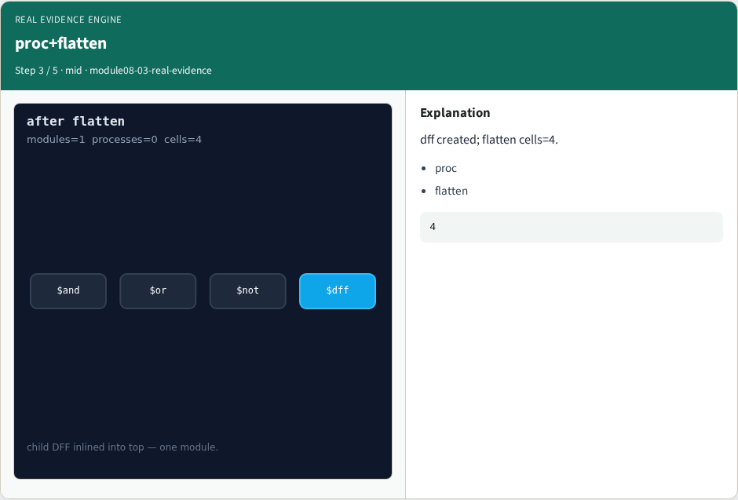
proc+flatten
proc+flatten
learn_yosys — 03 real evidence
Notes:
dff created; flatten cells=4.

Slide 6
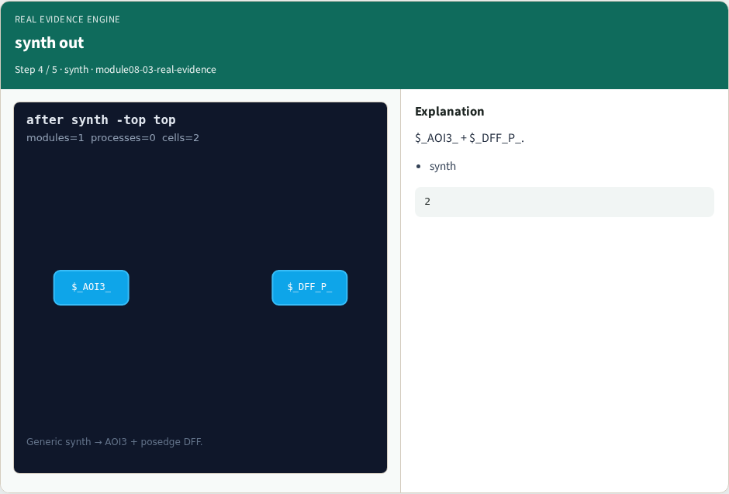
synth out
synth out
learn_yosys — 03 real evidence
Notes:
$_AOI3_ + $_DFF_P_.

Slide 7

OK
OK
learn_yosys — 03 real evidence
Notes:
GOLDEN: engine_ok=True.

Slide 8
Browser lab track
Open real-evidence
Open real-evidence
Build golden recipe; run Engine; confirm ok
learn_yosys — 03 real evidence
Notes:
Open **real-evidence**. Open **real-evidence**. Build golden recipe; run Engine; confirm ok.

Slide 9
Implement track
Call real_yosys_engine(); assert ok
learn_yosys — 03 real evidence
Notes:
Call real_yosys_engine(); assert ok.

Slide 10
Pitfalls
Stopping at toy yosys_engine
Wrong recipe order
learn_yosys — 03 real evidence
Notes:
Stopping at toy yosys_engine. Wrong recipe order.

Slide 11
Try these
From the common folder
learn_yosys — 03 real evidence
Notes:
From the common folder, run the real solvers self-test, or call `real_yosys_engine` directly.

Slide 12
Try these — try these
cd courses/learn_yosys/common
python3 real_solvers.py
learn_yosys — 03 real evidence

Slide 13
Pseudocode
Here is the check in plain steps
learn_yosys — 03 real evidence
Notes:
Here is the check in plain steps.

Slide 14
Pseudocode — try these
run full golden recipe
assert engine ok and synth cells two
learn_yosys — 03 real evidence

Slide 15
Next
Complete the quiz for this part
Next: offline compare, then wrap
learn_yosys — 03 real evidence
Notes:
Next: offline compare, then wrap.

