Slide 1
Why proc mux
Combo case and if processes become mux cells before registers appear
learn_yosys — 01 proc mux
Notes:
Combo case and if processes become mux cells before registers appear.

Slide 2
The idea
GOLDEN: mux_count=1; type is dollar mux
learn_yosys — 01 proc mux
Notes:
GOLDEN: mux_count=1; type is dollar mux.

Slide 3
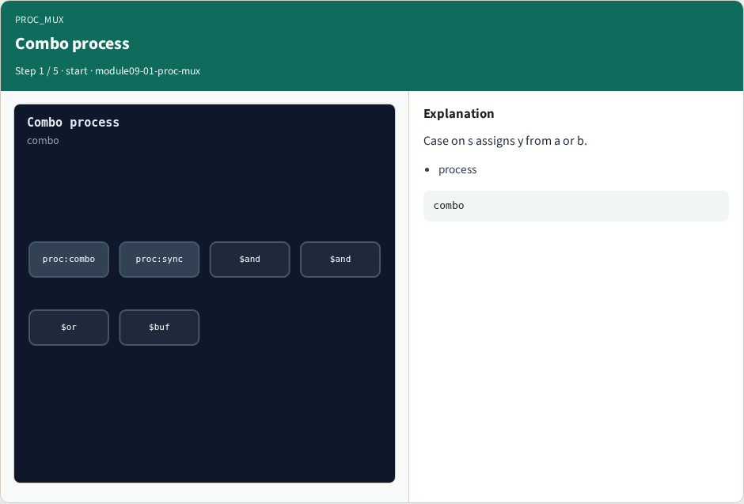
Combo process
Combo process
learn_yosys — 01 proc mux
Notes:
Case on s assigns y from a or b.

Slide 4
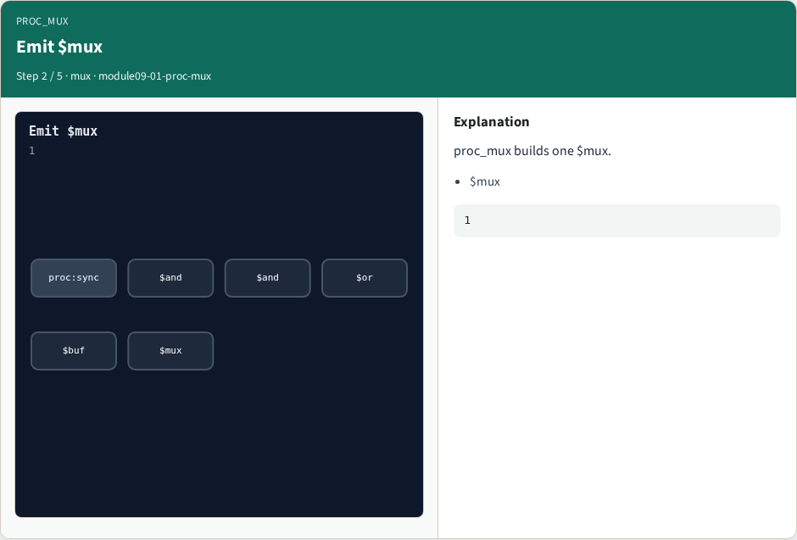
Emit $mux
Emit $mux
learn_yosys — 01 proc mux
Notes:
proc_mux builds one $mux.

Slide 5

S/A/B/Y
S/A/B/Y
learn_yosys — 01 proc mux
Notes:
Sel s; A=a; B=b; Y=y.

Slide 6

Combo removed
Combo removed
learn_yosys — 01 proc mux
Notes:
Combo process is gone.

Slide 7

Golden
Golden
learn_yosys — 01 proc mux
Notes:
GOLDEN: mux_count=1.

Slide 8
Browser lab track
Open proc-mux
Replace the combo process with one mux cell and Check
learn_yosys — 01 proc mux
Notes:
Open **proc-mux**. Replace the combo process with one mux cell and Check.

Slide 9
Implement track
Call algo_proc_mux(); assert mux_count == 1 and the cell type is dollar mux
learn_yosys — 01 proc mux
Notes:
Call algo_proc_mux(); assert mux_count == 1 and the cell type is dollar mux.

Slide 10
Pitfalls
Leaving the combo process in place
Mapping sync processes as muxes
learn_yosys — 01 proc mux
Notes:
Leaving the combo process in place. Mapping sync processes as muxes.

Slide 11
Try these
From the common folder, run the algo solvers self-test, or call `algo_proc_mux` directly
learn_yosys — 01 proc mux
Notes:
From the common folder, run the algo solvers self-test, or call `algo_proc_mux` directly.

Slide 12
Try these — try these
cd courses/learn_yosys/common
python3 algo_solvers.py
learn_yosys — 01 proc mux

Slide 13
Pseudocode
Here is the check in plain steps
learn_yosys — 01 proc mux
Notes:
Here is the check in plain steps.

Slide 14
Pseudocode — try these
for each combo process with two cases:
emit dollar mux (S,A,B,Y)
drop that process
ok if mux_count == 1
learn_yosys — 01 proc mux

Slide 15
Next
Complete the quiz for this part
Next: proc_dff with async reset
learn_yosys — 01 proc mux
Notes:
Next: proc_dff with async reset.

