Slide 1
Why proc dff
Sync processes become flip-flops; async reset rides on the ARST ports
learn_yosys — 03 proc dff arst
Notes:
Sync processes become flip-flops; async reset rides on the ARST ports.

Slide 2
The idea
GOLDEN: one dollar adff with arst; processes left = 0
Real Yosys binds the same
learn_yosys — 03 proc dff arst
Notes:
GOLDEN: one dollar adff with arst; processes left = 0. Real Yosys binds the same.

Slide 3
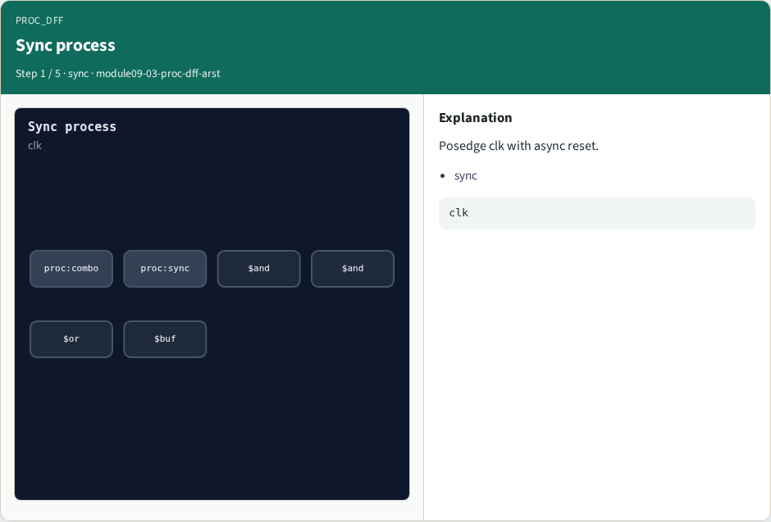
Sync process
Sync process
learn_yosys — 03 proc dff arst
Notes:
Posedge clk with async reset.

Slide 4
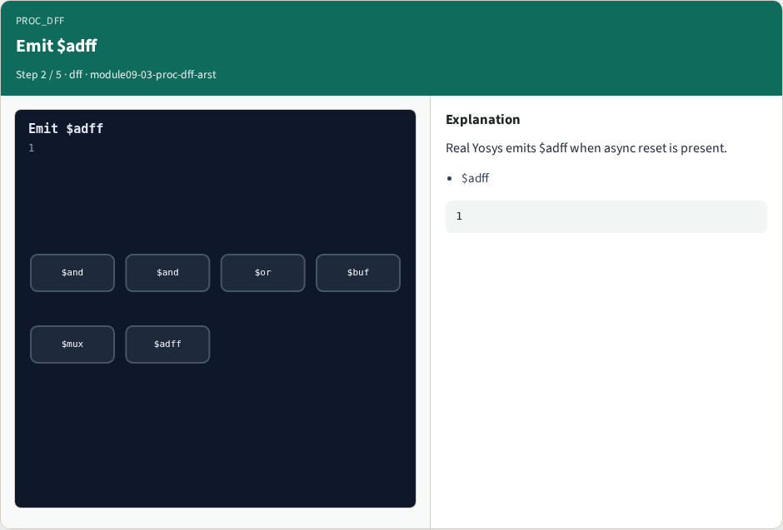
Emit $adff
Emit $adff
learn_yosys — 03 proc dff arst
Notes:
Real Yosys emits $adff when async reset is present.

Slide 5

ARST port
ARST port
learn_yosys — 03 proc dff arst
Notes:
Reset becomes ARST on the $adff.

Slide 6

Processes=0
Processes=0
learn_yosys — 03 proc dff arst
Notes:
All processes lowered.

Slide 7
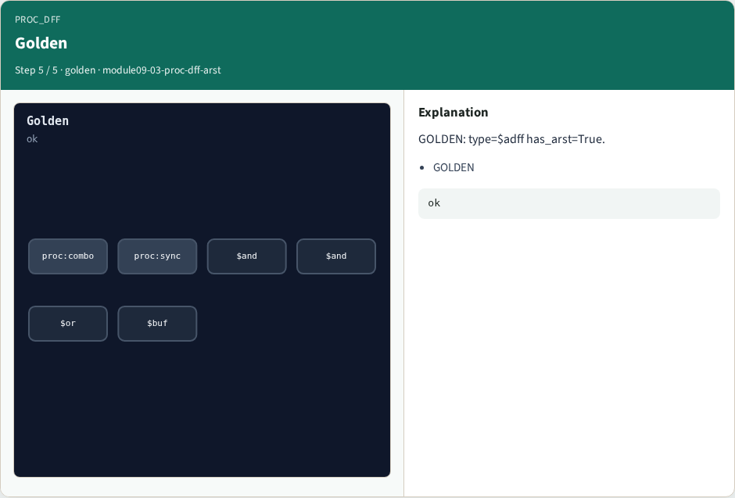
Golden
Golden
learn_yosys — 03 proc dff arst
Notes:
GOLDEN: type=$adff has_arst=True.

Slide 8
Browser lab track
Open proc-dff-arst
Emit the $adff with reset ports, clear all processes, and confirm the real bind
learn_yosys — 03 proc dff arst
Notes:
Open **proc-dff-arst**. Emit the $adff with reset ports, clear all processes, and confirm the real bind.

Slide 9
Implement track
Call algo_proc_dff(); assert reg_type is $adff, has_arst is True, processes == 0
Then run partc_bind.py
learn_yosys — 03 proc dff arst
Notes:
Call algo_proc_dff(); assert reg_type is $adff, has_arst is True, processes == 0. Then run partc_bind.py.

Slide 10
Pitfalls
Emitting plain $dff when async reset is present
Stopping before processes reach zero
learn_yosys — 03 proc dff arst
Notes:
Emitting plain $dff when async reset is present. Stopping before processes reach zero.

Slide 11
Try these
From the common folder
learn_yosys — 03 proc dff arst
Notes:
From the common folder, run the algo solvers self-test, or call `algo_proc_dff` and `partc_bind` directly.

Slide 12
Try these — try these
cd courses/learn_yosys/common
python3 algo_solvers.py
python3 partc_bind.py
learn_yosys — 03 proc dff arst

Slide 13
Pseudocode
Here is the check in plain steps
learn_yosys — 03 proc dff arst
Notes:
Here is the check in plain steps.

Slide 14
Pseudocode — try these
run proc_mux first
for each sync process:
if reset present: emit $adff (CLK,D,Q,ARST)
else: emit $dff (CLK,D,Q)
ok if reg_type==$adff and processes==0
learn_yosys — 03 proc dff arst

Slide 15
Next
Complete the quiz for this part
Next: opt_clean and opt_expr goldens
learn_yosys — 03 proc dff arst
Notes:
Next: opt_clean and opt_expr goldens.

