Slide 1
Why opt clean
Dead logic and constant buffers waste cells; clean and fold shrink the netlist
learn_yosys — 01 opt clean expr
Notes:
Dead logic and constant buffers waste cells; clean and fold shrink the netlist.

Slide 2
The idea
GOLDEN: opt_clean removed=2; opt_expr folded=1
learn_yosys — 01 opt clean expr
Notes:
GOLDEN: opt_clean removed=2; opt_expr folded=1.

Slide 3
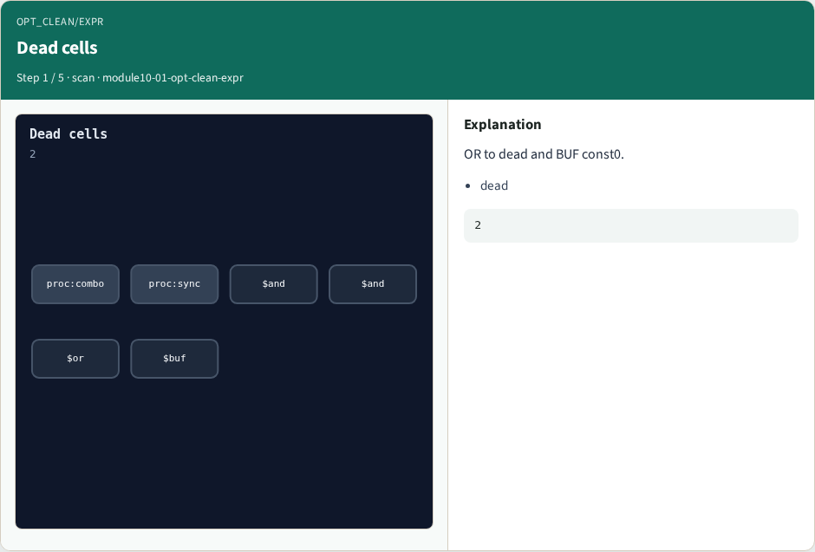
Dead cells
Dead cells
learn_yosys — 01 opt clean expr
Notes:
OR to dead and BUF const0.

Slide 4

opt_clean
opt_clean
learn_yosys — 01 opt clean expr
Notes:
Remove 2 unused cells.

Slide 5

opt_expr
opt_expr
learn_yosys — 01 opt clean expr
Notes:
Fold const0 BUF.

Slide 6

Keep live
Keep live
learn_yosys — 01 opt clean expr
Notes:
Mux/DFF/ANDs that fan out stay.

Slide 7

Golden
Golden
learn_yosys — 01 opt clean expr
Notes:
GOLDEN: removed=2 folded=1.

Slide 8
Browser lab track
Open opt-clean-expr
Remove dead cells and fold the const0 buffer
learn_yosys — 01 opt clean expr
Notes:
Open **opt-clean-expr**. Remove dead cells and fold the const0 buffer.

Slide 9
Implement track
Call algo_opt_clean(); assert removed_count == 2
Call algo_opt_expr(); assert folded_count == 1
learn_yosys — 01 opt clean expr
Notes:
Call algo_opt_clean(); assert removed_count == 2. Call algo_opt_expr(); assert folded_count == 1.

Slide 10
Pitfalls
Deleting live fanout
Counting fold after clean already dropped the buffer
learn_yosys — 01 opt clean expr
Notes:
Deleting live fanout. Counting fold after clean already dropped the buffer.

Slide 11
Try these
From the common folder, run the algo solvers self-test, or call `algo_opt_clean` directly
learn_yosys — 01 opt clean expr
Notes:
From the common folder, run the algo solvers self-test, or call `algo_opt_clean` directly.

Slide 12
Try these — try these
cd courses/learn_yosys/common
python3 algo_solvers.py
learn_yosys — 01 opt clean expr

Slide 13
Pseudocode
Here is the check in plain steps
learn_yosys — 01 opt clean expr
Notes:
Here is the check in plain steps.

Slide 14
Pseudocode — try these
mark used nets from POs backward
drop cells whose Y/Q never used (keep mux/dff)
fold dollar buf tied to const0
ok if removed==2 and folded==1
learn_yosys — 01 opt clean expr

Slide 15
Next
Complete the quiz for this part
Next: opt_merge of duplicate ANDs
learn_yosys — 01 opt clean expr
Notes:
Next: opt_merge of duplicate ANDs.

