Slide 1
Why extract
Extract spots library-shaped cones and collapses them to a single macro
learn_yosys — 03 extract subcircuit
Notes:
Extract spots library-shaped cones and collapses them to a single macro.

Slide 2
The idea
GOLDEN: matches=1; macro=ANDOR2
learn_yosys — 03 extract subcircuit
Notes:
GOLDEN: matches=1; macro=ANDOR2.

Slide 3
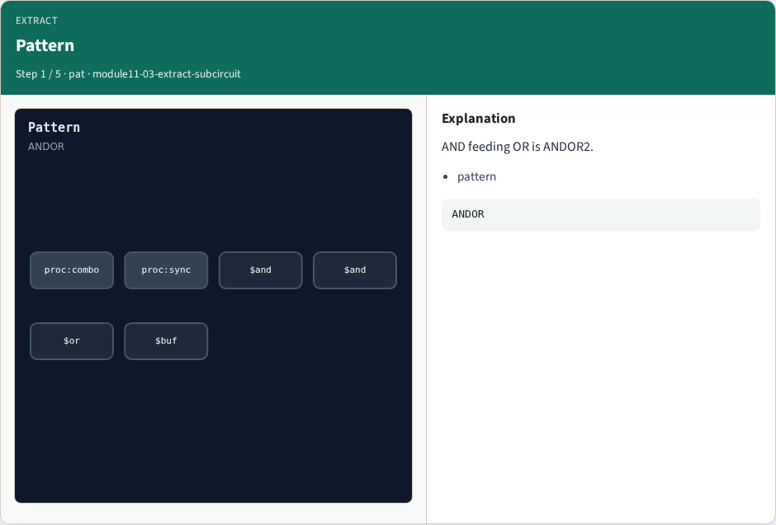
Pattern
Pattern
learn_yosys — 03 extract subcircuit
Notes:
AND feeding OR is ANDOR2.

Slide 4

Match
Match
learn_yosys — 03 extract subcircuit
Notes:
Find isomorphic subgraph.

Slide 5

Macro cell
Macro cell
learn_yosys — 03 extract subcircuit
Notes:
Replace with ANDOR2.

Slide 6
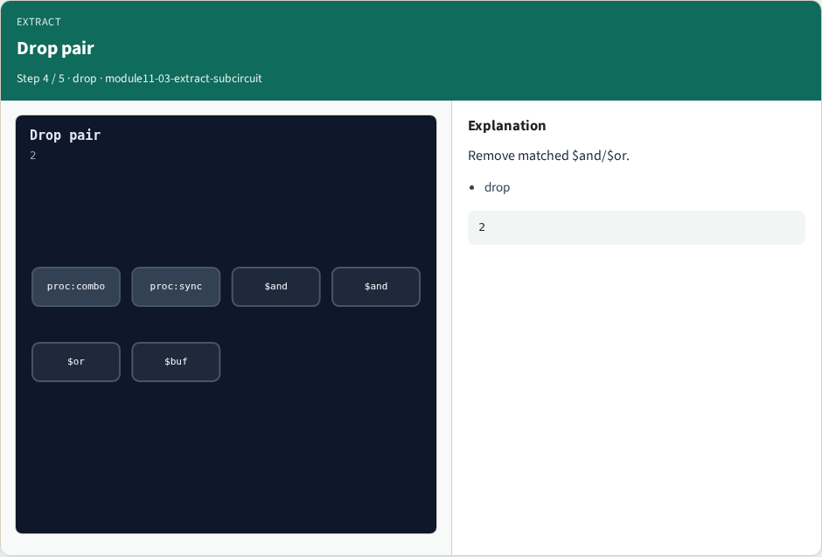
Drop pair
Drop pair
learn_yosys — 03 extract subcircuit
Notes:
Remove matched $and/$or.

Slide 7

Golden
Golden
learn_yosys — 03 extract subcircuit
Notes:
GOLDEN: matches=1.

Slide 8
Browser lab track
Open extract-subcircuit
Match the ANDOR2 cone and replace it
learn_yosys — 03 extract subcircuit
Notes:
Open **extract-subcircuit**. Match the ANDOR2 cone and replace it.

Slide 9
Implement track
Call algo_extract_iso(); assert matches == 1 and macro == 'ANDOR2'
learn_yosys — 03 extract subcircuit
Notes:
Call algo_extract_iso(); assert matches == 1 and macro == 'ANDOR2'.

Slide 10
Pitfalls
Running extract after clean removed the dead OR
Matching OR without an AND driver
learn_yosys — 03 extract subcircuit
Notes:
Running extract after clean removed the dead OR. Matching OR without an AND driver.

Slide 11
Try these
From the common folder
learn_yosys — 03 extract subcircuit
Notes:
From the common folder, run the algo solvers self-test, or call `algo_extract_iso` directly.

Slide 12
Try these — try these
cd courses/learn_yosys/common
python3 algo_solvers.py
learn_yosys — 03 extract subcircuit

Slide 13
Pseudocode
Here is the check in plain steps
learn_yosys — 03 extract subcircuit
Notes:
Here is the check in plain steps.

Slide 14
Pseudocode — try these
on post-proc netlist
find dollar or fed by dollar and
replace pair with ANDOR2 macro
ok if matches == 1
learn_yosys — 03 extract subcircuit

Slide 15
Next
Complete the quiz for this part
Next: memory_map algorithm
learn_yosys — 03 extract subcircuit
Notes:
Next: memory_map algorithm.

