Slide 1
Why memory
Memory passes turn array descriptions into dollar-mem cells with size and width
learn_yosys — 01 memory map algo
Notes:
Memory passes turn array descriptions into dollar-mem cells with size and width.

Slide 2
The idea
GOLDEN: one dollar mem; depth=8; width=4
learn_yosys — 01 memory map algo
Notes:
GOLDEN: one dollar mem; depth=8; width=4.

Slide 3

Array
Array
learn_yosys — 01 memory map algo
Notes:
Width 4 depth 8.

Slide 4
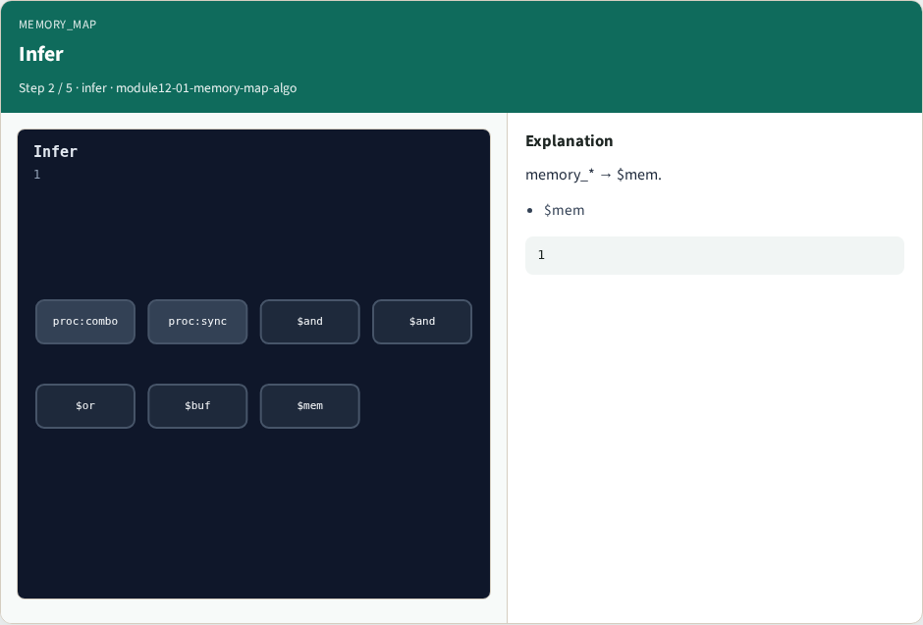
Infer
Infer
learn_yosys — 01 memory map algo
Notes:
memory_* → $mem.

Slide 5
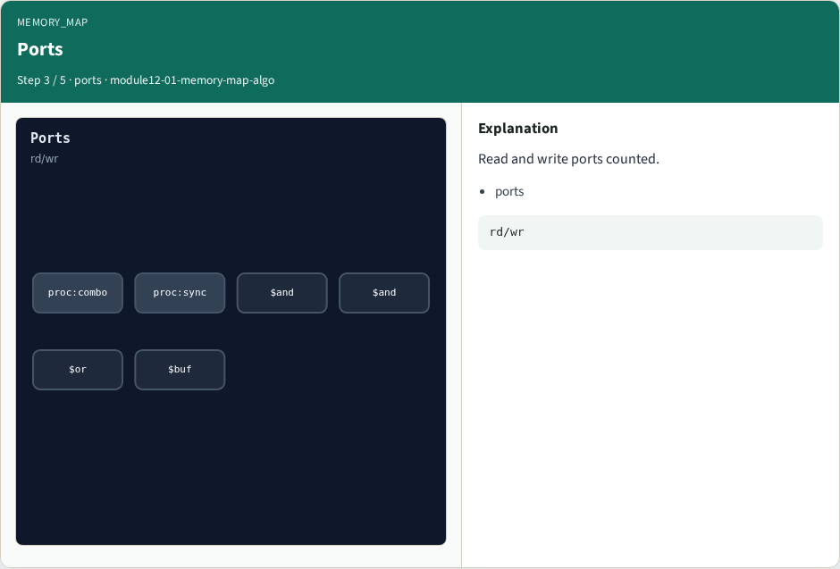
Ports
Ports
learn_yosys — 01 memory map algo
Notes:
Read and write ports counted.

Slide 6

SIZE
SIZE
learn_yosys — 01 memory map algo
Notes:
SIZE=depth=8.

Slide 7

Golden
Golden
learn_yosys — 01 memory map algo
Notes:
GOLDEN: depth=8 width=4.

Slide 8
Browser lab track
Open memory-map-algo
Build the mem cell and Check depth and width
learn_yosys — 01 memory map algo
Notes:
Open **memory-map-algo**. Build the mem cell and Check depth and width.

Slide 9
Implement track
Call algo_memory_map(); assert depth == 8 and width == 4
learn_yosys — 01 memory map algo
Notes:
Call algo_memory_map(); assert depth == 8 and width == 4.

Slide 10
Pitfalls
Swapping depth and width
Ignoring read versus write ports
learn_yosys — 01 memory map algo
Notes:
Swapping depth and width. Ignoring read versus write ports.

Slide 11
Try these
From the common folder, run the algo solvers self-test, or call `algo_memory_map` directly
learn_yosys — 01 memory map algo
Notes:
From the common folder, run the algo solvers self-test, or call `algo_memory_map` directly.

Slide 12
Try these — try these
cd courses/learn_yosys/common
python3 algo_solvers.py
learn_yosys — 01 memory map algo

Slide 13
Pseudocode
Here is the check in plain steps
learn_yosys — 01 memory map algo
Notes:
Here is the check in plain steps.

Slide 14
Pseudocode — try these
read memory block from tiny_algo
emit dollar mem WIDTH=width SIZE=depth
ok if depth==8 and width==4
learn_yosys — 01 memory map algo

Slide 15
Next
Complete the quiz for this part
Next: FSM detect and encoding bits
learn_yosys — 01 memory map algo
Notes:
Next: FSM detect and encoding bits.

