Slide 1
Why fsm
FSM passes count states and transitions, then choose encoding width
learn_yosys — 03 fsm detect
Notes:
FSM passes count states and transitions, then choose encoding width.

Slide 2
The idea
GOLDEN: states=3; transitions=3; encoding_bits=2
learn_yosys — 03 fsm detect
Notes:
GOLDEN: states=3; transitions=3; encoding_bits=2.

Slide 3
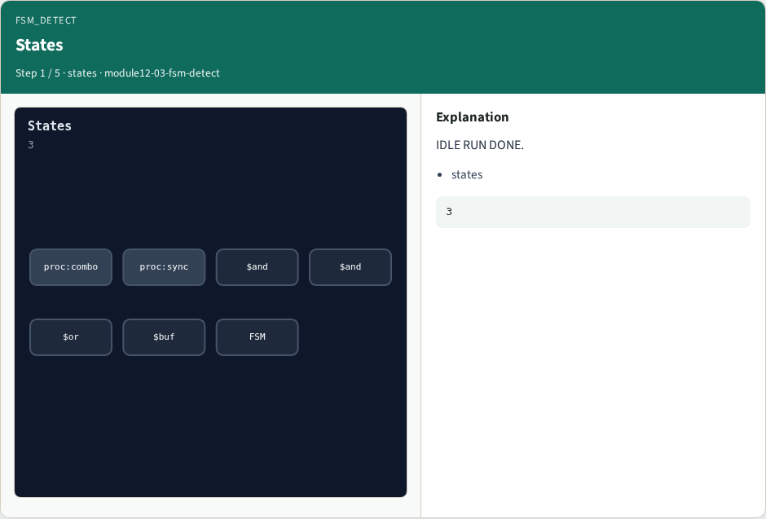
States
States
learn_yosys — 03 fsm detect
Notes:
IDLE RUN DONE.

Slide 4

Transitions
Transitions
learn_yosys — 03 fsm detect
Notes:
Three edges.

Slide 5
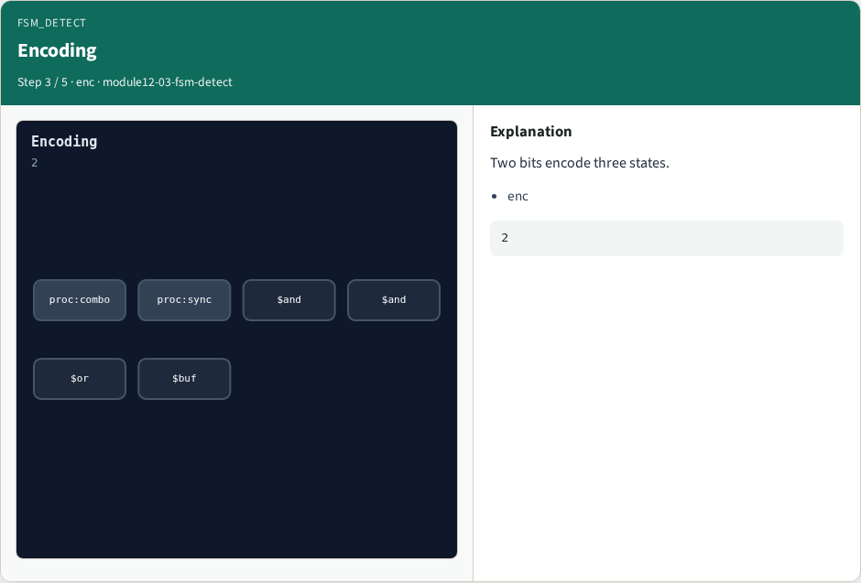
Encoding
Encoding
learn_yosys — 03 fsm detect
Notes:
Two bits encode three states.

Slide 6

Reset
Reset
learn_yosys — 03 fsm detect
Notes:
Reset state IDLE.

Slide 7

Golden
Golden
learn_yosys — 03 fsm detect
Notes:
GOLDEN: states=3 bits=2.

Slide 8
Browser lab track
Open fsm-detect
Read states, edges, and encoding width
learn_yosys — 03 fsm detect
Notes:
Open **fsm-detect**. Read states, edges, and encoding width.

Slide 9
Implement track
Call algo_fsm_detect(); assert states == 3, transitions == 3, encoding_bits == 2
learn_yosys — 03 fsm detect
Notes:
Call algo_fsm_detect(); assert states == 3, transitions == 3, encoding_bits == 2.

Slide 10
Pitfalls
Counting encoding bits as state count
Missing a transition edge
learn_yosys — 03 fsm detect
Notes:
Counting encoding bits as state count. Missing a transition edge.

Slide 11
Try these
From the common folder, run the algo solvers self-test, or call `algo_fsm_detect` directly
learn_yosys — 03 fsm detect
Notes:
From the common folder, run the algo solvers self-test, or call `algo_fsm_detect` directly.

Slide 12
Try these — try these
cd courses/learn_yosys/common
python3 algo_solvers.py
learn_yosys — 03 fsm detect

Slide 13
Pseudocode
Here is the check in plain steps
learn_yosys — 03 fsm detect
Notes:
Here is the check in plain steps.

Slide 14
Pseudocode — try these
states ← fsm.states; trans ← fsm.transitions
bits ← max encoding string length
ok if 3, 3, and 2
learn_yosys — 03 fsm detect

Slide 15
Next
Complete the quiz for this part
Next: ABC handoff AND count
learn_yosys — 03 fsm detect
Notes:
Next: ABC handoff AND count.

