Slide 1
Why abc
Yosys abc is a bridge: you hand an AIG-shaped cone to an external optimizer
learn_yosys — 01 abc handoff
Notes:
Yosys abc is a bridge: you hand an AIG-shaped cone to an external optimizer.

Slide 2
The idea
GOLDEN: abc_aig_ands=3 after opt_merge-shaped handoff
learn_yosys — 01 abc handoff
Notes:
GOLDEN: abc_aig_ands=3 after opt_merge-shaped handoff.

Slide 3
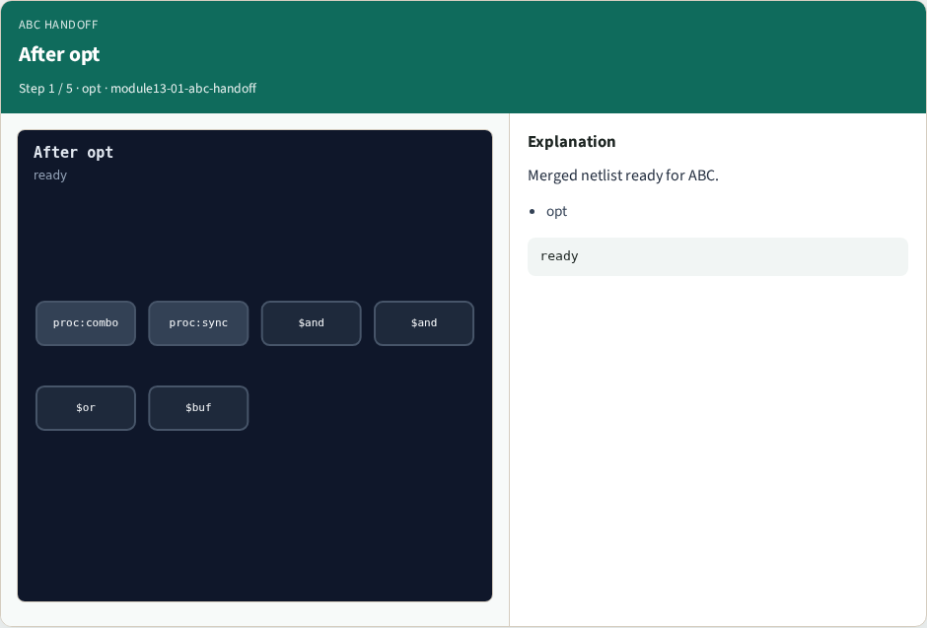
After opt
After opt
learn_yosys — 01 abc handoff
Notes:
Merged netlist ready for ABC.

Slide 4

AND budget
AND budget
learn_yosys — 01 abc handoff
Notes:
Count AND-ish nodes.

Slide 5

Mux cost
Mux cost
learn_yosys — 01 abc handoff
Notes:
Each $mux counts as two ANDs.

Slide 6

abc pass
abc pass
learn_yosys — 01 abc handoff
Notes:
Yosys abc bridges to ABC/ABC9.

Slide 7

Golden
Golden
learn_yosys — 01 abc handoff
Notes:
GOLDEN: aig_ands=3.

Slide 8
Browser lab track
Open abc-handoff
Count AND nodes for the ABC handoff
learn_yosys — 01 abc handoff
Notes:
Open **abc-handoff**. Count AND nodes for the ABC handoff.

Slide 9
Implement track
Call algo_abc_handoff(); assert aig_ands == 3
learn_yosys — 01 abc handoff
Notes:
Call algo_abc_handoff(); assert aig_ands == 3.

Slide 10
Pitfalls
Counting before merge
Treating mux as one AND instead of two in this model
learn_yosys — 01 abc handoff
Notes:
Counting before merge. Treating mux as one AND instead of two in this model.

Slide 11
Try these
From the common folder
learn_yosys — 01 abc handoff
Notes:
From the common folder, run the algo solvers self-test, or call `algo_abc_handoff` directly.

Slide 12
Try these — try these
cd courses/learn_yosys/common
python3 algo_solvers.py
learn_yosys — 01 abc handoff

Slide 13
Pseudocode
Here is the check in plain steps
learn_yosys — 01 abc handoff
Notes:
Here is the check in plain steps.

Slide 14
Pseudocode — try these
after opt_merge
and += 1 per dollar and; += 2 per dollar mux
ok if aig_ands == 3
learn_yosys — 01 abc handoff

Slide 15
Next
Complete the quiz for this part
Next: full Yosys algo engine check
learn_yosys — 01 abc handoff
Notes:
Next: full Yosys algo engine check.

