Slide 1
Why conflicts
Multi-patterning starts by finding which features cannot share the same mask
learn_multi_patterning — 01 conflict graph
Notes:
Multi-patterning starts by finding which features cannot share the same mask.

Slide 2
The idea
GOLDEN: 6 nodes, 5 edges (A-B, A-C, B-C, D-E, E-F), min_same_mask=2
learn_multi_patterning — 01 conflict graph
Notes:
GOLDEN: 6 nodes, 5 edges (A-B, A-C, B-C, D-E, E-F), min_same_mask=2.

Slide 3
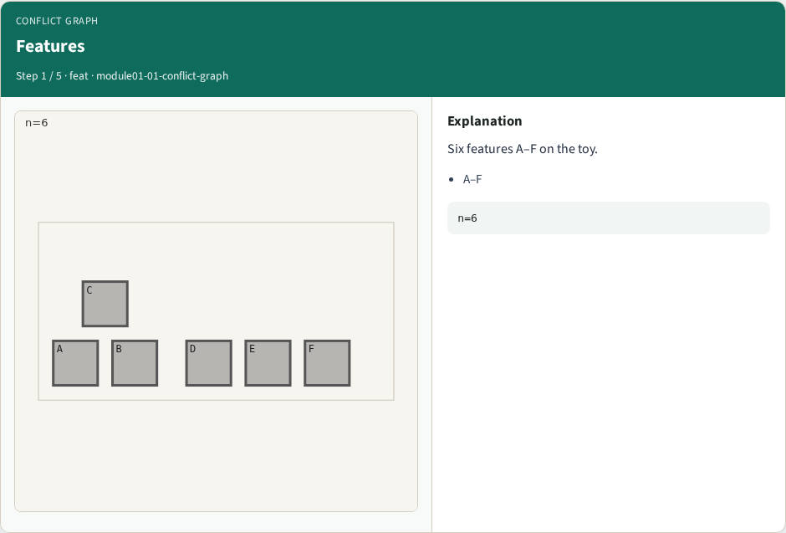
Features
Features
learn_multi_patterning — 01 conflict graph
Notes:
Six features A–F on the toy.

Slide 4
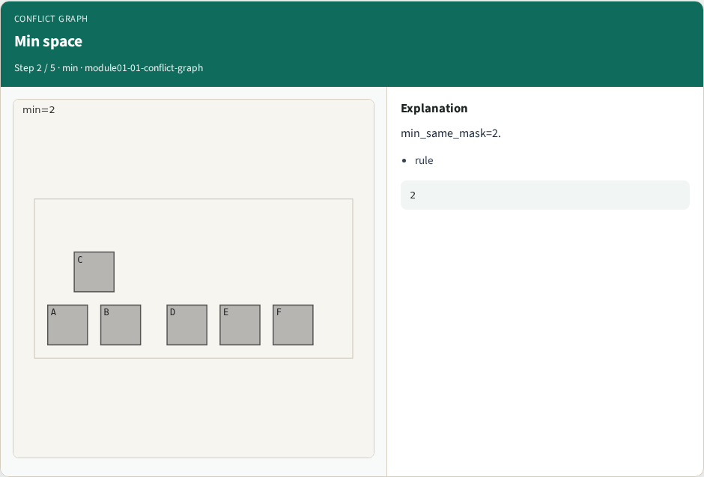
Min space
Min space
learn_multi_patterning — 01 conflict graph
Notes:
min_same_mask=2.

Slide 5

Edges
Edges
learn_multi_patterning — 01 conflict graph
Notes:
Conflict if gap < 2 → 5 edges.

Slide 6

Triangle
Triangle
learn_multi_patterning — 01 conflict graph
Notes:
A–B–C form a triangle.

Slide 7
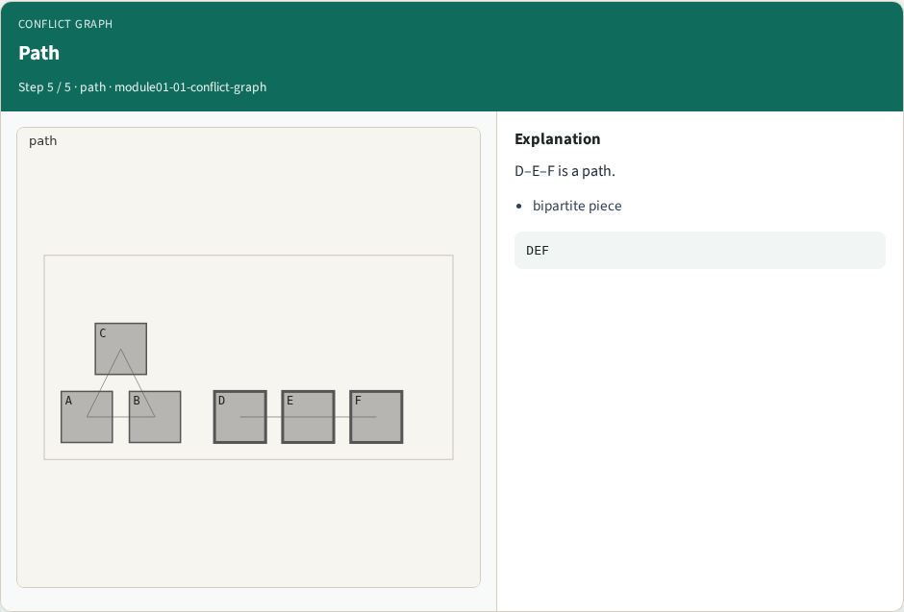
Path
Path
learn_multi_patterning — 01 conflict graph
Notes:
D–E–F is a path.

Slide 8
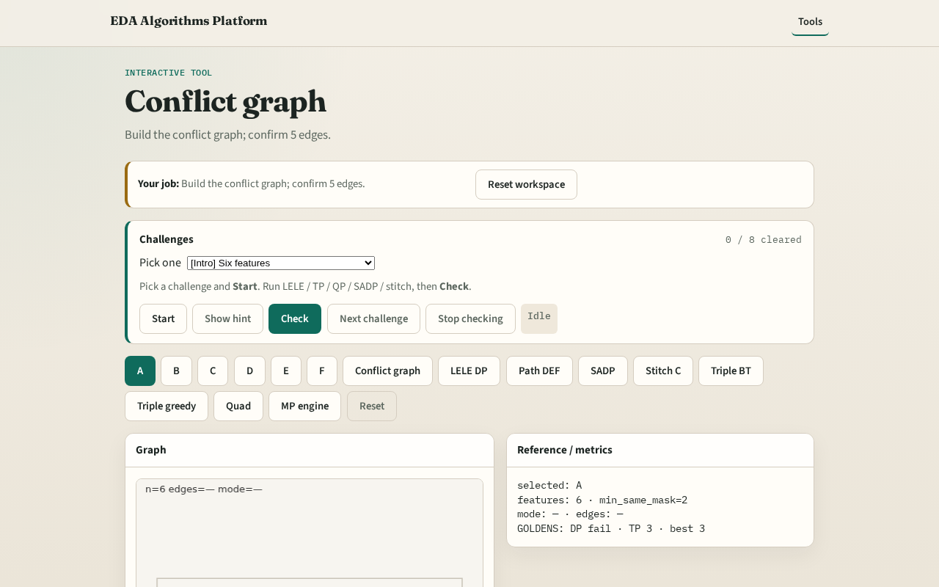
Browser lab track
Browser lab starter
learn_multi_patterning — 01 conflict graph
Notes:
Open **conflict-graph**. Build graph; confirm 6 nodes and 5 edges.

Slide 9
Implement track
Call build_conflict_graph(); assert feature_count==6 and edge_count==5
learn_multi_patterning — 01 conflict graph
Notes:
Call build_conflict_graph(); assert feature_count==6 and edge_count==5.

Slide 10
Pitfalls
Using center distance instead of bbox gap
Forgetting min_same_mask from JSON
learn_multi_patterning — 01 conflict graph
Notes:
Using center distance instead of bbox gap. Forgetting min_same_mask from JSON.

Slide 11
Your turn
Next: LELE double patterning as 2-coloring
learn_multi_patterning — 01 conflict graph
Notes:
Next: LELE double patterning as 2-coloring.

