Slide 1
LELE overview
LELE double patterning assigns two lithography masks by 2-coloring conflicts
learn_multi_patterning — 03 double lele
Notes:
LELE double patterning assigns two lithography masks by 2-coloring conflicts.

Slide 2
The idea
GOLDEN: lele_double ok=False on the full graph (triangle A-B-C)
learn_multi_patterning — 03 double lele
Notes:
GOLDEN: lele_double ok=False on the full graph (triangle A-B-C).

Slide 3

LELE idea
LELE idea
learn_multi_patterning — 03 double lele
Notes:
LELE DP = two masks via 2-coloring.

Slide 4

Two masks
Two masks
learn_multi_patterning — 03 double lele
Notes:
Assign color 0/1 to features.

Slide 5
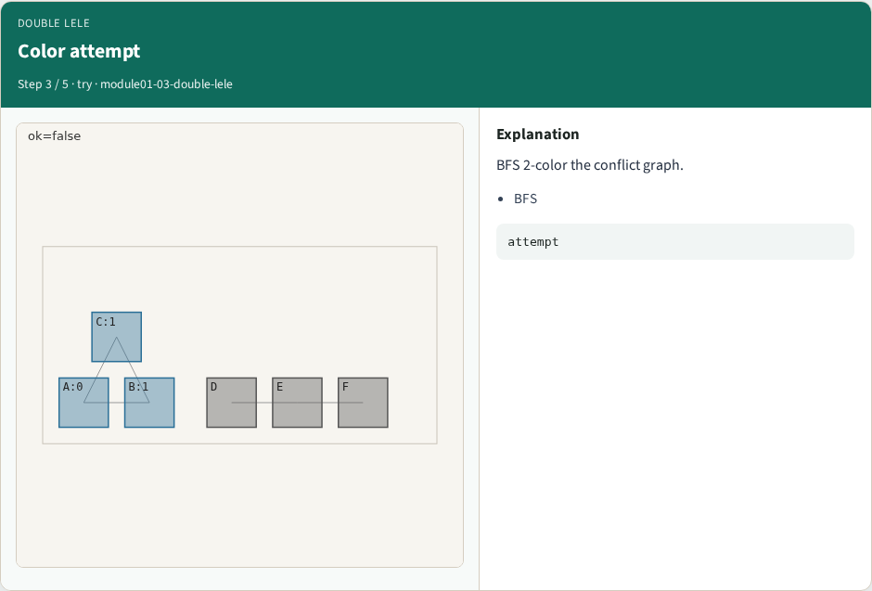
Color attempt
Color attempt
learn_multi_patterning — 03 double lele
Notes:
BFS 2-color the conflict graph.

Slide 6
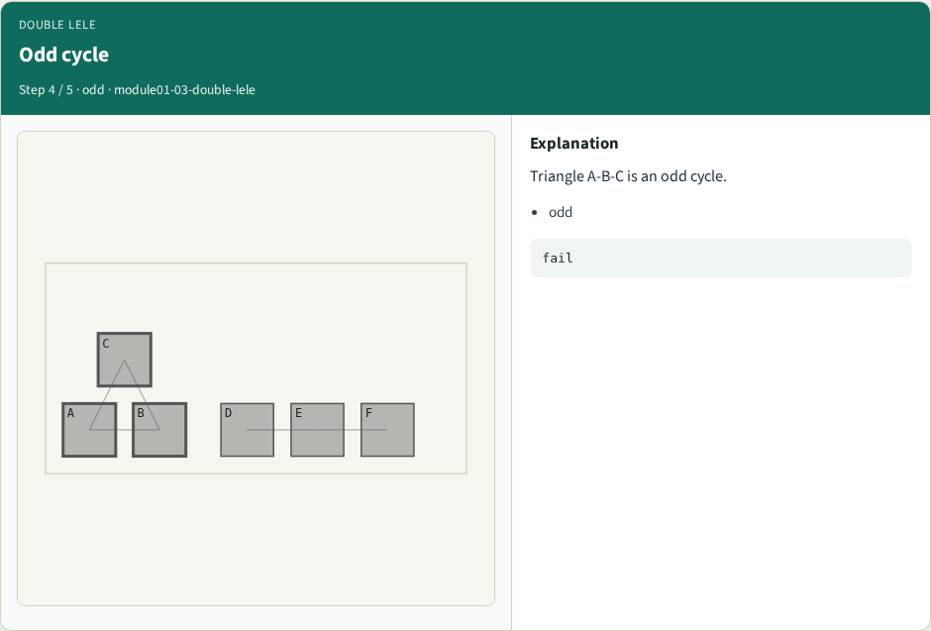
Odd cycle
Odd cycle
learn_multi_patterning — 03 double lele
Notes:
Triangle A-B-C is an odd cycle.

Slide 7
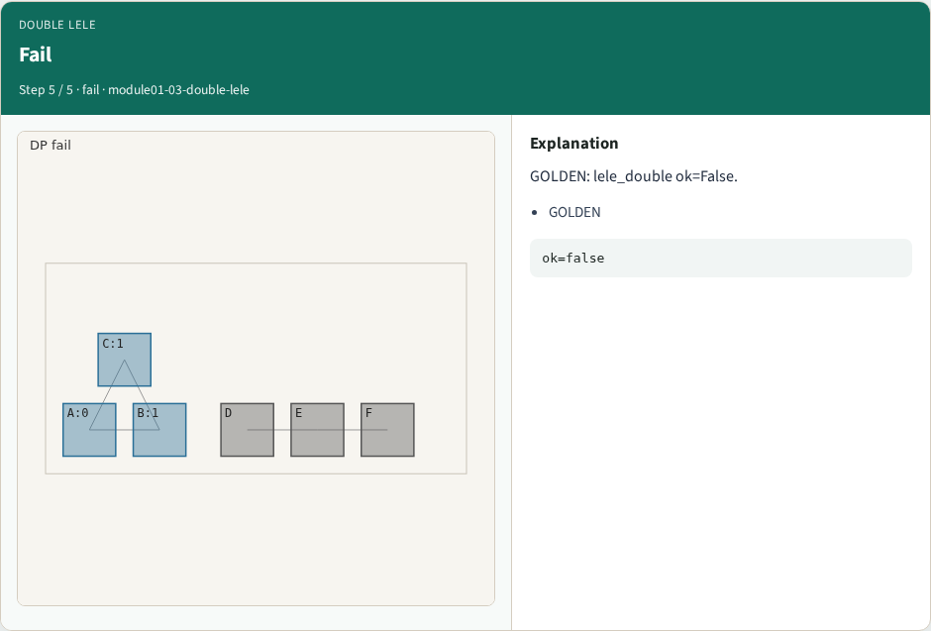
Fail
Fail
learn_multi_patterning — 03 double lele
Notes:
GOLDEN: lele_double ok=False.

Slide 8

Browser lab track
Browser lab starter
learn_multi_patterning — 03 double lele
Notes:
Open **double-lele**. Run LELE; confirm ok=False on tiny_mp.

Slide 9
Implement track
Call lele_double(); assert ok is False
learn_multi_patterning — 03 double lele
Notes:
Call lele_double(); assert ok is False.

Slide 10
Pitfalls
Assuming DP always works
Ignoring odd cycles in the full layout
learn_multi_patterning — 03 double lele
Notes:
Assuming DP always works. Ignoring odd cycles in the full layout.

Slide 11
Your turn
Next: bipartite check on a subgraph
learn_multi_patterning — 03 double lele
Notes:
Next: bipartite check on a subgraph.

