Slide 1
DP feasibility
A subgraph that is bipartite can still be double-patterned even when the full chip is not
learn_multi_patterning — 05 bipartite check
Notes:
A subgraph that is bipartite can still be double-patterned even when the full chip is not.

Slide 2
The idea
GOLDEN: path_lele ok=True on nodes D, E, F
learn_multi_patterning — 05 bipartite check
Notes:
GOLDEN: path_lele ok=True on nodes D, E, F.

Slide 3
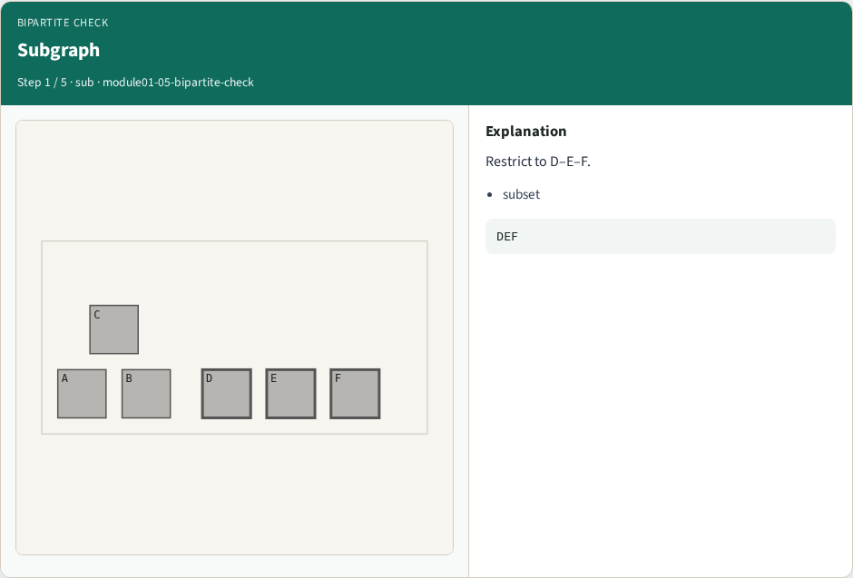
Subgraph
Subgraph
learn_multi_patterning — 05 bipartite check
Notes:
Restrict to D–E–F.

Slide 4

BFS color
BFS color
learn_multi_patterning — 05 bipartite check
Notes:
2-color BFS on the path.

Slide 5

Path DEF
Path DEF
learn_multi_patterning — 05 bipartite check
Notes:
Path has no odd cycle.

Slide 6
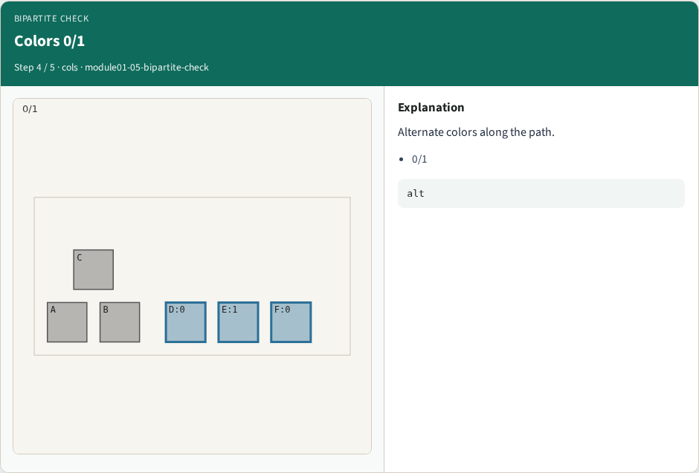
Colors 0/1
Colors 0/1
learn_multi_patterning — 05 bipartite check
Notes:
Alternate colors along the path.

Slide 7
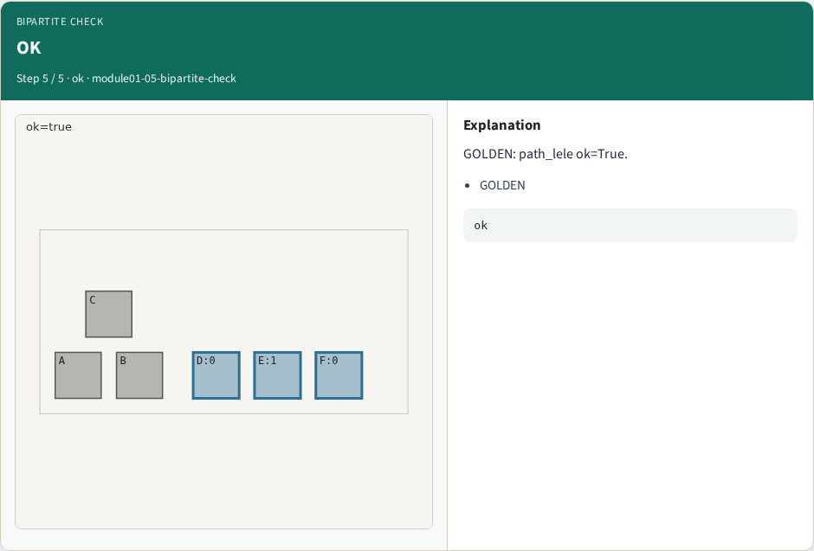
OK
OK
learn_multi_patterning — 05 bipartite check
Notes:
GOLDEN: path_lele ok=True.

Slide 8
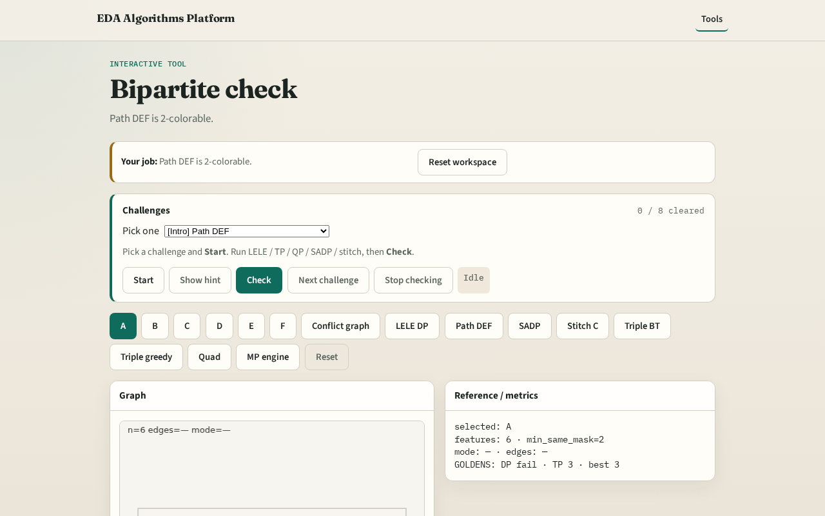
Browser lab track
Browser lab starter
learn_multi_patterning — 05 bipartite check
Notes:
Open **bipartite-check**. Run path check; confirm ok=True for D-E-F.

Slide 9
Implement track
Call path_lele(); assert ok is True
learn_multi_patterning — 05 bipartite check
Notes:
Call path_lele(); assert ok is True.

Slide 10
Pitfalls
Testing full graph when the lesson is subgraph feasibility
Confusing LELE with SADP
learn_multi_patterning — 05 bipartite check
Notes:
Testing full graph when the lesson is subgraph feasibility. Confusing LELE with SADP.

Slide 11
Your turn
Next: SADP mandrel assignment
learn_multi_patterning — 05 bipartite check
Notes:
Next: SADP mandrel assignment.

