Slide 1
SADP lite
SADP is not LELE coloring , mandrels print first; spacers form between mandrels
learn_multi_patterning — 01 double sadp
Notes:
SADP is not LELE coloring — mandrels print first; spacers form between mandrels.

Slide 2
The idea
GOLDEN: mandrel_count=3 (A, D, F on the toy greedy pick)
learn_multi_patterning — 01 double sadp
Notes:
GOLDEN: mandrel_count=3 (A, D, F on the toy greedy pick).

Slide 3

Mandrel
Mandrel
learn_multi_patterning — 01 double sadp
Notes:
SADP starts from mandrel features.

Slide 4

Spacer
Spacer
learn_multi_patterning — 01 double sadp
Notes:
Neighbors can be spacer-defined.

Slide 5
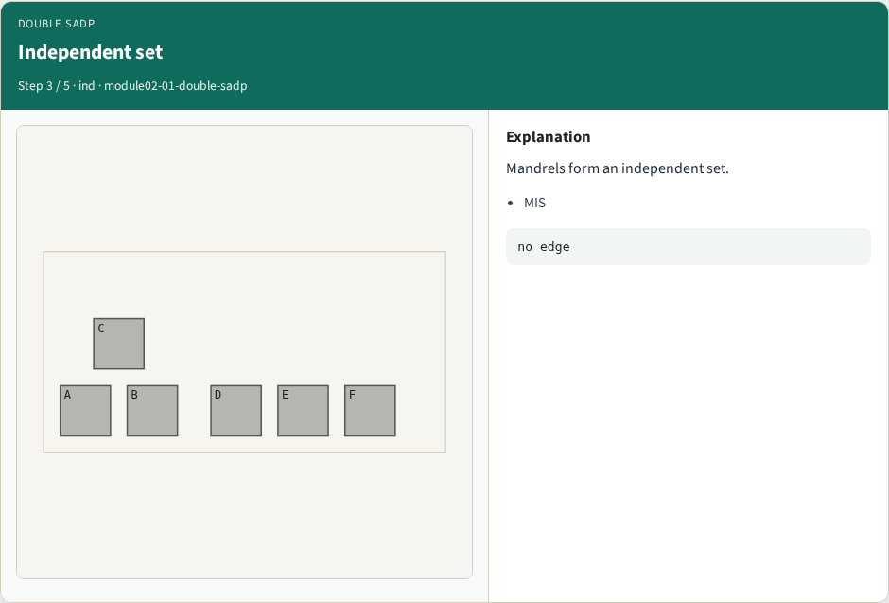
Independent set
Independent set
learn_multi_patterning — 01 double sadp
Notes:
Mandrels form an independent set.

Slide 6
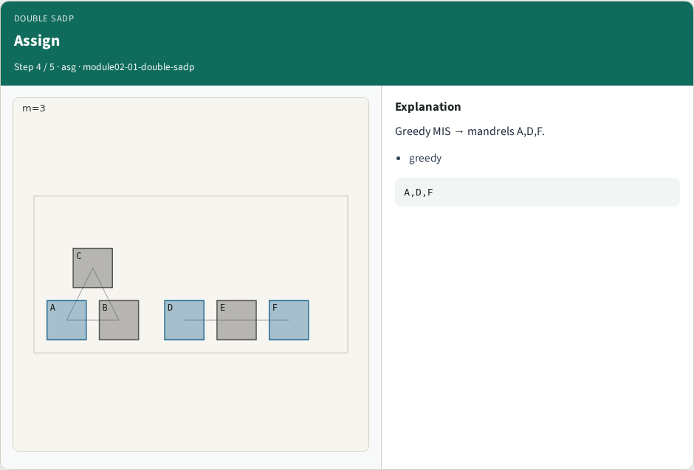
Assign
Assign
learn_multi_patterning — 01 double sadp
Notes:
Greedy MIS → mandrels A,D,F.

Slide 7
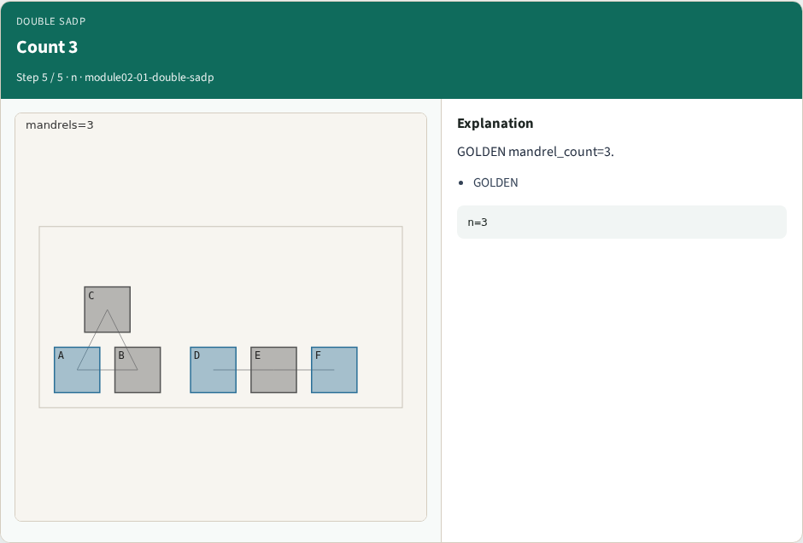
Count 3
Count 3
learn_multi_patterning — 01 double sadp
Notes:
GOLDEN mandrel_count=3.

Slide 8
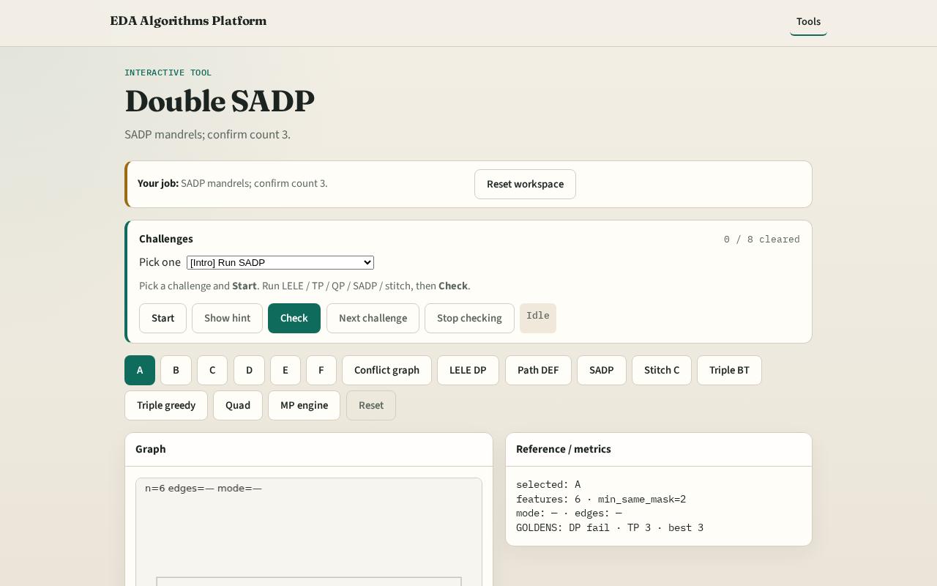
Browser lab track
Browser lab starter
learn_multi_patterning — 01 double sadp
Notes:
Open **double-sadp**. Run SADP assign; confirm mandrel_count=3.

Slide 9
Implement track
Call sadp_assign(); assert mandrel_count==3
learn_multi_patterning — 01 double sadp
Notes:
Call sadp_assign(); assert mandrel_count==3.

Slide 10
Pitfalls
Treating SADP as 2-coloring
Expecting same result as LELE
learn_multi_patterning — 01 double sadp
Notes:
Treating SADP as 2-coloring. Expecting same result as LELE.

Slide 11
Your turn
Next: stitch to break odd cycles
learn_multi_patterning — 01 double sadp
Notes:
Next: stitch to break odd cycles.

