Slide 1
Stitch overview
Stitching splits a feature so conflicts drop , restoring DP feasibility without extra masks
learn_multi_patterning — 03 stitch lite
Notes:
Stitching splits a feature so conflicts drop — restoring DP feasibility without extra masks.

Slide 2
The idea
GOLDEN: stitch_makes_dp True after splitting C → C1, C2
learn_multi_patterning — 03 stitch lite
Notes:
GOLDEN: stitch_makes_dp True after splitting C → C1, C2.

Slide 3
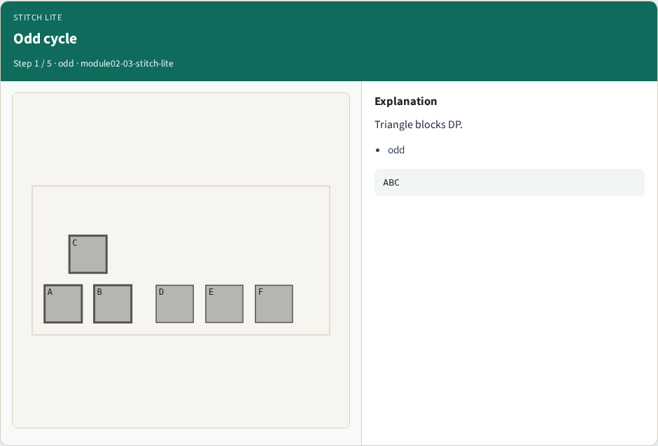
Odd cycle
Odd cycle
learn_multi_patterning — 03 stitch lite
Notes:
Triangle blocks DP.

Slide 4

Split C
Split C
learn_multi_patterning — 03 stitch lite
Notes:
Replace C with C1 and C2.

Slide 5
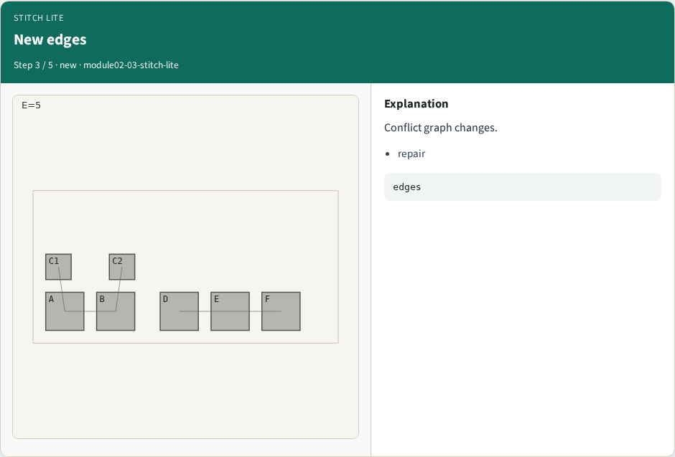
New edges
New edges
learn_multi_patterning — 03 stitch lite
Notes:
Conflict graph changes.

Slide 6
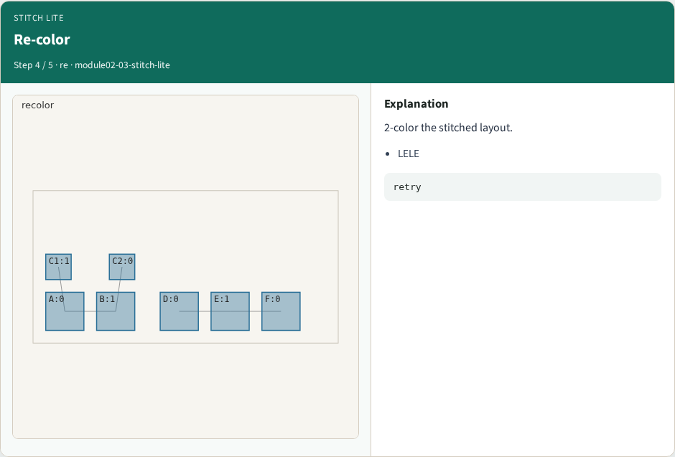
Re-color
Re-color
learn_multi_patterning — 03 stitch lite
Notes:
2-color the stitched layout.

Slide 7
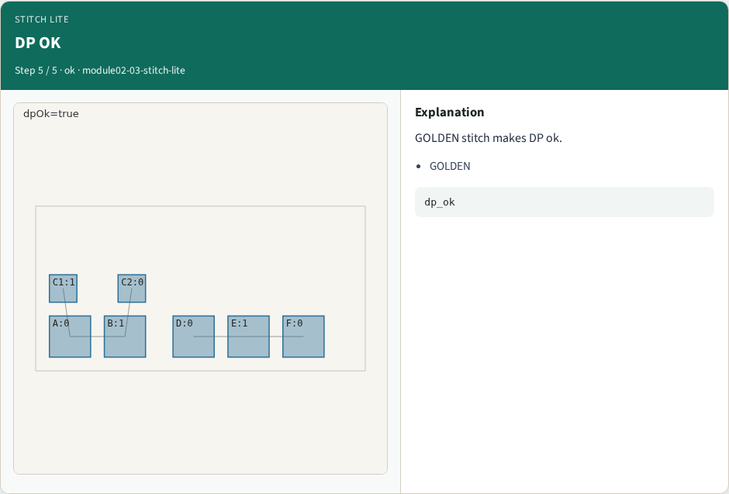
DP OK
DP OK
learn_multi_patterning — 03 stitch lite
Notes:
GOLDEN stitch makes DP ok.

Slide 8
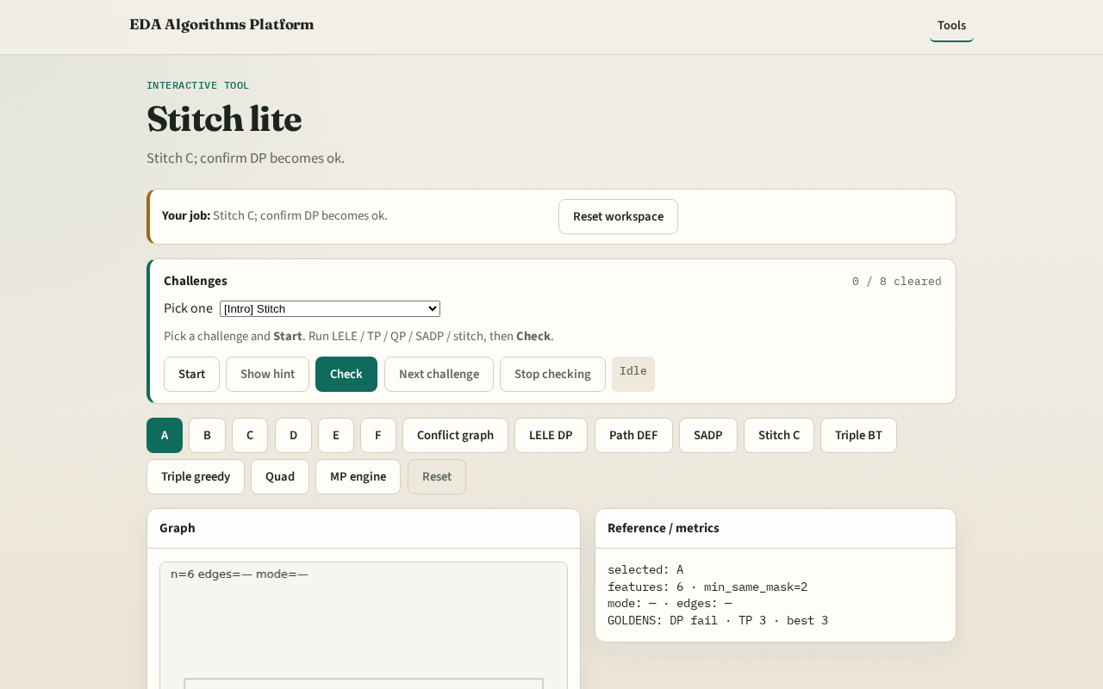
Browser lab track
Browser lab starter
learn_multi_patterning — 03 stitch lite
Notes:
Open **stitch-lite**. Run stitch; confirm dp_ok=True.

Slide 9
Implement track
Call stitch_feature('C'); assert dp_ok is True
learn_multi_patterning — 03 stitch lite
Notes:
Call stitch_feature('C'); assert dp_ok is True.

Slide 10
Pitfalls
Splitting without reducing conflicts
Assuming stitch always needs TP
learn_multi_patterning — 03 stitch lite
Notes:
Splitting without reducing conflicts. Assuming stitch always needs TP.

Slide 11
Your turn
Next: triple patterning with 3 colors
learn_multi_patterning — 03 stitch lite
Notes:
Next: triple patterning with 3 colors.

