Slide 1
Triple patterning
When two masks fail, triple patterning assigns three masks with a 3-coloring
learn_multi_patterning — 01 triple color
Notes:
When two masks fail, triple patterning assigns three masks with a 3-coloring.

Slide 2
The idea
GOLDEN: colors_used=3, ok=True on tiny_mp
learn_multi_patterning — 01 triple color
Notes:
GOLDEN: colors_used=3, ok=True on tiny_mp.

Slide 3
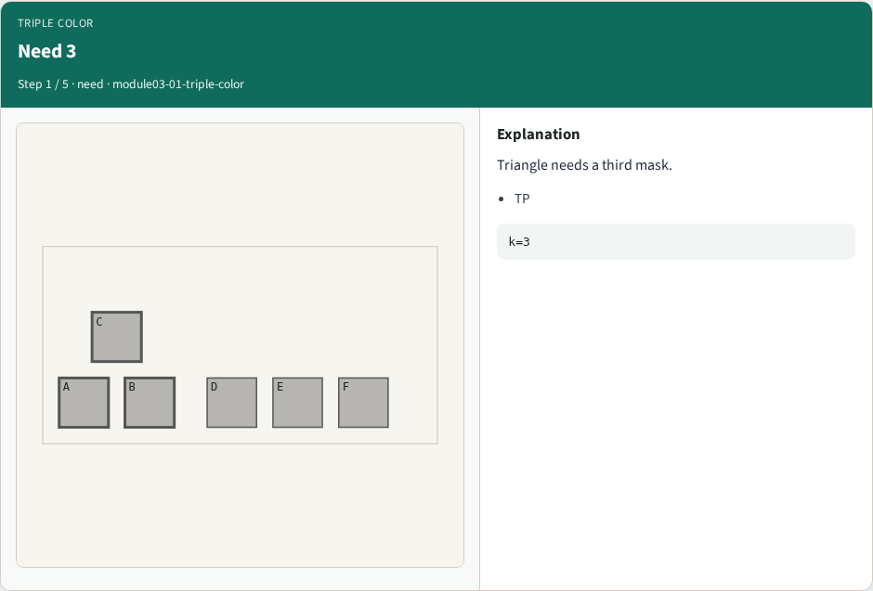
Need 3
Need 3
learn_multi_patterning — 01 triple color
Notes:
Triangle needs a third mask.

Slide 4

Backtrack
Backtrack
learn_multi_patterning — 01 triple color
Notes:
Search a valid 3-coloring.

Slide 5
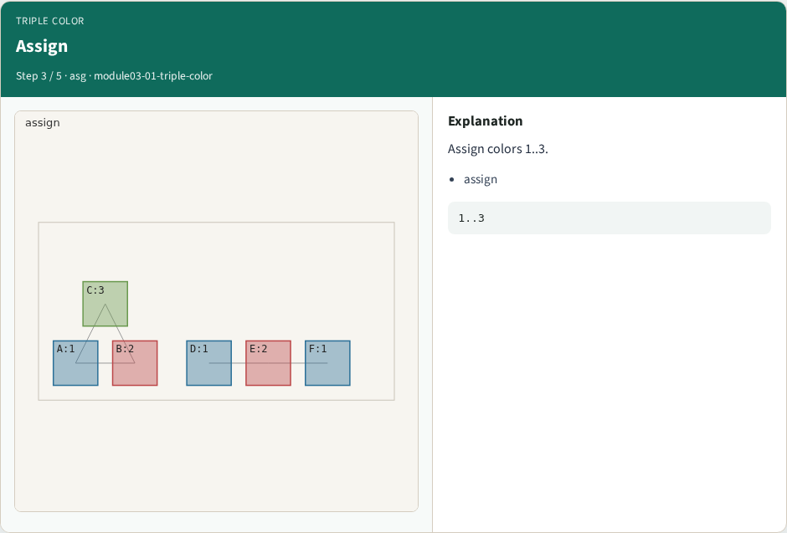
Assign
Assign
learn_multi_patterning — 01 triple color
Notes:
Assign colors 1..3.

Slide 6
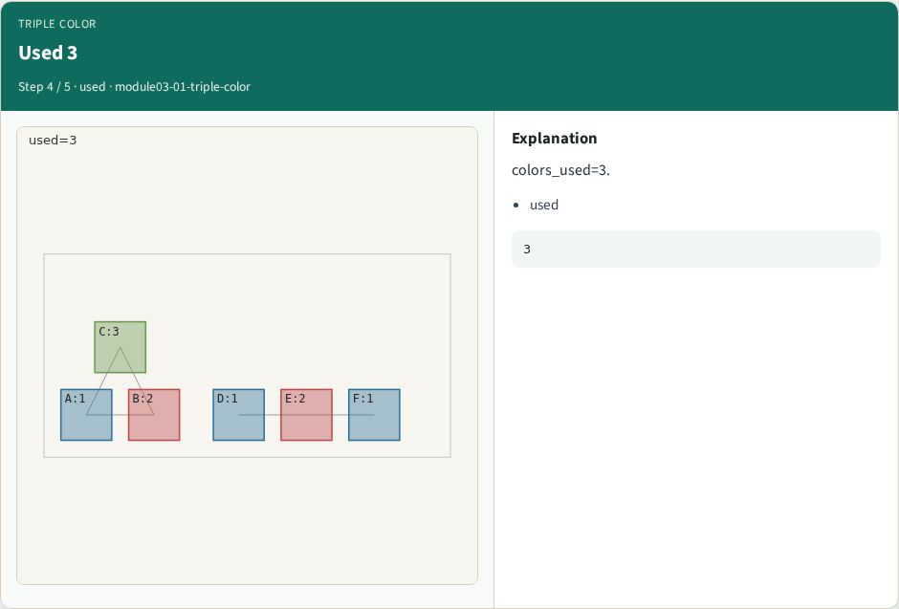
Used 3
Used 3
learn_multi_patterning — 01 triple color
Notes:
colors_used=3.

Slide 7
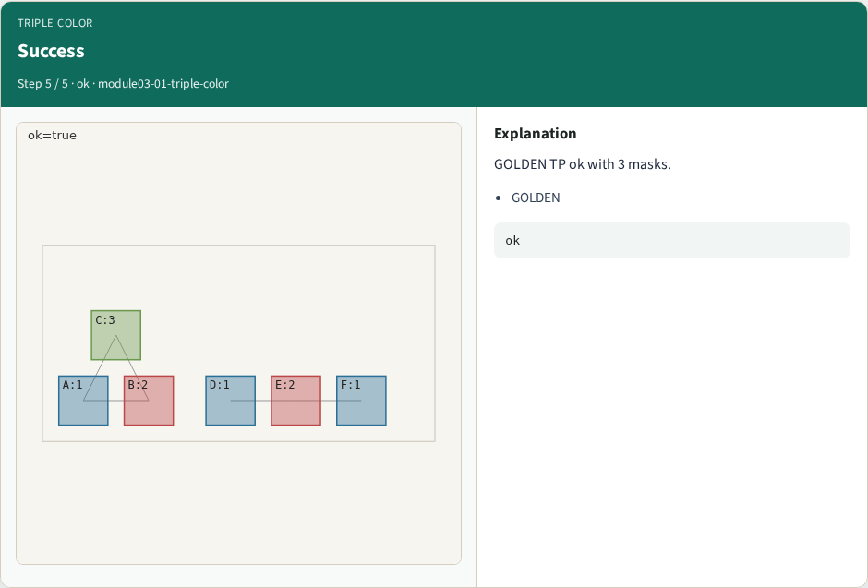
Success
Success
learn_multi_patterning — 01 triple color
Notes:
GOLDEN TP ok with 3 masks.

Slide 8
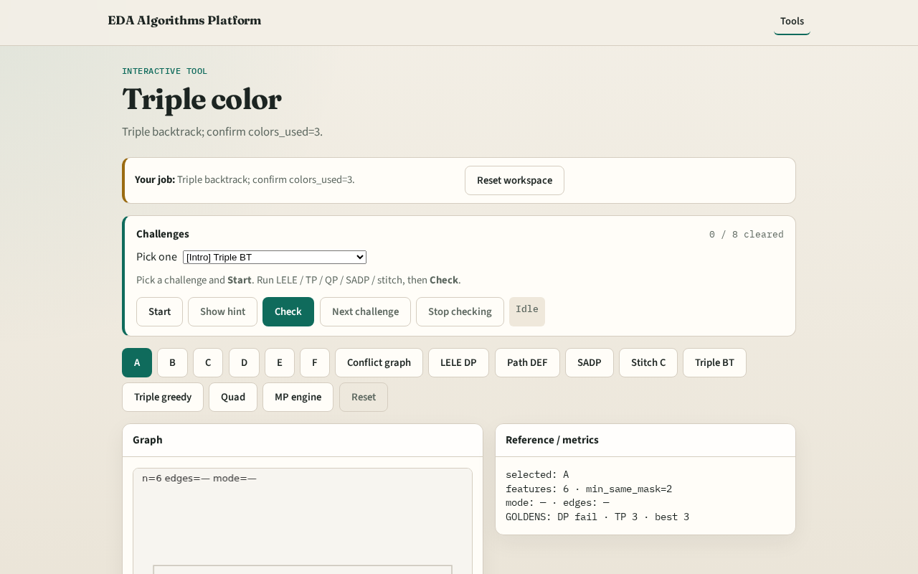
Browser lab track
Browser lab starter
learn_multi_patterning — 01 triple color
Notes:
Open **triple-color**. Run triple backtrack; confirm colors_used=3.

Slide 9
Implement track
Call triple_pattern(method='backtrack'); assert ok and colors_used==3
learn_multi_patterning — 01 triple color
Notes:
Call triple_pattern(method='backtrack'); assert ok and colors_used==3.

Slide 10
Pitfalls
Greedy-only when backtrack is required
Stopping at 2 colors after stitch lesson
learn_multi_patterning — 01 triple color
Notes:
Greedy-only when backtrack is required. Stopping at 2 colors after stitch lesson.

Slide 11
Your turn
Next: compare greedy vs backtrack decompositions
learn_multi_patterning — 01 triple color
Notes:
Next: compare greedy vs backtrack decompositions.

