Slide 1
Decomp literacy
Production flows may use greedy heuristics or exact backtrack , know when they differ
learn_multi_patterning — 03 triple decomp
Notes:
Production flows may use greedy heuristics or exact backtrack — know when they differ.

Slide 2
The idea
On tiny_mp both methods succeed; colors_used=3 for greedy and backtrack
learn_multi_patterning — 03 triple decomp
Notes:
On tiny_mp both methods succeed; colors_used=3 for greedy and backtrack.

Slide 3
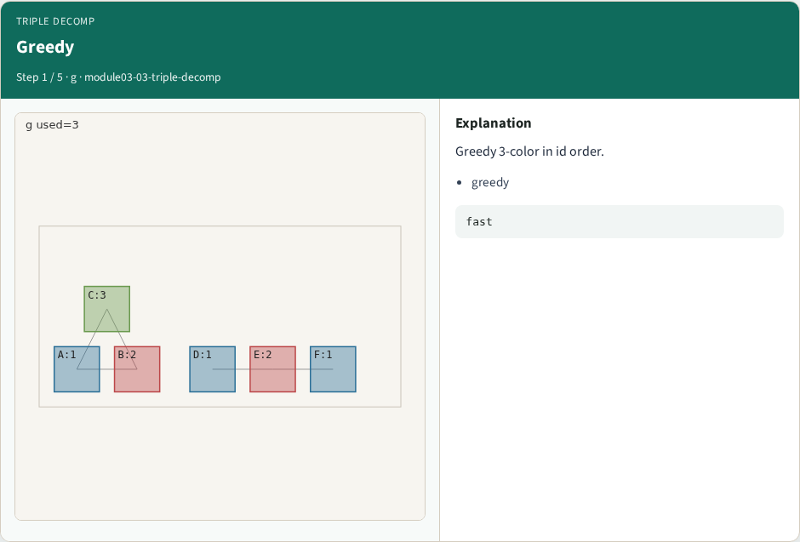
Greedy
Greedy
learn_multi_patterning — 03 triple decomp
Notes:
Greedy 3-color in id order.

Slide 4
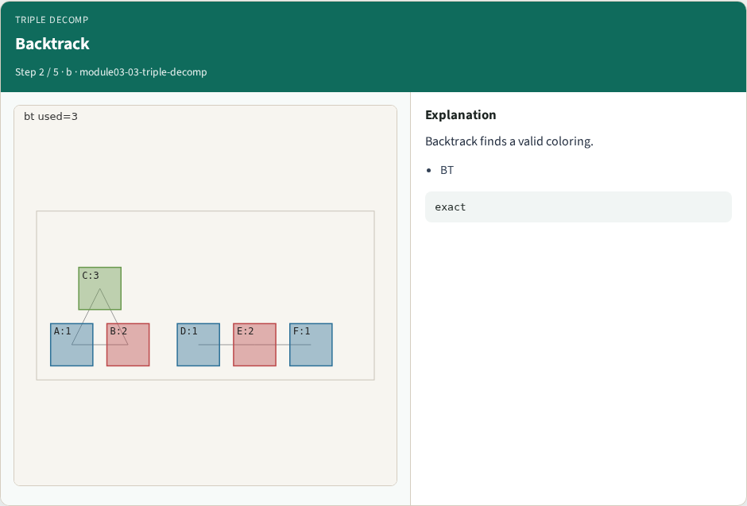
Backtrack
Backtrack
learn_multi_patterning — 03 triple decomp
Notes:
Backtrack finds a valid coloring.

Slide 5
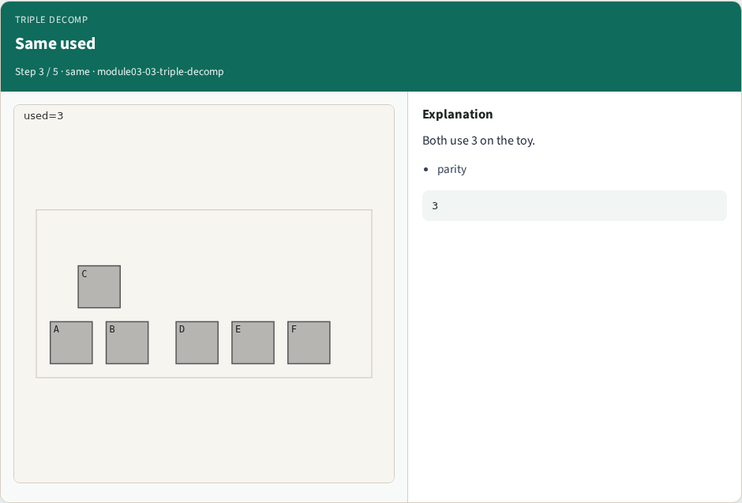
Same used
Same used
learn_multi_patterning — 03 triple decomp
Notes:
Both use 3 on the toy.

Slide 6

Methods
Methods
learn_multi_patterning — 03 triple decomp
Notes:
Decomp literacy: greedy vs search.

Slide 7

Choose
Choose
learn_multi_patterning — 03 triple decomp
Notes:
Prefer BT when greedy fails.

Slide 8
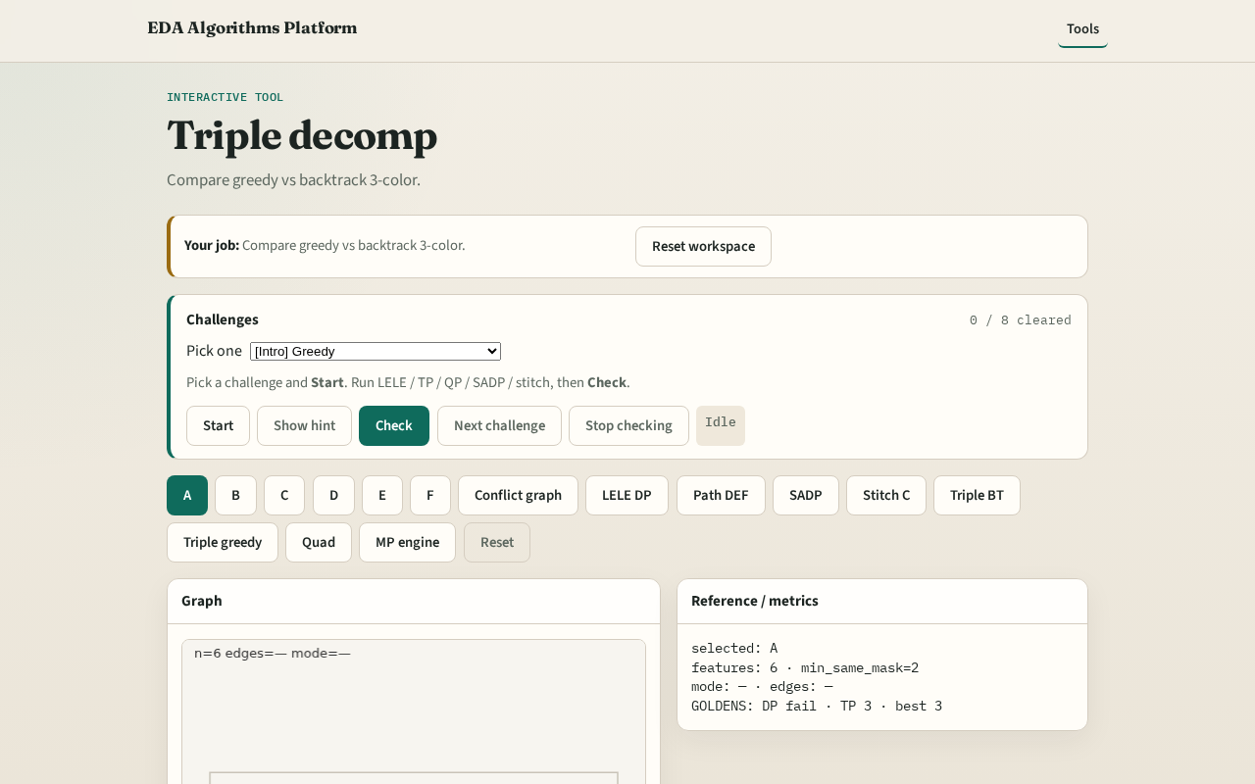
Browser lab track
Browser lab starter
learn_multi_patterning — 03 triple decomp
Notes:
Open **triple-decomp**. Run both methods; compare colors_used.

Slide 9
Implement track
Compare color_greedy(G,3) vs color_backtrack(G,3); assert both ok
learn_multi_patterning — 03 triple decomp
Notes:
Compare color_greedy(G,3) vs color_backtrack(G,3); assert both ok.

Slide 10
Pitfalls
Assuming greedy always equals backtrack
Ignoring failure cases on larger graphs
learn_multi_patterning — 03 triple decomp
Notes:
Assuming greedy always equals backtrack. Ignoring failure cases on larger graphs.

Slide 11
Your turn
Next: quad patterning with headroom
learn_multi_patterning — 03 triple decomp
Notes:
Next: quad patterning with headroom.

