Slide 1
Quad patterning
Quad patterning reserves four masks; greedy coloring shows headroom when fewer suffice
learn_multi_patterning — 05 quad color
Notes:
Quad patterning reserves four masks; greedy coloring shows headroom when fewer suffice.

Slide 2
The idea
GOLDEN: colors_used=3, k=4, ok=True on tiny_mp
learn_multi_patterning — 05 quad color
Notes:
GOLDEN: colors_used=3, k=4, ok=True on tiny_mp.

Slide 3
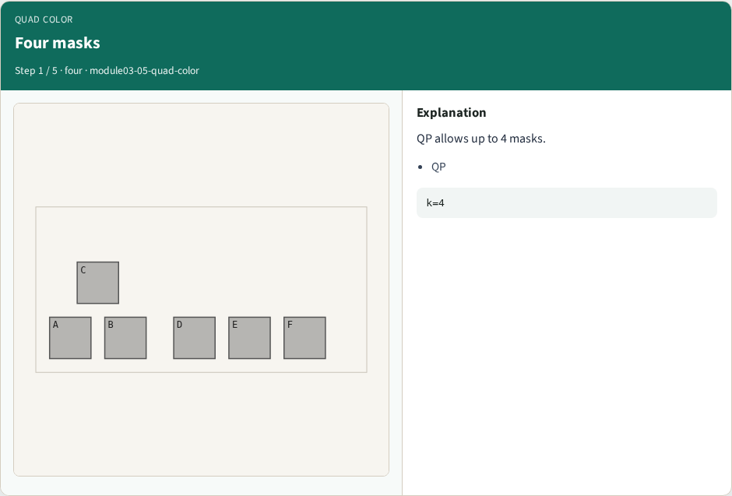
Four masks
Four masks
learn_multi_patterning — 05 quad color
Notes:
QP allows up to 4 masks.

Slide 4
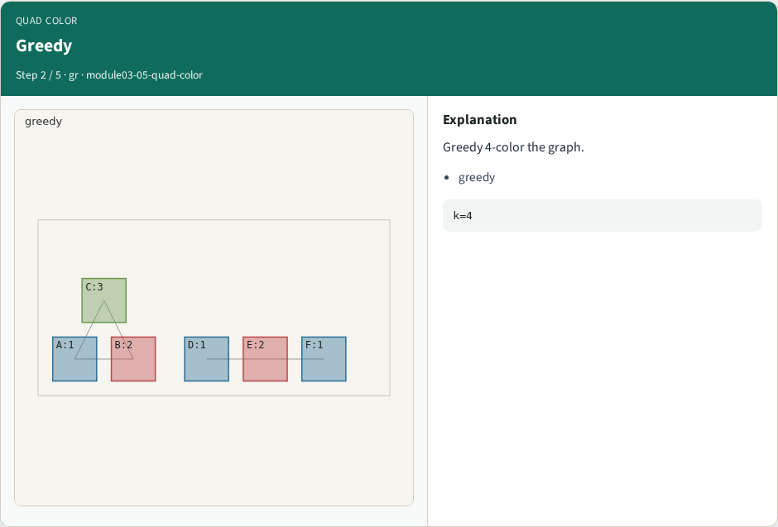
Greedy
Greedy
learn_multi_patterning — 05 quad color
Notes:
Greedy 4-color the graph.

Slide 5

Used 3
Used 3
learn_multi_patterning — 05 quad color
Notes:
Toy only needs 3 colors.

Slide 6

Headroom
Headroom
learn_multi_patterning — 05 quad color
Notes:
Extra mask is headroom.

Slide 7
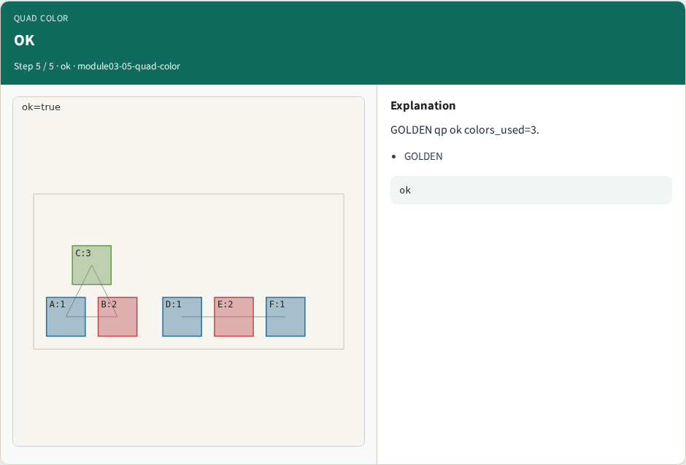
OK
OK
learn_multi_patterning — 05 quad color
Notes:
GOLDEN qp ok colors_used=3.

Slide 8
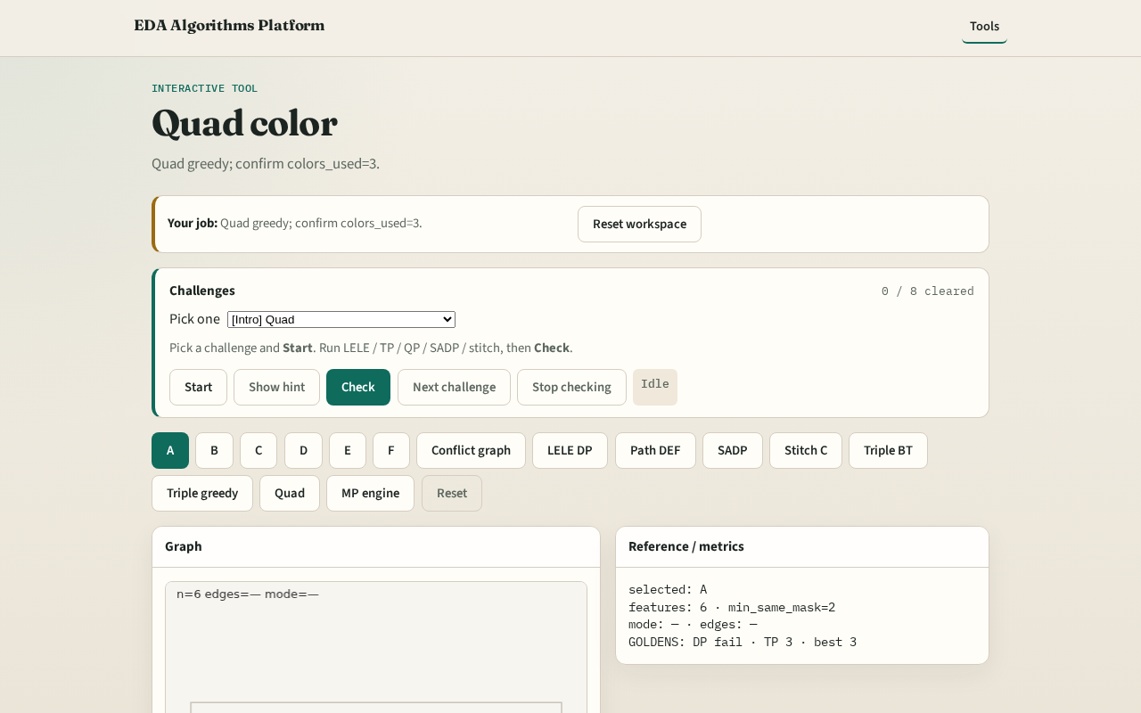
Browser lab track
Browser lab starter
learn_multi_patterning — 05 quad color
Notes:
Open **quad-color**. Run quad greedy; confirm colors_used=3.

Slide 9
Implement track
Call quad_pattern(method='greedy'); assert ok and colors_used==3
learn_multi_patterning — 05 quad color
Notes:
Call quad_pattern(method='greedy'); assert ok and colors_used==3.

Slide 10
Pitfalls
Requiring all four masks used
Confusing QP with TP
learn_multi_patterning — 05 quad color
Notes:
Requiring all four masks used. Confusing QP with TP.

Slide 11
Your turn
Next: multi-patterning engine pass
learn_multi_patterning — 05 quad color
Notes:
Next: multi-patterning engine pass.

