Slide 1
MP engine
A tiny MP engine picks the minimum mask count that succeeds on the layout
learn_multi_patterning — 01 mp engine
Notes:
A tiny MP engine picks the minimum mask count that succeeds on the layout.

Slide 2
The idea
GOLDEN: best_masks=3, dp_ok=False, tp_ok=True
learn_multi_patterning — 01 mp engine
Notes:
GOLDEN: best_masks=3, dp_ok=False, tp_ok=True.

Slide 3
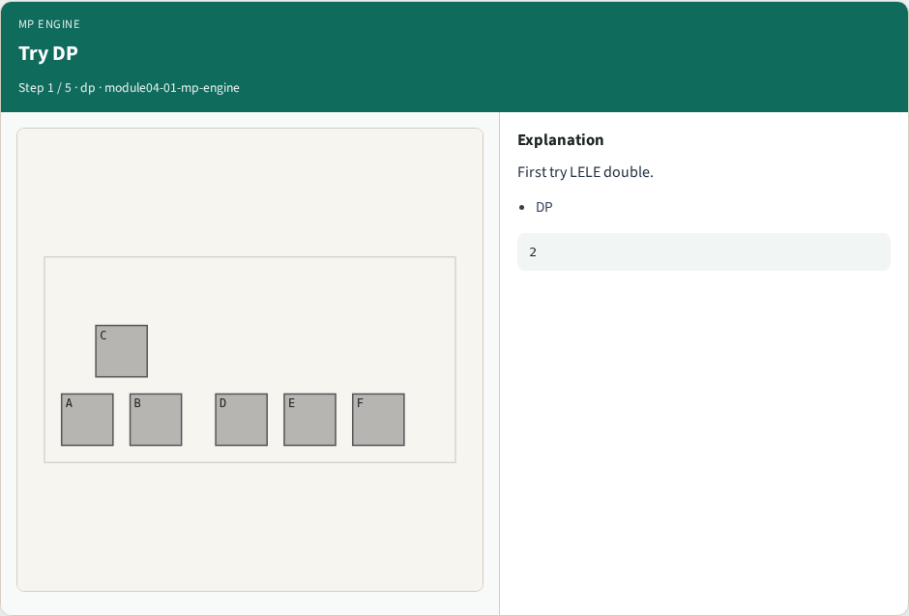
Try DP
Try DP
learn_multi_patterning — 01 mp engine
Notes:
First try LELE double.

Slide 4
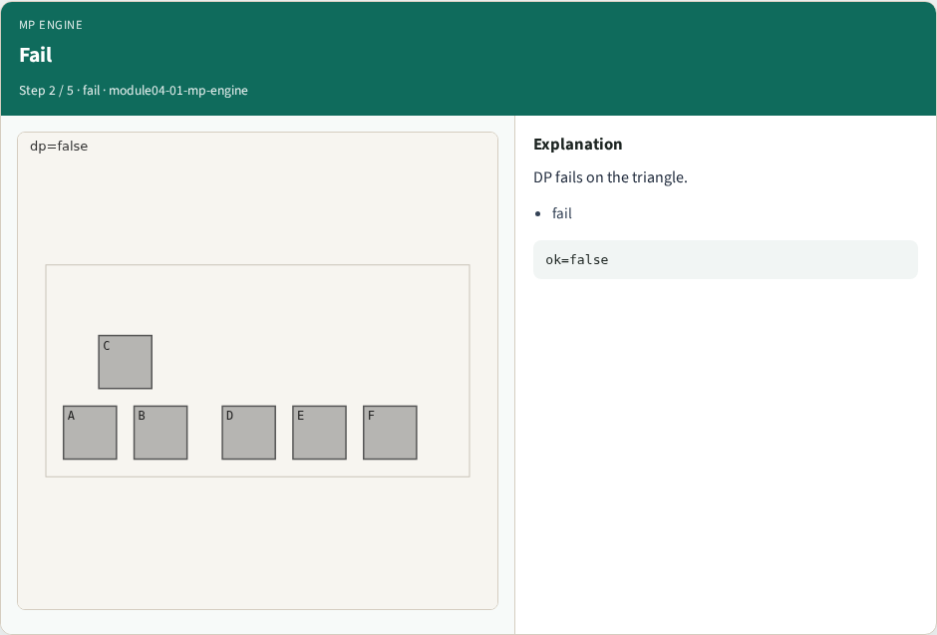
Fail
Fail
learn_multi_patterning — 01 mp engine
Notes:
DP fails on the triangle.

Slide 5
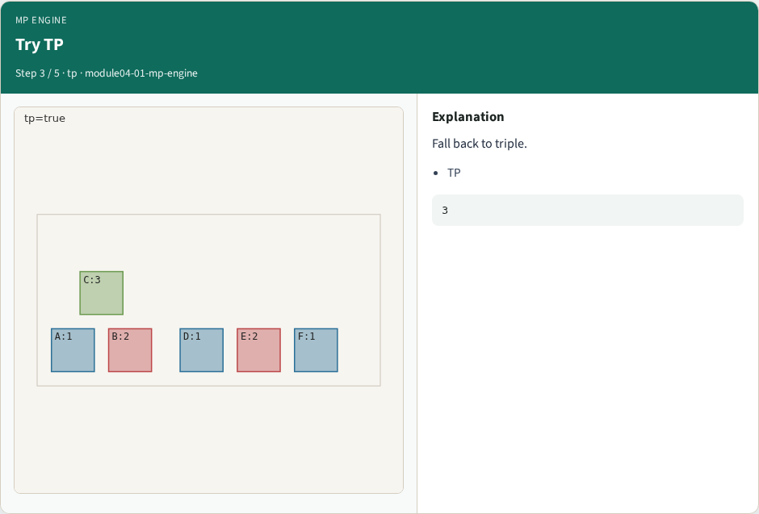
Try TP
Try TP
learn_multi_patterning — 01 mp engine
Notes:
Fall back to triple.

Slide 6
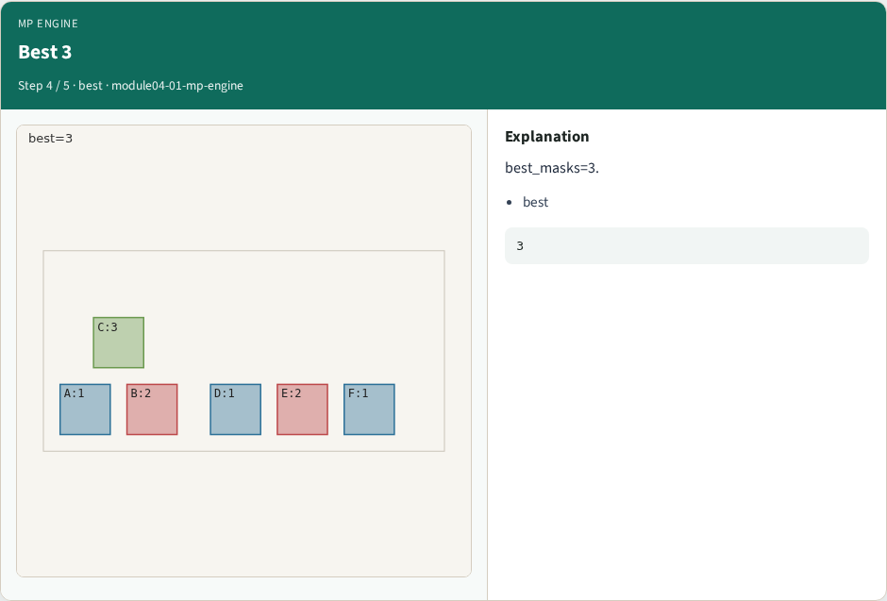
Best 3
Best 3
learn_multi_patterning — 01 mp engine
Notes:
best_masks=3.

Slide 7
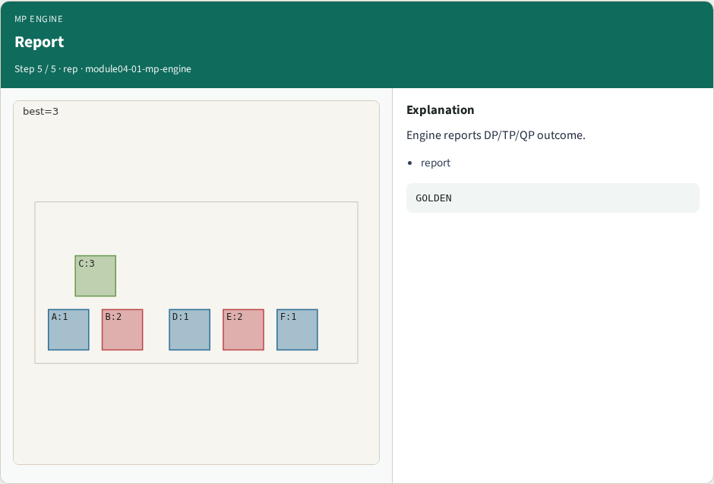
Report
Report
learn_multi_patterning — 01 mp engine
Notes:
Engine reports DP/TP/QP outcome.

Slide 8
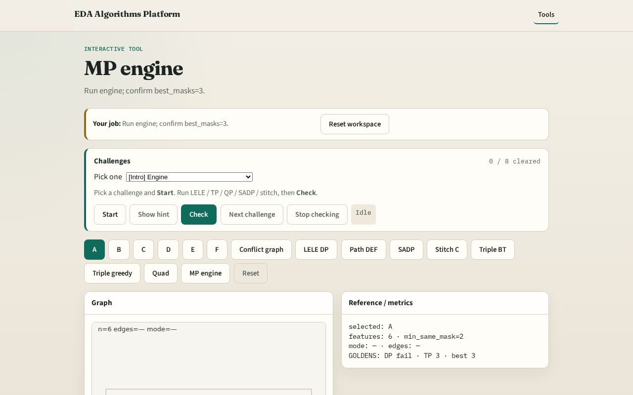
Browser lab track
Browser lab starter
learn_multi_patterning — 01 mp engine
Notes:
Open **mp-engine**. Run engine; confirm best_masks=3.

Slide 9
Implement track
Call mp_engine(); assert best_masks==3 and dp_ok is False and tp_ok is True
learn_multi_patterning — 01 mp engine
Notes:
Call mp_engine(); assert best_masks==3 and dp_ok is False and tp_ok is True.

Slide 10
Pitfalls
Stopping after DP failure
Reporting QP when TP already succeeds
learn_multi_patterning — 01 mp engine
Notes:
Stopping after DP failure. Reporting QP when TP already succeeds.

Slide 11
Your turn
Next: offline benchmark compare, then wrap
learn_multi_patterning — 01 mp engine
Notes:
Next: offline benchmark compare, then wrap.

