Slide 1
Why edges
Pattern engines begin with polygons and their edges on named layers
learn_pattern_matching — 01 edges polygons
Notes:
Pattern engines begin with polygons and their edges on named layers.

Slide 2
The idea
GOLDEN: 5 shapes, 3 layers, 20 edges (4 per shape), 3 shapes on M1
learn_pattern_matching — 01 edges polygons
Notes:
GOLDEN: 5 shapes, 3 layers, 20 edges (4 per shape), 3 shapes on M1.

Slide 3

Shapes
Shapes
learn_pattern_matching — 01 edges polygons
Notes:
Five rectangles: A,B,D on M1; C on M2; V on VIA.

Slide 4

Layers
Layers
learn_pattern_matching — 01 edges polygons
Notes:
Layers M1, M2, VIA — GOLDEN layer_count=3.

Slide 5
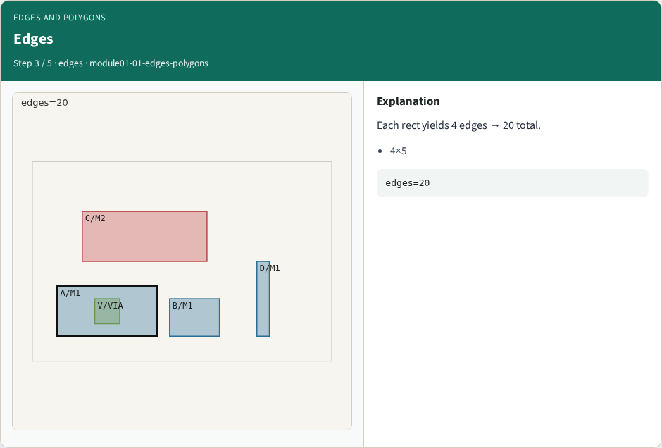
Edges
Edges
learn_pattern_matching — 01 edges polygons
Notes:
Each rect yields 4 edges → 20 total.

Slide 6
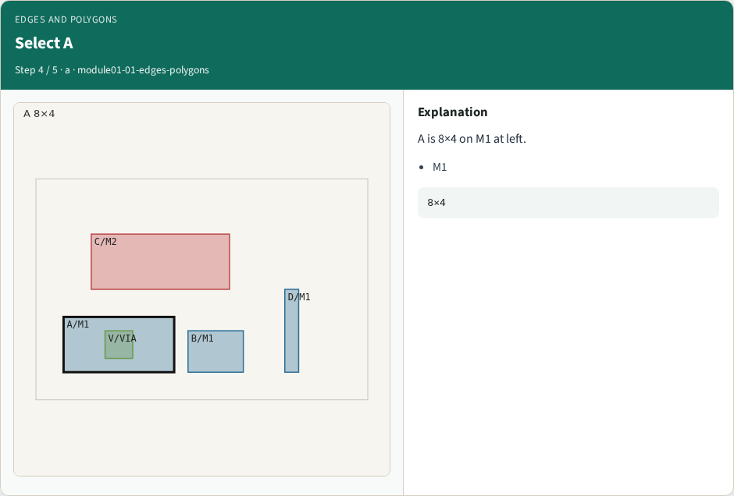
Select A
Select A
learn_pattern_matching — 01 edges polygons
Notes:
A is 8×4 on M1 at left.

Slide 7
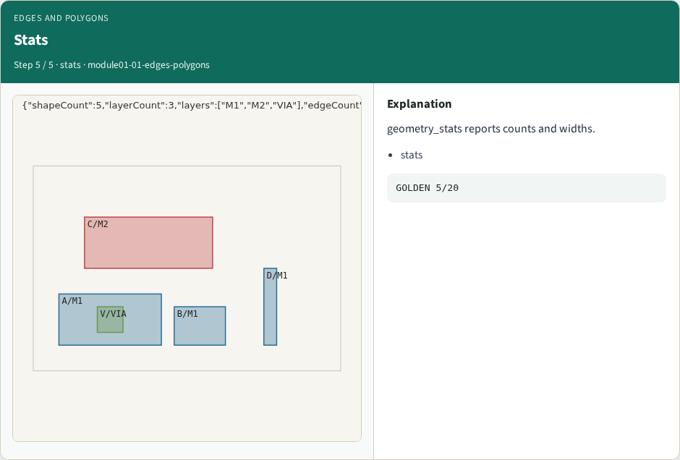
Stats
Stats
learn_pattern_matching — 01 edges polygons
Notes:
geometry_stats reports counts and widths.

Slide 8
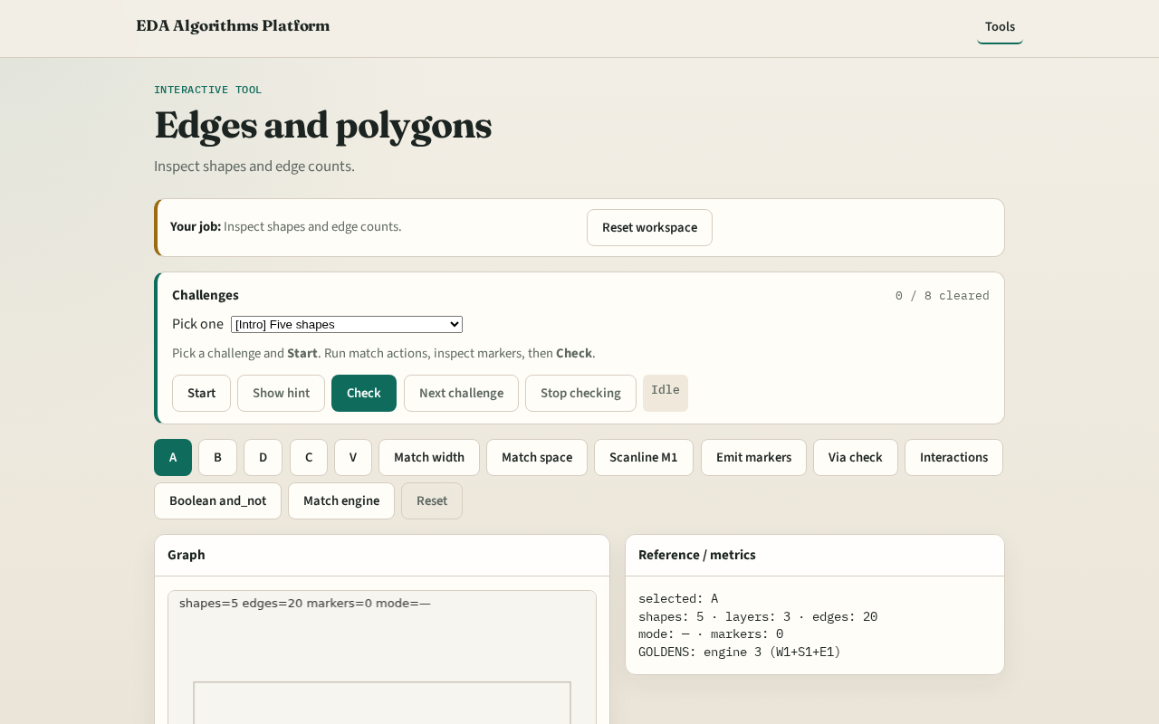
Browser lab track
Browser lab starter
learn_pattern_matching — 01 edges polygons
Notes:
Open **edges-polygons**. Select shapes; confirm shape_count=5 and edge_count=20.

Slide 9
Implement track
Call geometry_stats(); assert shape_count==5 and edge_count==20
learn_pattern_matching — 01 edges polygons
Notes:
Call geometry_stats(); assert shape_count==5 and edge_count==20.

Slide 10
Pitfalls
Counting only cells
Mixing chip size with shape count
learn_pattern_matching — 01 edges polygons
Notes:
Counting only cells. Mixing chip size with shape count.

Slide 11
Your turn
Next: single-layer edge-pair spacing
learn_pattern_matching — 01 edges polygons
Notes:
Next: single-layer edge-pair spacing.

