Slide 1
Edge pair
Spacing patterns compare facing edges of same-layer shapes with overlapping projections
learn_pattern_matching — 03 single layer edge pair
Notes:
Spacing patterns compare facing edges of same-layer shapes with overlapping projections.

Slide 2
The idea
On M1, A–B gap is 1 but min_space=2 → one space marker
GOLDEN space_markers=1
learn_pattern_matching — 03 single layer edge pair
Notes:
On M1, A–B gap is 1 but min_space=2 → one space marker. GOLDEN space_markers=1.

Slide 3

Neighbors
Neighbors
learn_pattern_matching — 03 single layer edge pair
Notes:
A left of B on M1 with y-projection overlap.

Slide 4
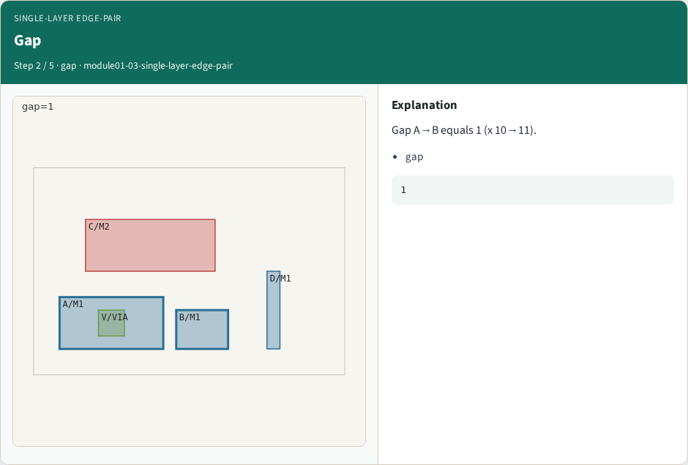
Gap
Gap
learn_pattern_matching — 03 single layer edge pair
Notes:
Gap A→B equals 1 (x 10→11).

Slide 5

Limit
Limit
learn_pattern_matching — 03 single layer edge pair
Notes:
min_space[M1]=2.

Slide 6

Marker
Marker
learn_pattern_matching — 03 single layer edge pair
Notes:
Emit space marker on shapes A,B.

Slide 7
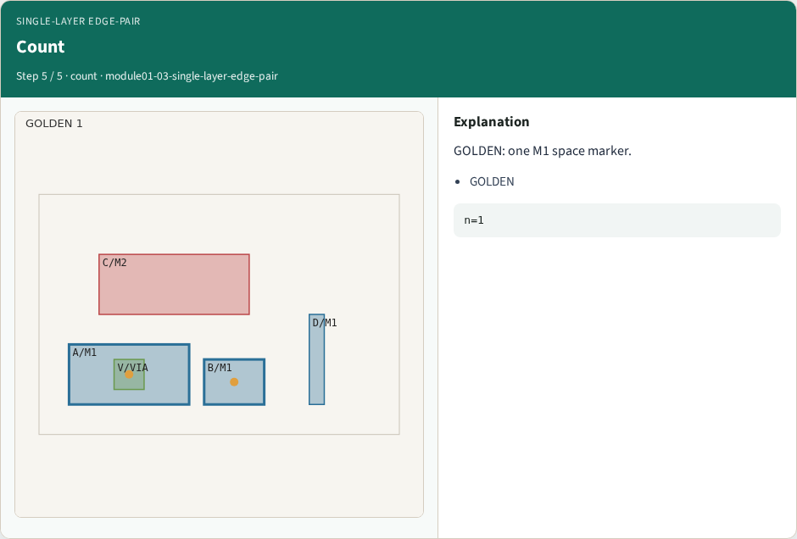
Count
Count
learn_pattern_matching — 03 single layer edge pair
Notes:
GOLDEN: one M1 space marker.

Slide 8
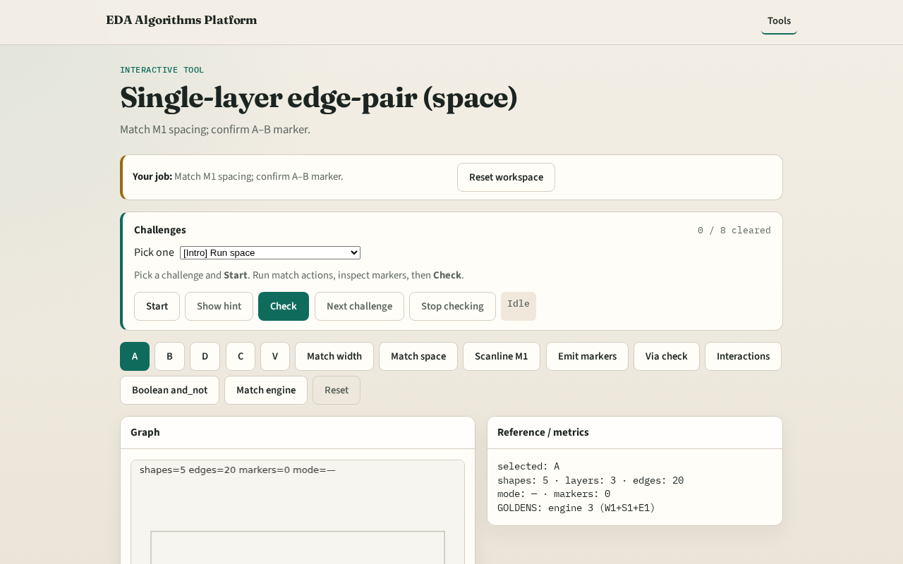
Browser lab track
Browser lab starter
learn_pattern_matching — 03 single layer edge pair
Notes:
Open **single-layer-edge-pair**. Run Match space; confirm one A–B marker.

Slide 9
Implement track
Call match_space(layer='M1'); assert len==1 and shapes {A,B}
learn_pattern_matching — 03 single layer edge pair
Notes:
Call match_space(layer='M1'); assert len==1 and shapes {A,B}.

Slide 10
Pitfalls
Matching without projection overlap
Checking different layers as one pair
learn_pattern_matching — 03 single layer edge pair
Notes:
Matching without projection overlap. Checking different layers as one pair.

Slide 11
Your turn
Next: single-layer region / enclosure
learn_pattern_matching — 03 single layer edge pair
Notes:
Next: single-layer region / enclosure.

