Slide 1
Region width
Width patterns treat a polygon as a region and measure its smallest extent
learn_pattern_matching — 05 single layer region
Notes:
Width patterns treat a polygon as a region and measure its smallest extent.

Slide 2
The idea
D is 1×6 on M1; min_width[M1]=3 → width marker
GOLDEN width_markers=1
learn_pattern_matching — 05 single layer region
Notes:
D is 1×6 on M1; min_width[M1]=3 → width marker. GOLDEN width_markers=1.

Slide 3
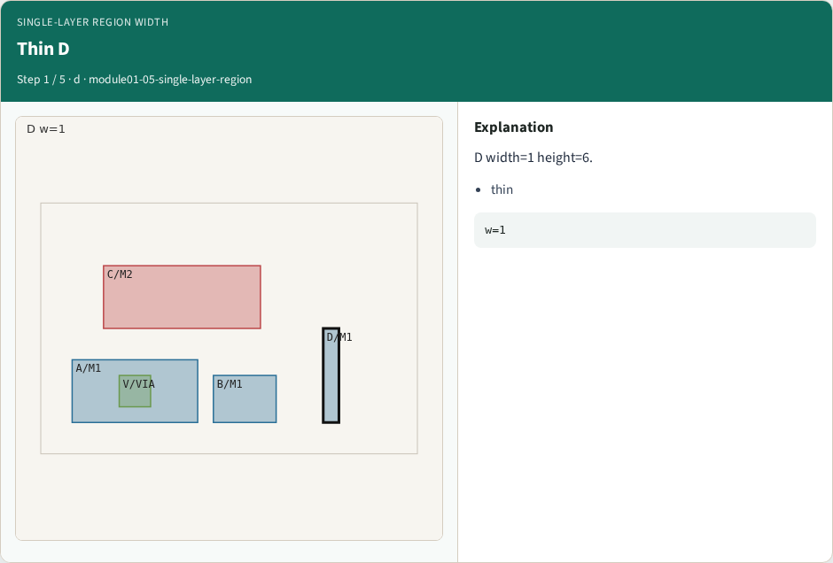
Thin D
Thin D
learn_pattern_matching — 05 single layer region
Notes:
D width=1 height=6.

Slide 4

Min width
Min width
learn_pattern_matching — 05 single layer region
Notes:
min_width[M1]=3.

Slide 5

Measure
Measure
learn_pattern_matching — 05 single layer region
Notes:
thin = min(w,h) = 1.

Slide 6
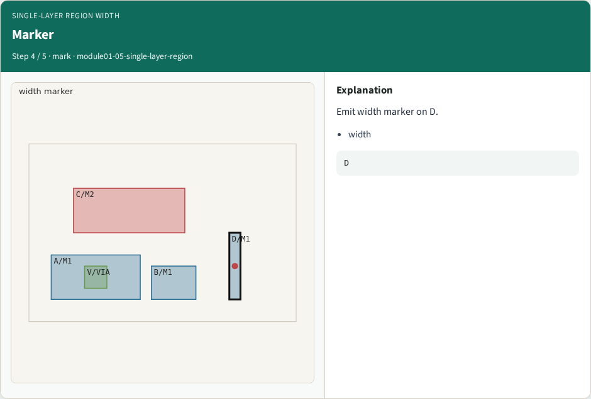
Marker
Marker
learn_pattern_matching — 05 single layer region
Notes:
Emit width marker on D.

Slide 7
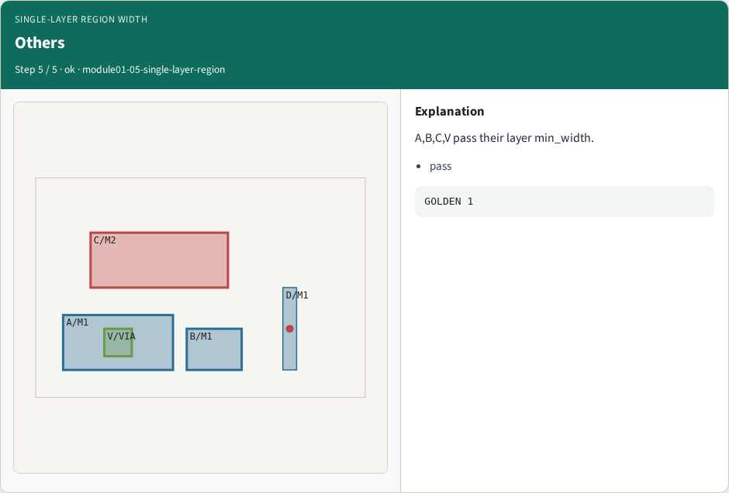
Others
Others
learn_pattern_matching — 05 single layer region
Notes:
A,B,C,V pass their layer min_width.

Slide 8
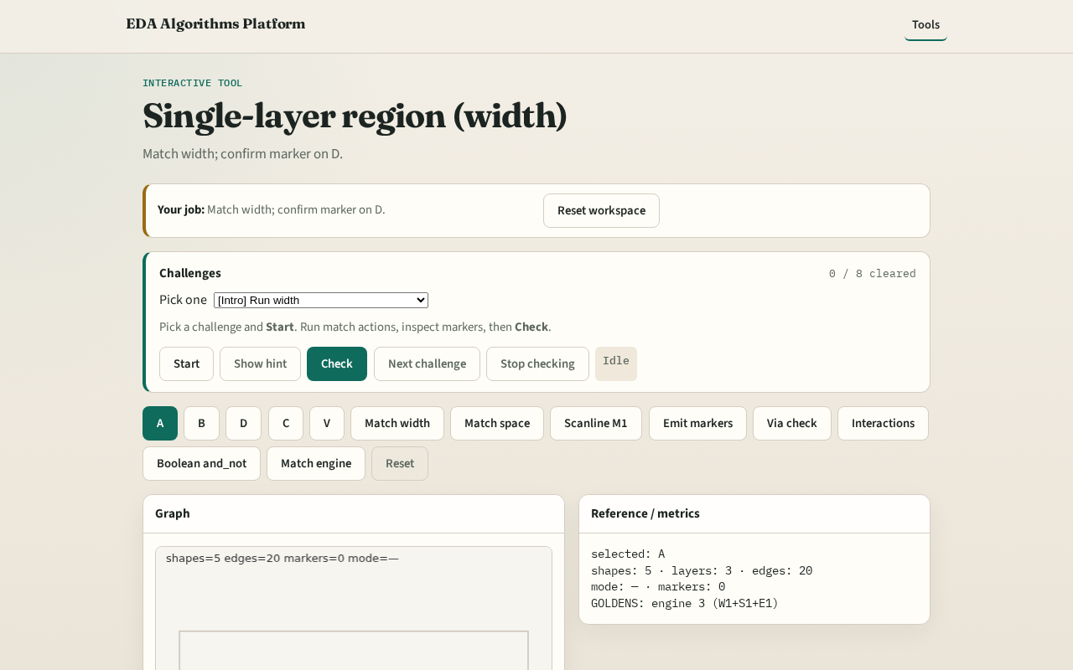
Browser lab track
Browser lab starter
learn_pattern_matching — 05 single layer region
Notes:
Open **single-layer-region**. Run Match width; confirm marker on D.

Slide 9
Implement track
Call match_width(); assert one marker on D
learn_pattern_matching — 05 single layer region
Notes:
Call match_width(); assert one marker on D.

Slide 10
Pitfalls
Using area instead of min(w,h)
Applying M2 limits to M1
learn_pattern_matching — 05 single layer region
Notes:
Using area instead of min(w,h). Applying M2 limits to M1.

Slide 11
Your turn
Next: scanline sweep
learn_pattern_matching — 05 single layer region
Notes:
Next: scanline sweep.

