Slide 1
Scanline
Production matchers often sweep a scanline across edges instead of O(n²) pairs only
learn_pattern_matching — 01 scanline sweep
Notes:
Production matchers often sweep a scanline across edges instead of O(n²) pairs only.

Slide 2
The idea
M1 has 3 shapes → 6 events (enter/leave each)
Events sort by x then enter-before-leave
learn_pattern_matching — 01 scanline sweep
Notes:
M1 has 3 shapes → 6 events (enter/leave each). Events sort by x then enter-before-leave.

Slide 3
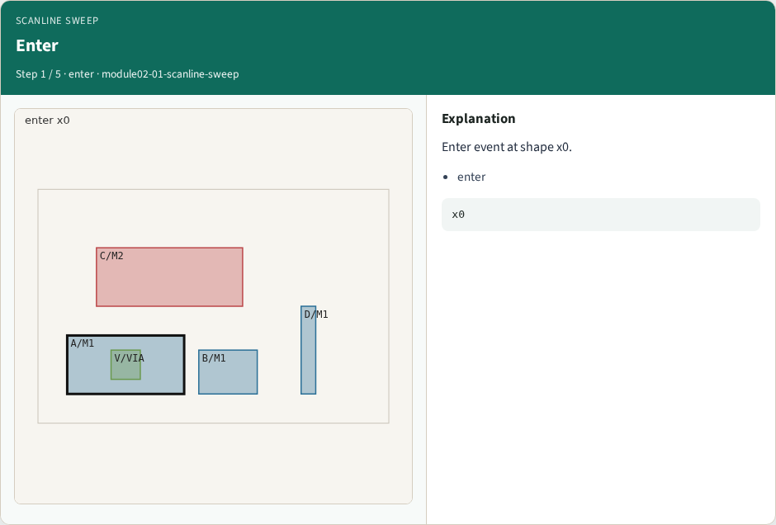
Enter
Enter
learn_pattern_matching — 01 scanline sweep
Notes:
Enter event at shape x0.

Slide 4

Leave
Leave
learn_pattern_matching — 01 scanline sweep
Notes:
Leave event at shape x1.

Slide 5
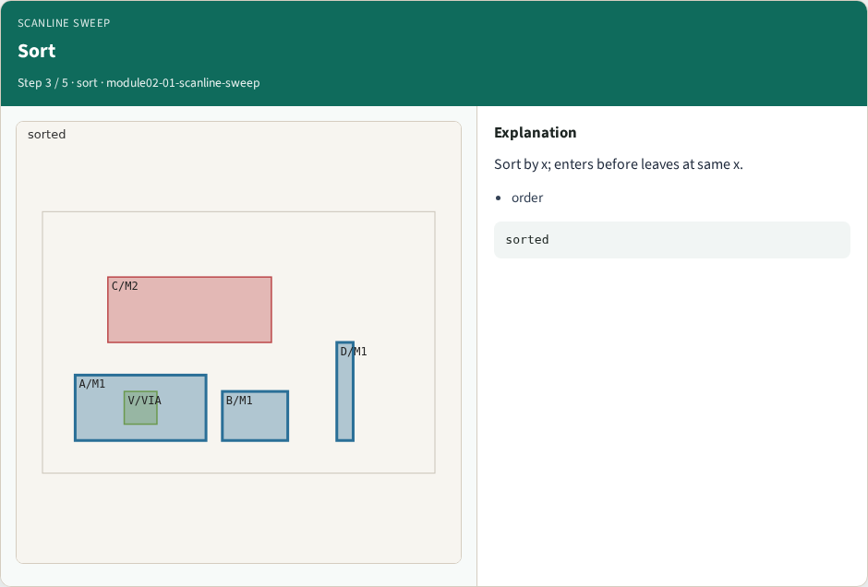
Sort
Sort
learn_pattern_matching — 01 scanline sweep
Notes:
Sort by x; enters before leaves at same x.

Slide 6

M1 count
M1 count
learn_pattern_matching — 01 scanline sweep
Notes:
GOLDEN: 6 events on M1.

Slide 7

Use
Use
learn_pattern_matching — 01 scanline sweep
Notes:
Active set between events drives pair checks.

Slide 8
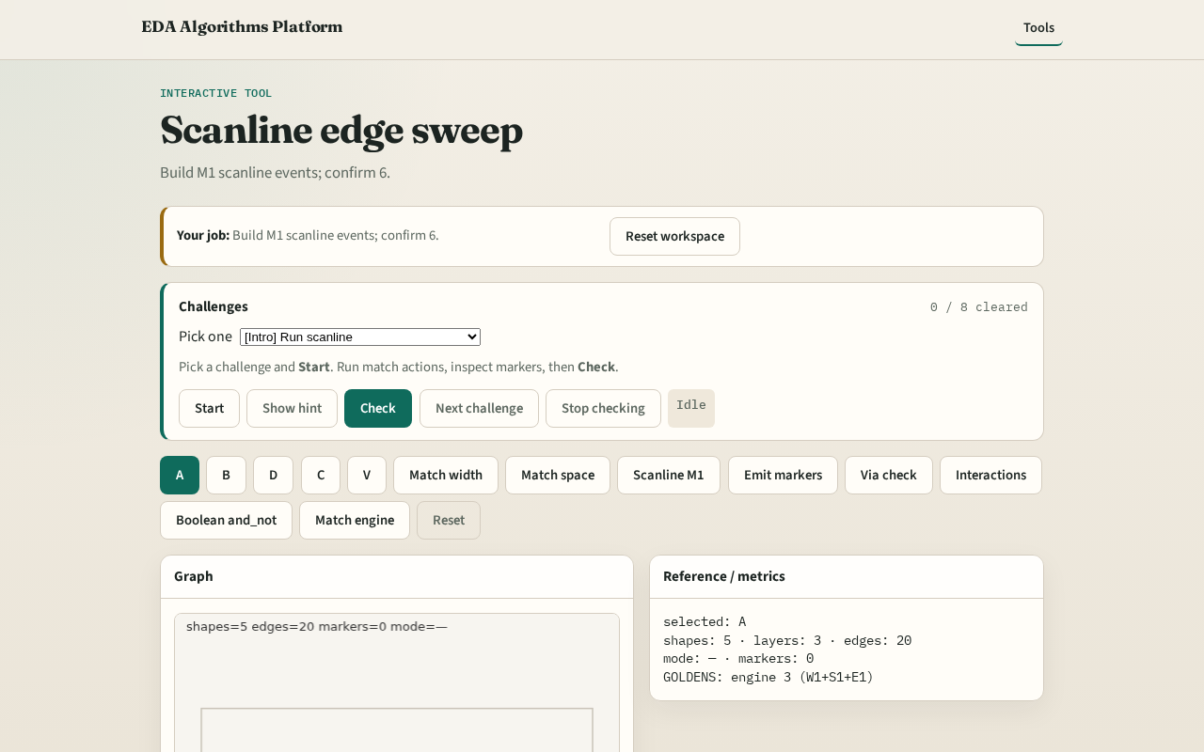
Browser lab track
Browser lab starter
learn_pattern_matching — 01 scanline sweep
Notes:
Open **scanline-sweep**. Run Scanline M1; confirm 6 events.

Slide 9
Implement track
Call scanline_events('M1'); assert len==6
learn_pattern_matching — 01 scanline sweep
Notes:
Call scanline_events('M1'); assert len==6.

Slide 10
Pitfalls
Forgetting leave events
Sorting leaves before enters at same x
learn_pattern_matching — 01 scanline sweep
Notes:
Forgetting leave events. Sorting leaves before enters at same x.

Slide 11
Your turn
Next: marker emission
learn_pattern_matching — 01 scanline sweep
Notes:
Next: marker emission.

