Slide 1
Markers
A marker is a typed hit (width/space/…) pointing at shapes , DRC later maps markers to violations
learn_pattern_matching — 03 marker emit
Notes:
A marker is a typed hit (width/space/…) pointing at shapes — DRC later maps markers to violations.

Slide 2
The idea
Emit_markers combines width and space → at least 2 markers (D + A–B)
learn_pattern_matching — 03 marker emit
Notes:
emit_markers combines width and space → at least 2 markers (D + A–B).

Slide 3
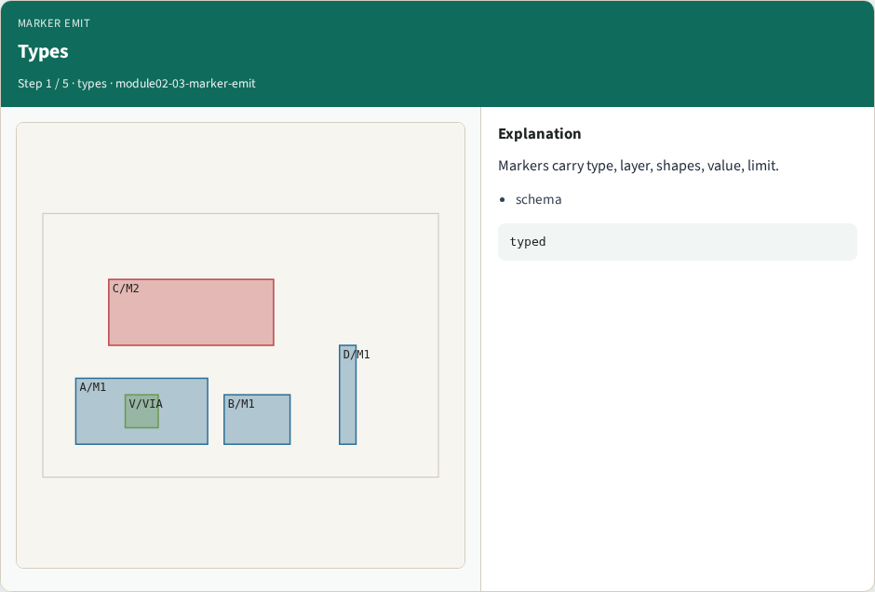
Types
Types
learn_pattern_matching — 03 marker emit
Notes:
Markers carry type, layer, shapes, value, limit.

Slide 4
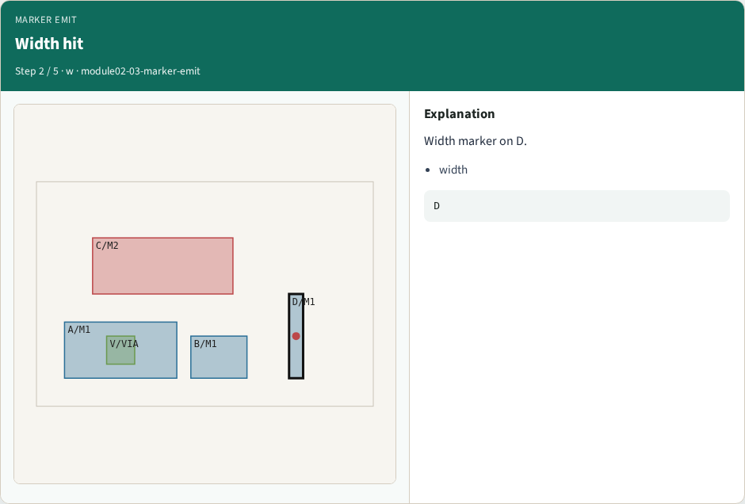
Width hit
Width hit
learn_pattern_matching — 03 marker emit
Notes:
Width marker on D.

Slide 5
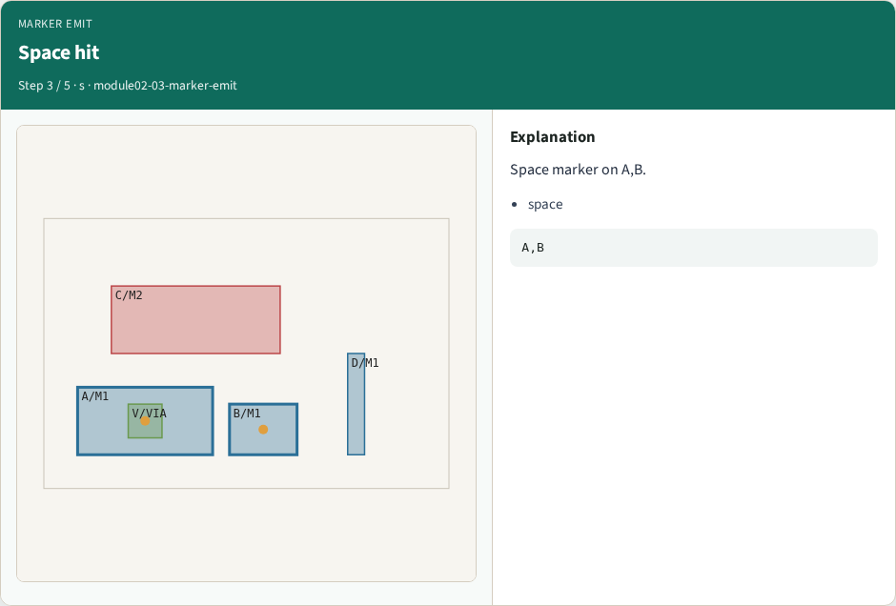
Space hit
Space hit
learn_pattern_matching — 03 marker emit
Notes:
Space marker on A,B.

Slide 6
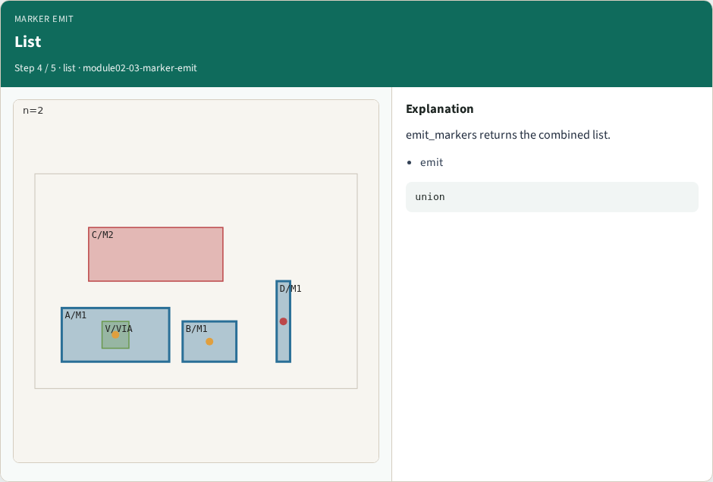
List
List
learn_pattern_matching — 03 marker emit
Notes:
emit_markers returns the combined list.

Slide 7

Count
Count
learn_pattern_matching — 03 marker emit
Notes:
At least 2 single-layer markers.

Slide 8
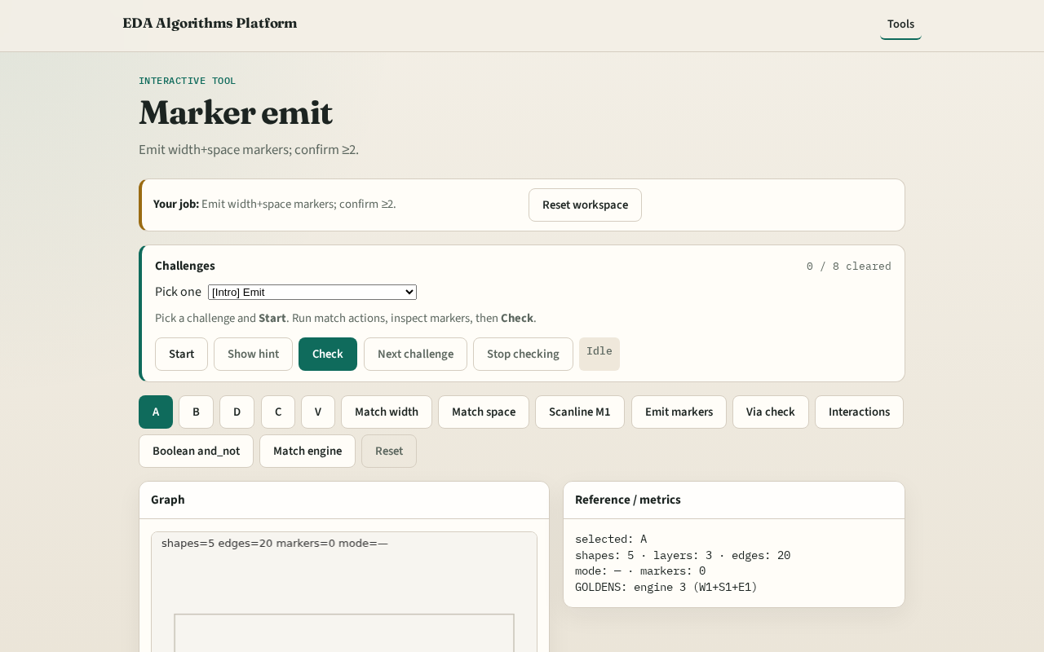
Browser lab track
Browser lab starter
learn_pattern_matching — 03 marker emit
Notes:
Open **marker-emit**. Run Emit markers; confirm ≥2 markers.

Slide 9
Implement track
Call emit_markers(); assert len >= 2
learn_pattern_matching — 03 marker emit
Notes:
Call emit_markers(); assert len >= 2.

Slide 10
Pitfalls
Dropping value/limit fields
Mixing multi-layer into emit early
learn_pattern_matching — 03 marker emit
Notes:
Dropping value/limit fields. Mixing multi-layer into emit early.

Slide 11
Your turn
Next: multi-layer via enclosure
learn_pattern_matching — 03 marker emit
Notes:
Next: multi-layer via enclosure.

