Slide 1
Via enclose
Enclosure is a region pattern across layers: inner VIA must sit inside outer metal with margin
learn_pattern_matching — 01 multi layer via
Notes:
Enclosure is a region pattern across layers: inner VIA must sit inside outer metal with margin.

Slide 2
The idea
V inside A on M1 with margins ≥1 → OK
V not inside C on M2 → enclosure marker
GOLDEN enclosure_markers=1
learn_pattern_matching — 01 multi layer via
Notes:
V inside A on M1 with margins ≥1 → OK. V not inside C on M2 → enclosure marker. GOLDEN enclosure_markers=1.

Slide 3
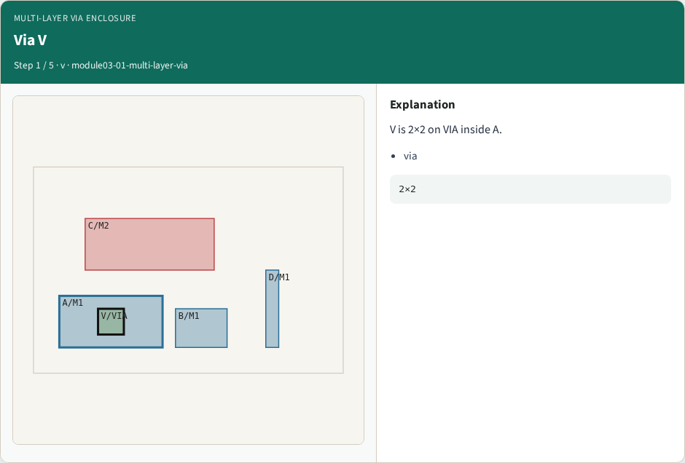
Via V
Via V
learn_pattern_matching — 01 multi layer via
Notes:
V is 2×2 on VIA inside A.

Slide 4
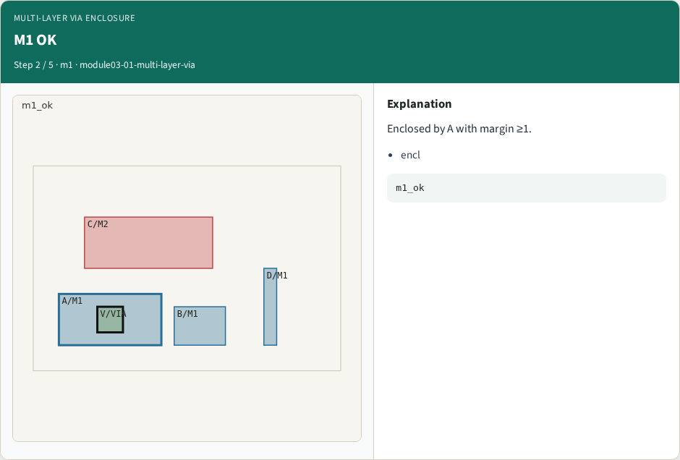
M1 OK
M1 OK
learn_pattern_matching — 01 multi layer via
Notes:
Enclosed by A with margin ≥1.

Slide 5
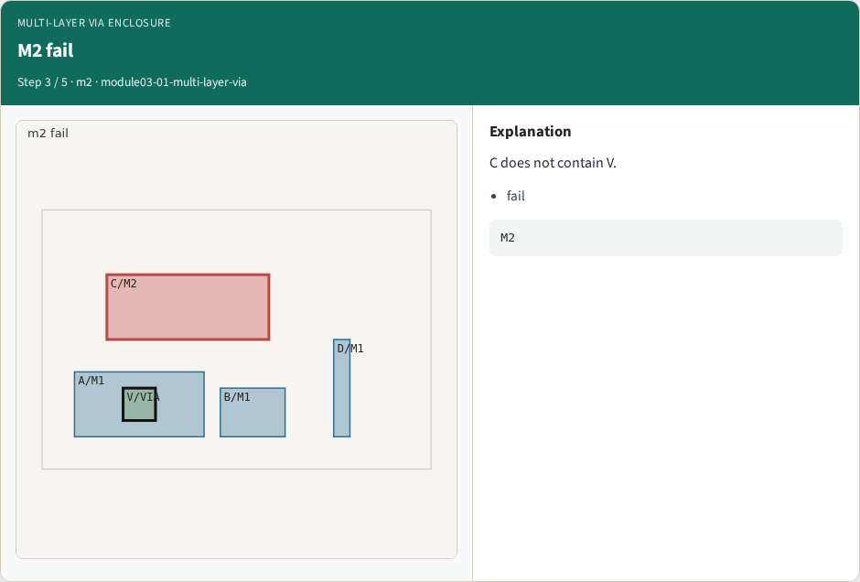
M2 fail
M2 fail
learn_pattern_matching — 01 multi layer via
Notes:
C does not contain V.

Slide 6
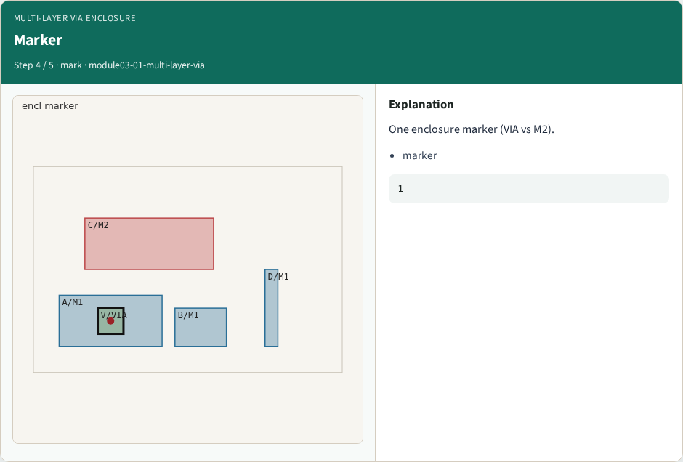
Marker
Marker
learn_pattern_matching — 01 multi layer via
Notes:
One enclosure marker (VIA vs M2).

Slide 7

API
API
learn_pattern_matching — 01 multi layer via
Notes:
multi_layer_via_check reports m1_ok / m2_ok.

Slide 8
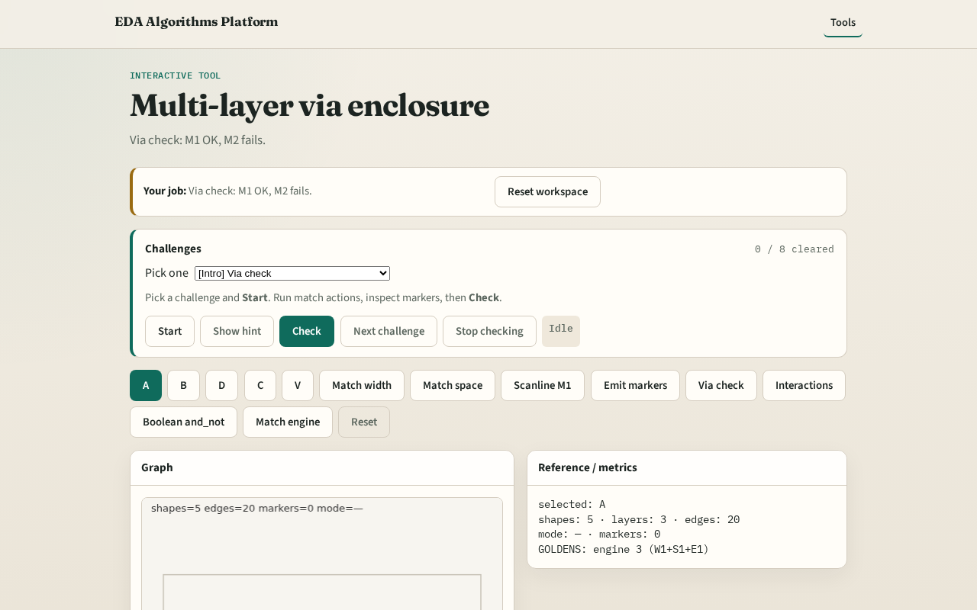
Browser lab track
Browser lab starter
learn_pattern_matching — 01 multi layer via
Notes:
Open **multi-layer-via**. Run Via check; confirm m1_ok and one M2 marker.

Slide 9
Implement track
Call multi_layer_via_check(); assert m1_ok and enclosure_markers==1
learn_pattern_matching — 01 multi layer via
Notes:
Call multi_layer_via_check(); assert m1_ok and enclosure_markers==1.

Slide 10
Pitfalls
Requiring same-layer enclosure
Ignoring margin limit
learn_pattern_matching — 01 multi layer via
Notes:
Requiring same-layer enclosure. Ignoring margin limit.

Slide 11
Your turn
Next: multi-layer interactions
learn_pattern_matching — 01 multi layer via
Notes:
Next: multi-layer interactions.

