Slide 1
Interactions
Interaction patterns find shapes on different layers whose regions overlap , candidates for via/contact checks
learn_pattern_matching — 03 multi layer interaction
Notes:
Interaction patterns find shapes on different layers whose regions overlap — candidates for via/contact checks.

Slide 2
The idea
V overlaps A (VIA∩M1)
GOLDEN: at least the (A,V) pair
learn_pattern_matching — 03 multi layer interaction
Notes:
V overlaps A (VIA∩M1). GOLDEN: at least the (A,V) pair.

Slide 3
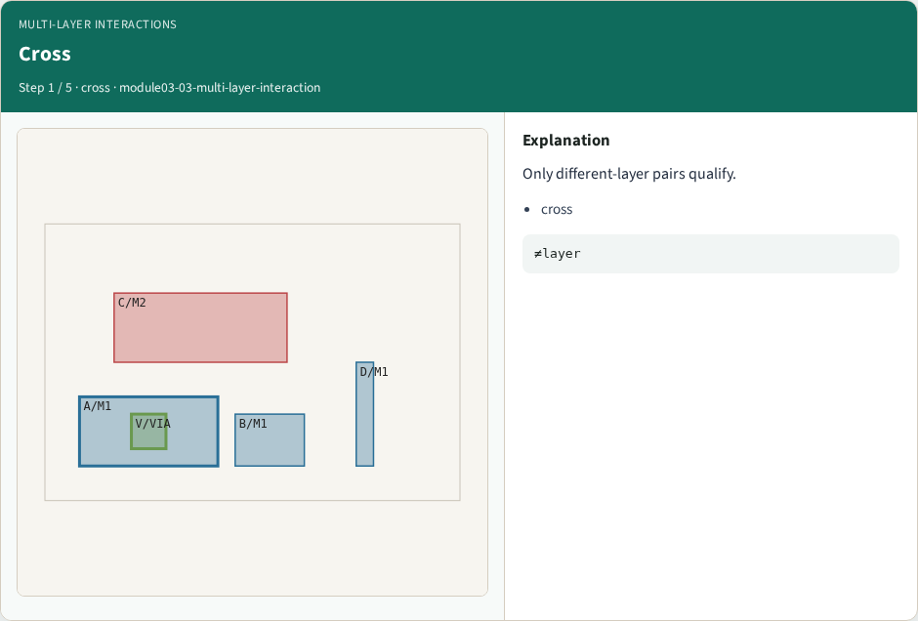
Cross
Cross
learn_pattern_matching — 03 multi layer interaction
Notes:
Only different-layer pairs qualify.

Slide 4
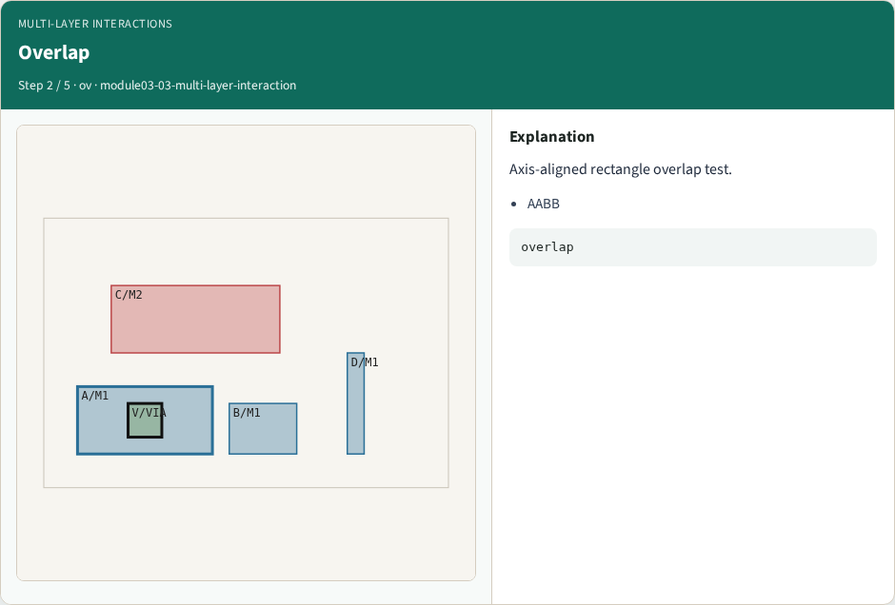
Overlap
Overlap
learn_pattern_matching — 03 multi layer interaction
Notes:
Axis-aligned rectangle overlap test.

Slide 5
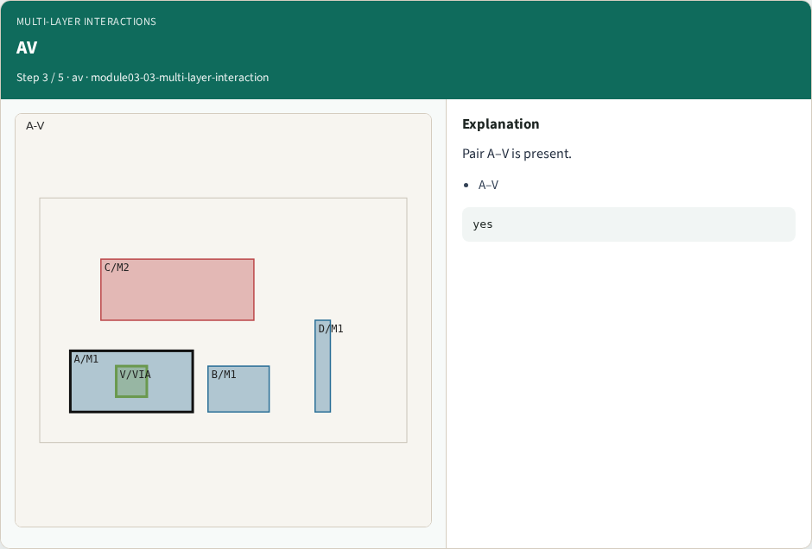
AV
AV
learn_pattern_matching — 03 multi layer interaction
Notes:
Pair A–V is present.

Slide 6
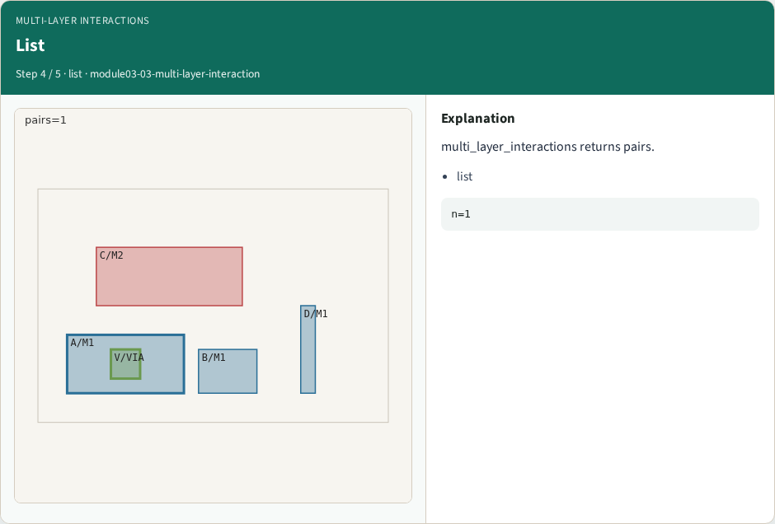
List
List
learn_pattern_matching — 03 multi layer interaction
Notes:
multi_layer_interactions returns pairs.

Slide 7

Use
Use
learn_pattern_matching — 03 multi layer interaction
Notes:
Interactions feed enclosure and boolean patterns.

Slide 8
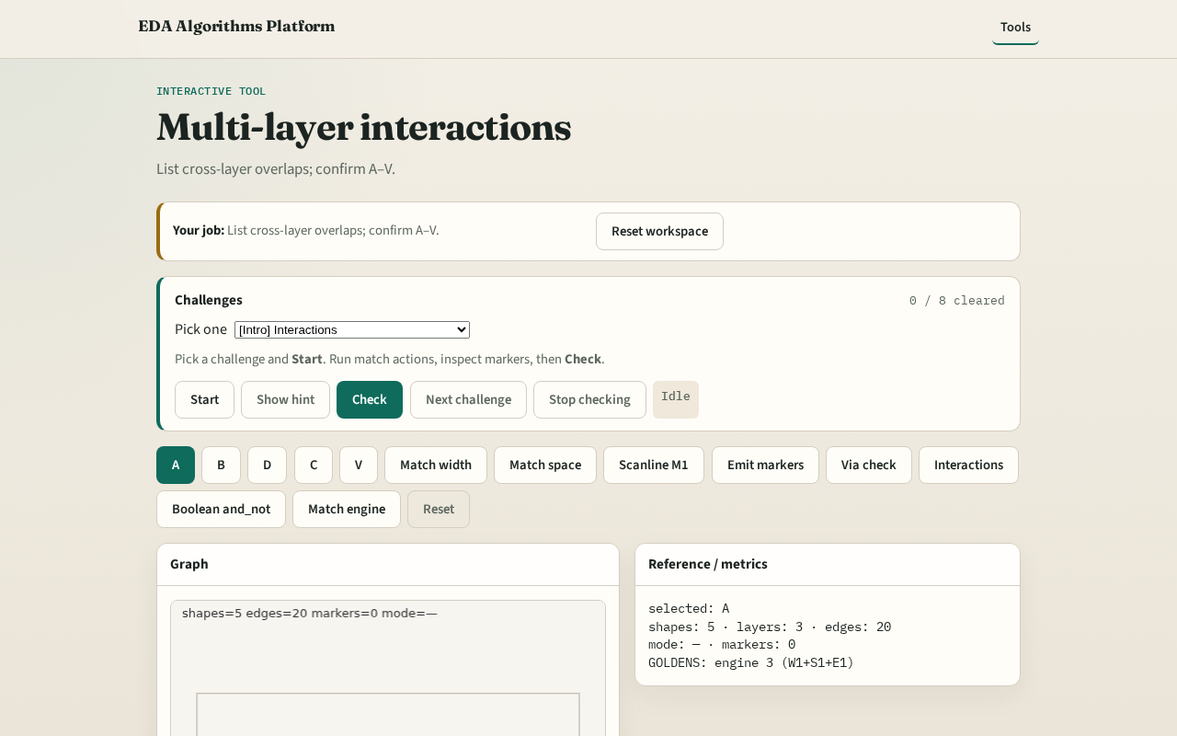
Browser lab track
Browser lab starter
learn_pattern_matching — 03 multi layer interaction
Notes:
Open **multi-layer-interaction**. Run Interactions; confirm A–V pair.

Slide 9
Implement track
Call multi_layer_interactions(); assert ('A','V') in pairs
learn_pattern_matching — 03 multi layer interaction
Notes:
Call multi_layer_interactions(); assert ('A','V') in pairs.

Slide 10
Pitfalls
Including same-layer overlaps
Using center distance only
learn_pattern_matching — 03 multi layer interaction
Notes:
Including same-layer overlaps. Using center distance only.

Slide 11
Your turn
Next: layered boolean
learn_pattern_matching — 03 multi layer interaction
Notes:
Next: layered boolean.

