Slide 1
Boolean
Boolean patterns combine coverage predicates across layers (AND / OR / AND-NOT)
learn_pattern_matching — 05 layered boolean
Notes:
Boolean patterns combine coverage predicates across layers (AND / OR / AND-NOT).

Slide 2
The idea
V covered by M1 and not by M2 → and_not hit
GOLDEN boolean_and_hits=1
learn_pattern_matching — 05 layered boolean
Notes:
V covered by M1 and not by M2 → and_not hit. GOLDEN boolean_and_hits=1.

Slide 3
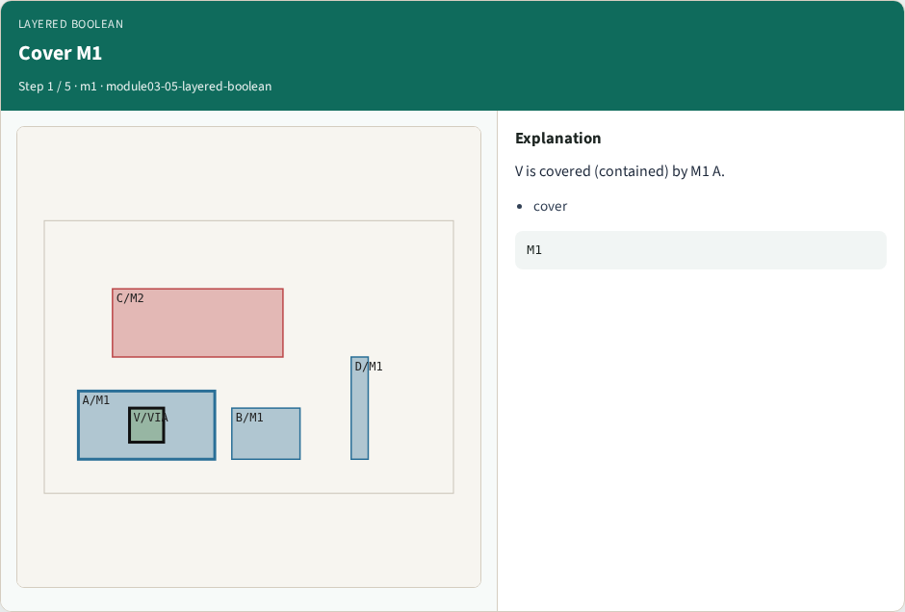
Cover M1
Cover M1
learn_pattern_matching — 05 layered boolean
Notes:
V is covered (contained) by M1 A.

Slide 4
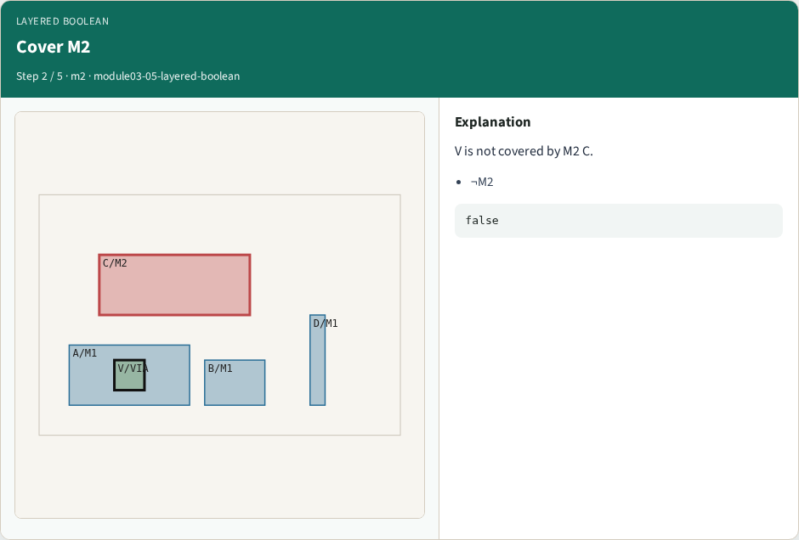
Cover M2
Cover M2
learn_pattern_matching — 05 layered boolean
Notes:
V is not covered by M2 C.

Slide 5
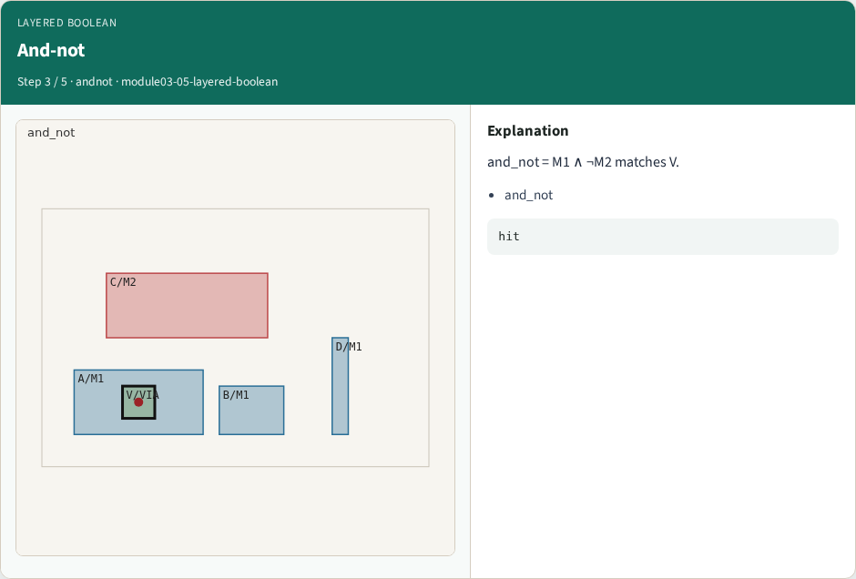
And-not
And-not
learn_pattern_matching — 05 layered boolean
Notes:
and_not = M1 ∧ ¬M2 matches V.

Slide 6

And
And
learn_pattern_matching — 05 layered boolean
Notes:
and = M1 ∧ M2 matches none on the toy.

Slide 7
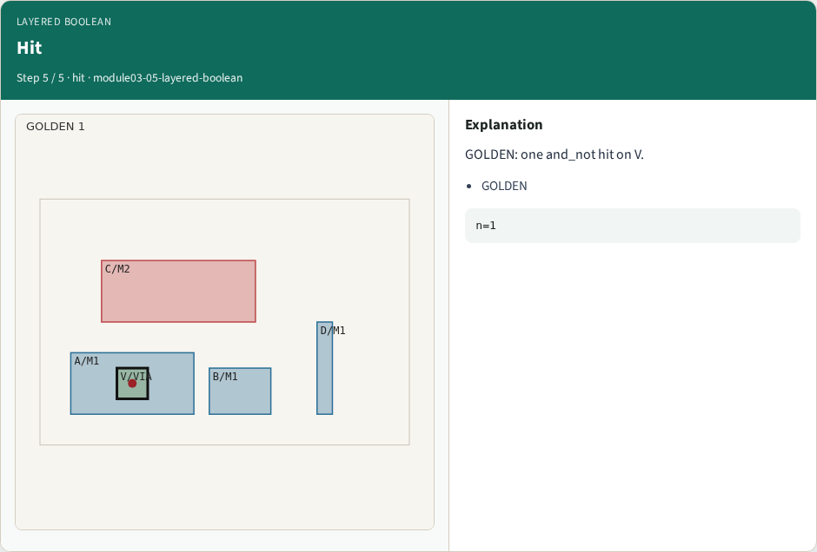
Hit
Hit
learn_pattern_matching — 05 layered boolean
Notes:
GOLDEN: one and_not hit on V.

Slide 8
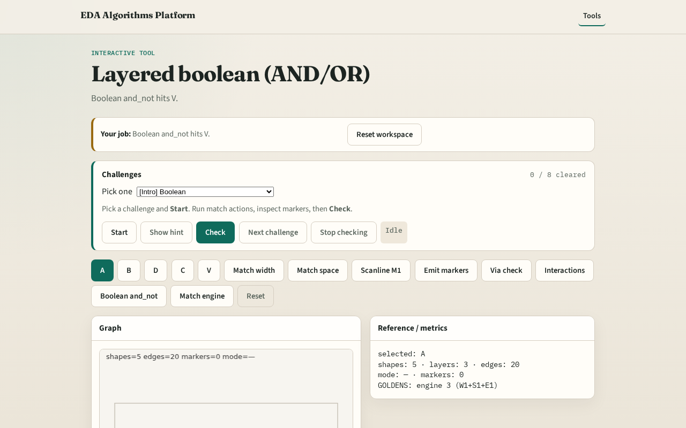
Browser lab track
Browser lab starter
learn_pattern_matching — 05 layered boolean
Notes:
Open **layered-boolean**. Run Boolean and_not; confirm hit on V.

Slide 9
Implement track
Call layered_boolean('and_not'); assert one hit on V
learn_pattern_matching — 05 layered boolean
Notes:
Call layered_boolean('and_not'); assert one hit on V.

Slide 10
Pitfalls
Confusing overlap with containment
Swapping AND and AND-NOT
learn_pattern_matching — 05 layered boolean
Notes:
Confusing overlap with containment. Swapping AND and AND-NOT.

Slide 11
Your turn
Next: full match engine pass
learn_pattern_matching — 05 layered boolean
Notes:
Next: full match engine pass.

