Slide 1
Engine
A tiny match engine chains single-layer and multi-layer patterns into one marker list
learn_pattern_matching — 01 match engine
Notes:
A tiny match engine chains single-layer and multi-layer patterns into one marker list.

Slide 2
The idea
GOLDEN match_engine_markers=3 (width 1 + space 1 + enclosure 1)
learn_pattern_matching — 01 match engine
Notes:
GOLDEN match_engine_markers=3 (width 1 + space 1 + enclosure 1).

Slide 3
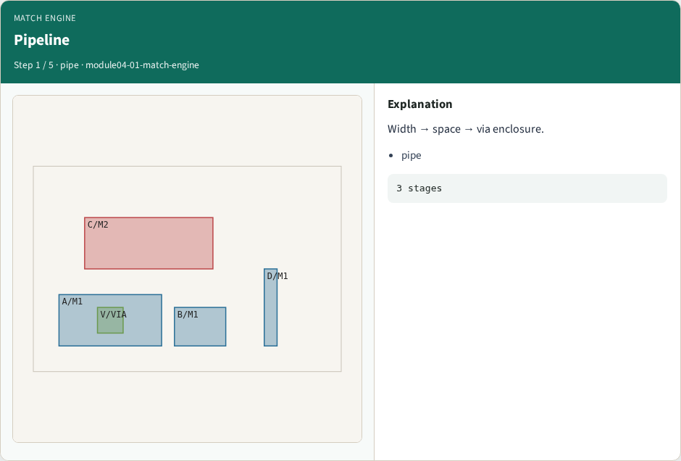
Pipeline
Pipeline
learn_pattern_matching — 01 match engine
Notes:
Width → space → via enclosure.

Slide 4
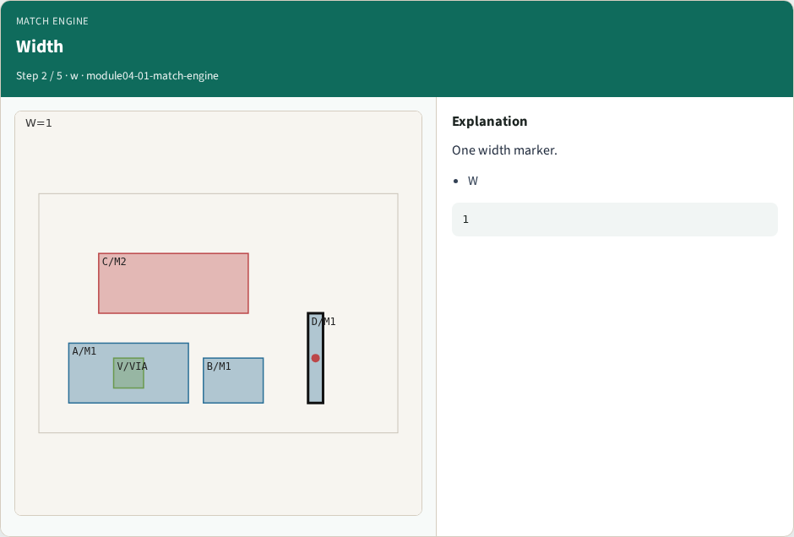
Width
Width
learn_pattern_matching — 01 match engine
Notes:
One width marker.

Slide 5
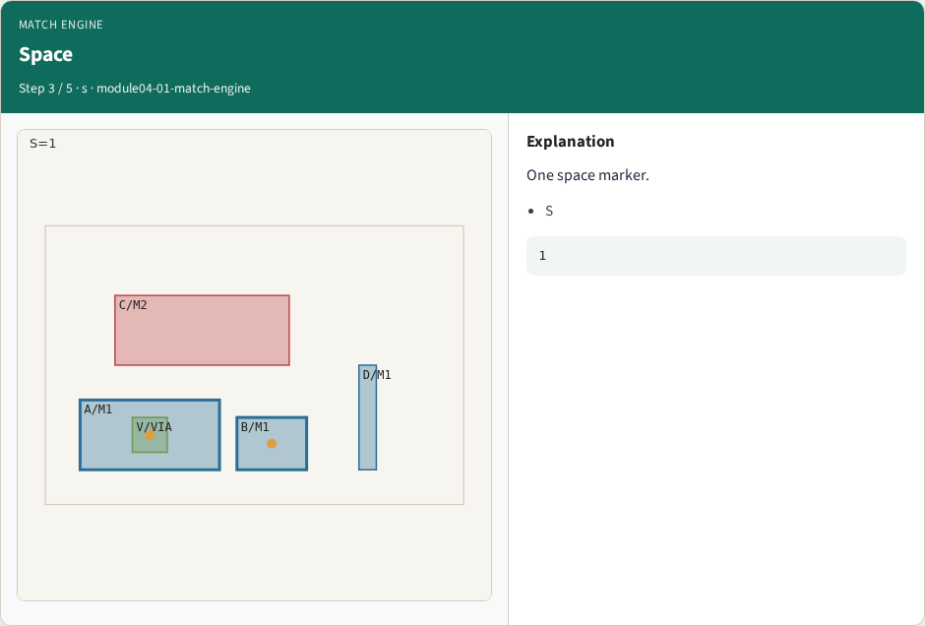
Space
Space
learn_pattern_matching — 01 match engine
Notes:
One space marker.

Slide 6

Encl
Encl
learn_pattern_matching — 01 match engine
Notes:
One enclosure marker.

Slide 7

Total
Total
learn_pattern_matching — 01 match engine
Notes:
count=3 on tiny_patterns.

Slide 8
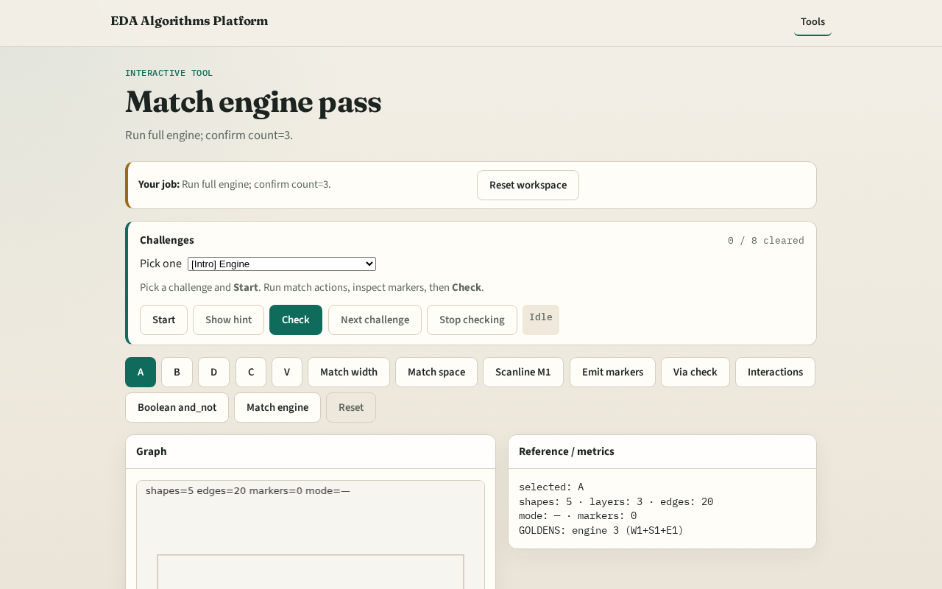
Browser lab track
Browser lab starter
learn_pattern_matching — 01 match engine
Notes:
Open **match-engine**. Run Match engine; confirm count=3.

Slide 9
Implement track
Call match_engine(); assert count==3
learn_pattern_matching — 01 match engine
Notes:
Call match_engine(); assert count==3.

Slide 10
Pitfalls
Stopping after width only
Double-counting boolean as DRC markers
learn_pattern_matching — 01 match engine
Notes:
Stopping after width only. Double-counting boolean as DRC markers.

Slide 11
Your turn
Next: offline compare, then wrap
learn_pattern_matching — 01 match engine
Notes:
Next: offline compare, then wrap.

