Slide 1
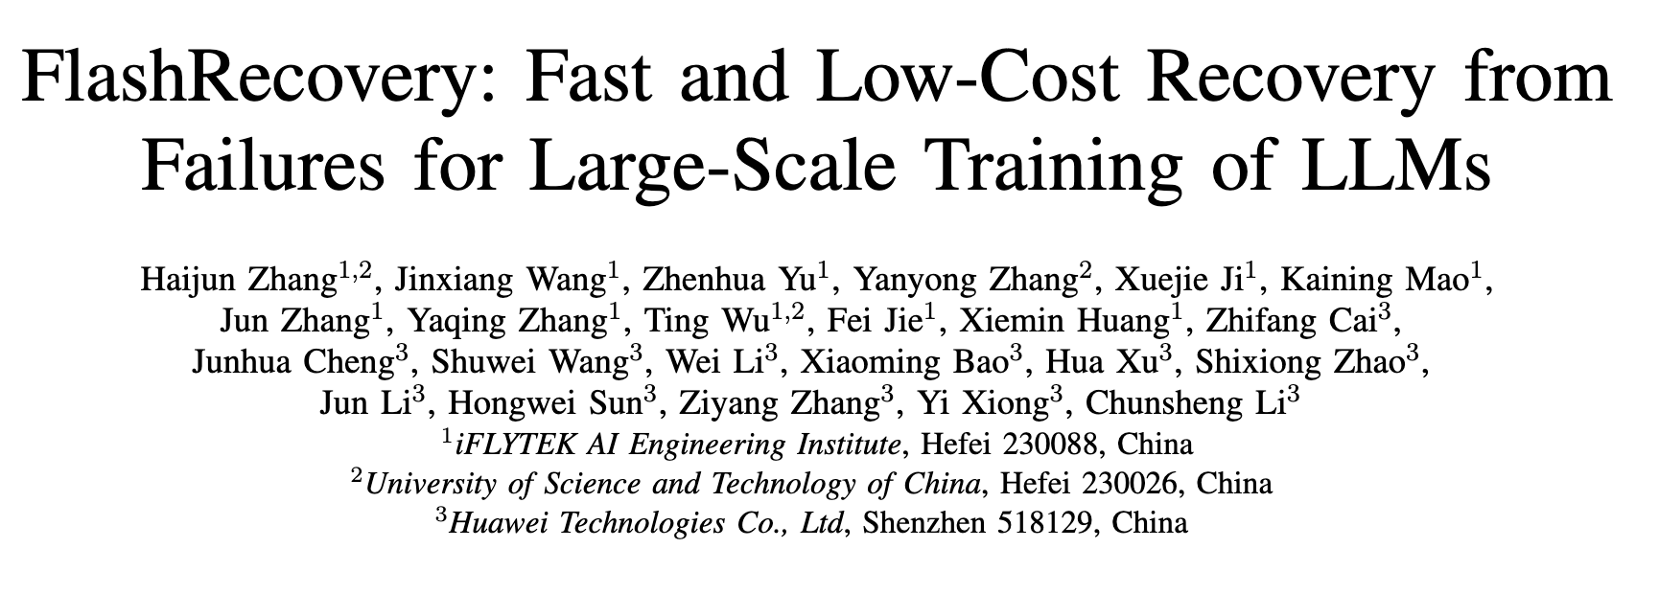
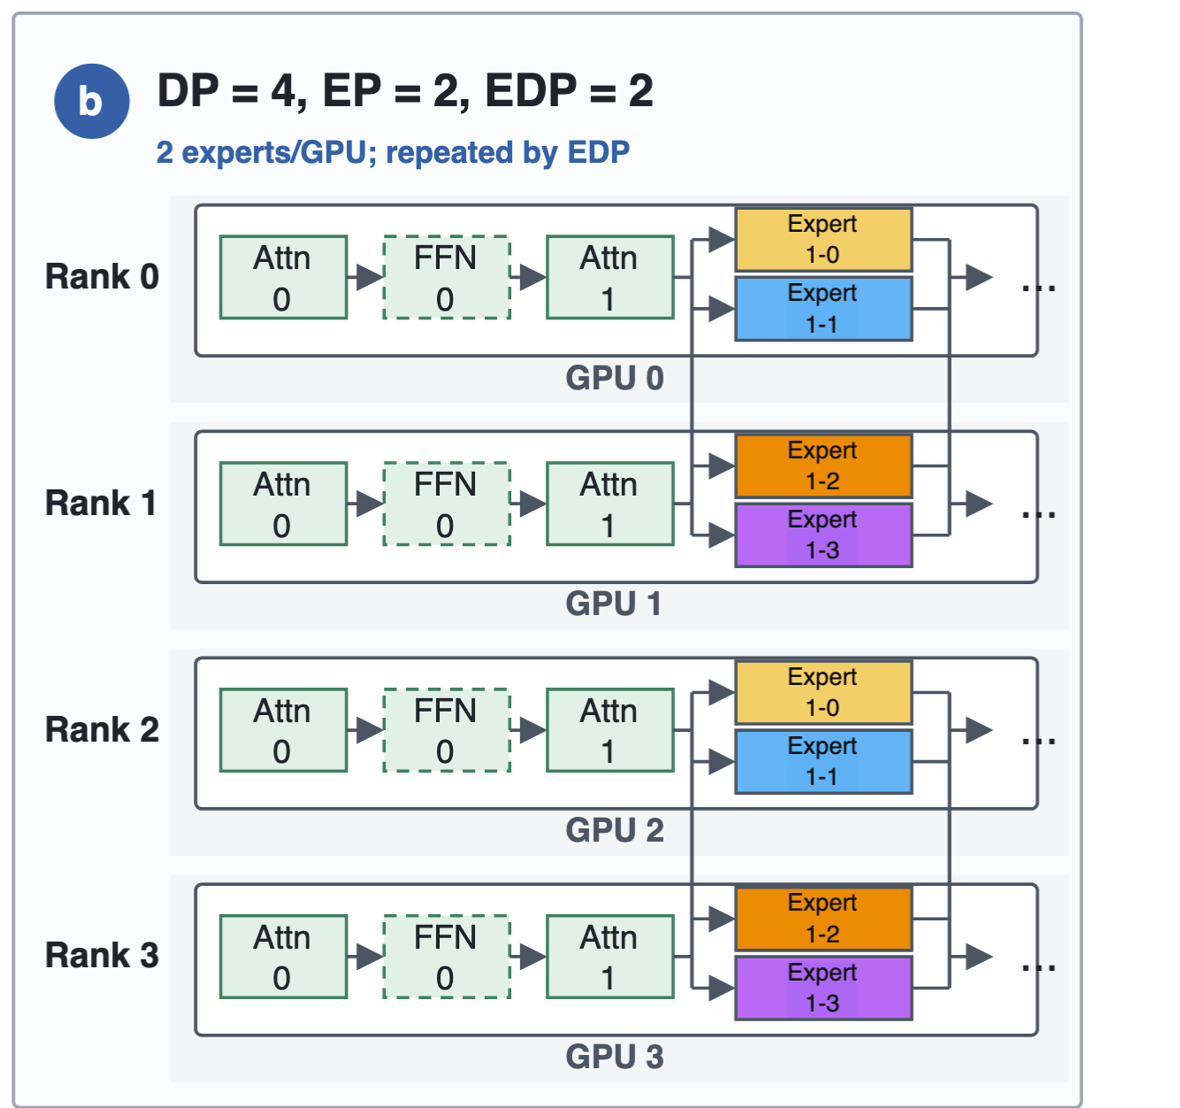
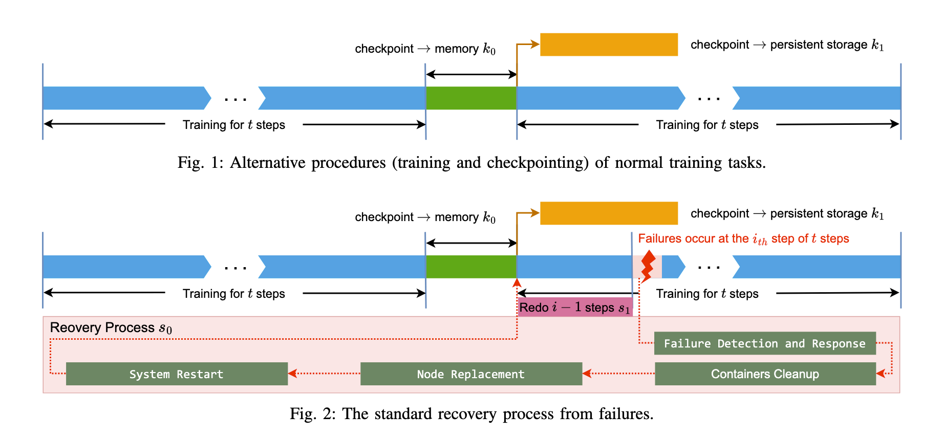
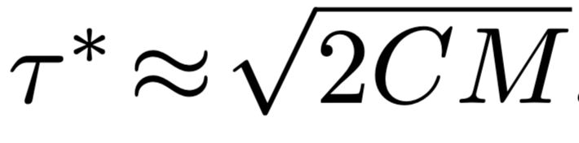
Notes:
[Sources] - https://arxiv.org/abs/2509.03047

Slide 2
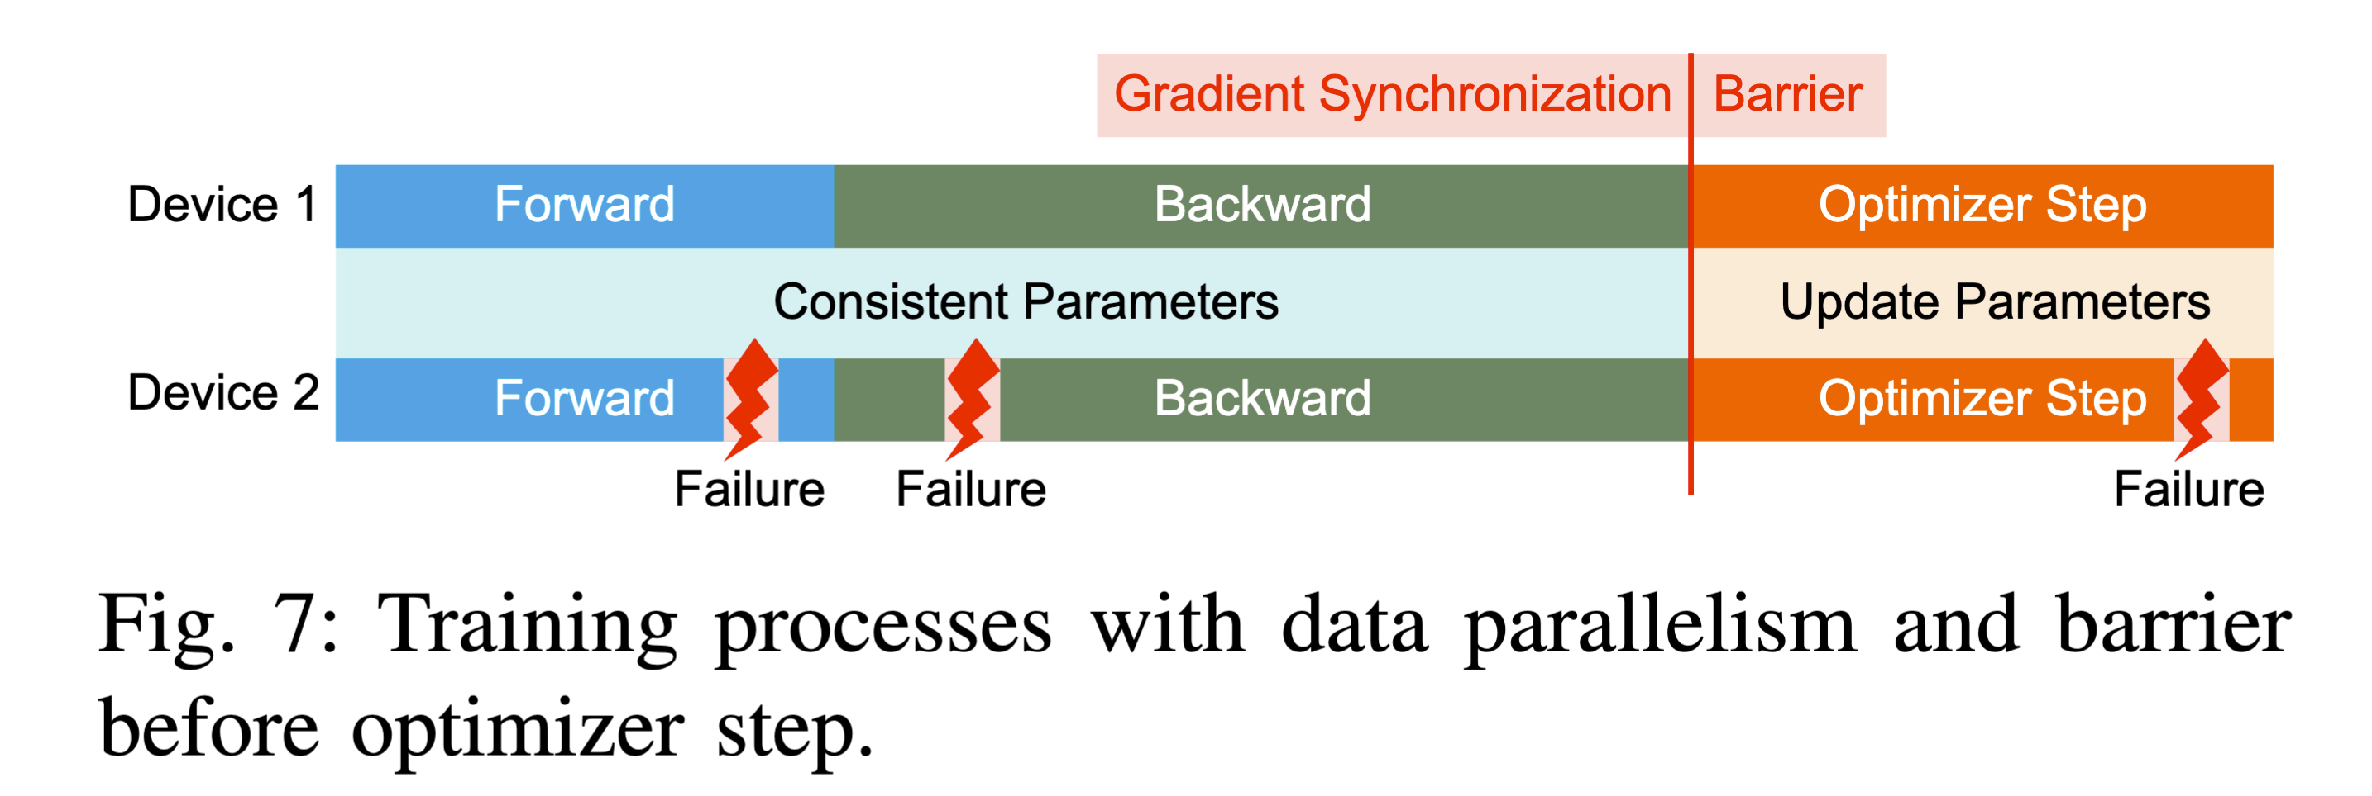
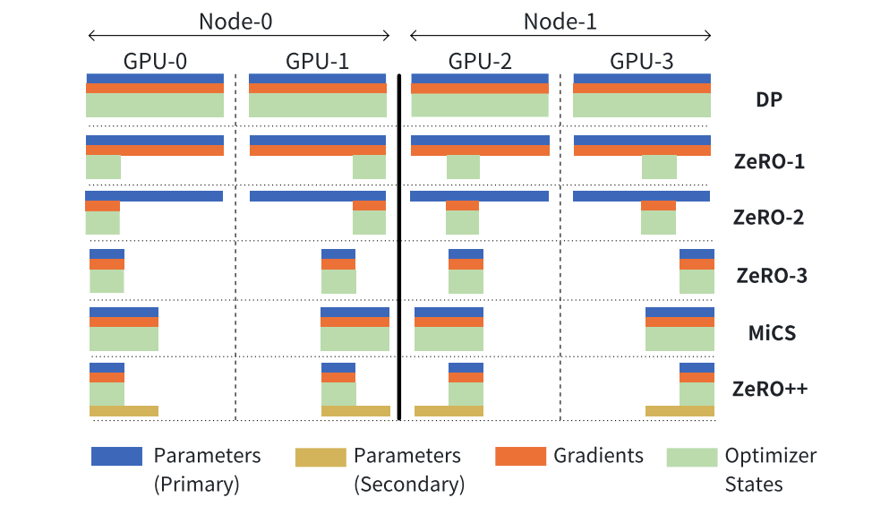
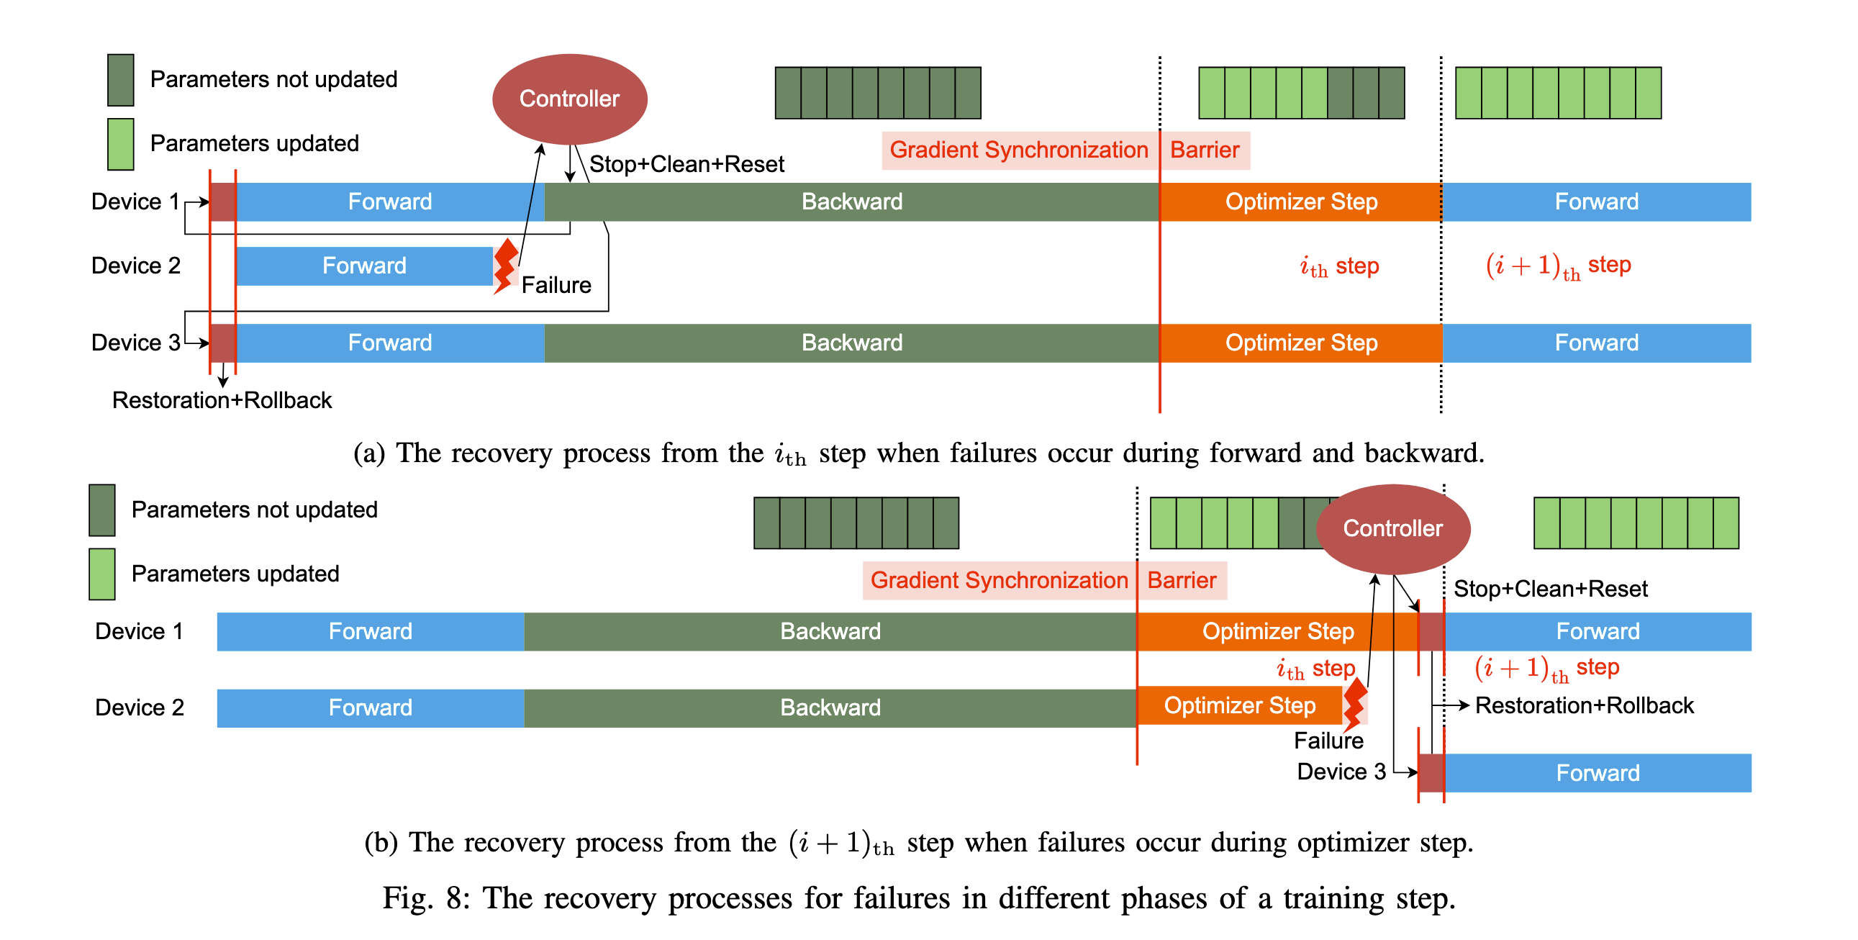
Notes:
[Sources] - https://arxiv.org/abs/2509.03047

Slide 3
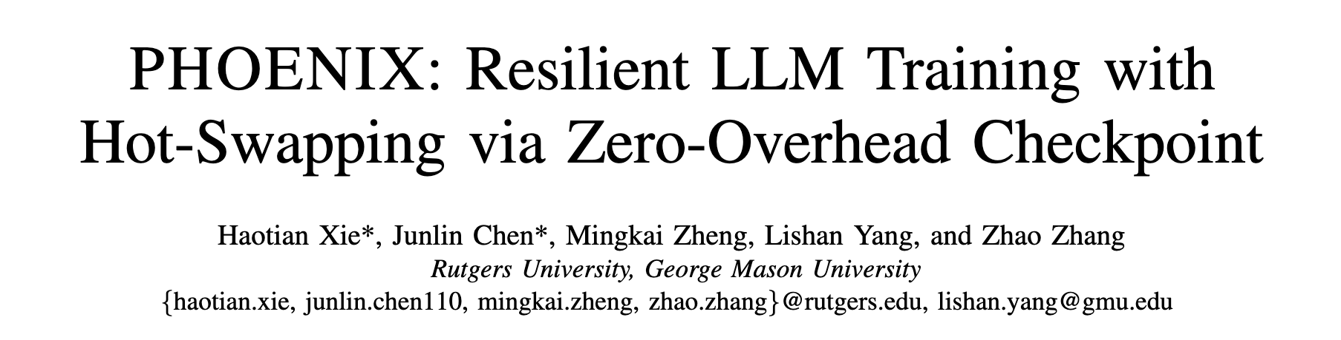
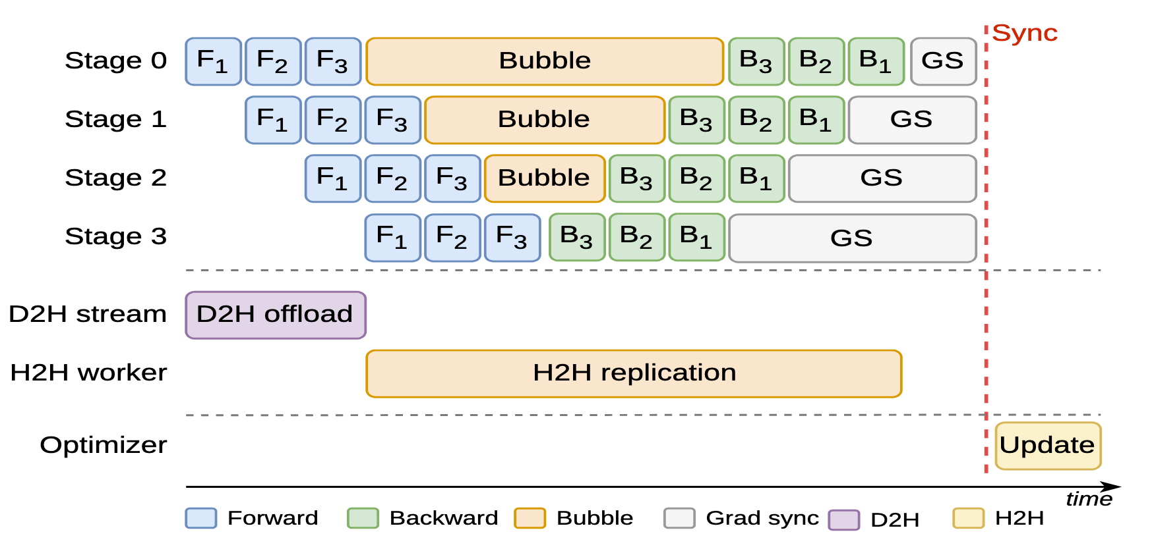
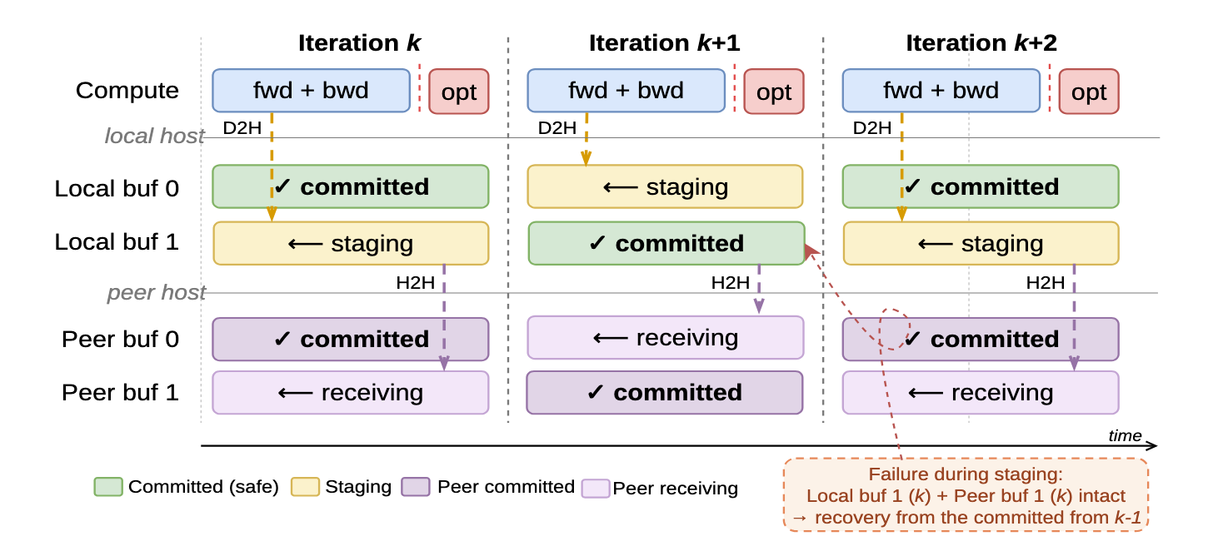
暂时故障
永久故障
D2H：GPU 显存 → 本机 pinned host memory cudaMemcpyAsync、PyTorch copy_(non_blocking=True)
当前 rank 的完整状态：optimizer shard、local model-parameter shard，以及 step、并行配置、RNG state 等元数据
H2H：本机 host memory → 另一个节点的 host memory chunked MPI
只发送 optimizer-state shard 和元数据，不发送模型参数
Notes:
[Sources] - https://arxiv.org/abs/2607.01646

Slide 4
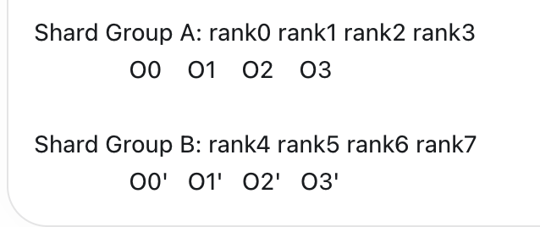
梯度打包
Hybrid Shard
_HYBRID_SHARD_ZERO2
relaunch

Slide 5
MoEGambit 热替换：逻辑 rank 不变，物理 worker 原位替换
04
框架 hook 只报告阶段；公共 runtime 负责恢复事务；launcher / watcher 负责跨进程编排
控制面
1 Hook / heartbeat
上报 iteration、phase、rank state
2 Launcher
捕获 worker exit；发 worker_failure
3 Watcher
冻结 recovery_epoch；选择 safe point
4 Rebuild descriptor
固化 logical rank、状态来源、版本
健康 ranks
到达 committed safe point
冻结 optimizer replica
通信代际切换
retire old WORLD
new TCPStore + selective groups
replacement worker
继承原 logical RANK
恢复后加入同一拓扑
训练面
D2H 本机完整快照
model + optimizer + metadata
H2H 远端副本
optimizer-only，独立 TCP
checkpoint shard
expert model / optimizer
恢复提交
首个完整 iteration 后 commit
状态面
核心不变量：任何 rank 恢复训练前，必须同时证明 topology generation、state version、group ordinal 与 descriptor 一致。
MoEGambit | end-to-end hot swap
Notes:
[Sources]
- /Users/zds/bsr-opensource/src/moegambit/runtime/runtime.py
- /Users/zds/bsr-opensource/src/moegambit/adapters/megatron/native_hooks.py
- /Users/zds/bsr-opensource/src/moegambit/adapters/deepspeed/integration.py

Slide 6
Launcher：把 OS 进程故障转换为 rank 级控制事件
05
Launcher 只管理本节点 worker 生命周期；全局恢复决策交给 watcher，避免节点各自推断
关键代码：worker_failure 包含物理位置与最后 rank state
Launcher 与 watcher 的双向协议
payload = {
"type": "worker_failure",
"node_rank": self.node_rank,
"local_rank": local_rank,
"global_rank": self.node_rank * self.nproc + local_rank,
"exit_code": int(returncode),
"rank_state": self.rank_states.get(global_rank, {}),
"control_owner": "launcher",
}
self._send_watcher(payload)
heartbeat →
step / phase / rank_states / workers
worker_failure →
failed node / local rank / exit code
← pause
写入 node-local pause_signal
← rebuild
descriptor + recovery_epoch + new rendezvous
设计边界
控制所有 node-local workers，但不调用训练 collective；pause / rebuild 通过 watcher TCP 与本地原子文件传递。
替换进程启动时继承原 global RANK，仅物理 PID / host endpoint 改变。
MoEGambit | launcher control protocol
Notes:
[Sources]
- /Users/zds/bsr-opensource/src/moegambit/adapters/megatron/compat_launcher.py:404
- /Users/zds/bsr-opensource/src/moegambit/adapters/megatron/compat_launcher.py:435

Slide 7
Watcher：冻结 recovery epoch，证明健康 ranks 位于同一安全版本
06
恢复不是“发现 spare 就重启”，而是先建立 quiescence proof，再决定热替换或 checkpoint fallback
self.recovery_epoch += 1
self.recovery_in_progress = True
send_pause_to_all_launchers(epoch)
resume_iteration = self._select_resume_iteration(
ready_steps, ready_step_tags, ready_phases)
proof = self._build_rank_quiescence_proof(
resume_iteration, killed_global_rank)
descriptor = self._write_recovery_descriptor(...)
if not descriptor["recovery"]["hot_swap_feasible"]:
return self._initiate_fallback_relaunch(reason)
self._launch_spare_worker(...)
send_rebuild_to_all_launchers(descriptor)
Watcher 状态机
DETECT
去重故障；锁定 failed rank
FREEZE
epoch + 1；PAUSE 发给所有节点
PROVE
汇总 step / phase / rank states
ADMIT
检查 quiescence 与恢复合同
REBUILD
启动 spare；广播 descriptor
任一条件不成立：descriptor 不发布，所有 survivor 走 checkpoint relaunch；不允许带着不一致状态继续。
MoEGambit | watcher epoch and admission
Notes:
[Sources]
- /Users/zds/bsr-opensource/src/moegambit/adapters/megatron/compat_watcher.py:2397
- /Users/zds/bsr-opensource/src/moegambit/adapters/megatron/compat_watcher.py:2557
- /Users/zds/bsr-opensource/src/moegambit/adapters/megatron/compat_watcher.py:1567

Slide 8
Recovery descriptor：把恢复来源与版本固化成可验证合同
07
Replacement 与 survivors 读取同一个 descriptor；任何来源、step 或 identity 不匹配都终止热替换
状态对象
目标版本
来源
传输 / 恢复方式
验证
non-expert parameters
resume step t
dense peer
peer stream / broadcast
identity
non-expert optimizer
resume step t
H2H peer replica
CPU snapshot restore
manifest
expert parameters
checkpoint c
checkpoint shard
load expert sidecar
hash
expert optimizer
checkpoint c
checkpoint shard
load optimizer shard
owner
runtime metadata
recovery epoch e
descriptor
recompute + rebind
epoch
"state_sources": {
"non_expert_parameters": {"kind": "peer_broadcast", "version_step": t},
"non_expert_optimizer": {"kind": "peer_broadcast", "version_step": t},
"expert_parameters": {"kind": "checkpoint_shard", "version_step": c},
"expert_optimizer": {"kind": "checkpoint_shard", "version_step": c},
"runtime_metadata": "recompute_from_descriptor"
}
intentional mixed version
稠密状态恢复到当前 committed step；专家状态允许从最近 checkpoint 恢复，但 checkpoint gap 必须满足 R2 合同。
MoEGambit | versioned recovery descriptor
Notes:
[Sources]
- /Users/zds/bsr-opensource/src/moegambit/adapters/megatron/compat_watcher.py:1940
- /Users/zds/bsr-opensource/src/moegambit/adapters/megatron/compat_watcher.py:2045
- /Users/zds/bsr-opensource/src/moegambit/runtime/recovery_plan.py:150

Slide 9
恢复期间的通信：旧 WORLD 不能承担停机协议
08
故障 rank 已无法参与 collective；若用旧 WORLD 做 pause / barrier，健康 rank 会被 NCCL watchdog 一起拖死
危险路径
dead rank → old WORLD collective 永远等不齐 → watchdog timeout / SIGABRT → 故障扩散
通信代际切换顺序
1
2
3
4
5
6
控制面 PAUSE
冻结副本
retire old gen
new rendezvous
selective rebuild
rebind & warm
watcher TCP + local file
完成 D2H/H2H committed step
destroy WORLD / affected groups
new TCPStore + master port
只重建含 replacement 的 groups
刷新缓存引用；首个对齐 barrier
zero2_quiesce_summary = elastic_zero2_quiesce_for_recovery(step)
retained = mpu.prepare_elastic_selective_group_rebuild(failed_rank)
_elastic_destroy_process_group_generation(mpu, rank)
store = TCPStore(master_addr, rebuild_master_port, ...)
dist.init_process_group(..., store=store, rank=logical_rank)
mpu.initialize_model_parallel(...)
mpu.finalize_elastic_selective_group_rebuild()
_elastic_warmup_rebuild_communicators(failed_rank, timeout)
_elastic_rebuild_final_barrier()
保留
不包含 replacement 的健康子组；其 communicator 无需创建。
重建
WORLD 与包含 replacement 的 TP / CP / PP / EP / DP 派生组。
约束
所有 rank 以相同 ordinal 顺序创建受影响 group，并更新 model / optimizer / dispatcher 中缓存的 ProcessGroup 引用。
MoEGambit | communication generation rebuild
Notes:
[Sources]
- /Users/zds/bsr-opensource/src/moegambit/adapters/megatron/elastic_client.py:2622
- /Users/zds/bsr-opensource/src/moegambit/adapters/megatron/elastic_client.py:2971
- /Users/zds/bsr-opensource/Megatron-LM/megatron/core/parallel_state.py:154
- /Users/zds/bsr-opensource/src/moegambit/adapters/megatron/parallel_state_hooks.py:133

Slide 10
状态恢复：D2H 保存本 rank 完整状态，H2H 只复制 optimizer payload
09
状态通道独立于正在重建的 NCCL group；先校验 manifest / owner / step，再允许 replacement train_ready
本机 pinned CPU
完整 D2H snapshot
model + optimizer + metadata
Holder CPU
H2H optimizer replica
双缓冲 / committed step
Survivor GPU
model shard
optimizer shard
Replacement GPU
恢复原 logical rank
state contract validated
D2H
H2H / TCP
restore
Checkpoint expert shard
class Zero2MemoryReplicaManager:
"""Double-buffered Phoenix-style D2H/H2H state replication.
local_* callbacks append model and framework state
to the D2H buffer without increasing the H2H payload.
"""
destination.copy_(tensor.detach().view(-1), non_blocking=True)
torch.cuda.current_stream().synchronize()
Replacement 恢复顺序
1 校验 descriptor hash / epoch / logical rank
2 恢复 expert checkpoint shard
3 从 current-step peer 同步 non-expert model
4 从 H2H committed replica 恢复 optimizer
5 验证 manifest + state version → train_ready
MoEGambit | D2H / H2H state contract
Notes:
[Sources]
- /Users/zds/bsr-opensource/src/moegambit/replication/optimizer_memory.py:546
- /Users/zds/bsr-opensource/src/moegambit/adapters/megatron/elastic_client.py:3292
- /Users/zds/bsr-opensource/src/moegambit/adapters/megatron/elastic_client.py:5703
- /Users/zds/bsr-opensource/src/moegambit/adapters/deepspeed/integration.py:467

Slide 11
训练阶段故障：按 step 事务决定 replay、restore 或 checkpoint fallback
10
安全版本由 optimizer commit 定义；半更新的 optimizer state 绝不直接继续
故障位置
状态判断
恢复动作
为什么安全
目标 step
forward / backward
optimizer 未修改
REPLAY_STEP
丢弃当前 microbatch 的未提交计算
committed t
optimizer before
尚未进入 step()
REPLAY_STEP
参数与 optimizer 仍是同一版本
committed t
optimizer during
可能部分写入
RESTORE_AND_REPLAY
先恢复 committed CPU snapshot；缺失则 fallback
committed t
optimizer after
step 已前进，副本未提交
CHECKPOINT_RESTART
禁止把新参数与旧副本拼接
checkpoint c
checkpoint commit 前后
optimizer 已 committed
RESUME_COMMITTED
checkpoint 只有发布成功才推进 checkpoint_step
committed t
if phase <= OPTIMIZER_BEFORE:
return REPLAY(committed_t)
elif phase == OPTIMIZER_DURING:
return RESTORE(committed_t) if snapshot_step == committed_t else FALLBACK(checkpoint_c)
elif phase == OPTIMIZER_AFTER:
return FALLBACK(checkpoint_c)
return RESUME(committed_t)
唯一提交点
mark_optimizer_committed()
→ 参数、optimizer、iteration 同步推进
→ 新副本完成后才允许下一个 safe point
MoEGambit | step transaction and failure decision
Notes:
[Sources]
- /Users/zds/bsr-opensource/src/moegambit/core/step_transaction.py:201
- /Users/zds/bsr-opensource/Megatron-LM/megatron/training/training.py:1294
- /Users/zds/bsr-opensource/src/moegambit/adapters/megatron/native_hooks.py:712

Slide 12
Upgrade / recovery 原子事务：provisional → 首个 iteration 提交
11
恢复过程中再次故障时，不在半完成拓扑上继续；废弃当前 generation，重新选择合同或 checkpoint relaunch
PREPARE
epoch + descriptor
QUIESCE
safe point + replicas
REBUILD
new PG generation
RESTORE
model / optimizer
VALIDATE
manifest / ordinal
PROVISIONAL
first full step
COMMIT
all ranks ack
故障发生在 upgrade 中
PREPARE → RESTORE
当前 generation 未提交
停止 spare / 关闭临时 transport；epoch + 1 后重新编排
VALIDATE
合同或 group ordinal 不一致
禁止 train_ready；直接 checkpoint fallback
PROVISIONAL first step
部分 rank 未完成或再次故障
丢弃 provisional step；从 committed t 再恢复
COMMIT 后
恢复已经原子生效
按新故障启动下一 recovery epoch
report("post_rebuild_commit_ready", step)
if not wait_phase_count(world_size, timeout): abort_recovery_epoch()
clear_post_rebuild_trace() # all ranks acknowledged COMMIT
原子边界 = 全部 ranks 完成首个 post-rebuild iteration 并确认。
MoEGambit | atomic recovery commit
Notes:
[Sources]
- /Users/zds/bsr-opensource/src/moegambit/adapters/megatron/elastic_client.py:1199
- /Users/zds/bsr-opensource/src/moegambit/adapters/megatron/compat_watcher.py:2397
- /Users/zds/bsr-opensource/src/moegambit/adapters/deepspeed/integration.py:467

Slide 13
当前缺陷：仍需在真实 GPU 集群完成系统级验证
12
下列项目不是单元测试可替代的检查；需要真实 NCCL、真实调度延迟与多维并行拓扑
拓扑与故障覆盖
正确性与无故障不变量
01
rank 位置
05
重复恢复
故障 rank 覆盖每个 CP、PP stage、EP rank 与 node local rank。
第一次恢复成功后再次故障；验证 recovery_epoch、旧 transport 清理与重复回退。
02
故障规模
06
资源调度
覆盖多卡同时故障与整节点故障；验证热替换边界及 checkpoint fallback。
不能用torchrun启动，起任务可能还要结合蚂蚁这边的业务
03
optional groups
07
故障逻辑
并行度为 1 时，所有 optional group 都能跳过且不影响初始化与恢复。
目前是注入故障，直接kill worker进程
04
故障时机
08
正常训练零扰动
覆盖 forward、backward、optimizer before / after、checkpoint commit 前后。
所有恢复开关打开但无故障时：无额外 barrier、无 iteration 回归、无额外 NCCL group creation。
B卡特性
MoEGambit | real-cluster validation matrix
Notes:
[Sources]
- User-provided validation requirements in the current task.
- /Users/zds/bsr-opensource/src/moegambit/observability/events.py

